Slide 1
DUAL Ports
Port of Vordingborg
Sustainable Port Expension,
from strategy to project
Developing Low Carbon Utilities, Abilities and potential of regional entrepreneurial Ports
DUAL Ports is co-funded by the North Sea Region Programme 2014-2020; Eco-innovation priority. www.northsearegion.eu/dual-ports J-No: 38-2-7-15

Slide 2
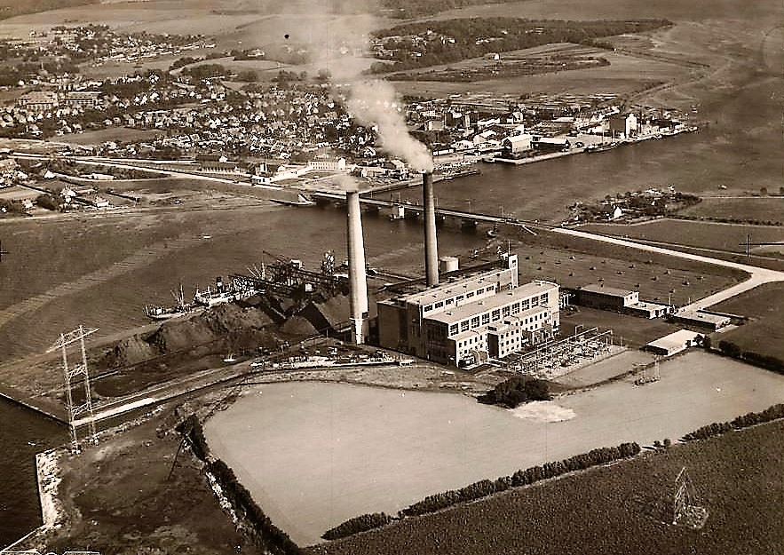
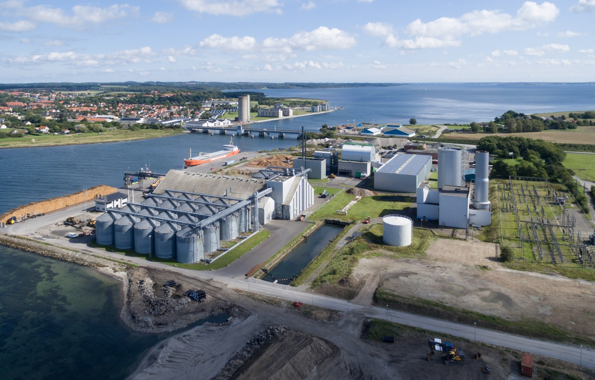
DUAL Ports is co-funded by the North Sea Region Programme 2014-2020; Eco-innovation priority. www.northsearegion.eu/dual-ports J-No: 38-2-7-15

Slide 3
Strategy for a Port Expansion
Expanding the Port of Vordingborg significantly in order to attract new shipping companies and to create growth possibilities for existing companies on the Port.
Expand the port in 5 phases where every phase has to be financed by new contracts and turnover.
Phase 1 to 3 of the port expansion to be realized between 2015 and 2019. Phase 4 and 5 from 2019 to 2027.
Port expansion in a sustainable way.
DUAL Ports is co-funded by the North Sea Region Programme 2014-2020; Eco-innovation priority. www.northsearegion.eu/dual-ports J-No: 38-2-7-15

Slide 4
How sustainable?
Land fill Projects based on recycling of soil, polluted soil and other recycled resources. (asphalt, incinerated garbage (slag), fly ash, concrete)
LED Lighting of the Port with newest technology and management system
DUAL Ports is co-funded by the North Sea Region Programme 2014-2020; Eco-innovation priority. www.northsearegion.eu/dual-ports J-No: 38-2-7-15

Slide 5
Why sustainable?
Environment (global & national)
Green Profile of the Port (marketing)
Economic Benefits (Port & Municipality)
Port , direct savings establishing the port
Municipality , indirect savings for regional/local companies (transport costs)
New Companies creating new business, with new Technologies to the Port (long term)
DUAL Ports is co-funded by the North Sea Region Programme 2014-2020; Eco-innovation priority. www.northsearegion.eu/dual-ports J-No: 38-2-7-15

Slide 6
Port expansion with recycled resources
Challenges
Human factor
Economics
Technical
Availability
Constructional
Legal Documentation
Time
DUAL Ports is co-funded by the North Sea Region Programme 2014-2020; Eco-innovation priority. www.northsearegion.eu/dual-ports J-No: 38-2-7-15

Slide 7
Port expansion with recycled resources
Challenges: Human factor
Consultants Technically
Governing bodies Knowledge and/or experience
Citizens Social
Clients Quality and reputation
Own organization Resources
DUAL Ports is co-funded by the North Sea Region Programme 2014-2020; Eco-innovation priority. www.northsearegion.eu/dual-ports J-No: 38-2-7-15

Slide 8
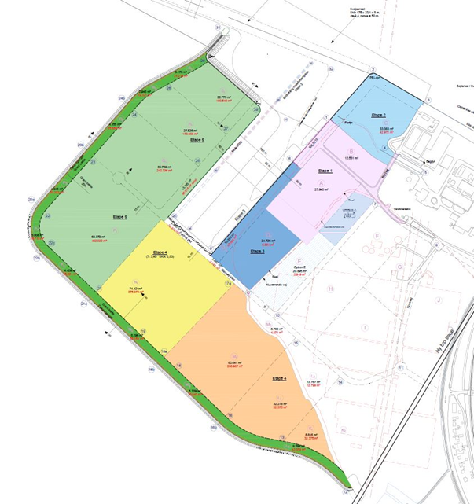
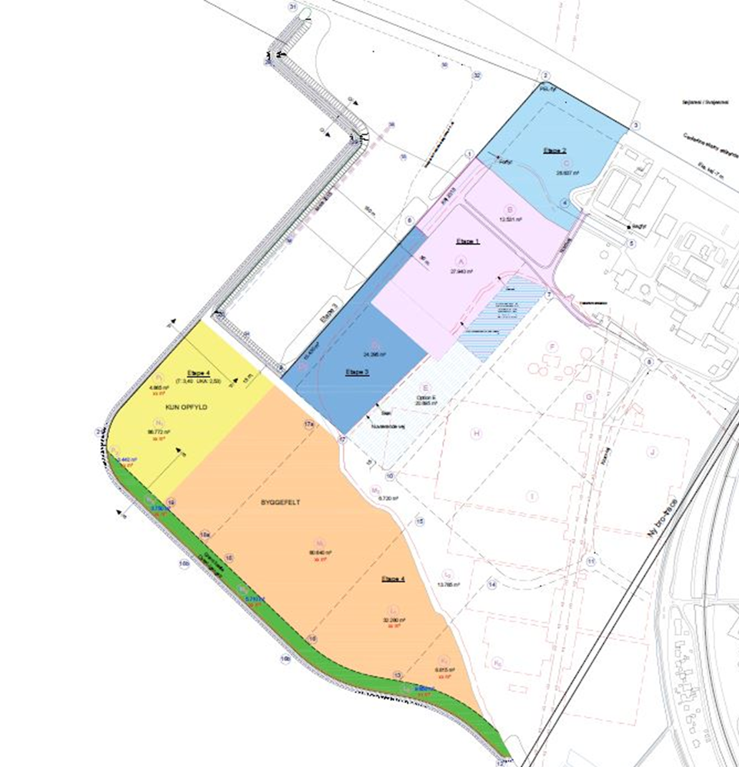
Port expansion with recycled resources
Challenges: Human factor Citizens Social
DUAL Ports is co-funded by the North Sea Region Programme 2014-2020; Eco-innovation priority. www.northsearegion.eu/dual-ports J-No: 38-2-7-15

Slide 9
Port expansion with recycled resources
Challenges : Economics
Feasibility studies (economic, physical)
Lack of risk capital
Time delay return on investment
Studies (HR, consultants, reports)
Expansion (plant and infrastructure)
Establishing company (depending on client about 4 to 16 months)
Growth Generated turnover (start up, production and logistics, marketing)
DUAL Ports is co-funded by the North Sea Region Programme 2014-2020; Eco-innovation priority. www.northsearegion.eu/dual-ports J-No: 38-2-7-15

Slide 10
Port expansion with recycled resources
Challenges : Technical
Characteristics of resources
Purpose (end user) & requirements
Priority;
Time vs. Technical possibilities (slag or soil)
Uniformity (bigger scale, 40.000 to 100.000 tons lots)
Environmental restrictions (location, covered / uncovered areas)
Technical behavior (when wet or dry, transport)
DUAL Ports is co-funded by the North Sea Region Programme 2014-2020; Eco-innovation priority. www.northsearegion.eu/dual-ports J-No: 38-2-7-15

Slide 11
Port expansion with recycled resources
Challenges : Availability of resources
Where (transport costs)
When (ad hoc or depot)
Volumes
Uniformity
Legal Documentation
Temporarily storage
Economical benefit
DUAL Ports is co-funded by the North Sea Region Programme 2014-2020; Eco-innovation priority. www.northsearegion.eu/dual-ports J-No: 38-2-7-15

Slide 12
Port expansion with recycled resources
Challenges : Constructional
Legal Documentation (direct and indirect, short & long term)
Restrictions, environmental and technical
Storage (intermediate and permanently)
Building level, heights and volumes
Location in the building project
Pre compression
Time schedule
DUAL Ports is co-funded by the North Sea Region Programme 2014-2020; Eco-innovation priority. www.northsearegion.eu/dual-ports J-No: 38-2-7-15

Slide 13
Port expansion with recycled resources
Challenges : Legal Documentation
Environmental impact assessment (port expansion)
Several governing bodies
Time & Timing
Resources (economic, HR)
Detailed project descriptions, environmental (short & long term)
Bureaucratic system
Several departments on national, regional and local level)
Time schedule
DUAL Ports is co-funded by the North Sea Region Programme 2014-2020; Eco-innovation priority. www.northsearegion.eu/dual-ports J-No: 38-2-7-15

Slide 14
Port expansion with recycled resources
Challenges : Time
”Time is money”
Momentum
Board / municipality / politicians willing to invest
Client ready to expand and to invest
Ownership to the project
Return on investment (readiness areas)
Global or national cyclically (agriculture, financial crisis)
Legislation
DUAL Ports is co-funded by the North Sea Region Programme 2014-2020; Eco-innovation priority. www.northsearegion.eu/dual-ports J-No: 38-2-7-15

Slide 15
Port expansion with recycled resources
Outcome
Business case, financial analysis (2016/2017)
Investment strategy & financing (2017)
50 year contract with client
EIA finished
All legal documentation received (national, regional, local)
DUAL Ports is co-funded by the North Sea Region Programme 2014-2020; Eco-innovation priority. www.northsearegion.eu/dual-ports J-No: 38-2-7-15

Slide 16
Port expansion with recycled resources
Status
Port expansion Phase 2 & 3
Start September 2017
Completion ultimo 2018
Several information tours on the Port
Exhibition Library
DUAL Ports is co-funded by the North Sea Region Programme 2014-2020; Eco-innovation priority. www.northsearegion.eu/dual-ports J-No: 38-2-7-15

Slide 17
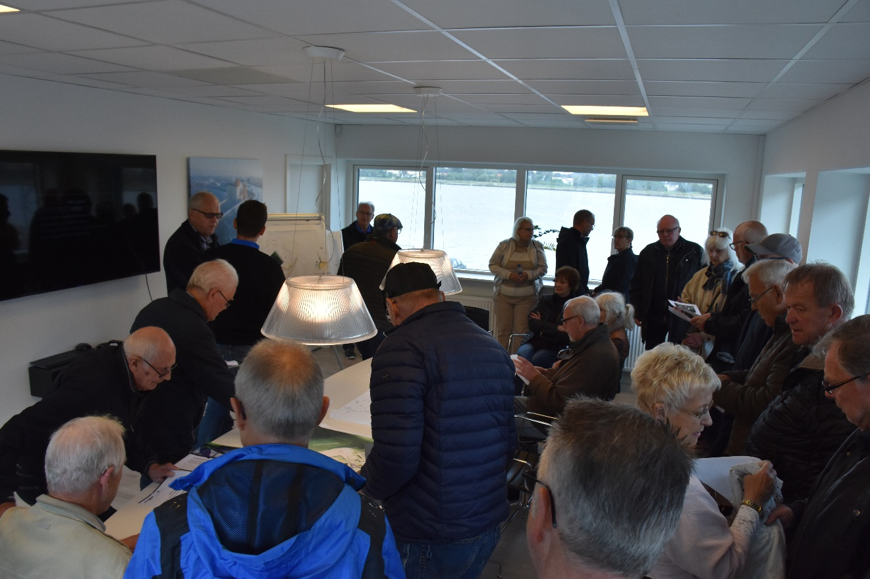
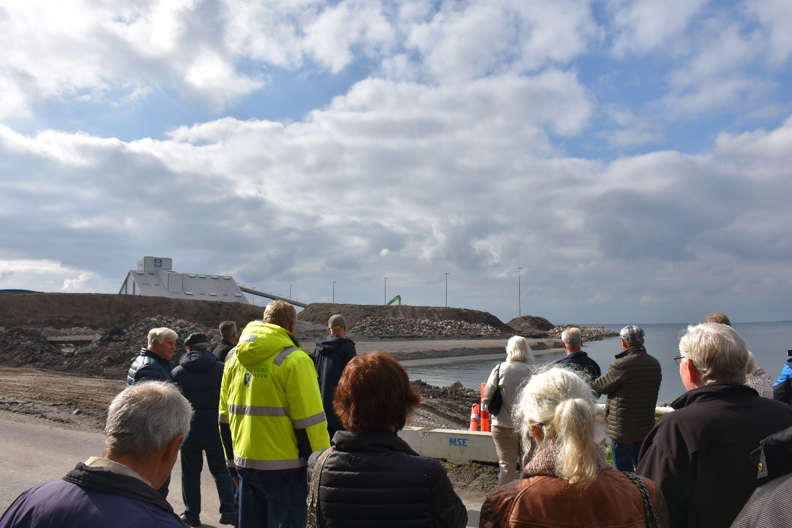
Port expansion with recycled resources
DUAL Ports is co-funded by the North Sea Region Programme 2014-2020; Eco-innovation priority. www.northsearegion.eu/dual-ports J-No: 38-2-7-15

Slide 18
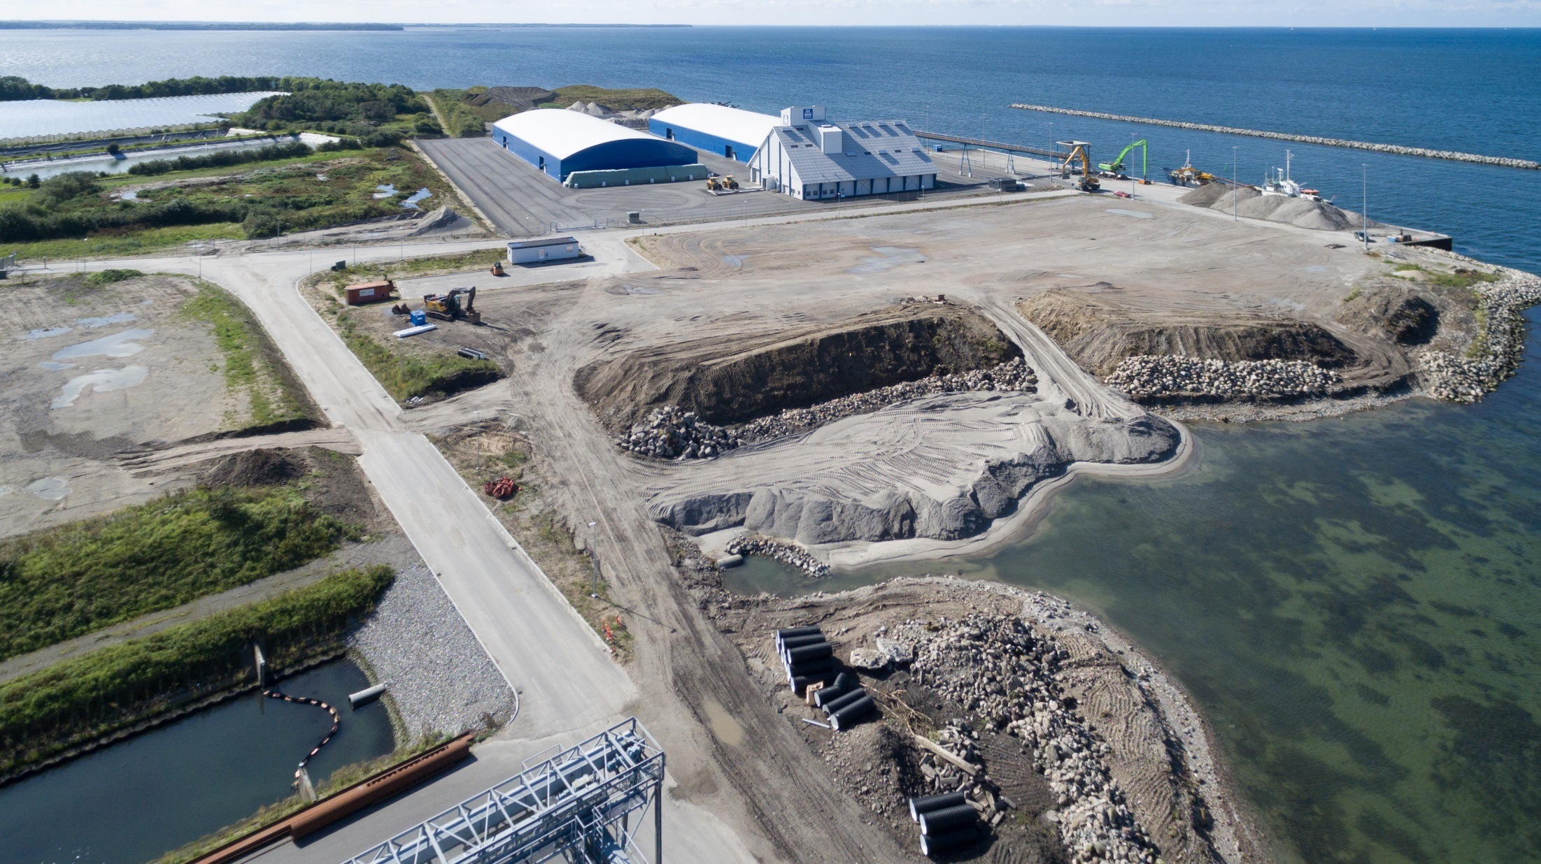
DUAL Ports is co-funded by the North Sea Region Programme 2014-2020; Eco-innovation priority. www.northsearegion.eu/dual-ports J-No: 38-2-7-15

Slide 19
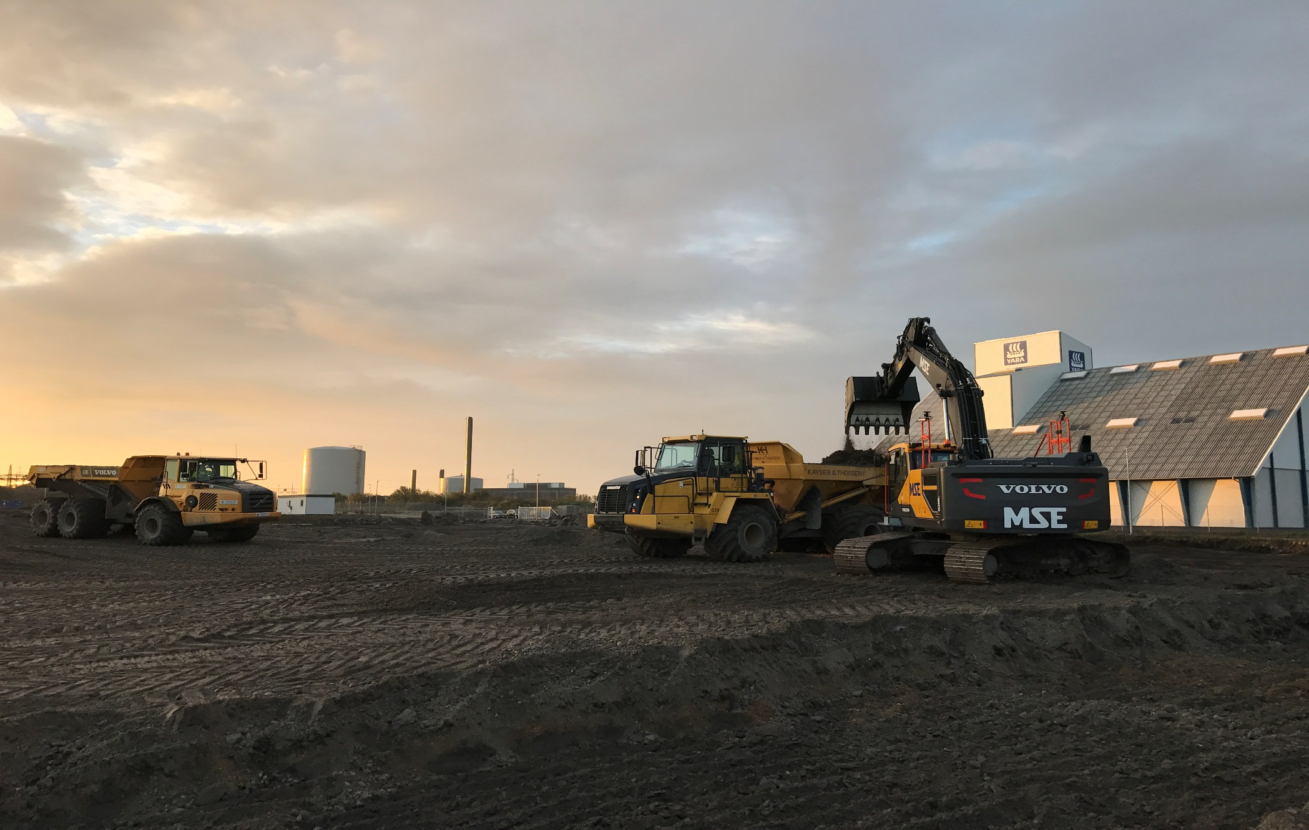
DUAL Ports is co-funded by the North Sea Region Programme 2014-2020; Eco-innovation priority. www.northsearegion.eu/dual-ports J-No: 38-2-7-15

