Slide 1
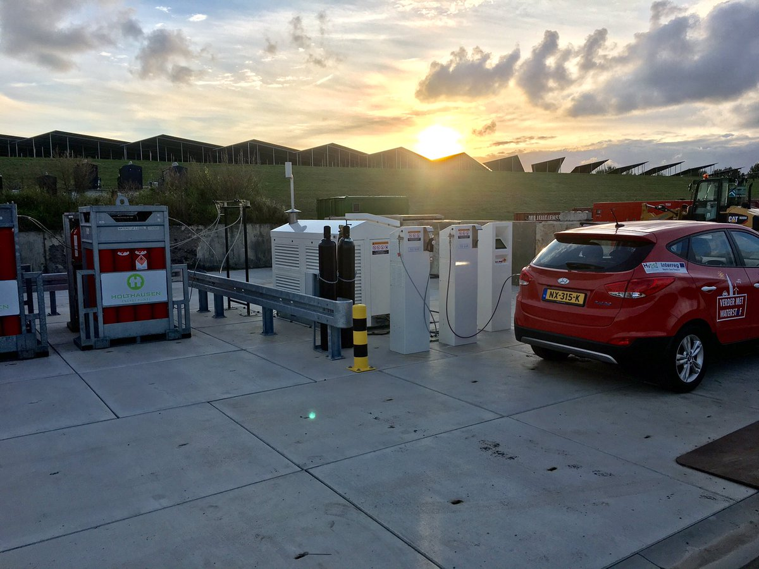

Workshop: Delivering Solar Powered Hydrogen Vehicles in Groningen
Aberdeen, 1st October 2019
Sjaak Schuit, Municipality of Groningen

Slide 2




Ambitions of the municipality of Groningen
Roadmap Groningen Carbon Neutral 2035
Zero Emission City Logistics in 2025
Zero Emission public transport in 2020
Hydrogen is part of these ambitions
Groningen is partner in European hydrogen programs:
JIVE 2: 20 hydrogen busses and a filling station (in 2020)
Revive: 2 garbage collection trucks
HyTrEc2: 6 municipal hydrogen vehicles and refuelling station
Hector: hydrogen garbage collection truck

Slide 3
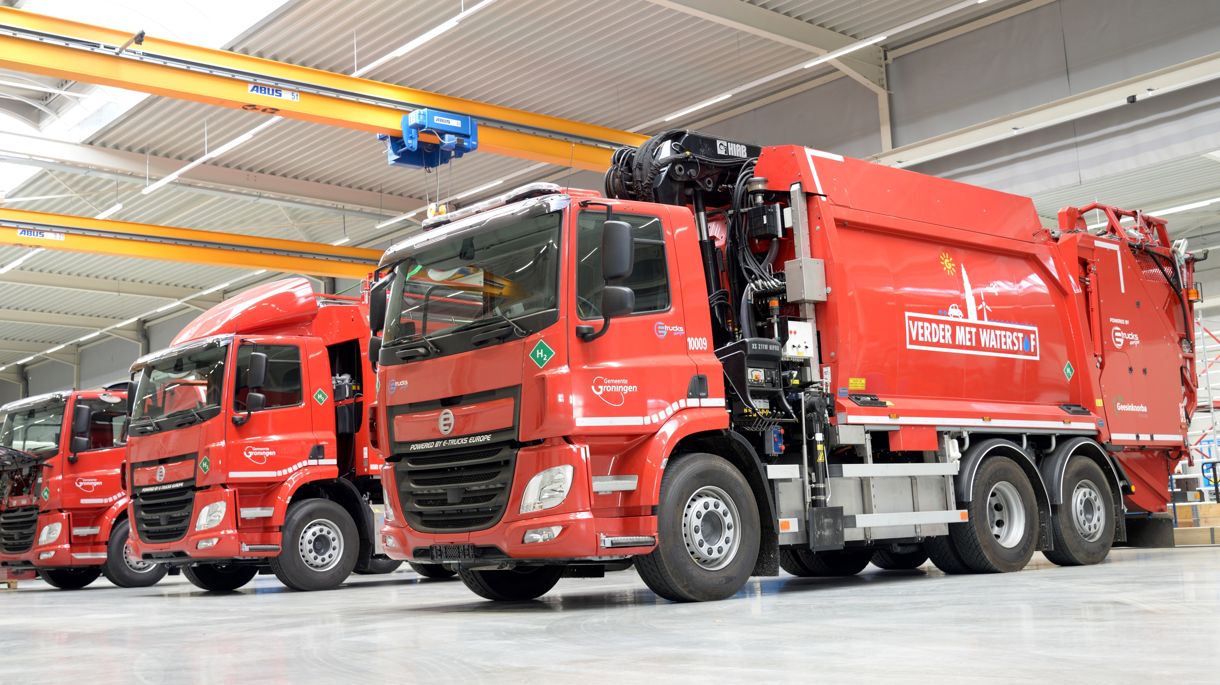
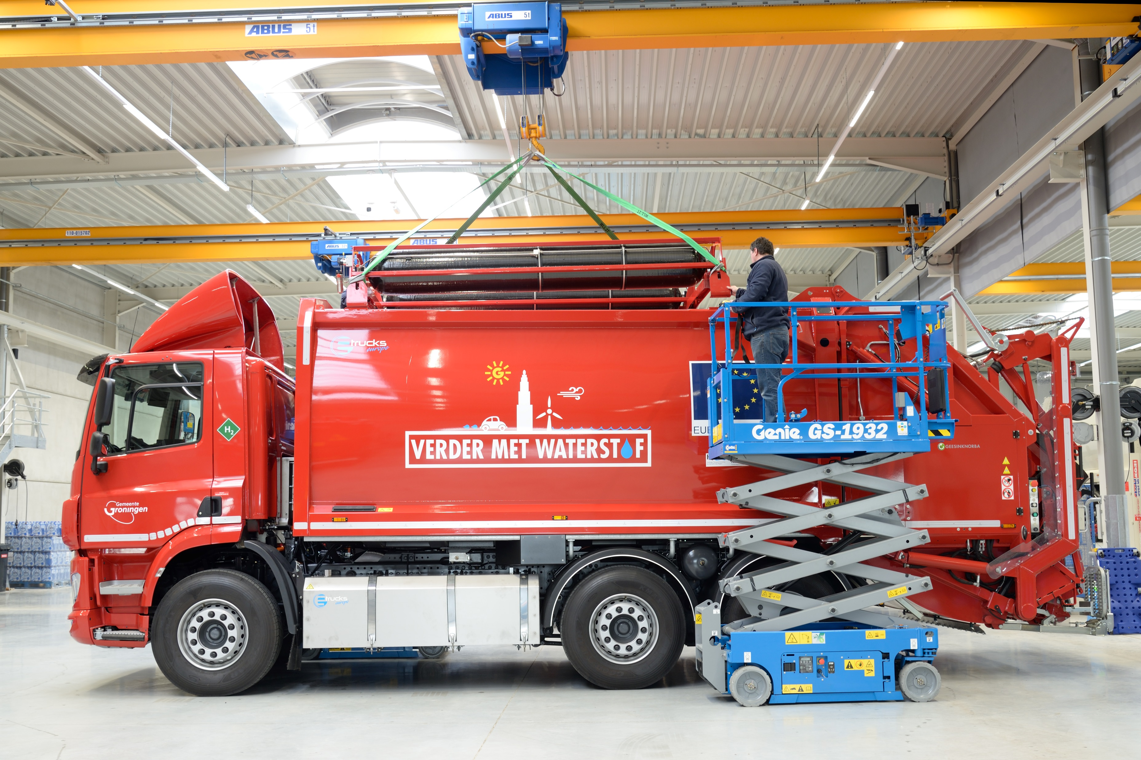
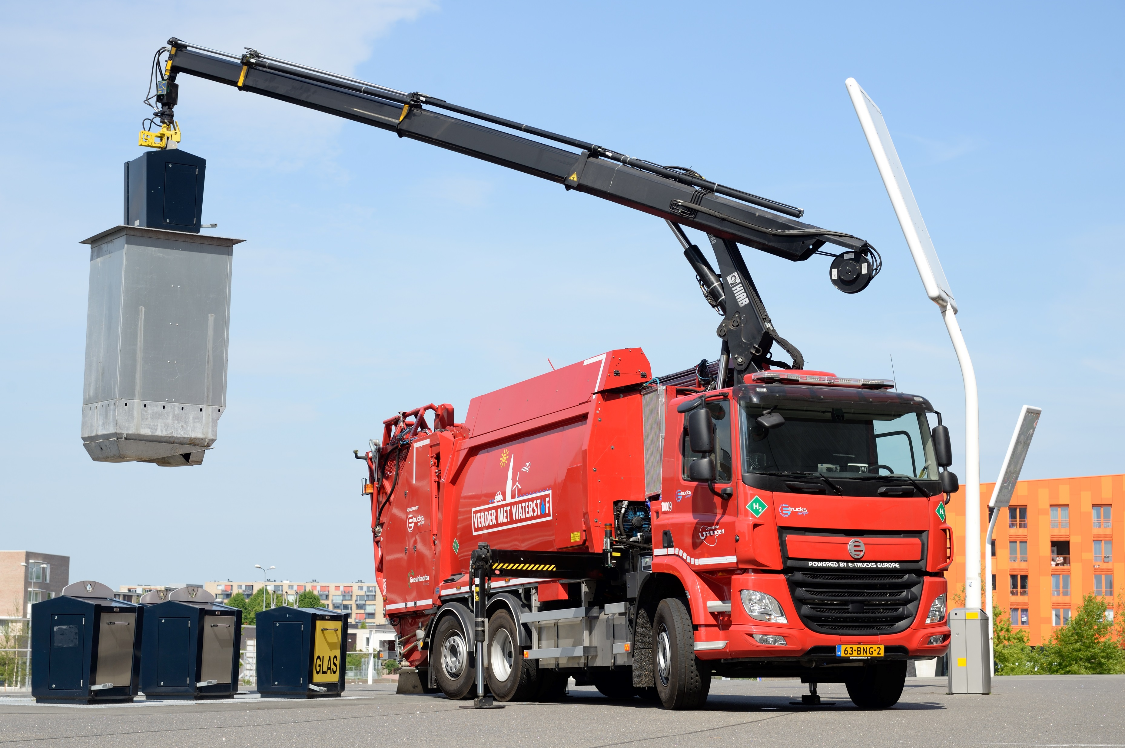
Hydrogen Vehicles for Garbage Collection
Groningen is partner in REVIVE, HyTrEc2 and HECTOR.
These include in total five garbage Trucks.
Groningen has also garbage trucks outside these programs.
The first garbage trucks started operations in 2019. All trucks will be operational in 2020.
The HECTOR program also includes adaption of the indoor parking and maintenance.

Slide 4
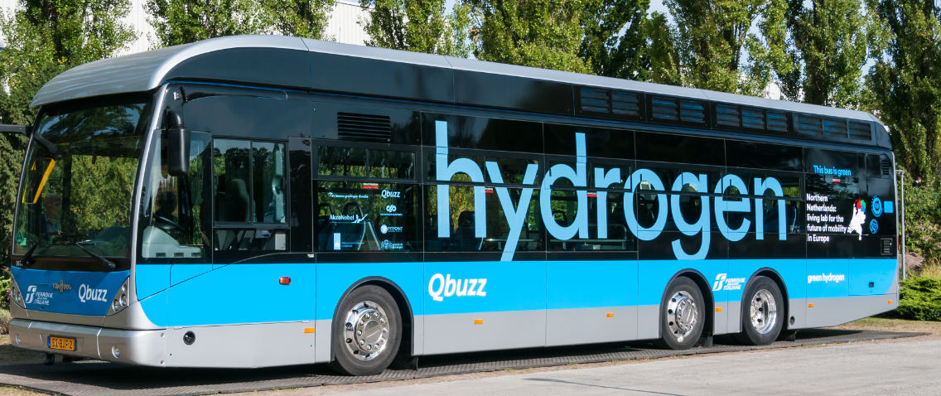

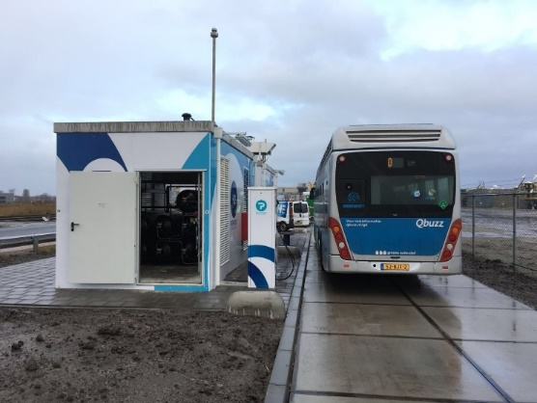
Hydrogen Busses
2 Hydrogen busses operational in Groningen since 2017 as part of High V.LO-City project. They have their own refuelling station.
Municipality of Groningen is partner in OV-bureau Groningen-Drenthe.
In 2018 Qbuzz won concession for zero emission public transport starting December 2019.
Included in the offer are 20 hydrogen busses. These busses are part of JIVE 2 project.

Slide 5
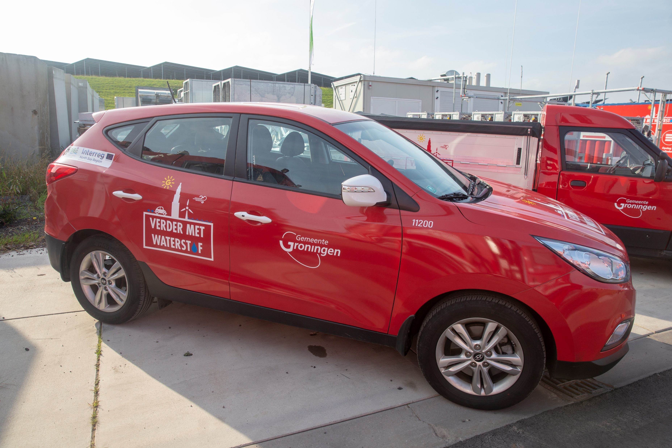
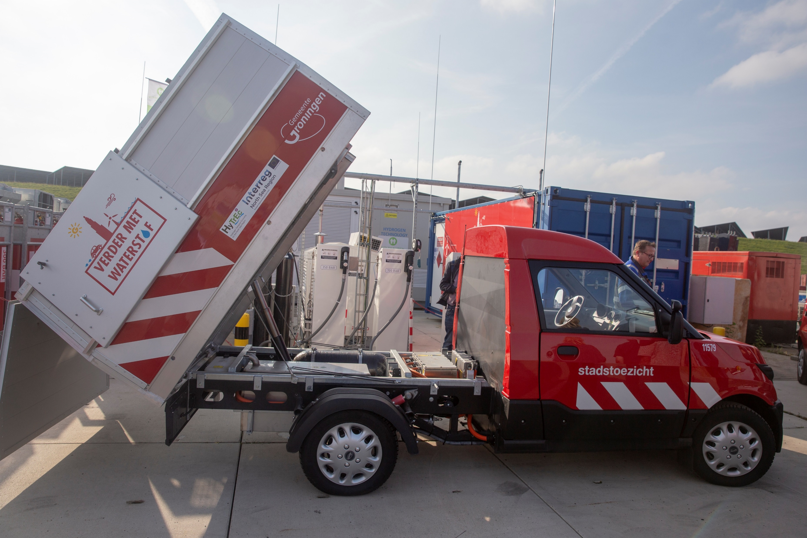
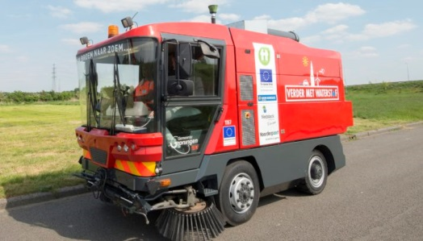
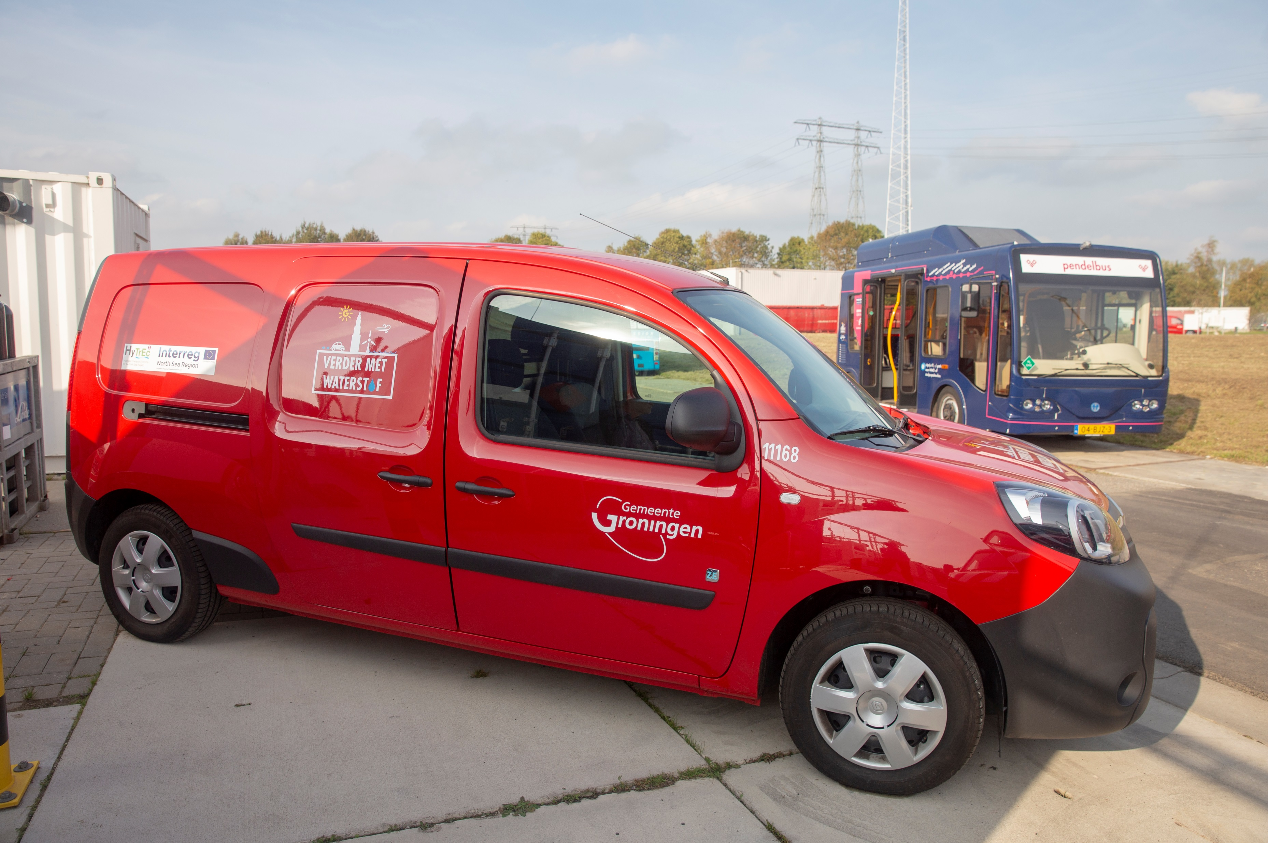
Other Hydrogen Vehicles
Four other vehicles in HyTrEc2:
  2 Hyundai ix35
  Streetscooter
  Kangoo
Small bus for the city centre.
Street sweeper.

Slide 6

Coming soon: much more hydrogen
New vehicles
More vehicles for garbage collection
VW Transporters
VW Crafters
Two Hydrogen Refuelling Stations
A new refuelling station in Groningen for public use as part of the Dutch DKTI project H2GROw.
A new refuelling station for the 20 busses of the JIVE 2 project.

Slide 7
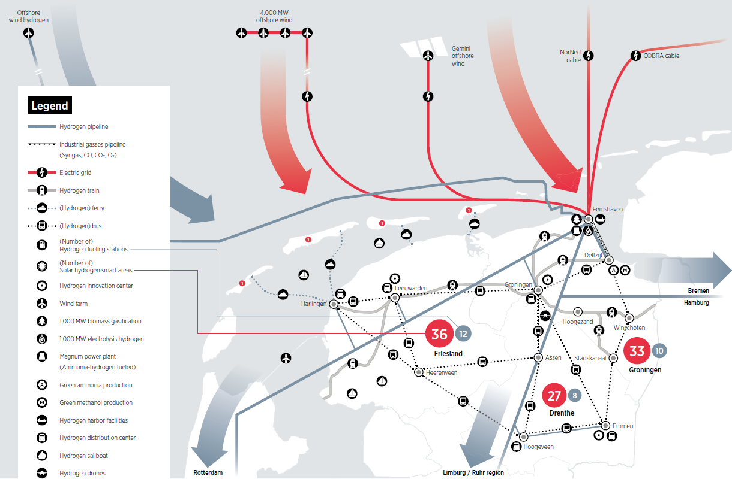
The bigger picture: Green Hydrogen Economy
Producing hydrogen by electrolysis
Electricity mainly from North Sea wind farms
Reuse natural gas infrastructure for hydrogen
Hydrogen
  for industry and mobility
  to balance the energy grid
  for heating

Slide 8
Thank you for your attention

