Slide 1
HyTrEc 2
Can fuel cells and battery technologies ever live in harmony?
Dr. Nick McCarthy
Technical Specialist
nick.mccarthy@cenex.co.uk

Slide 2

Introduction to Cenex
Established in 2005 as the UK’s first Centre of Excellence for Low Carbon and Fuel Cell technologies.
Cenex has developed a UK-leading reputation for low carbon vehicle and infrastructure analysis and fleet deployment support for ultra-low carbon alternative fuel use, including:
    Electricity
    Biomethane
    Hydrogen
Today Cenex operates as an independent not-for-profit consultancy specialising in the delivery of projects, supporting innovation and market development.

Slide 3

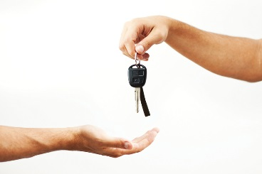
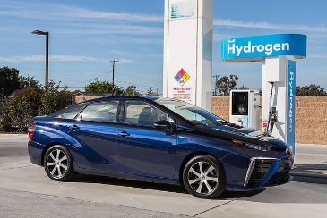
Why do demonstration projects?
Prove range & durability of new emerging technologies
Put vehicles in the hands of real customers
Begin to form a refuelling network – even with a mature vehicle technology, an infrastructure is needed before people will invest

Slide 4
Topics for today
Some battery basics
Some hydrogen basics
Hydrogen and battery safety
Battery and Hydrogen transport
HyTrEc 2 introduction and initial results

Slide 5
Battery Basics

Slide 6
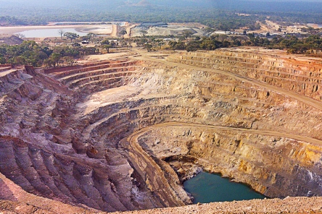
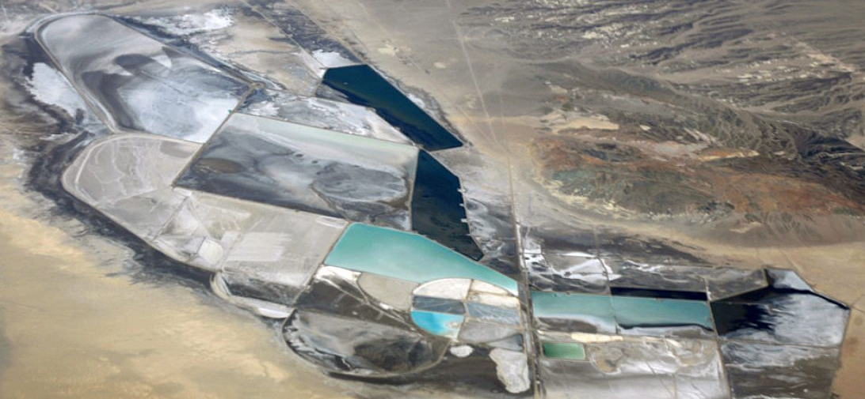
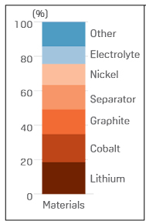
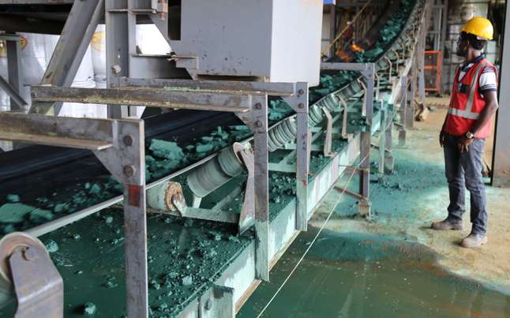
Notes:
Pictures – Copper mine, lithium salt evaporation ponds and cobalt processing
Types of battery chemistry: Nickel metal hydride (30–80 Wh/kg and long life, but poor efficiency) NaAlNiCl4 (aka Zebra , 120 Wh/kg, but poor power to weight and must be heated to 270 degrees C) & Lithium ion or Lipo (lithium iron phosphate lithium-manganese spinel 140 Wh/kg , low self discharge a self-discharge rate (5% per month?)

Slide 7
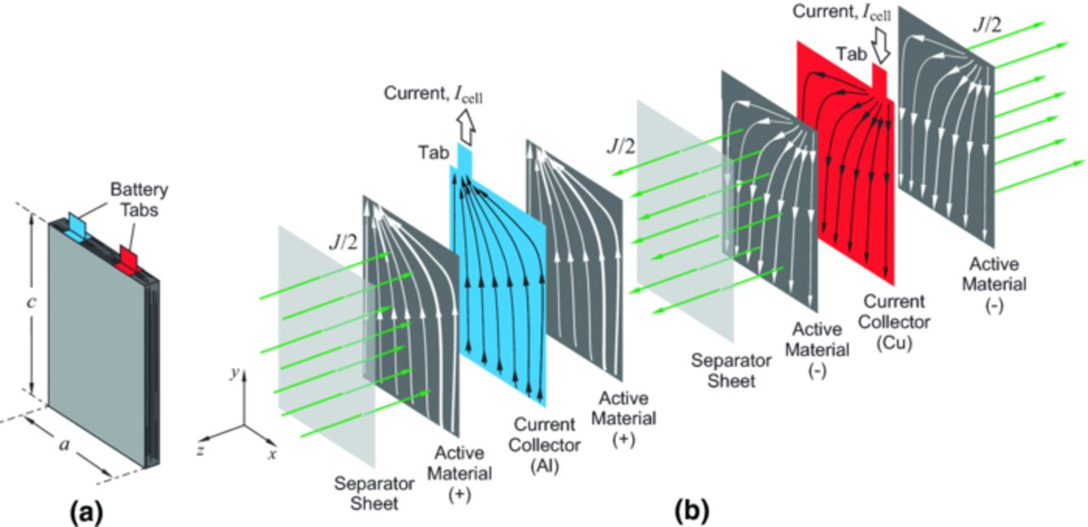
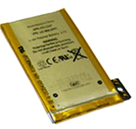
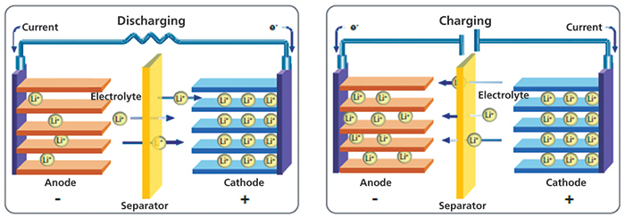
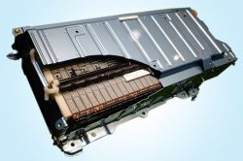
Battery basics
e⁻ Discharge
e⁻ Charge

Slide 8
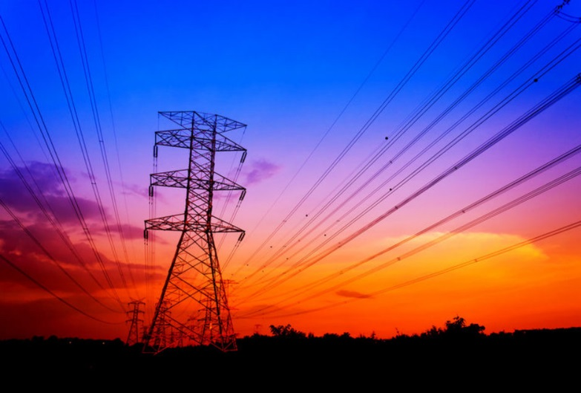
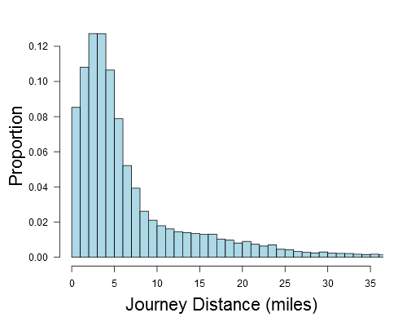
Battery benefits
85% cycle efficiency is amazing!
Electrical infrastructure is well established
National grid scale is feasible
  Local grid reinforcement is increasingly problematic
Zero emission across a huge array of sectors
BEVs rapidly approaching cost parity with ICE
L1 overnight charging sufficing for 90%(+) of private UK journeys
We need zero emission BEVs for our civilisation

Slide 9
Hydrogen Basics

Slide 10
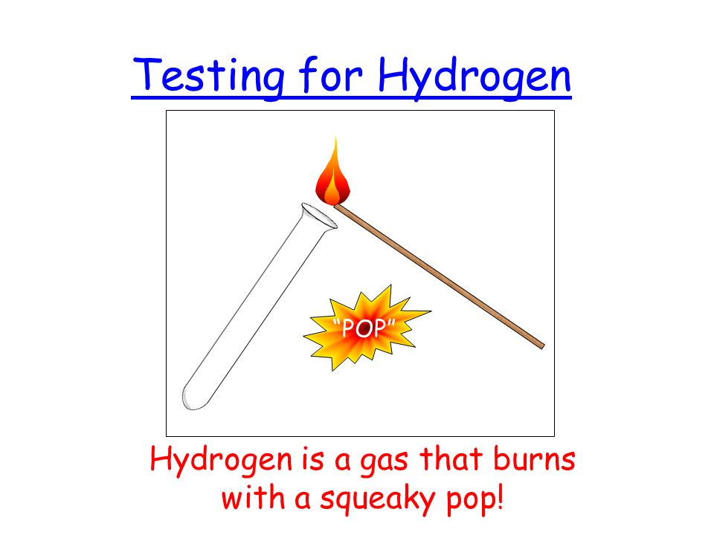

H2 basics
2H₂ + O₂
2H₂O

Slide 11
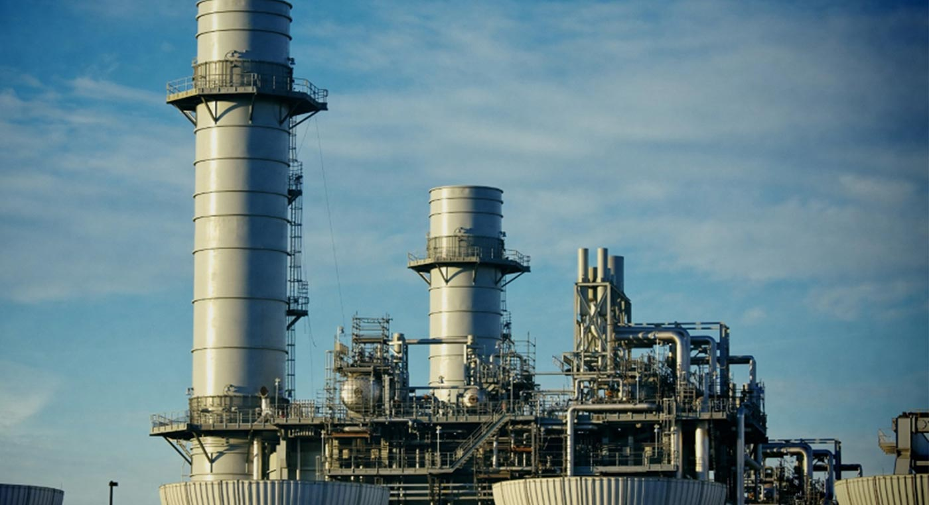
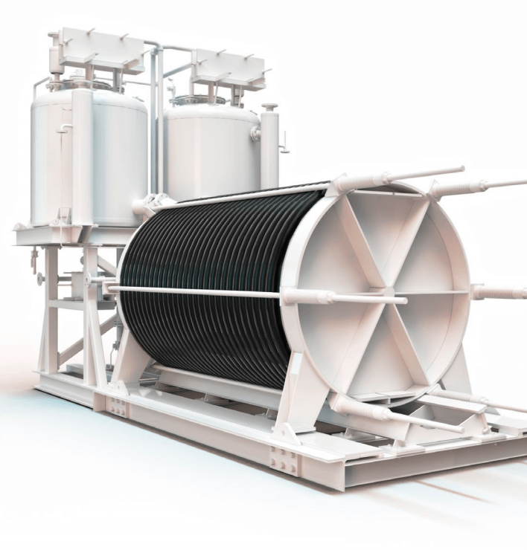
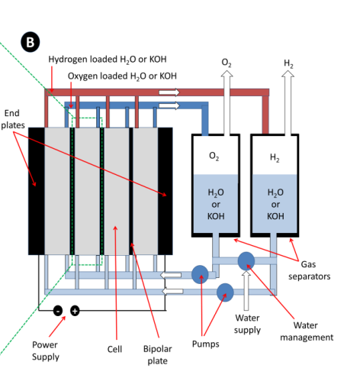
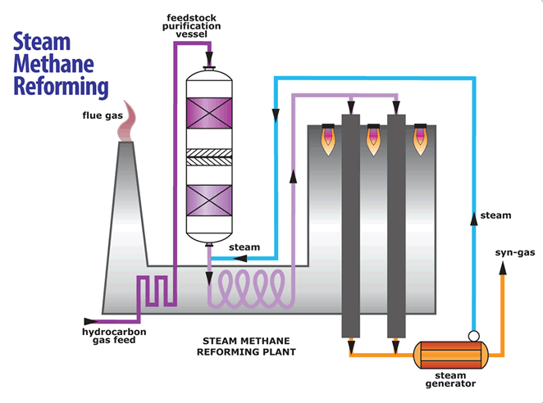
CO₂ produced depends on where you get the electricity from
One ton of hydrogen produced will also produce
9 to 12 tons of CO₂.
http://www.eajv.ca/spip.php?page=article&id_article=5
https://www.studentenergy.org/topics/steam-methane-reforming
https://www.windpowerengineering.com/wp-content/uploads/2017/10/PEM-electrolyzer.png
http://www.electrochemsci.org/papers/vol13/130201173.pdf
Notes:
We already know how to manufacture, transport and use H2 -Existing production of H2 is 95% from fossil fuels
Steam methane reforming of methane
Hydrogen vehicles world wide do not use SMR H2. In the EU and UK majority of projects use 80%+ electrolysed hydrogen

Slide 12
H2 benefits
64% more energy per kg when compared to conventional fuel (Diesel)
Superb mass based energy density
  Volumetric density… no so much!
Circular economy / reaction
You can make it almost anywhere in the world
Long term power storage with minimal loss
Zero emission across a huge array of sectors
We need zero emission hydrogen for our civilisation
H₂
O₂
Water + Power
Reaction
Water
Notes:
Hydrogen reacts with oxygen to create water, and the reaction is reversable.
Hydrogen is very light weight (superb mass based energy density)

Slide 13
Safety Issues

Slide 14
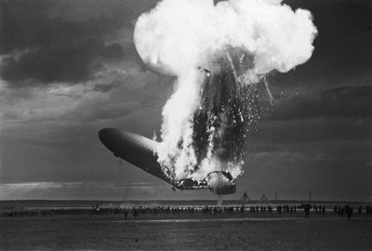
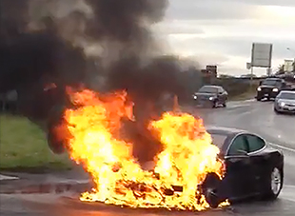
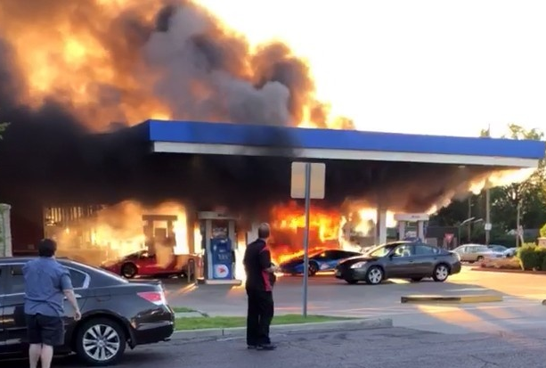
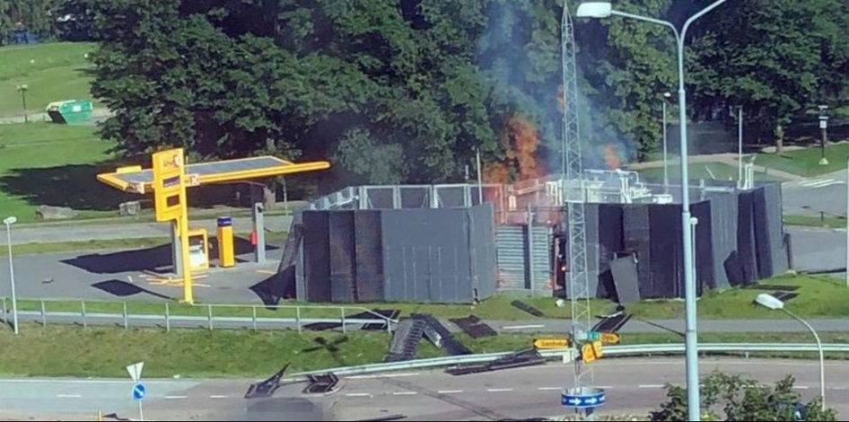
Notes:
Pictures clockwise – Hindenburg H2 fire, BEV thermal runaway, H2 station cylinder failure, conventional fossil fuel forecourt fire
How many petrol forecourt station fires n the USA each year? 5,000

Slide 15
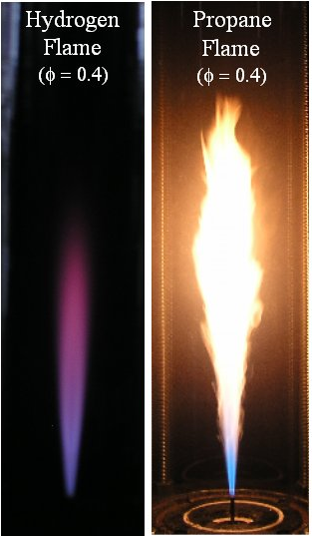
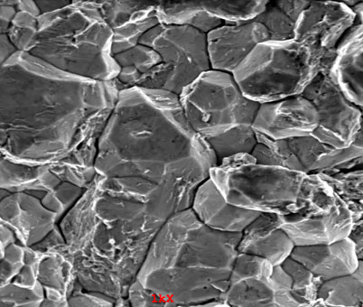
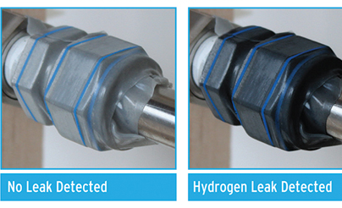
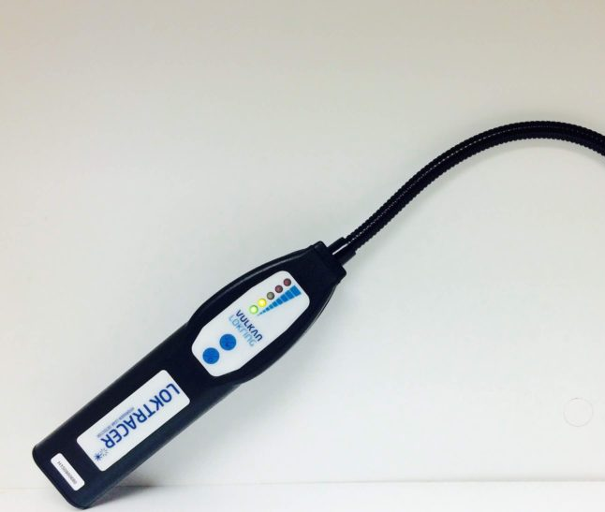
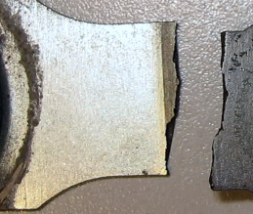
Notes:
122 Leadenhall street (cheese grater building) suffered from embrittled bolts which had to be replaced in 2014

Slide 16
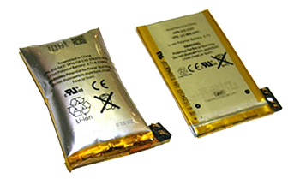
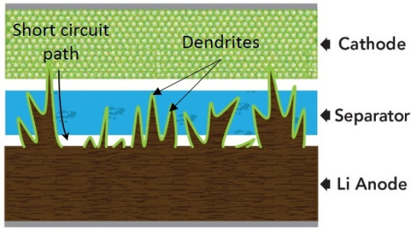
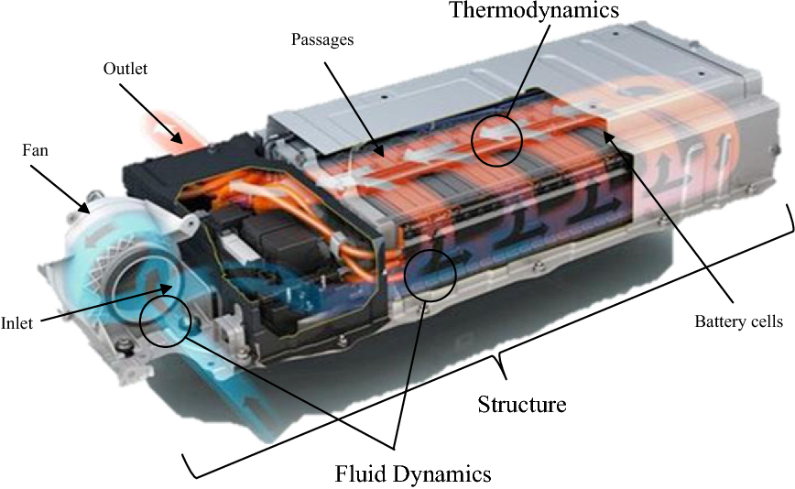
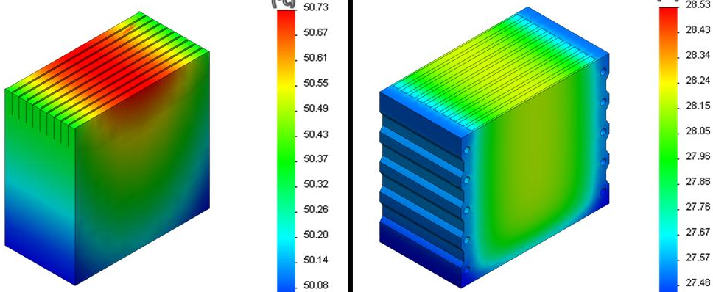

Slide 17
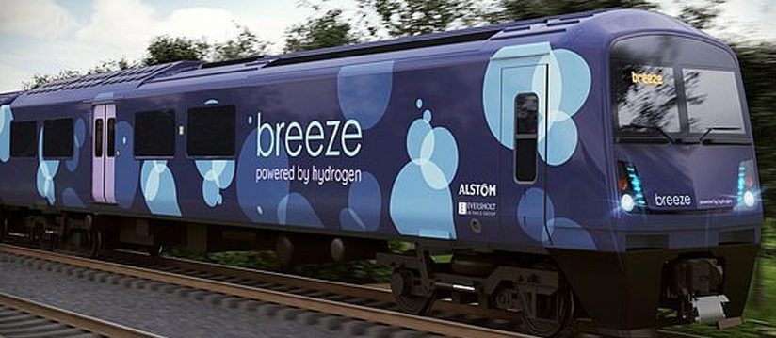
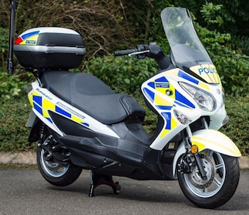
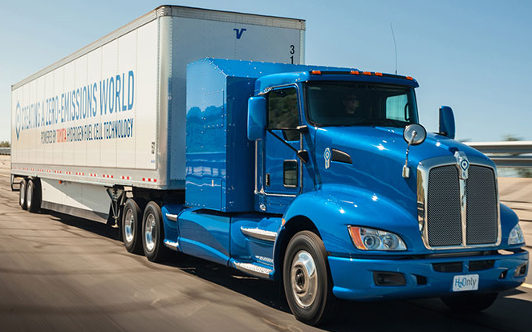
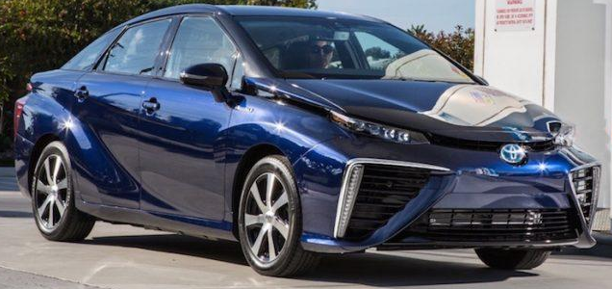
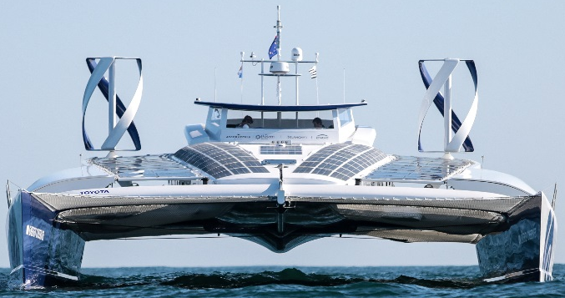
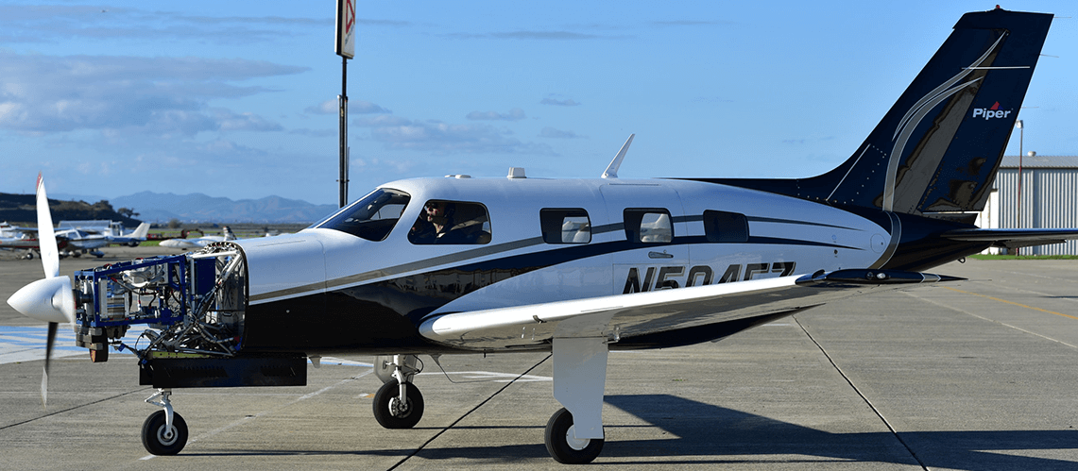
Transport
Notes:
Which of the above operates on BEV, FCEV or both? All are hybrids
SNCF’s n(French railway company) objective was "to have not a single diesel (train) left on French railroads in 15 years.“ just ordered 15 new H2 trains (august 29th 2019)

Slide 18
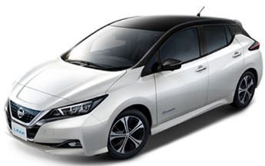
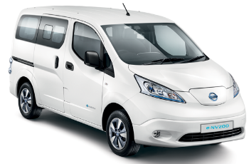
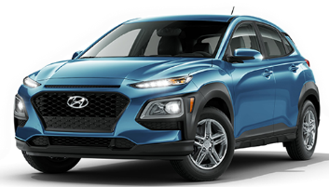
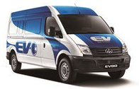
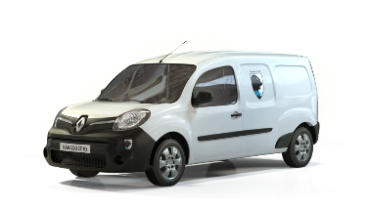
Types of BEV vehicles in the UK & EU today
Hyundai Kona
£ | 35 k
Seats | 5
Range | 279 miles
Charge port | Type 2 / CCS2
Bat | 67 kWh
Lvl 2 charge duration | 10 hours
Nissan Leaf
£ | 36 k
Seats | 5
Range | 239 miles
Charge port | Type 2/ CHAdeMO
Bat | 62 kWh
Lvl 2 charge duration | 11.5 hours
Nissan eNV200
£ | 30 k
Seats | 2
Range | 124 miles
Charge port | Type 2/ CHAdeMO
Bat | 40 kWh
Lvl 2 charge duration | 7.5 hours
Out Now (2018)
Out Now (2016)
Out Now (2015)
Renault
Kangoo
£ | 35 k
Seats | 2
Range | 129 miles
Charge port | Type 2
Bat | 33 kWh
Lvl 2 charge duration | 7 hours
LDV EV80
£ | 54 k
Seats | 2
Range | 91 miles
Charge port | Type 2
Bat | 56 kWh
Lvl 2 charge duration | 10.5 hours
Out Now (2015)
Out Now (2015)

Slide 19
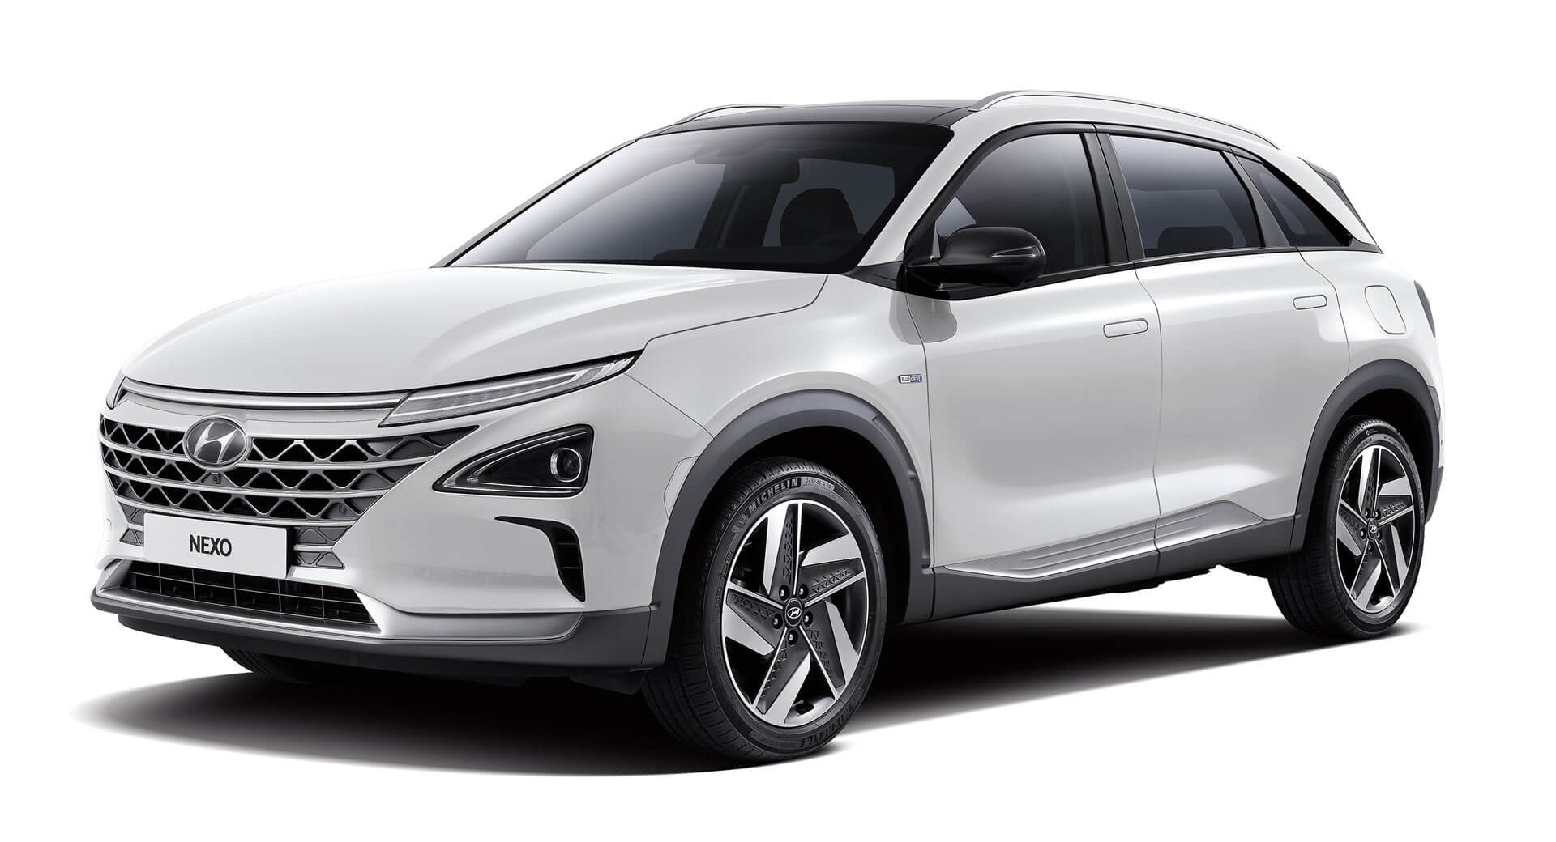
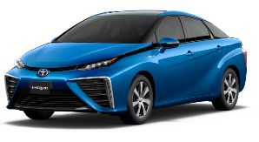
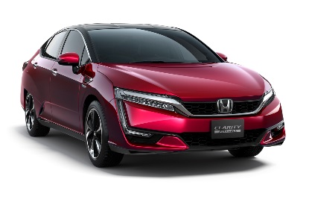
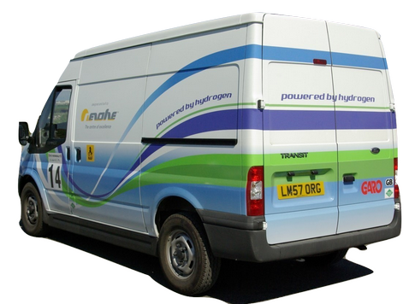
Types of H2 vehicles in the UK & EU today
Hyundai Nexo
£ | 69 k
Seats | 5
Range | 414 miles
H2 | 6.3 kg (3 tanks)
H2 P | 700 bar
Bat | 40 kWh
FC Stack size | 95 kW
Toyota Mirai
£ | 66 k
Seats | 4
Range | 312 miles
H2 | 5 kg (2 tanks)
H2 P | 700 bar
Bat | 1.6 kWh
FC Stack size | 113 kW
Honda Clarity
£ | 42 k
Seats | 5
Range | 435 miles
H2 | 5 kg (2 tanks)
H2 P | 700 bar
Bat | 1.6 kWh
FC Stack size | 100 kW
Out Now (2018)
Out Now (2016)
Out Now (2017)
Symbio RE
Kangoo
£ | Vehicle 18 k(+ 60/month battery/H2 rental)
Seats | 2
Range | 100 EV, 250 EV-H2 miles
H2 | 1.8 kg
H2 P | 350 bar
Bat | 22kWh
FC Stack size | 5kW
ULEMCo dual fuel H2 - diesel Ford Transit
£ | -
Seats | 2
Range | 95 - 135 miles
H2 | 3.2 kg (2 tanks)
H2 P | 350 bar
Engine size | 2.2 litre
Engine type | Euro 5
Out Now (2015)
Out Now (2015)

Slide 20
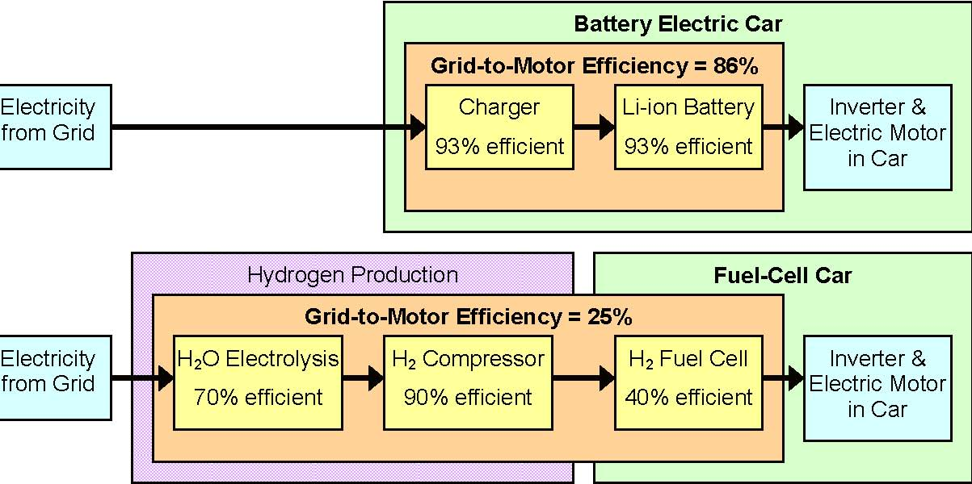
The above argument ignores three critically important issues:
compares BEVs to FCEVs – but ignores the opportunity to displace ICE
Duty cycles requirements and refuelling / recharging
self-weight of vehicles as battery size increases
Notes:
A catalytic converter in a diesel passenger vehicle typically uses 3-7 grams of platinum compared with around 30-60 grams currently needed for a fuel cell for the same vehicle.
Toyota Mirai stated Pt content is 30 g, Nexo uses 56 g of Pt, China is leading the way, targeting 2 million fuel cell vehicles by 2030. “A battery-electric 40 t truck with 500 km range needs 8 t of battery” (2019, Katsuhiko Hirose, Toyota)
A 2/5 axle tractor-trailer combination has a maximum permissible load of weight of between 10 t to 20 t. 3/3 tractor trailer can go up to 28 t. Maximum diesel fuel weight is ~850 kg (1,000 litres).

Slide 21
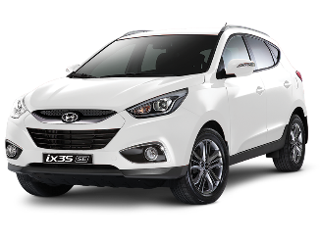
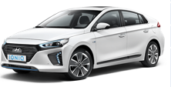
FC & EV like-for-like comparison
Hyundai ix35
£ | £53k
Seats | 5
Range | 369 miles
H2 | 5.6 kg (2 tanks) 3.5 mins
H2 P | 700 bar
Bat | 24 kWh
FC Stack size | 100 kW
Hyundai IONIQ Electric
£ | £25k
Seats | 5
Range | 174 miles
AC | Available
DC -rapid | 20 - 80% 30 mins
Bat | 28 kWh
Connector | CCS (up to 50 kW)
Production (2014-2017)
Debut (2017)

Slide 22
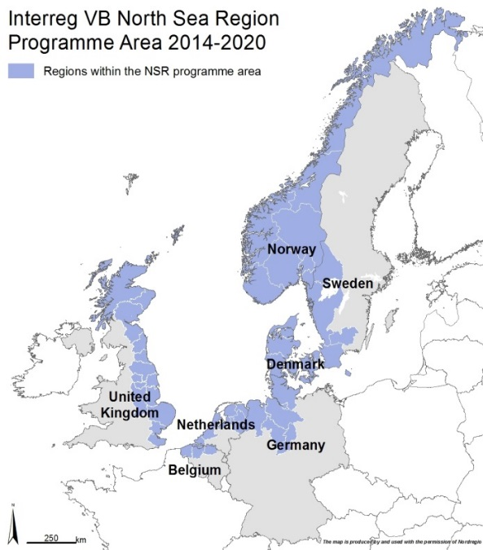








HyTrEc 2
Comparison of BEVs and FCEV
HyTrEc2 Partners

Slide 23

Interreg North Sea Region projects – HyTrEc 2
Project Name
Dates
No. Vehicles
No. HRS
Locations
To date:
1 HRS
By 2020:
3 HRS
UK, France, Germany, Denmark, Norway, Sweden
To date: 4
By 2020:
30 H2 vehicles
HyTrEc
2016-2022
HyTrEc2 primary focus is demonstration, skills and infrastructure creation.
Up to 80 personnel trained in the use, maintenance and fuelling of H2 transport and plant equipment in the marine transport industries.

Slide 24
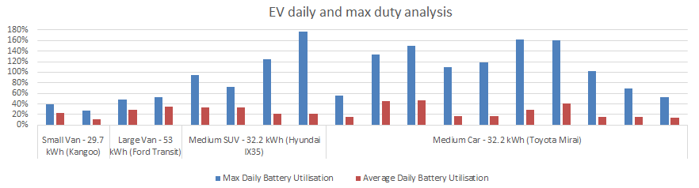
18 vehicles in a fleet – Red line is the ‘one charge per day’ lie for a BEV
Winter operations and driving style reduce range by up to 30%
Only 7 vehicles can reliably perform all duties on a one charge per day

Slide 25


Slide 26
Comparison of BEVs and FCEV

Slide 27




Notes:
Joint purchase agreements are driving the price per vehicle down

Slide 28


Bus model
  BYD-Ebus (best in class 2017/18)
    Range =155miles, 4.5 hour* charge time
  Average FC/hybrid bus (CHIC 2016 report)
    Range = 218 miles, 15 minutes refuel
Aberdeen
Aberdeen - Dundee city centre journey (~70 miles shortest route: assume 1.5 hour journey time)
100% EV bus = 7 trips in 24 hours (4.5 hour break every 2 trips)
FC-EV hybrid = 15 trips in 24 hours (0.25 hour break every three trips)
Dundee
Notes:
* Full charge with standard 80 kW BYD charge system

Slide 29
15 t payload model (40 t HGV)
  BEV semi-truck
    Assume 15 t payload HGV requires 550 kWh battery, and has a range of ~400 km
    Estimated battery mass is 400 kg mass of battery = 6.4 kWh/kg
    HGV requires 1.375 kWh per km
    mass of battery per km = (1.375/0.26) = 5.3 kg/km
  FC semi-truck
    Assume 15 t payload requires 448 kg of fuel cell (228 kW peak power)
    5 kg of H2 requires 85 kg of tanks
    30 kg of H2 for ~320 km
    mass of 224 Kw FC = 448 kg
    mass of H2+ tank per km = 1.7 kg
Notes:
Model is a horrible hybrid of data from Daimler, tesla, Toyota and Kenworth (Daimler e-Cascadia Electric Truck)
(based on Tesla battery packs, no Daimler data available)

Slide 30


Slide 31

TTSI/Kenworth/Toyota FCEV truck trials
2011 Vision Vehicles Class 8 FCET
Range: 150 miles
2017, Kenworth / Toyota Mk1
Class 8 FCET
Range: 200 miles
2018, Kenworth / Toyota Mk 2
Class 8 FCET, +12 kWh battery
With sleeper cab
Range: 300+ miles

Slide 32


(2016) | Electric | H₂-FC | EV-H₂FC Rex (%?)
Range
Refuelling Availability
Refuelling speed
AQ g/km
WTW gCO₂/km (100% renewable)
Price (includes efficiency) |  |  | ? ? ?

Slide 33
Topics for today
Some battery basics
Some hydrogen basics
Hydrogen and battery safety
Battery and Hydrogen transport
HyTrEc 2 introduction and initial results

Slide 34
Thank you for listening
Dr. Nick McCarthy
Technical Specialist
nick.mccarthy@cenex.co.uk

Slide 35
Bibliography
Dr Peter Speers (2015): D6.12: Hytec Final Summary Technical Report: Online (last accessed 20/01/2017): http://www.fch.europa.eu/sites/default/files/project_results_and_deliverables/Final%20overall%20technical%20report.pdf
Graham et al (2016): London Hydrogen Network Expansion: Project Summary Report: Online (last accessed 20/01/2017)
Periodic Report Summary 1 - HYFIVE (Hydrogen For Innovative Vehicles)
http://cordis.europa.eu/result/rcn/176047_en.html
H2ME – year 1 report available in 413 H2ME/Reports/Deliverables/D4.7
Element Energy (2012): Hydrogen Transport in activities in London and HyTEC: Online (last accessed 19/01/2017)
https://setis.ec.europa.eu/sites/default/files/reports/Driving_and_parking_patterns_of_European_car_drivers-a_mobility_survey.pdf page 56
NEDC range: 380km

