Slide 1
The North Sea Region Programme and its commitment to Eco-innovation
NON STOP kick-off meeting
Zwolle
30 October 2019
Jesper Jönsson

Slide 2
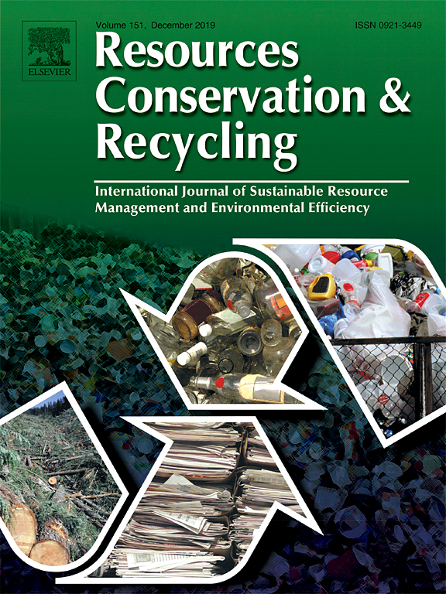
First CE article published in 2007
101 publications 2015 - 2017

Slide 3
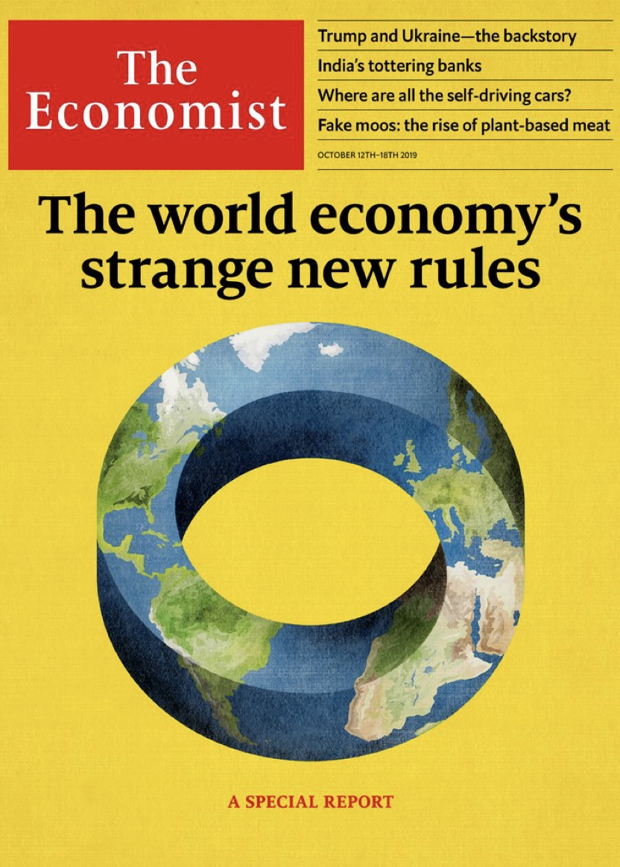
‘Closing the loop of Circularity’

Slide 5
‘The value of products and materials is maintained for as long as possible’.

Slide 6
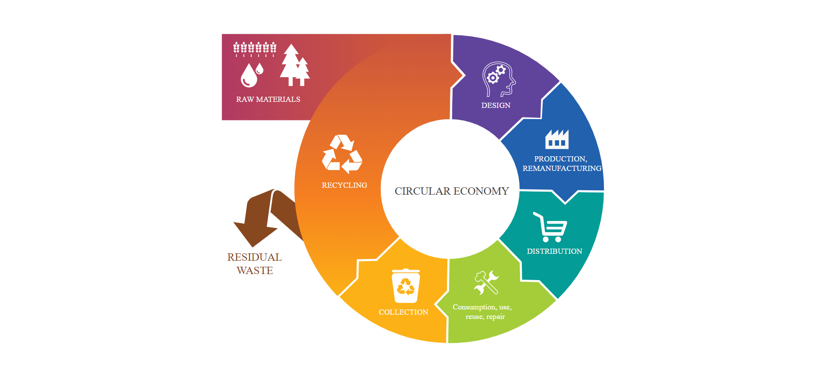

Slide 8
17 approved projects
EUR 39.7 Million / EUR 1.8 Million (Norway)
215 beneficiaries

Slide 11
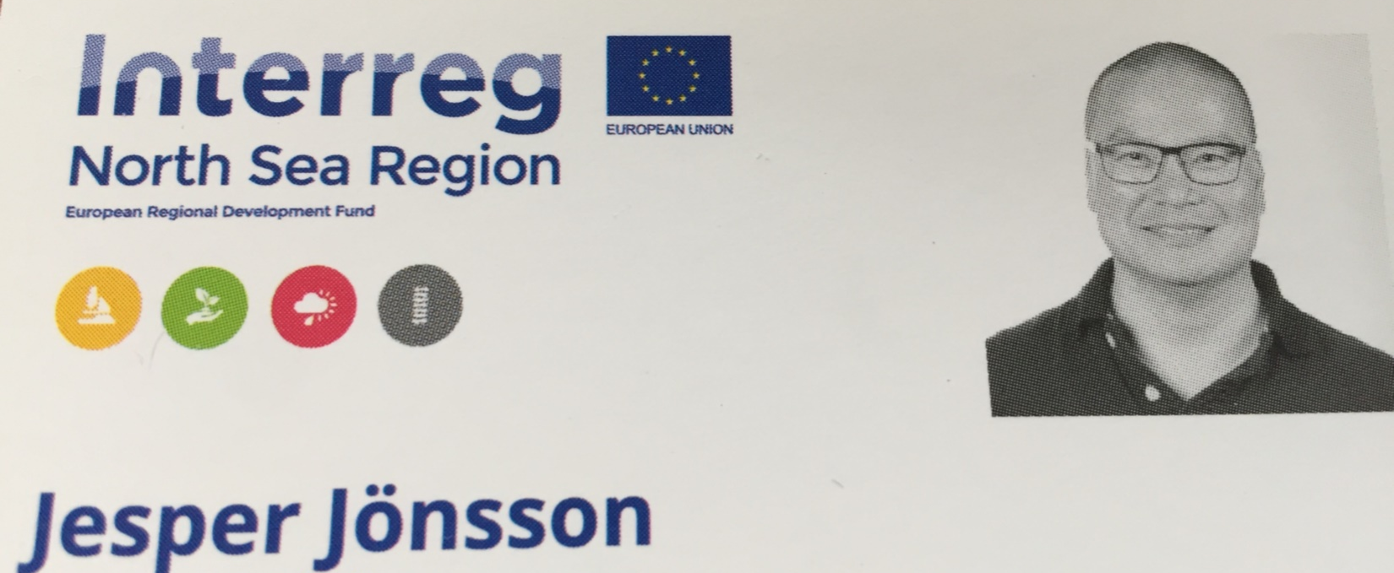
jesper.joensson@northsearegion.eu +45 21 35 89 23

