Slide 1





Local Carbon Fuel Options for Local and Regional Freight Transport: Civitas PORTIS, HyTrEc2 and the Hydrogen Economy in Aberdeen
Sustainable Freight Conference
5th December 2019
Cambridge
David Dunne, Aberdeen City Council

Slide 2
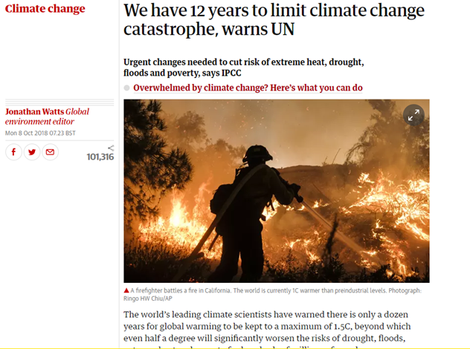
The policy context
Carbon Emissions and Climate Change: 80% reduction by 2050
Low Emission Zones 2018-2020 in Scotland
Petrol and Diesel phase out 2032 Scotland

Slide 3

The freight policy context
Heavy goods vehicles are estimated to account for around
17% of UK greenhouse gas emissions from road transport
21% of road transport NOₓ emissions
just 5% of vehicle miles

Slide 4
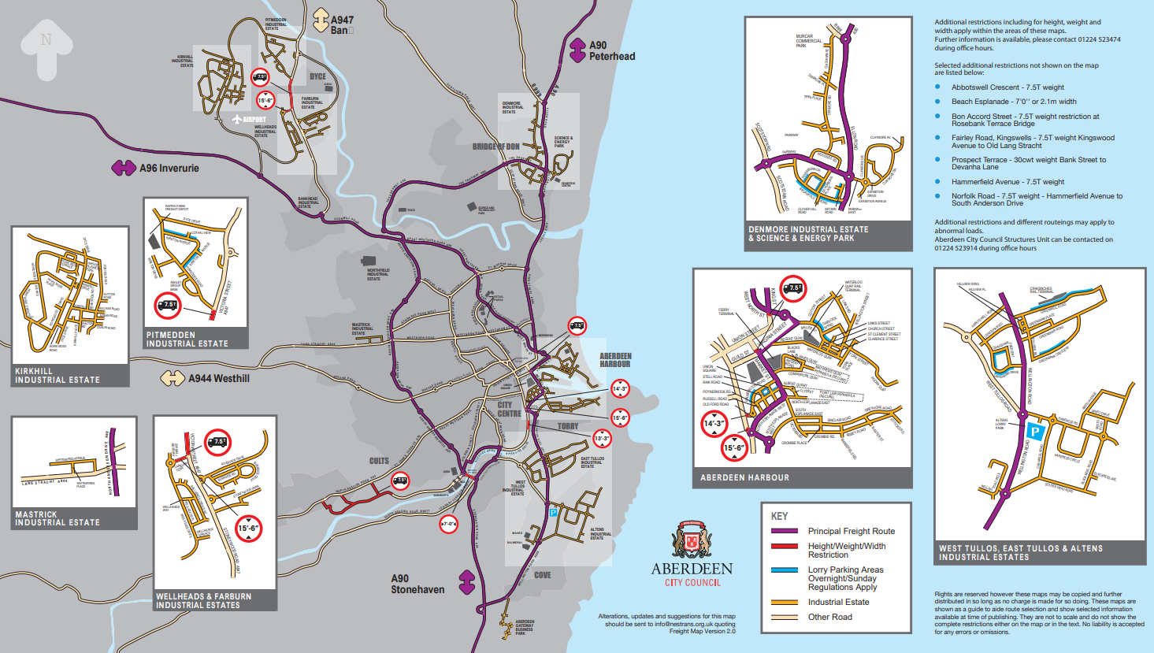
Aberdeen Freight

Slide 5


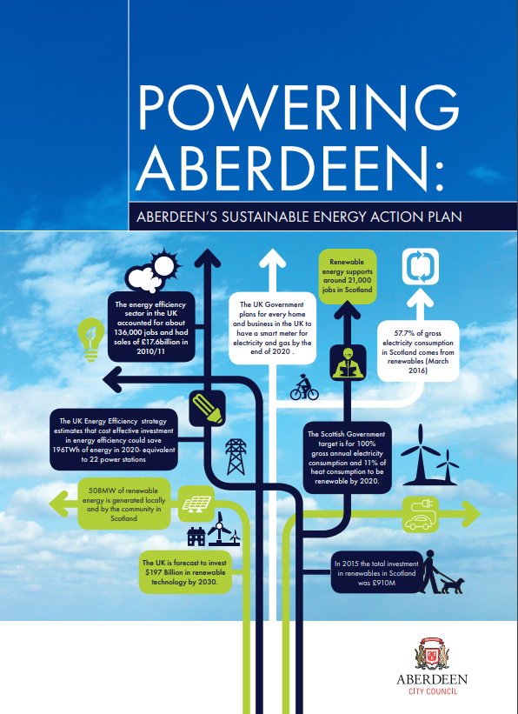
Aberdeen
ACC has been working hard to make the City a leader of renewable transport. The City boasts:
2 Hydrogen Production and Refuelling Stations
a dedicated hydrogen maintenance facilities
a growing fleet of hydrogen vehicles (62 – 2019)
21 electric vehicle charging points
In addition, the City is currently undertaking feasibility tests for a Low Emission Zone which will restrict the most polluting vehicles

Slide 6
CIVITAS PORTIS
A project focused on design, demonstration and evaluation of integrated packages of sustainable mobility in five port cities in Europe. Aberdeen is one of the 'Advanced' cities.
One of the intended outcomes of the project is to implement measures designed to improve the efficiency of urban freight transport, including the use of low emission vehicles.

Slide 7
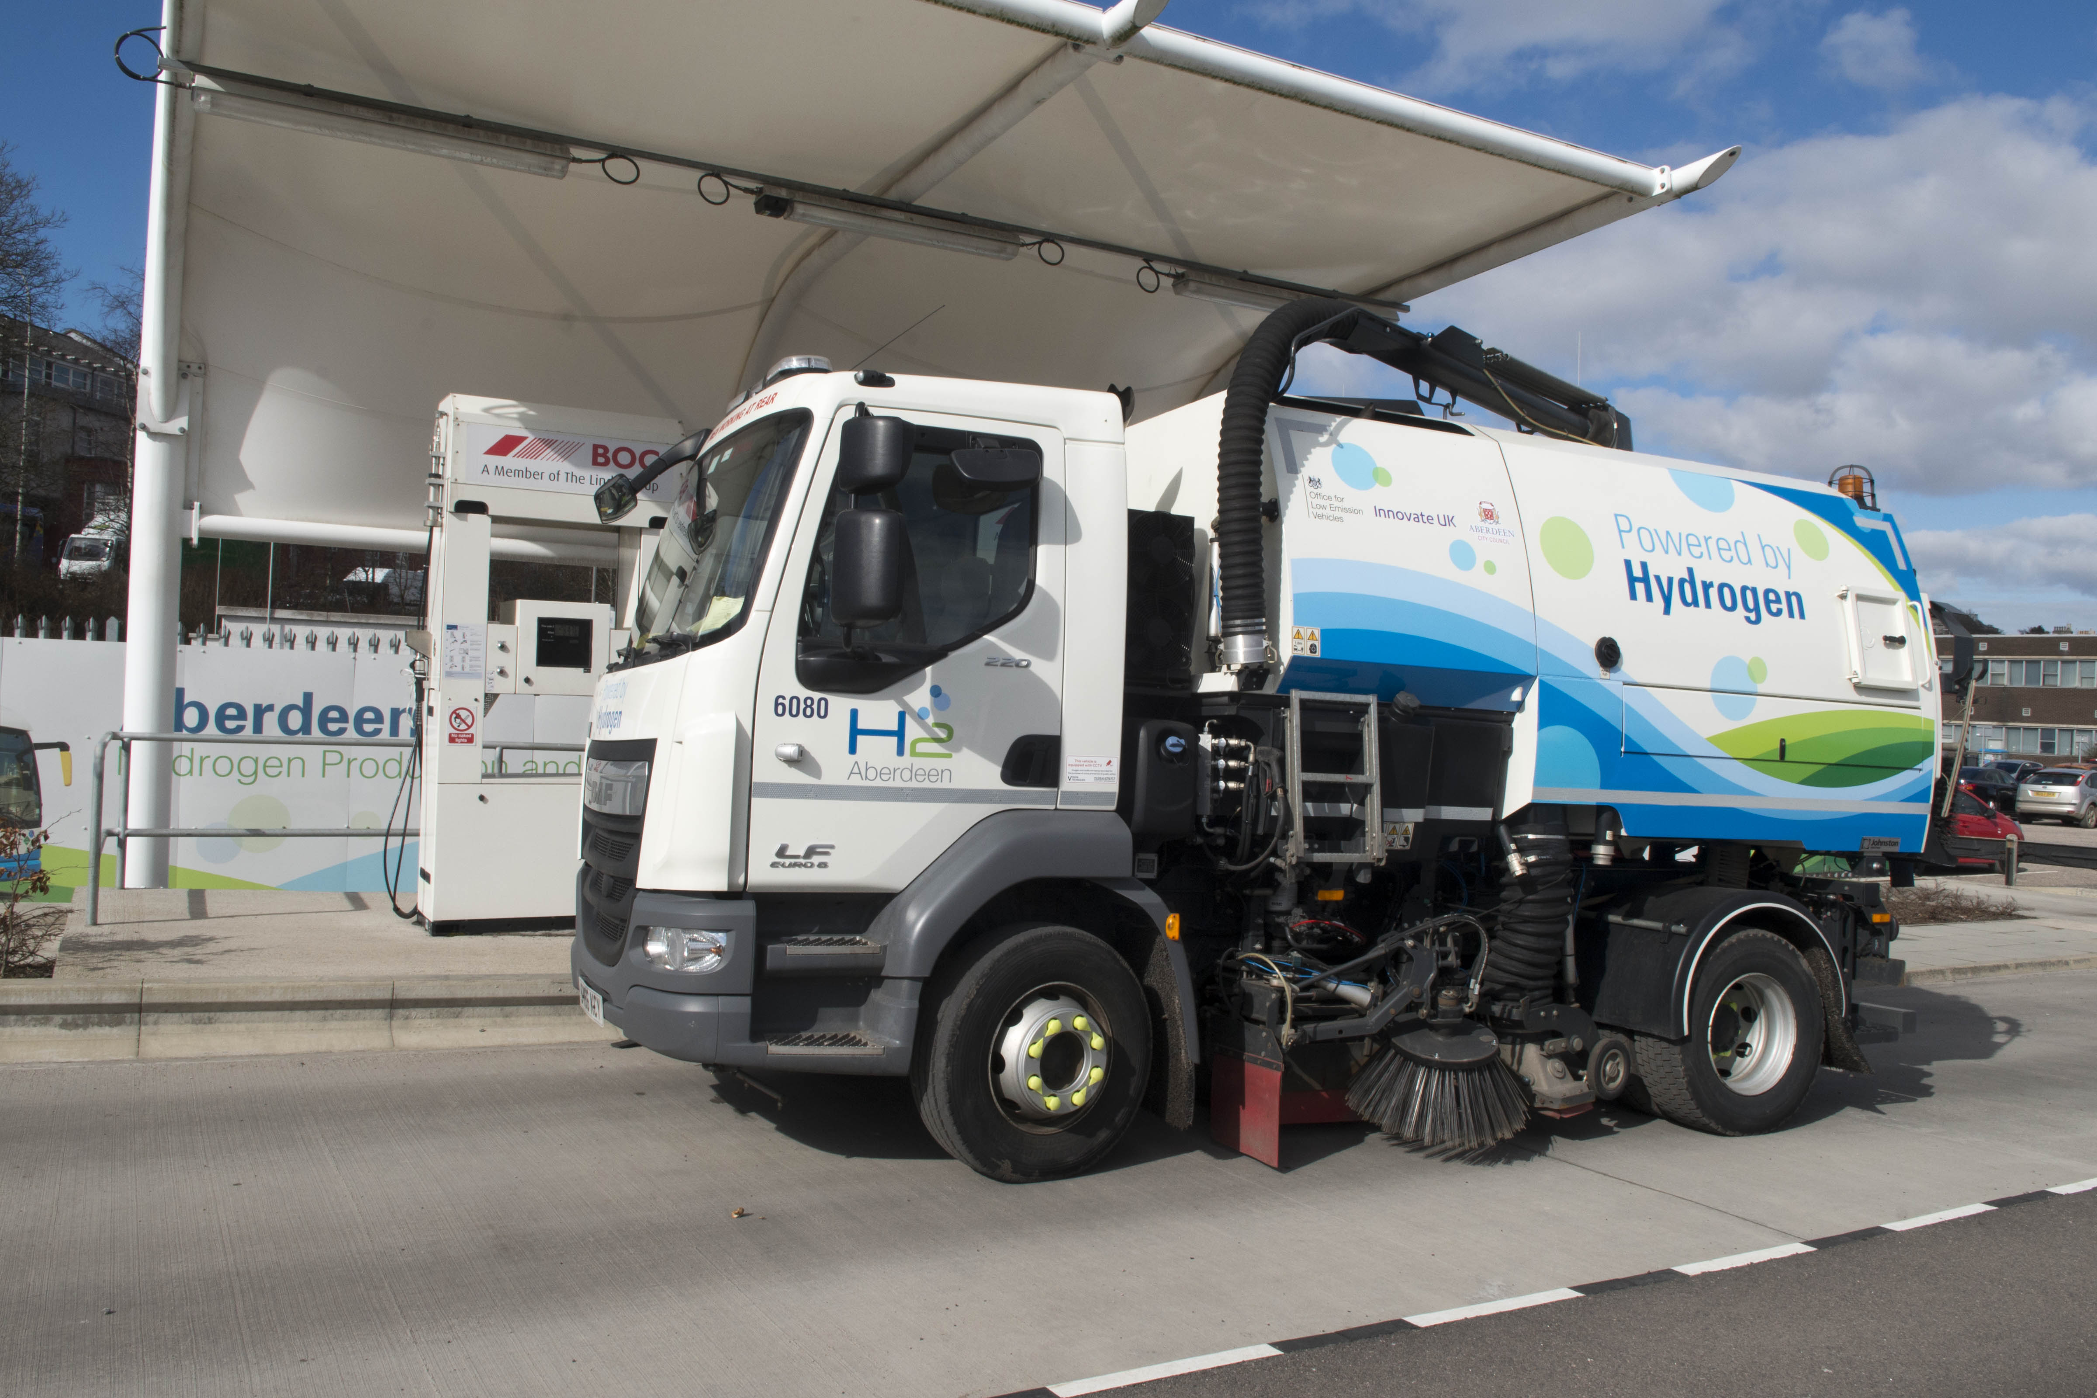
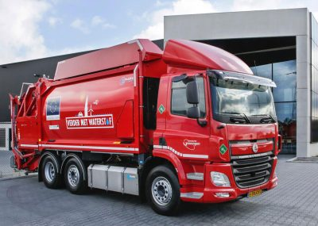
HyTrEc2
A project made up of eight organisations with the aim of creating the conditions for Hydrogen Fuel Cell Electric Vehicles (FCEVs) deployment in the North Sea Region
One of the intended outcomes of the project is to improve operational efficiency by piloting hydrogen in a wide range of vehicles including large vehicles.

Slide 8
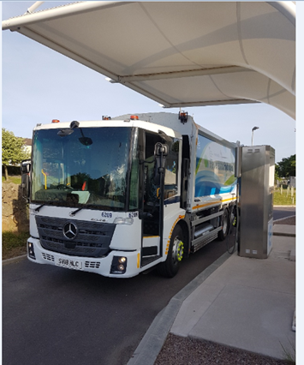
Aberdeen: Sustainable Freight
Public sector experience converting large vehicles:
2 retrofitted diesel / hydrogen roadsweepers - world’s 1st (HyTrEc2 project)
2 retrofitted diesel / hydrogen waste trucks (H2 Aberdeen funded by Innovate UK)
an entirely Hydrogen fuel cell waste truck arriving 2020 (HECTOR project)

Slide 9
Processes:
Retrofit large vehicles
1.5kg hydrogen tank
Success!
Switch on hydrogen in city centre, especially in air quality management areas
Retrofitted road sweeper can do 160 miles on one tank
Road sweepers and waste trucks retrofit with 1.5kg hydrogen tank
Alternate use of diesel and hydrogen
Now all ACC large vehicles (waste trucks and road sweepers), where practically possible, will have hydrogen
Use diesel when travelling in-between areas
Total miles in h2 | 20857 | 70%
Total miles (h2 & diesel) | 29605 | 100%
Notes:
Speaking to retrofitting companies about including the hydrogen tank and fuel cell during the manufacture of the vehicle – so no additional cost & save time

Slide 10
Lessons Learnt
Limited supply chain – need to ensure parts available locally
Expertise for maintenance – need local training programmes
ACC demonstration vehicles have been hugely influential
Limited local companies for retrofitting- travel time needed
Base vehicles need to be available to retrofitting
New technology so must allow more time for troubleshooting
Ensure warranty remains

Slide 11

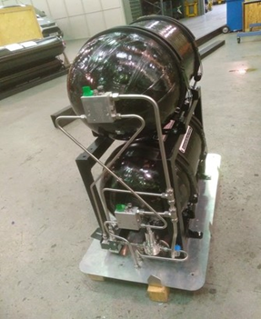
Aberdeen:
Sustainable Freight
Aberdeen has experience fostering private-public relationships to encourage the uptake of low-carbon freight.
Through Civitas PORTIS ACC and Siemens are working together to introduce a hydrogen-diesel van to the Siemens fleet in Aberdeen. Also working with two other companies to bring forward LEV pilots.

Slide 12
Processes:
Sought Partners 2018-2019
who would cover a certain mileage
Who carry out different types of activities
Meetings with retrofit company
Letter of Intent
Livery agreement
Delivery of vehicles & Retrofit
allowing ACC to place order and full lease agreement developed for each partner which would cover detailed t&cs
from previous experience hydrogen vehicle deployments and market testing had understanding of companies who could do the van conversion
Ensure inclusion partners logos
Decision of vehicle type, allow lead time for delivery of vehicle and time for conversion

Slide 13
Lessons Learnt
Not as simple as just buying a van!
Health & Safety has showed as a major consideration for companies
Telematics
Commercial reliability is very important
Allow more time for legal agreements
Important to have mix of low emission vehicles depending on the business operations
Beneficial to have an organisation acting as a facilitator as ACC has
ACC demonstration vehicles have been hugely influential

Slide 14
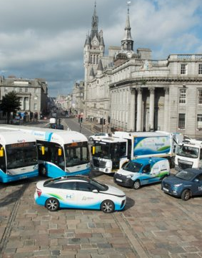

Thank you for listening
David Dunne
Contact Details:
Aberdeen City Council
Marischal College, Broad Street, Aberdeen, AB10 1AB
DDunne@aberdeencity.gov.uk
Further Information:
https://www.aberdeencity.gov.uk/
https://northsearegion.eu/hytrec2/
http://www.civitas.eu
www.h2aberdeen.com

