Slide 1
Communication Plan
Decom Tools

Slide 2
Content
Introduction
Communication objectives
Performance indicators
Basics:
Energy Innovation Cluster
Project partners
Logo and templates
Language
Target groups
Dissemination activities

Slide 3
1. Introduction
Energy Innovation Cluster has the overall responsibility for the project communication in Decom Tools.
The communication of the Decom Tools project will be carried out with participation from all project partners for maximum impact.

Slide 4
2. Communication objectives
The key objective is to inform about eco-innovative concepts for the end of offshore windfarms' lifecycle – including information about dismantling, logistic, recycling and repowering concepts.
Energy Innovation Cluster will inform the project partners and external stakeholders about the objective, activities and results from the project on an on-going basis.
The project communication aims to reach and engage external stakeholders to ensure public acceptance of a sustainable decommissioning agenda.
The project communication will provide a high level of awareness of the project and its results on a national, European level.
Finally, the project results will be made available to the target groups that are identified in the project.

Slide 5
3. Performance goals
Dissemination material and channels (brochure, roll-up, communication plan…): 8 / 800 users
Press releases: 3 / 200 users
Social media: 30 posts / 1500 users (reach)
Mid-term conference: 1 conference / 50 participants
Exchange with the NSRP: 3 events / 150 participants
Policy level event in Brussels: 1 event / 25 participants
Project website: 1 website / 2500 users
Final conference: 1 conference / 150 participants

Slide 6
4. Responsibilities – Energy Innovation Cluster
To support all project partners in the communication of Decom Tools
Coordinate all dissemination activities throughout the project: To ensure timing and transparency in the project communication
Distribution:
A European press list
A distribution list for the DecomTools newsletter

Slide 7
4.1. Responsibilities – Energy Innovation Cluster
Content:
Development and maintenance of the website: www.northsearegion.eu/decomtools
Provide all partners with a draft version of press releases during the project period on relevant topics from the project
Create and manage the project’s overall social media channels: LinkedIn, Twitter and Youtube
Visual partner presentations (short film for web and social media)
An external newsletter: 2-4 per year
Templates for documents, presentations and event material
A template for project communication reporting

Slide 8
4.2. Responsibilities – project partner
Each partner is responsible for their own project communication activities in their individual countries – by using lists for media and national/regional stakeholders
Each partner must provide Energy Innovation Cluster with text and visual content when requested
Each partner must translate and distribute the overall project press releases to national, regional and local press. Energy Innovation Cluster will provide the partners with English press material.
Keep Energy Innovation Cluster informed prior to release:
Press releases, articles (one week prior to release)
Conferences, fair stands (3 months prior to the planned activity)
Reporting:
Report your organisation’s communication

Slide 9
4.3 Logo and templates
DecomTools Logo
Use the official logo provided by Interreg North Sea Region – and the project logo created by Energy Innovation Cluster – on all publications, website, social media, promotion material.
Templates
Energy Innovation Cluster will design and distribute the logo and relevant templates to be used by all project partners.

Slide 10
4.4 Language
The project language is English.
In English:
Website
Social media channels
Newsletter
Reports
Video presentations of partners
International press releases from the project
Individual language
Press releases from each partner
Social media updates from each partner

Slide 11
5. Target groups
Primary | Secondary | Tertiary
Large private enterprises | Interest groups and NGO’s | Citizens
SMEs in the North Sea Region | Terminal operators
Higher education and research institutions | Logistic service providers
Infrastructural and public service providers | National and public authorities
Ports and port operators
Press

Slide 12
6. Dissimination activities
Dissemination | Timeline | Indicator
Communication plan | Q1 2019 | Final version ready in August 2019
Website | Q4 2018 | Active
Newsletter | Q2, Q3, Q4 | Q2 Published

Slide 13
6. Dissemination activities
Dissemination | Timeline | Indicator
LinkedIn | Q1 2019 | Active
Twitter | Q1 2019 | Active
Youtube | Q1 2019 | Active

Slide 14
6. Dissemination activities
Dissemination | Timeline | Indicator
Video statements | Q3 2019 | Published in August 2019
Roll-Up | Q1 2019 | Distributed to all partners
One-pager and flyer | Q1 2019 | Available on the website + all partners

Slide 15
6. Dissemination activities
Dissemination | Timeline | Indicator
Project templates | Q1 2019 | Available on Sharepoint
Project poster | Q1 2019 | Available on Sharepoint
One-pager | Q1 2019 | Available on the website

Slide 16
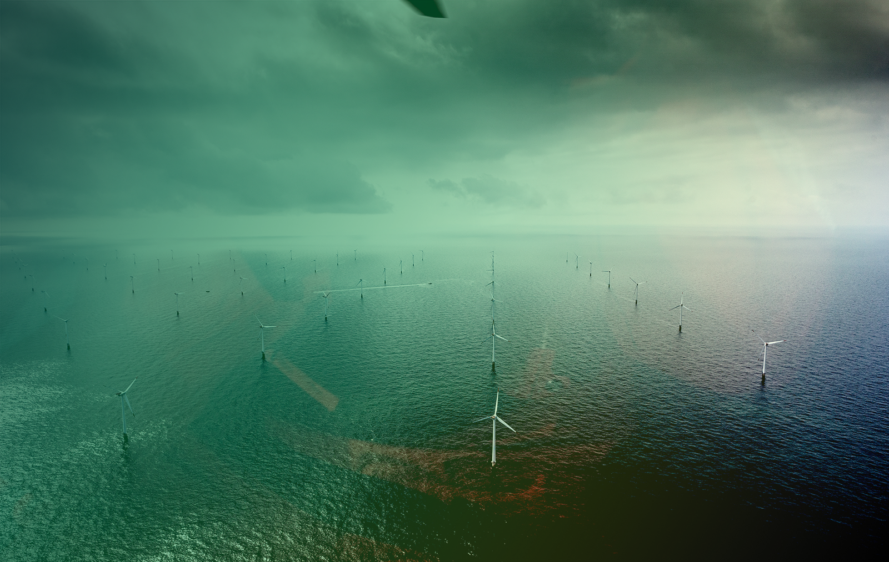
Jonas Nørholm Larsen
Communication Consultant
+45 21 22 43 04
jnl@eicluster.dk
Vi er lykkedes med at samle industrien og har nu sikret finansieringen. Vi er meget bevidste om det ansvar og den opgave, vi har fået. Nu skal vi eksekvere sammen med virksomhederne.
Glenda Napier CEO i Energy innovation Cluster
More information about DecomTools
www.northsearegion.eu/decomtools

