Slide 1
ADAPTIVE PATHWAY, HELSINGBORG
EXISTING CONDITIONS
OBJECT PROTECTION
INNER PROTECTION
Feasability study
Construction gradually
Uncertain in time
FIXED HH LINK
OUTER PROTECTION
Feasability study
Construction
2020
2050
2100

Slide 2
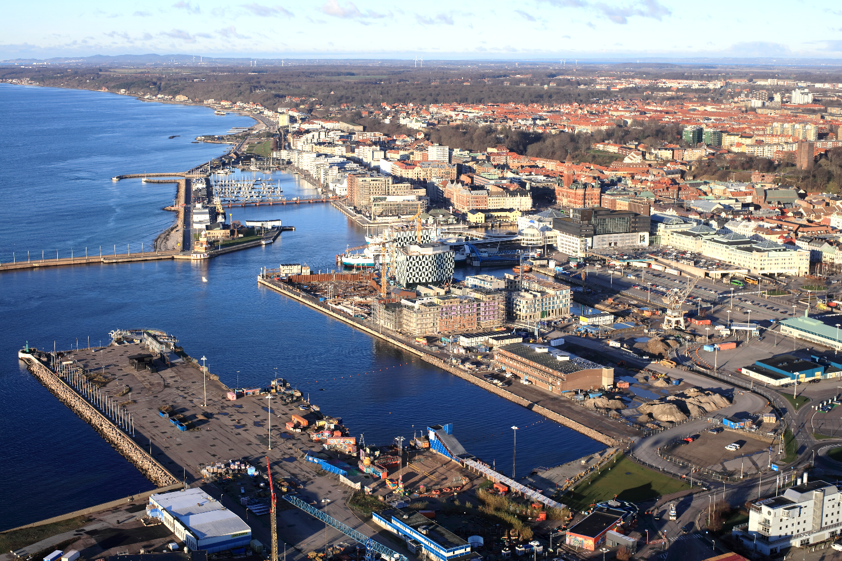
TEN RAILWAY (COPENHAGEN-OSLO)
CENTRAL STATION
POINTWISE PROTECTION (RAILWAY TUNNEL ETC)

Slide 3
TEN RAILWAY (COPENHAGEN-OSLO)
CENTRAL STATION
ADDING AN
INNER PROTECTION (CITY CENTRE AND THE RAILWAY)

Slide 4
TEN RAILWAY (COPENHAGEN-OSLO)
CENTRAL STATION
ADDING AN
OUTER PROTECTION (LONG TERM)

Slide 5
TEN RAILWAY (COPENHAGEN-OSLO)
CENTRAL STATION
OR ONLY ADDING AN
OUTER PROTECTION (AS PART OF A FIXED HH LINK)

