Slide 1
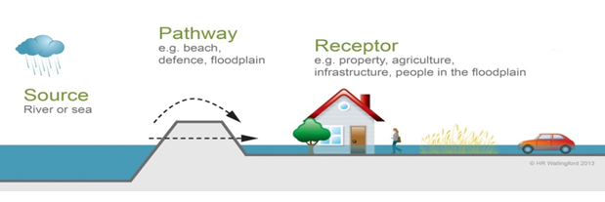
System analysis, Source-Path-Receptor approach
New seawall Middelkerke

Slide 2
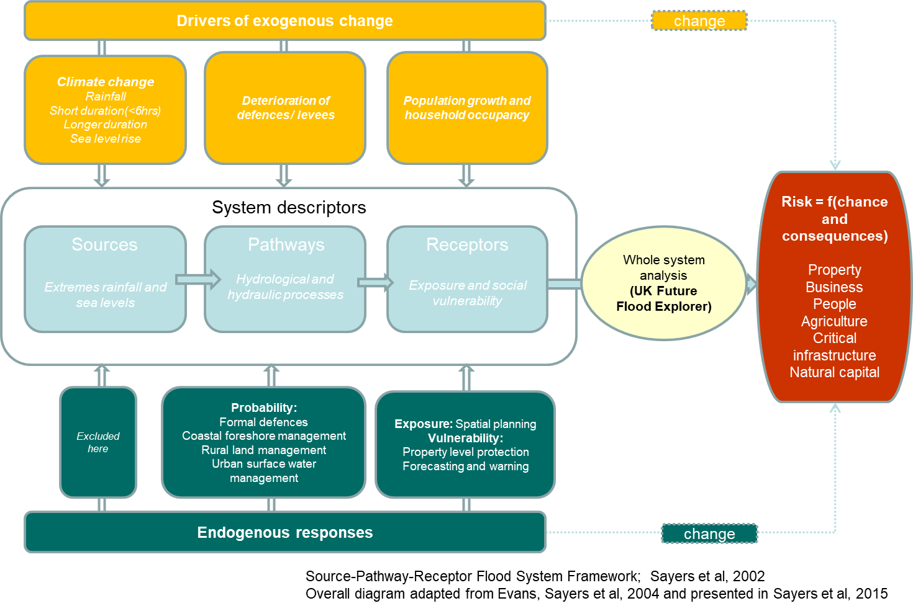
A whole systems based risk analysis
Climate change: 1. sea level rise
2. Extreme storms
Lowering of the beaches, deterioration of the sea wall
Sea level rise, incoming waves during a storm
Sea wall, beach in front of the sea wall
People living behind the sea wall
Flood defences
Coastal foreshore management
Property level protection
Forecasting and warning

Slide 3
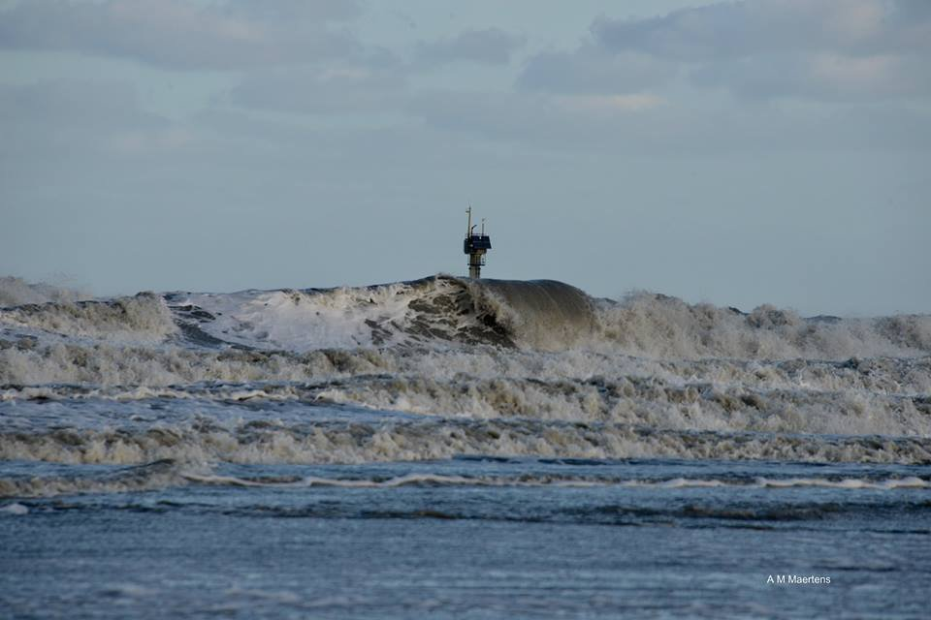
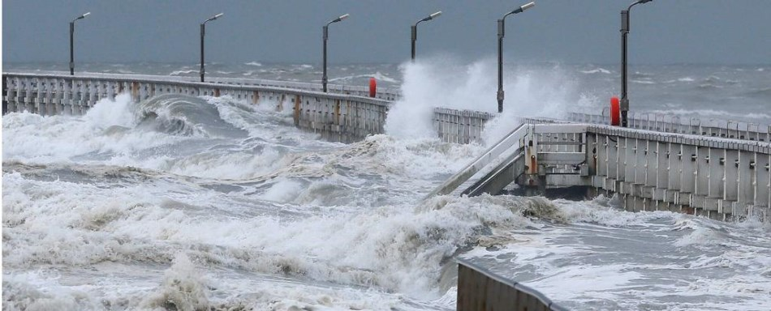
Source (1): wave attack during storm

Slide 4
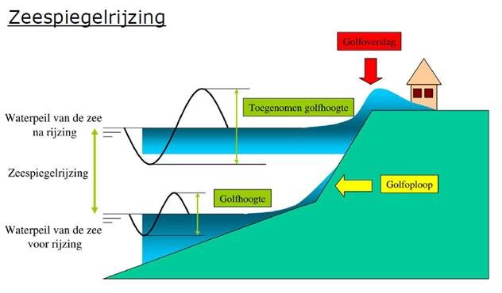
Source (2)
Seal level rise
Overtopping
Bigger waveheight
Water level due to SLR
Sea level rise
Wave run-up
Waveheight
Current water level

Slide 5
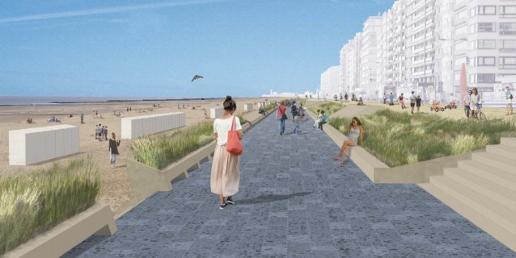
Pathway (1): the sea wall together with the beach will break the waves during a storm and limit the overtopping
Beach
New sea wall

Slide 6
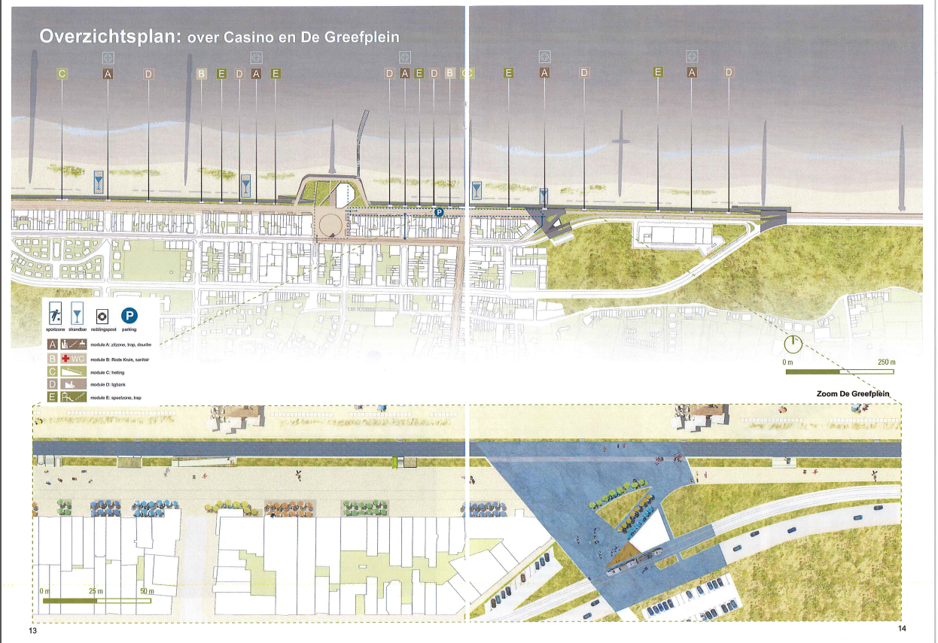
Pathway (2): overview of the project

Slide 7
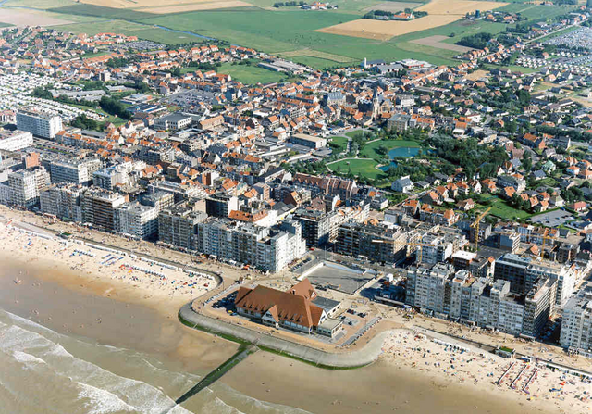
Receptor (1): the people living in Middelkerke

Slide 8
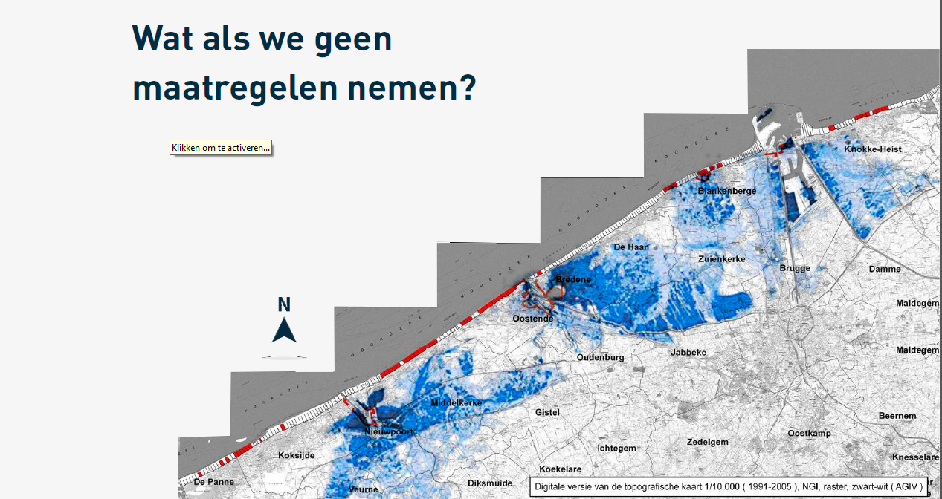
Receptor (2): all the people living in the hinterland
Floods due to +7m TAW sea level

