Slide 1

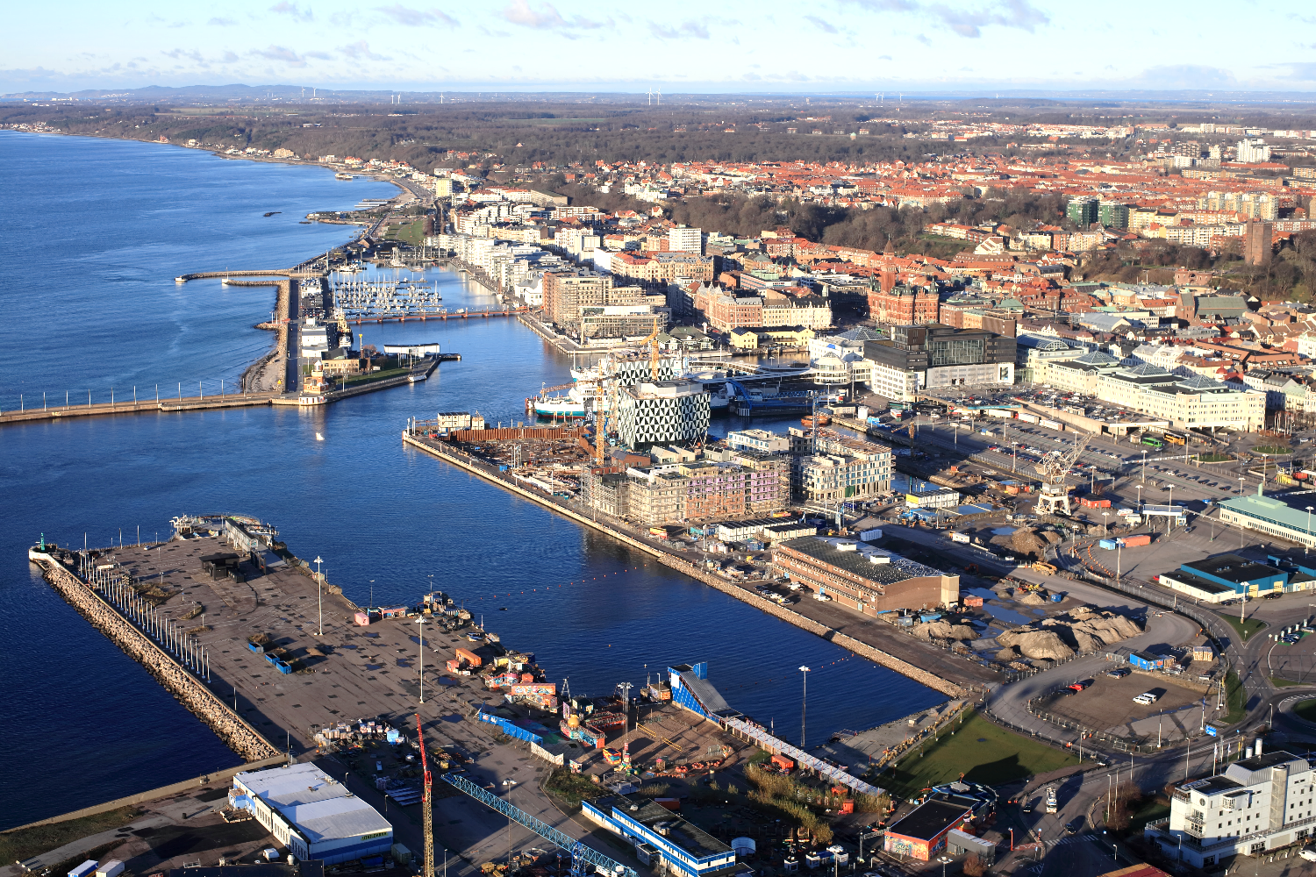
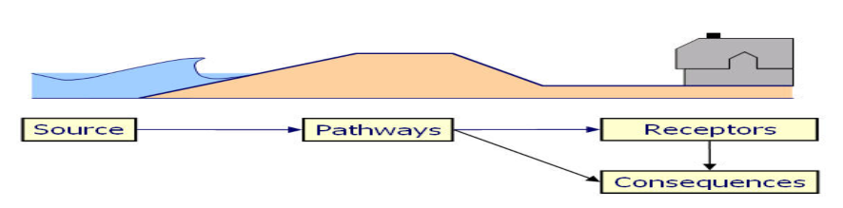
Source–Path-Receptor Framework Helsingborg
Source: Narayan et. al (2015) Investigating the Source – Pathway – Receptor – Consequence Framework for Coastal Flood System Analyses. Innovative Coastal Zone Management. ISBN: 978-0-7277-5749-4

Slide 2
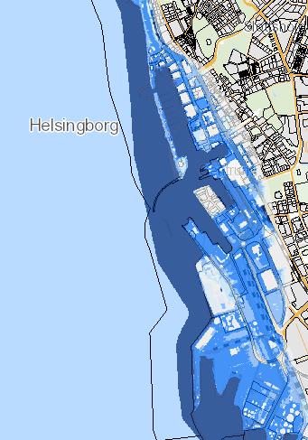

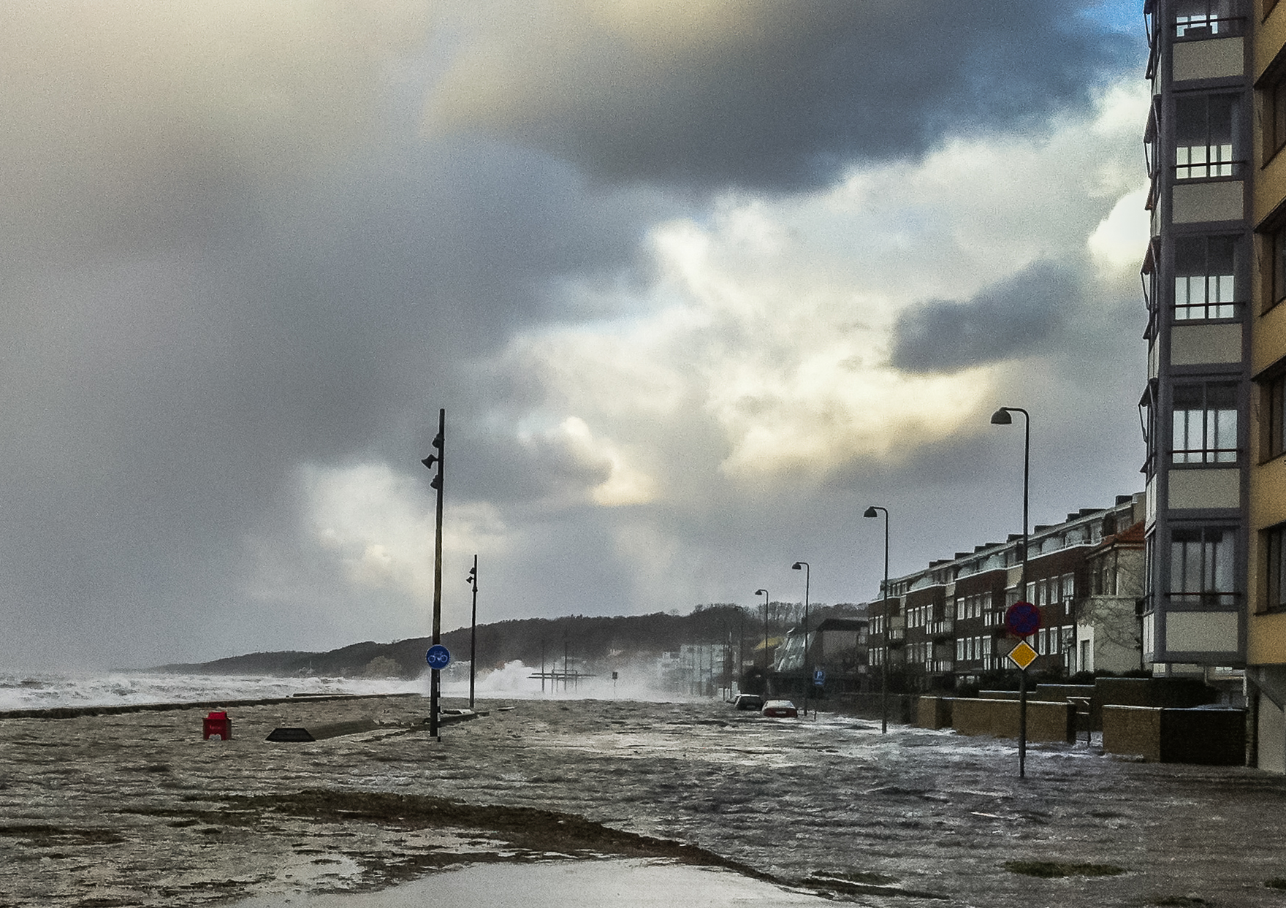
+ Sea level rise
+ Coastal storms
Sources
+ Heavy rain
Exogenous drivers of change
+ Climate change
+ Population growth
+ Densification of city centre

Slide 3
Pathway
+ Wave and wind setup → water overflow the small levee protecting the north tunnel opening
+ Water level exceeds city level
+ Water breaks through sand bags into Helsingborg C
+ Surface water
+ Draining systems overflow – pumping system stops working
+ Upland storage

Slide 4
Receptor
+ Critical infrastructure - rail road
+ Residential buildings
+ Commercial buildings
+ Ferry traffic
+ Work life
+ Recreatrion
+ Infrastructure – commuter traffic disturbances
+ If pumping systems out of order then this will affect
Object | 2035 >20 cm | 100y HW 2065 >20 cm | Extreme HW 2100 >20 cm
Residential houses |  | 46 | 90
Industry |  | 4 | 4
Complementary building |  | 113 | 167
Key societal functions |  | 14 | 13
Critical infrastructure |  | 7 | 8
Commercial buildings |  | 68 | 84
All functions/buildings |  | 252 | 368

