Slide 1
FAIR - results
Danish Coastal Authority

Slide 2
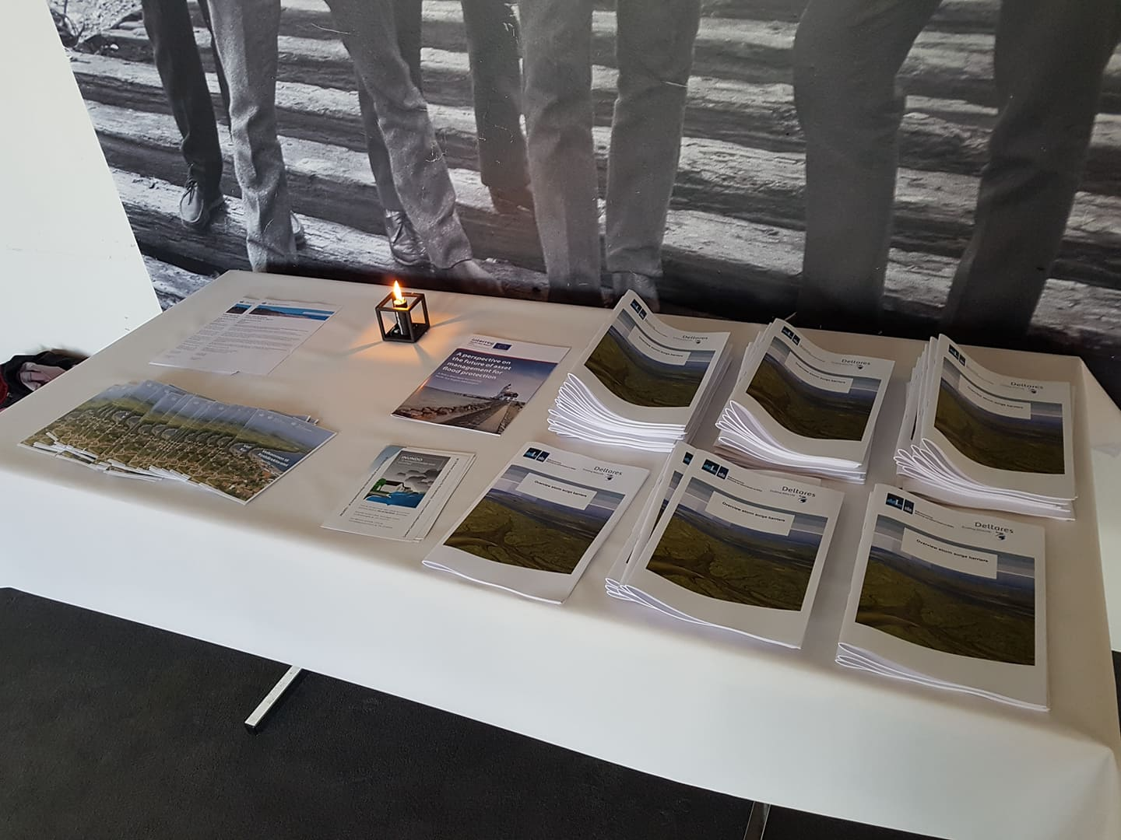
Participation in first danish Flood Gates Conference

Slide 3
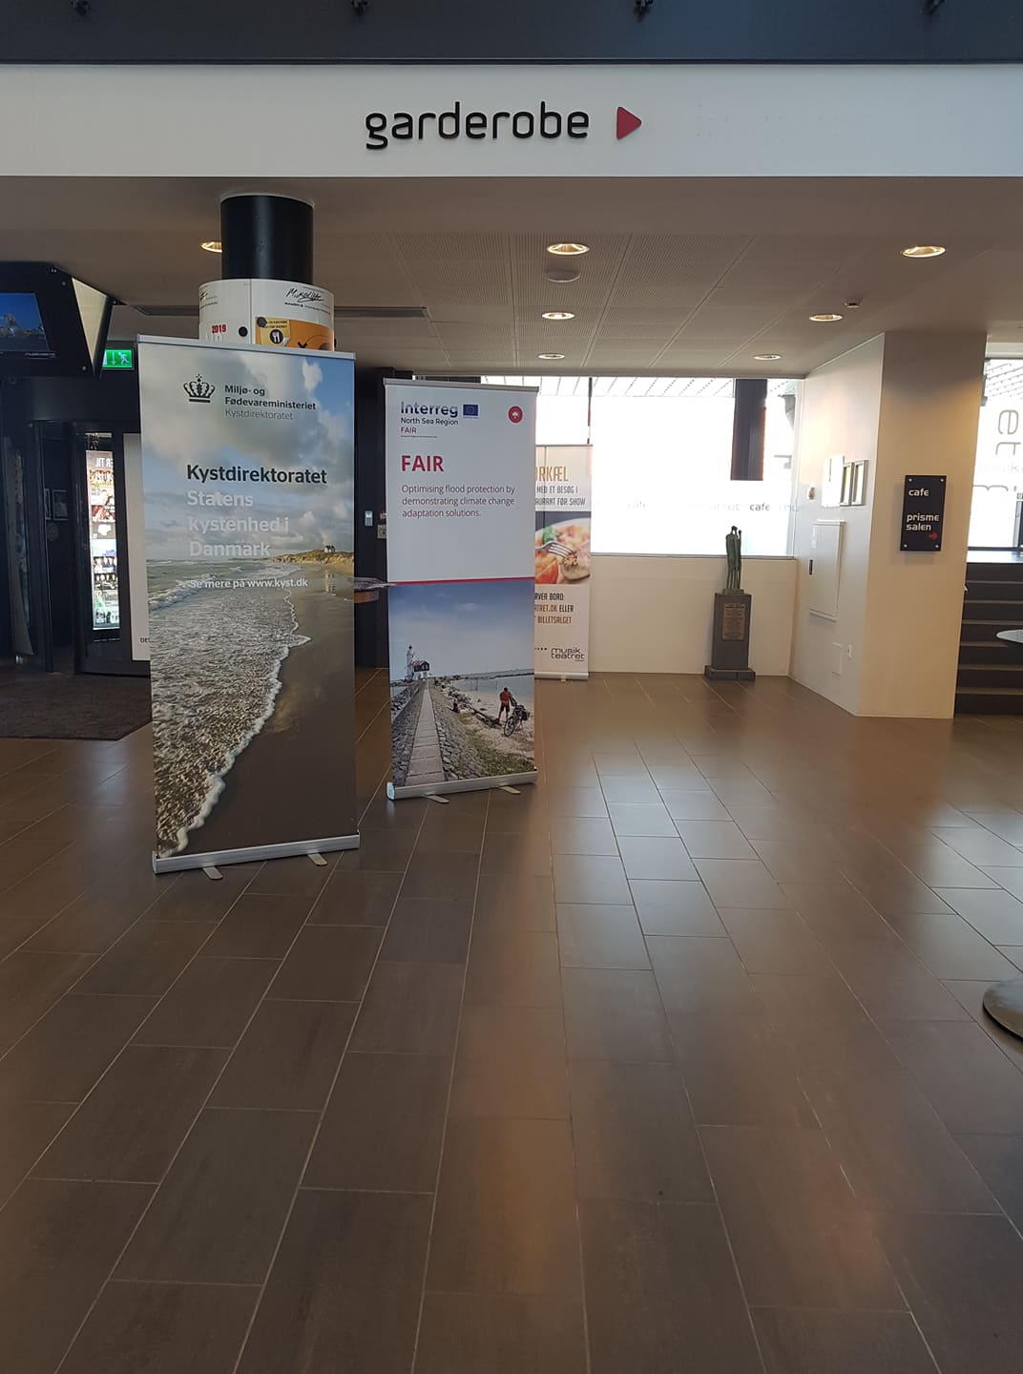
Participation in first danish Flood Gates Conference

Slide 4
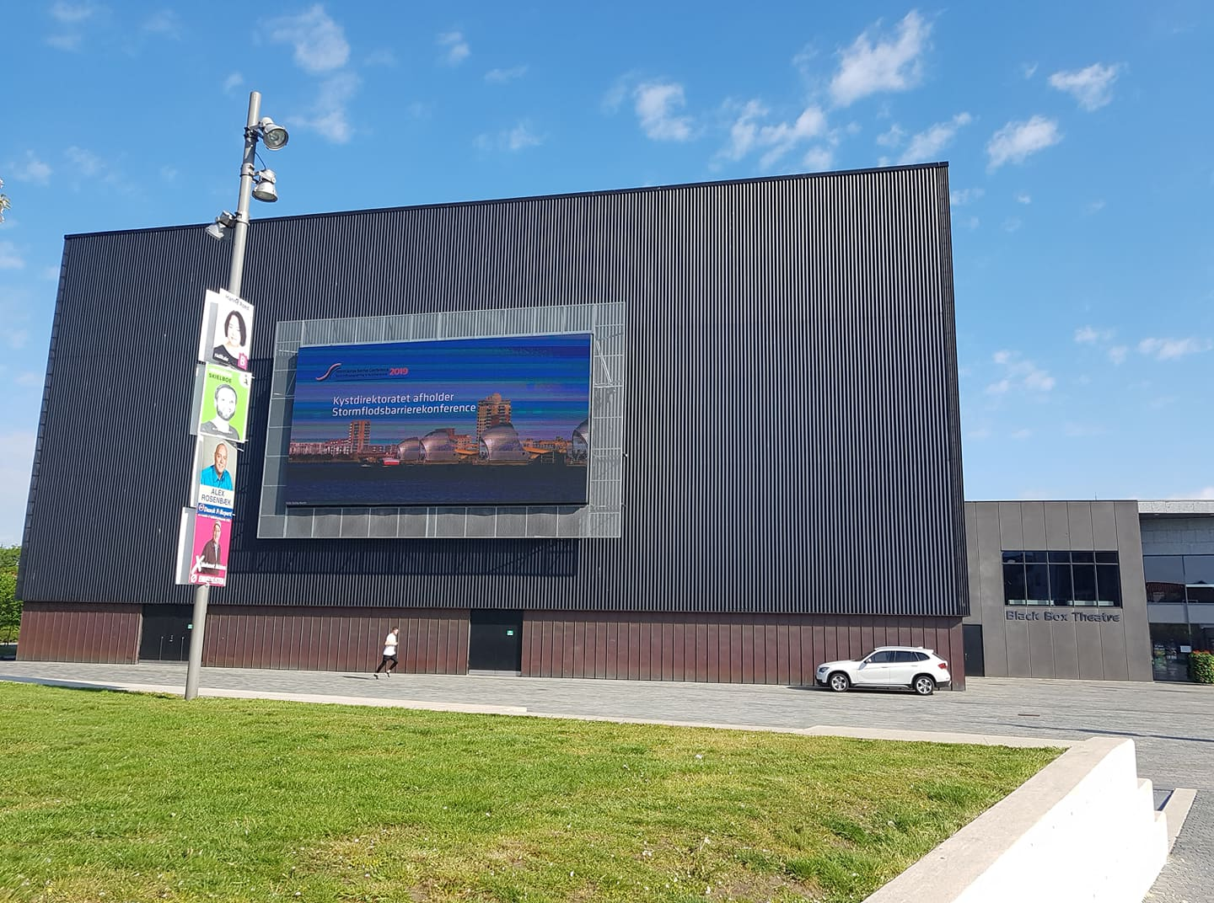
Participation in first danish Flood Gates Conference

Slide 5
News Article

Slide 6
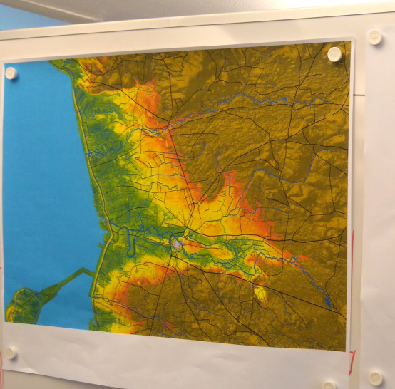
Mapping the pilot site

Slide 7
Article in national trade magazine ”Teknik og Miljø” – target audience: danish municipalities
https://www.ktc.dk/artikel/vestkystkommuner-indgaar-i-eu-projekt-om-oversvoemmelser

Slide 8
Conference poster (PDF)

Slide 9
Policy Brief Danish version (PDF)

Slide 10
Pump use in pilot site (PDF)

Slide 11
Stakeholder mapping
(PDF)

Slide 12
Financing overview

Slide 13
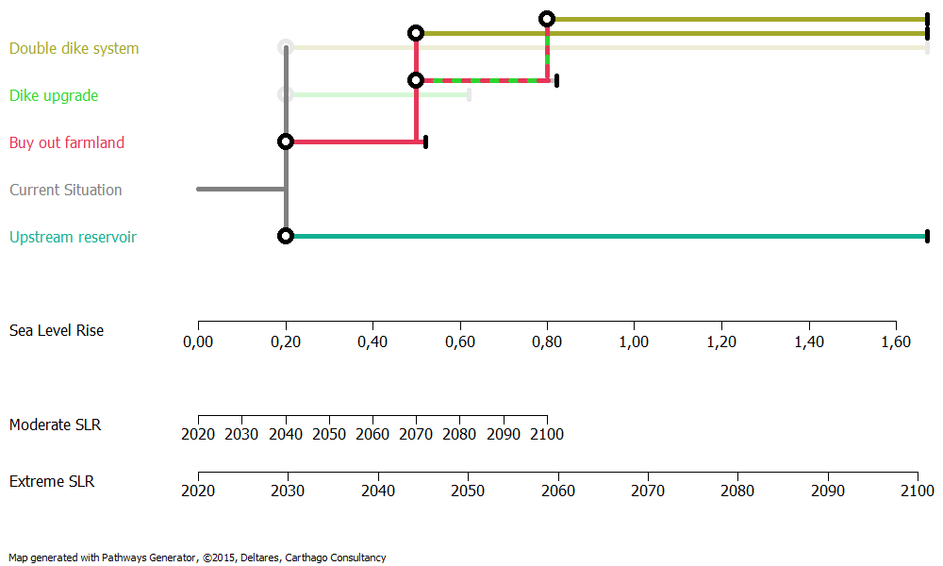
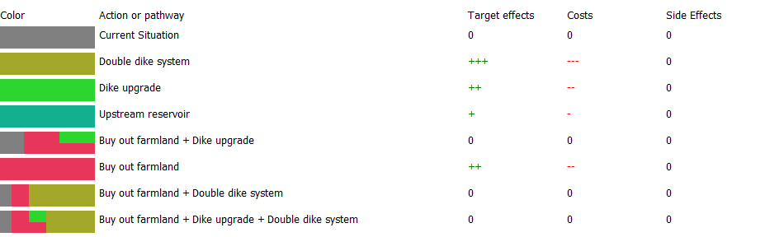
DAPP

Slide 14
DAPP

Slide 15
Joint proability analysis

Slide 16
SPR (PDF)

Slide 17
Vulnerability mapping (PDF)

Slide 18
Ribe System Analysis

Slide 19
Other results
Participation in IALCCE 2018 in Ghent, Belgium
Internal dissemination within the Ministry of Environment and Food
Membership of the ISTORM flood gates network, with the help of FAIR members

