Slide 1
Source-Pathway-Receptor Framework: A Structured Approach To System Understanding
Paul Sayers
Presentation FAIR, Billund
Contact: paul.sayers@sayersandpartners.co.uk
Sayers, P., Walsh, C. and Dawson, R. (2015) Climate impacts on flood and coastal erosion infrastructure. Published by Institution of Civil Engineers, London. Journal of Infrastructure Asset Management. DOI: 10.1680/iasma.14.00040
Sayers P B, Galloway Gerry, Penning-Rowsell Edmund, Shen F, Wen K, Chen Y, Le Quesne T (2014). Strategic flood management: ten ‘golden rules’ to guide a sound approach. Journal: International Journal of River Basin Management. DOI: 10.1080/15715124.2014.902378​
Sayers PB; Hall JW; Meadowcroft IC (2002). Towards risk-based flood hazard management in the UK. Civil Engineering 2002, 150(5), 36-42.
Notes:
1

Slide 2
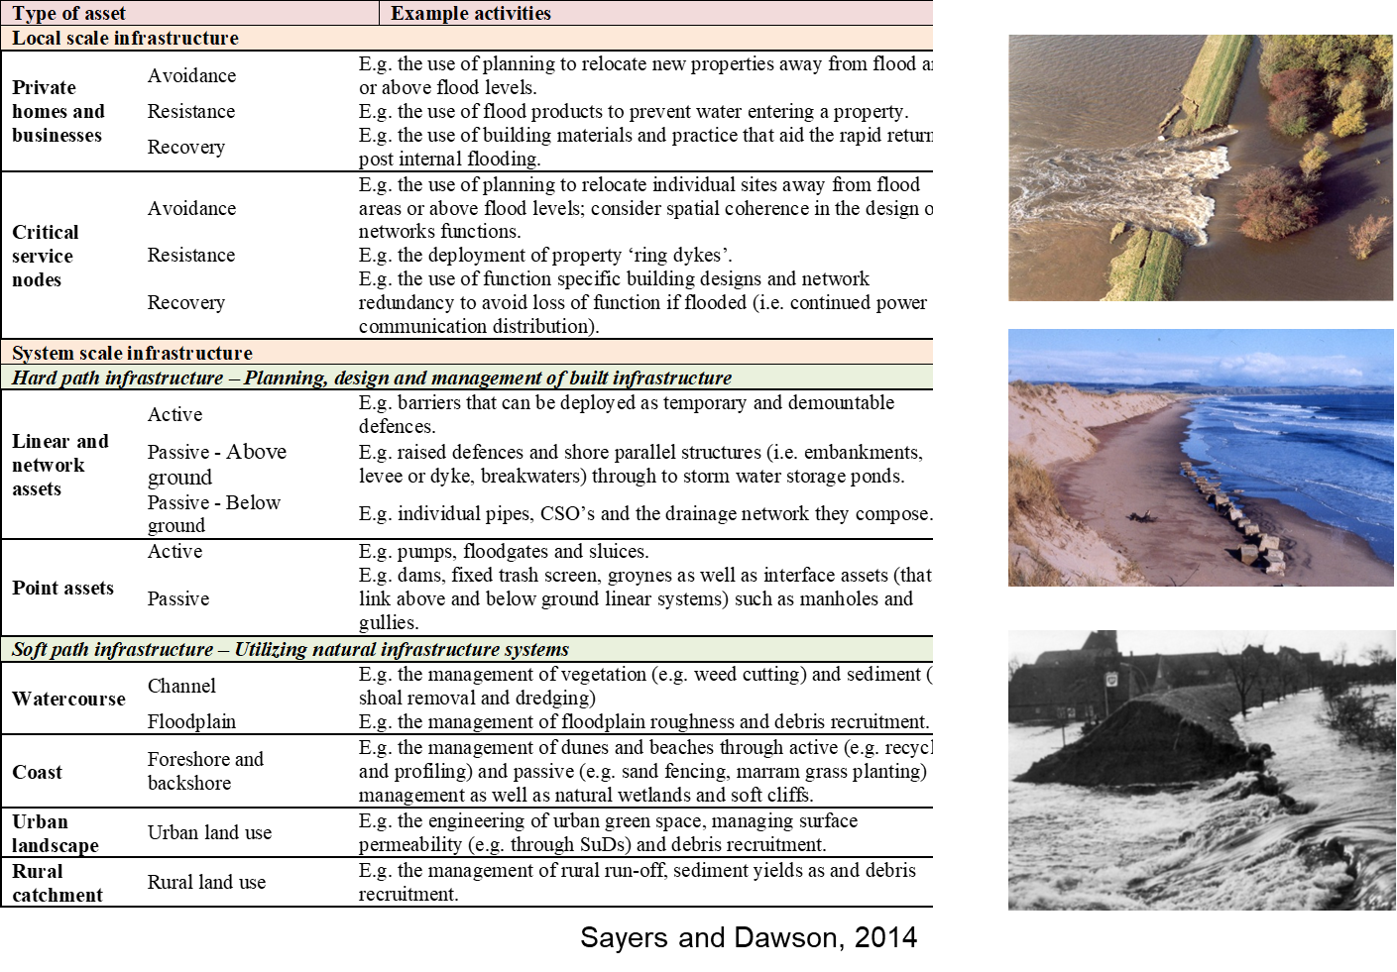
What is a flood defence ‘asset’
An flood defence asset is any feature that functions to reduce either the probability, depth, velocity or duration of a flood

Slide 3
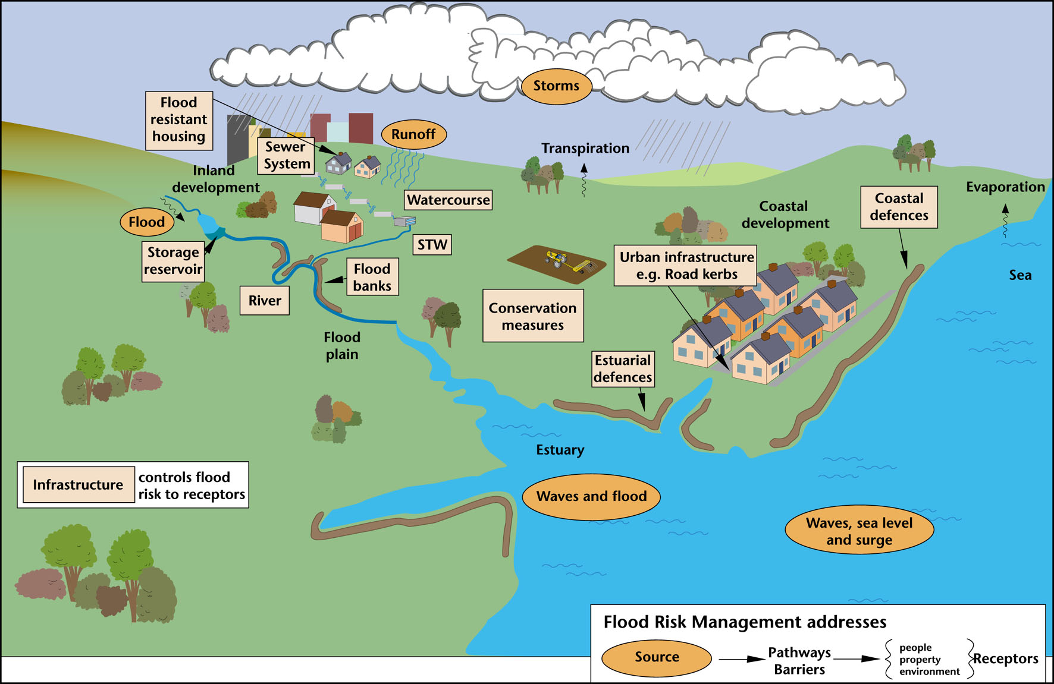
Flood defences systems exhibit spatial complexity
Asset systems
Assets perform as systems not in isolation – some assets are more critical than others and some data are more critical than others.
Bramley and Sayers, 2004
Notes:
Money and time are limited - driving the need to
Multiple rivers and drainage networks
Multiple driving sources – waves, surge, flow
Over 7000 individual defences, gates and barriers

Slide 4
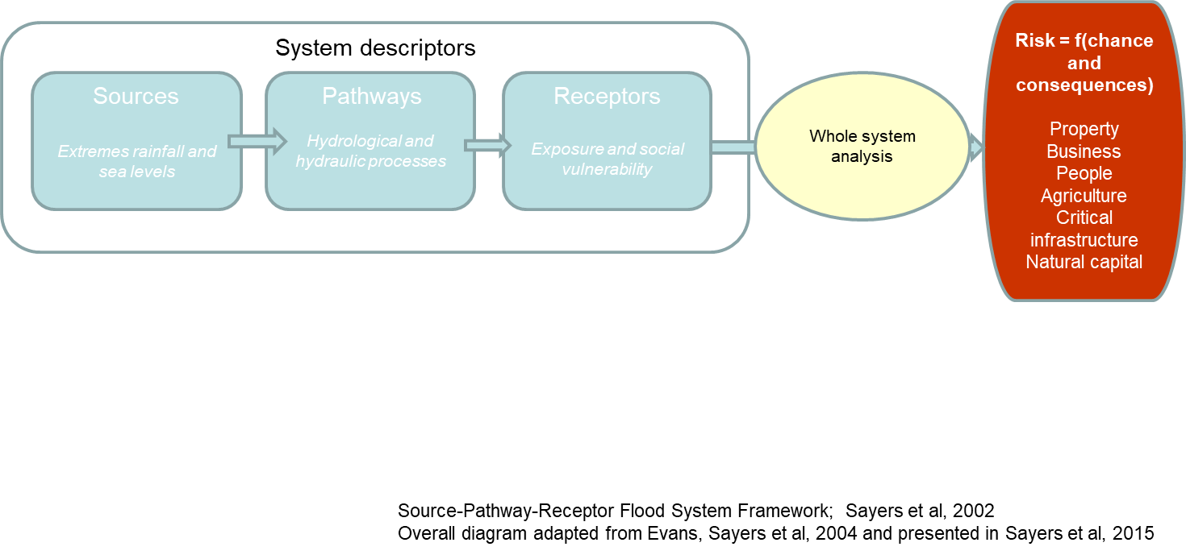
Approach: A whole systems based risk analysis

Slide 5
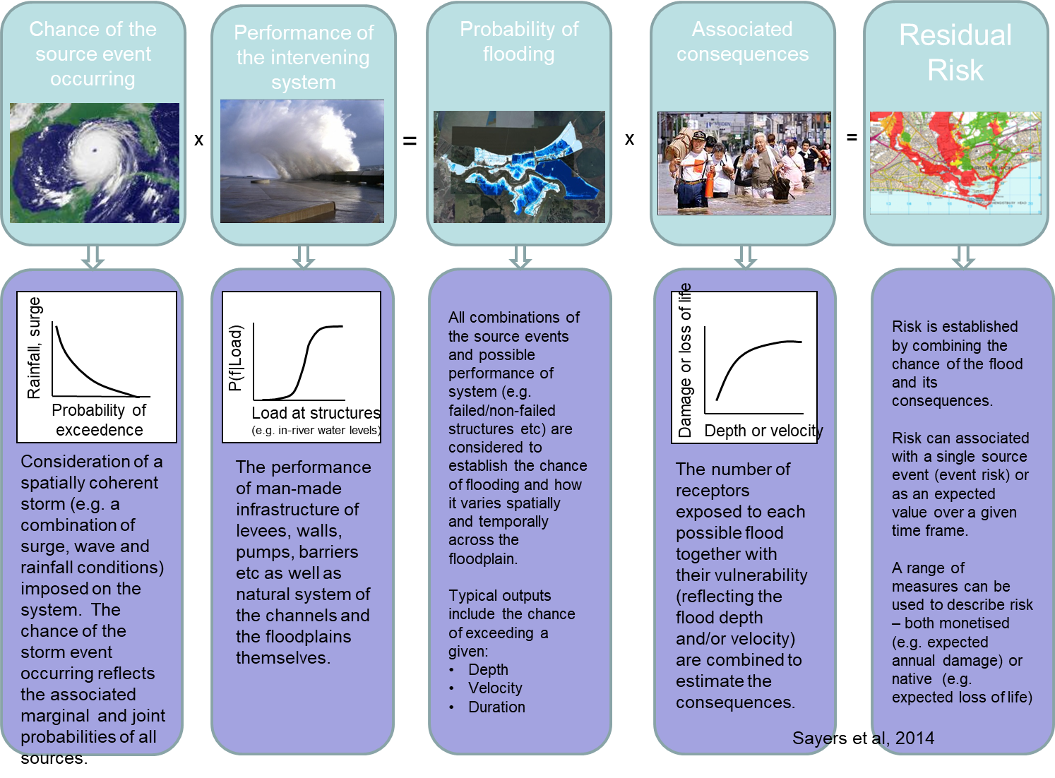
Notes:
[Click] For the purpose of this model, RISK is an index of possible life and property loss that was caused by flooding from a tropical storm or hurricane
[Click] RISK equals the odds of a tropical storm or hurricane hitting the New Orleans area
[Click] TIMES the strength and reliability of the protection system against that storm’s surge
[Click] TIMES the potential loss of life and property in the event of overtopping, breaching, rainfall, etc.
The risk and reliability model analyzes the protection system against possible hazards to understand and quantify risk so that it can be managed.
Now…let’s look at each of these a little more closely…[Click] CHANCE of HAZARD: While figuring out that not all hurricanes are the same, the scientists also realized that the old way of looking at past hurricanes to build a levee system was not the right way to do things.
Using all of the information they knew about hurricanes they used computers to create additional storms that we could possibly see here in the future - they modeled 152 storms from small hurricanes to extremely large ones. They modeled hurricanes that ranged from ones most people would consider common annual events, to ones of biblical proportions, as well as their likelihood of hitting the New Orleans area.
To put this in perspective, This is more than twice the number (68) of hurricanes that made landfall along the Louisiana, Mississippi and Alabama coastlines since 1851. As a reference, there have been 279 hurricanes in the continental United States from 1851 – 2006.
[Click] SYSTEM PERFORMANCE: IPET studied the entire 350-mile system; every span of levees, and every feature, meaning floodgates, walls, etc. They looked at it from two perspectives:
- What was the state of the protection system pre-Katrina, and what is it today.
The Army Corps of Engineers did the work on the 100-year designs to forecast future risk.
[Click] And finally CONSEQUENCES: This data was based on Pre-Katrina population and property information so the comparisons in terms of overall risk could be compared.
ARE THERE ANY QUESTIONS ON THIS SLIDE? It is critical that we explain this clearly to you before we move on.

Slide 6
But its more complex of course …systems exhibit temporal complexity
Structural deterioration
  of levees – sheet pile corrosion, surface erosion
Vegetation growth
  in channel and in levee banks
Blockage
  anthropogenic and natural debris
Climate change
  desiccation of soils, increased loads
Demographic change
  in the “protected” floodplain

Slide 7
…and the interventions options are numerous
Where?
      Improvement of which asset would yield the greatest benefit (e.g. reduce risk most)?
When?
      Is action required now, or can investment be postponed?
How?
      Should we collect more data or intervene?

Slide 8
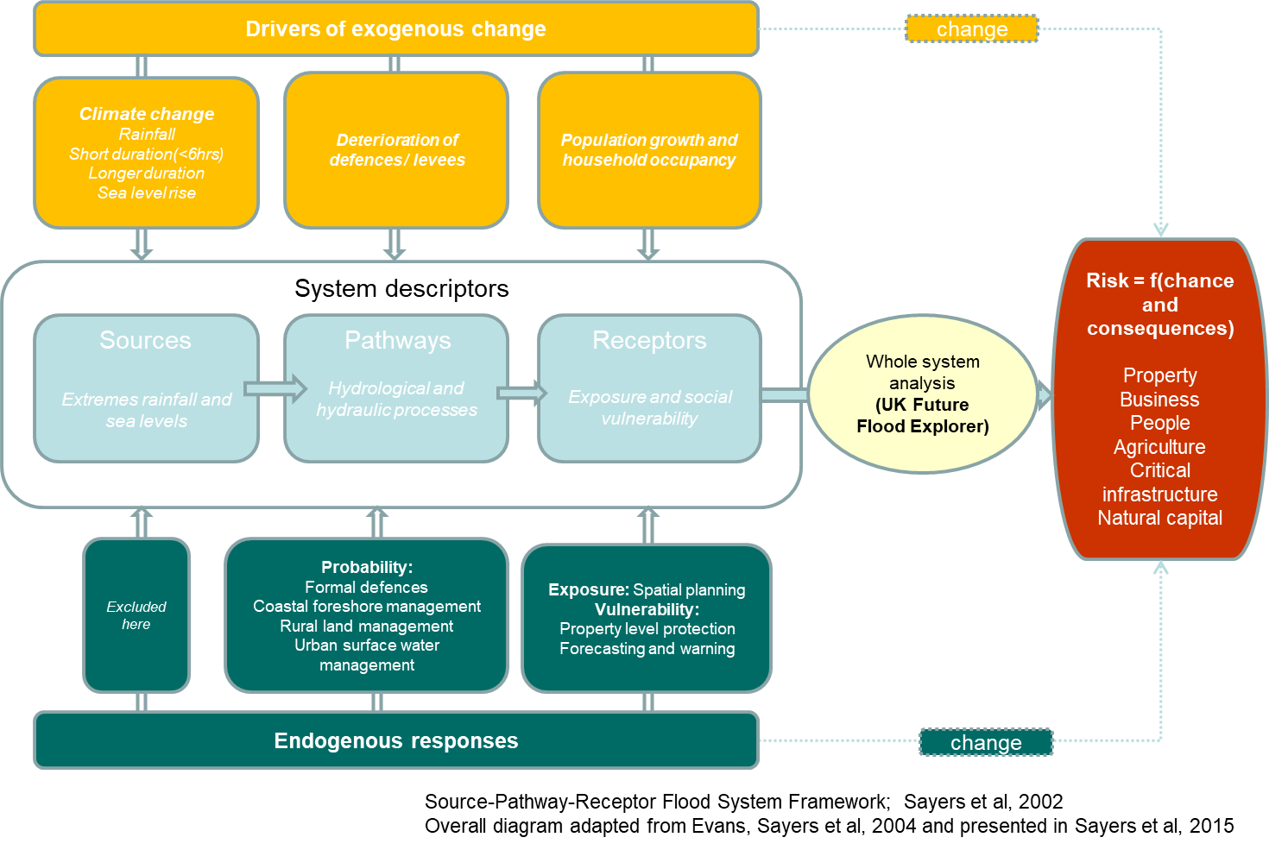
A whole systems based risk analysis

