Slide 1
Interreg FAIR task 3.1 Questionnaire
Part B – Case study – Project KIJK
Malmö, Sweden
by Manon de Vries
hoogheemraadschap Schieland and the Krimpenerwaard
september 2016
D2016-08-000893

Slide 2
This presentation
Question 3.1: Setting the scene of the case study
Question 3.2: Specific challenges and barriers to overcome
Question 3.3: Overview of tools and data to be used
Question 3.4: Decision process
Question 3.5: The relationship of asset management to board planning issues

Slide 3
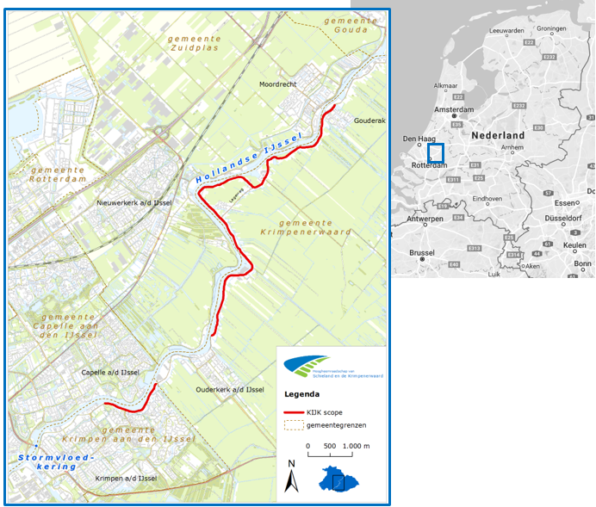
Question 3.1: Setting the scene of the case study
Project KIJK: Krachtige IJsseldijken Krimpenerwaard (i.e. powerfull IJssel dikes Krimpenerwaard).
A flood protection project in the Dutch Flood Protection Program (HWBP).
Situated within regional water authority HHSK, along the river Hollandse IJssel. The dikes (10,15 km) along this river are under investigation.

Slide 4
Question 3.1: Setting the scene of the case study
Physical setting: Heavily populated area just north of Rotterdam. Nearby natural areas are peat grassland and tidel forest. The average land subsidence (oxidation of peat) is 1,1 cm/yr.
Sources of flooding: High water levels due to wind storms, high river discharge after heavy precipitation, tidel influences. Climate change will worsen the effects.
Existing flood defence infrastructure: Dike with asphalt road cover, houses, offices, schools, monuments, hydraulic structures, harbours.
Just south of project KIJK a storm surge barrier is situated.

Slide 5
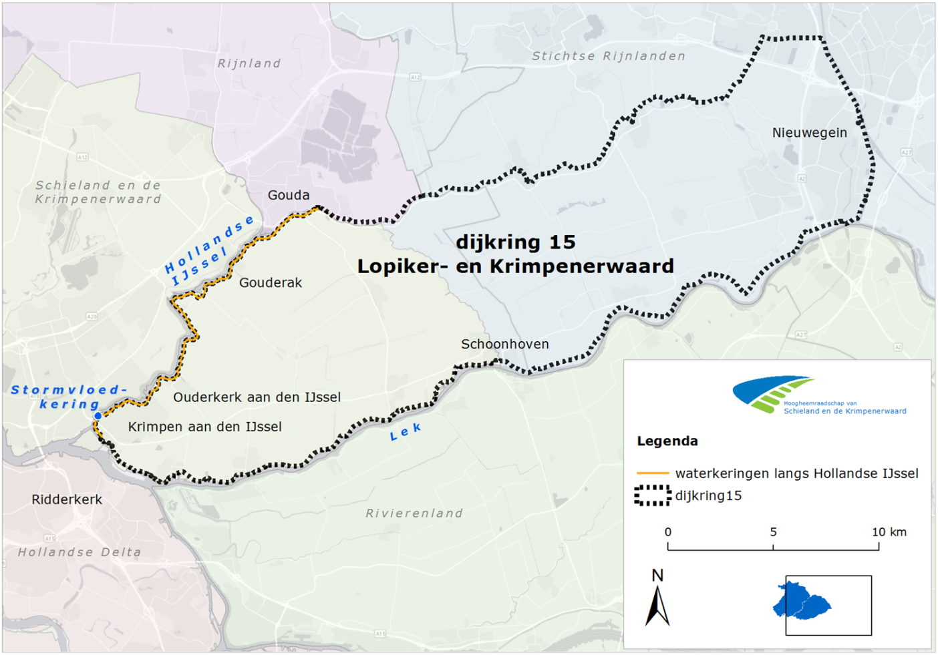
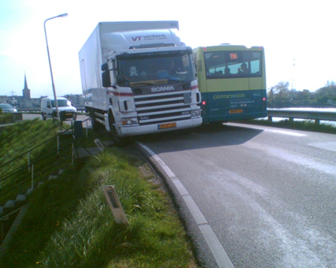
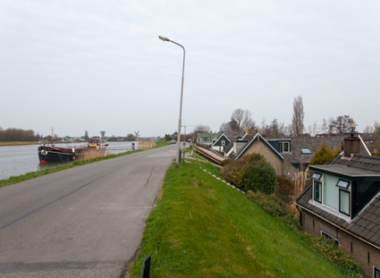
Question 3.1: Setting the scene of the case study

Slide 6
Question 3.1: Setting the scene of the case study
Socio-economic setting: semi-urban, 3 villages in 2 municipalities, part of dike ring area 15 that has 200.000 inhabitants.
A dike breach has a potential damage of 1 billion euros and 150 victims.
The historical flood disaster of 1953 a part the dike within project KIJK proved to be inadequate.
Goal (functional): to protect the citizens and economic values behind the dike against high water levels and flooding, and to meet the new Dutch safety standards.
With acceptance of local and regional authorities, inhabitants and other stakeholders.

Slide 7
Question 3.2: Specific challenges and barriers to overcome
Asset management challenge: Project KIJK is interested in gaining and sharing knowledge about the following:
  LCC in Systems Engineering (system approach);
  Maintenance costs index numbers of innovative solutions;
  The use of new LCC calculation or analysis tools if available.
Systems engineering approach: Thinking in functions rather than objects, so addressing the functional goal of protecting the citizens and economic values.
This could not only be solved with reinforcing the dike, but also with a combination of solutions in a broader perspective (lowering water levels, optimizing safety standard storm surge barrier, minimizing impact of possible flooding, innovative solutions), per dike section.

Slide 8
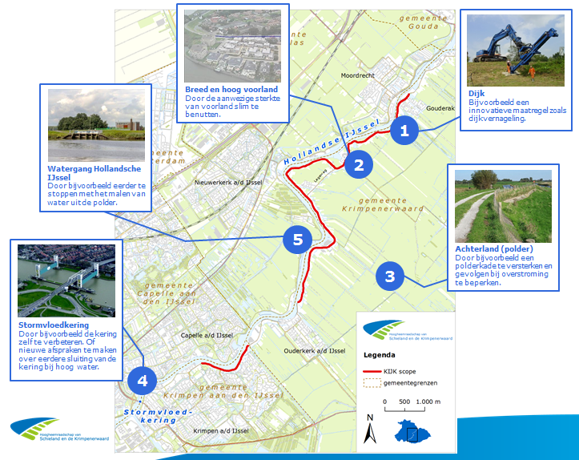
Question 3.2: Specific challenges and barriers to overcome
The broader perspective:

Slide 9
Question 3.2: Specific challenges and barriers to overcome
The failure mechanisms per dike section have already been analysed in project KIJK (in 2015-2016): landward stability, riverside stability, micro stability, floodplain stability, height, and grass/asphalt/stone dike cover.
The combination of possible solutions per dike section in project KIJK are being analysed at this moment, so the overview of asset types and activities still have to be determined (2016-2018).
The new safety standard for project KIJK is 1/10.000 (‘signaleringsnorm’).

Slide 10
Question 3.2: Specific challenges and barriers to overcome
Plans and policies: NNN areas, Deltaprogramma region Rijnmond Drechtsteden, area development, traffic plans, nearby projects, regulations.
Future change: Climate scenarios and socio-economic aspects (population growth) are incorporated in the Dutch legal safety standard.
Governance: Project KIJK is financed out of the ‘dike account’ of the Ministry of Infrastructure and Environment. The maintenance is paid by the asset owner, water authority HHSK.

Slide 11
Question 3.3: Overview of tools and data to be used
Reliability and deterioration: This still has to be determined in 2610, 2017 and 2018 project KIJK, together with external specialist engineers.

Slide 12
Question 3.4: Decision process
Future change: Climate scenarios are prescribed in The Netherlands and therefore accounted for in project KIJK.
Investment planning: No funding constraints, since necessary budget has been programmed.

Slide 13
Question 3.5: The relationship of asset management to board planning issues
Available budget is to meet the goal of project KIJK.
There are initiatives in multi-benefits (‘meekoppelkansen’) in project KIJK, e.g. road traffic safety and sustainability. The initiator is responsible for the necessary additional funding.

