Slide 1
Maturity of asset management of flood defences in the NSR: a baseline analysis
Coordination Meeting, Billund, day 2

Slide 2
What FAIR sets out to achieve?
Help do more for less – through better targeting of investment
Encourage multi functionality – through collaborative planning and connecting investments
Extend asset life – through smarter maintenance and renovation

Slide 3








How we will achieve these results?
The proof is in the eating … FAIR includes Asset Owners (AO) and Science Partners (SP), which provides the opportunity to share and improve ‘real world practice’.

Slide 4
Baseline analysis
To identify strengths and weaknesses in current practice we monitored the degree to which AOs implemented AM strategies
This enables AOs to identify the optimization potential, and supports them in linking the strategic, tactical and operational stages
Maturity matrices provide structure for baseline analysis

Slide 5
Steps involved
From a desk study, we developed a comprehensive framework for AM of flood defences
Based on the framework, we included (in our matrix) 3 Qs on stages of AM and 6 Qs on underlying factors
AOs self-assessed their maturity in interactive session with employees in various roles (strategic advisors, programme managers, operational managers)
AOs and SP together analyse and compare results in a validation workshop

Slide 6
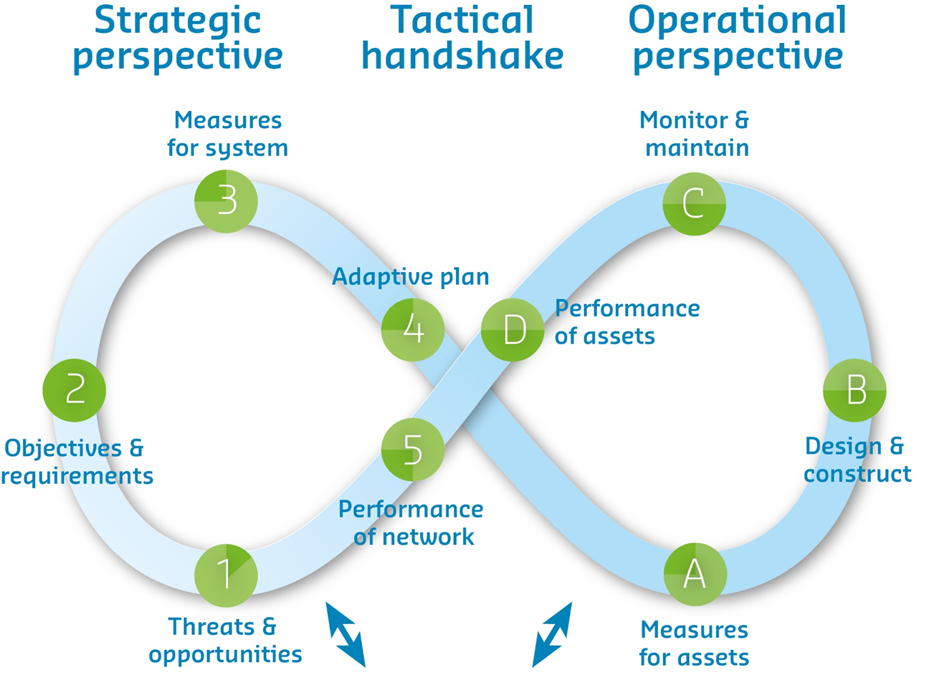
Framework for AM of flood defences

Slide 7
Maturity throughout 3 stages
Maturity level | Strategic (Steps 1-3) | Tactical (Steps 4, 5, A) | Operational (Steps B-D)
Optimal
Managed
Standard
Repeatable
Ad hoc
A long term vision is present, and a consistent method is applied to translate this vision into well-defined AM strategies, based on cost, risk and performance.
Performance of assets is not measured. Interventions are based on daily issues. There is no connection between maintenance, larger inter-ventions and performance.

Slide 8
Maturity of underlying factors
Maturity level | AM decisions | Information management | Internal coordination | External coordination
Optimal
Managed
Standard
Repeatable
Ad hoc
Life cycle costing is embedded in strategic, tactical and operation decisions and forms the basis of the evaluation of risks and opportunities.
The water authority informs both end users and other asset owners on the execution of maintenance of objects (before and after maintenance).

Slide 9
Maturity of underlying factors
Maturity level | Outsourcing activities | Processes and roles | Culture and Leadership
Optimal
Managed
Standard
Repeatable
Ad hoc
A combination of internal expertise is maintained on programming and execution with some activities and assets outsourced to deliver added value.
AM is one of the targets, but the is no formal route for employee driven innovation and few employees given the opportunity for AM specific training.

Slide 10
Maturity throughout 3 stages
Optimal
Managed
Standard
Repeatable
Ad hoc

Slide 11
Maturity of underlying factors

Slide 12
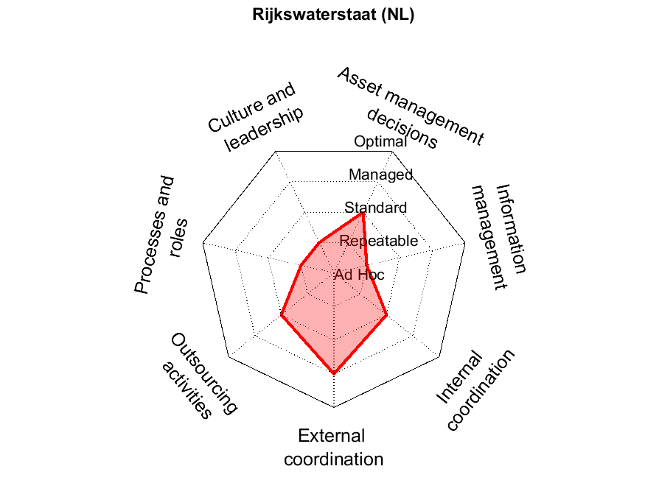

Slide 14
Initial insights
Ample potential in further mainstreaming AM strategies, particularly on tactical and operational level
Differences in maturity levels point to the opportunity to meaningfully share knowledge and experiences
Discussion on framework and maturity matrix helped to create a common vision and language

Slide 15
Next steps
Analysis and making sense of results in this workshop
Connect to key experts in organisation to validate results
Use the results to support transnational learning from AO to AO, not to compare between countries
Repeated monitoring to demonstrate progress of AOs and translate progress into project result indicators

Slide 16
This workshop (take notes!)
Did you interpret descriptions by SP in the same way?
Making sense: How do the results for underlying factors explain the results throughout 3 stages?
In context of your case study: On which criterium would you like to improve, and from whom can you learn?
Homework: How can we translate progress in PRI?

