Slide 1


Collaborative Risk Informed Decision Analysis (CRIDA)
Berry Gersonius

Slide 2
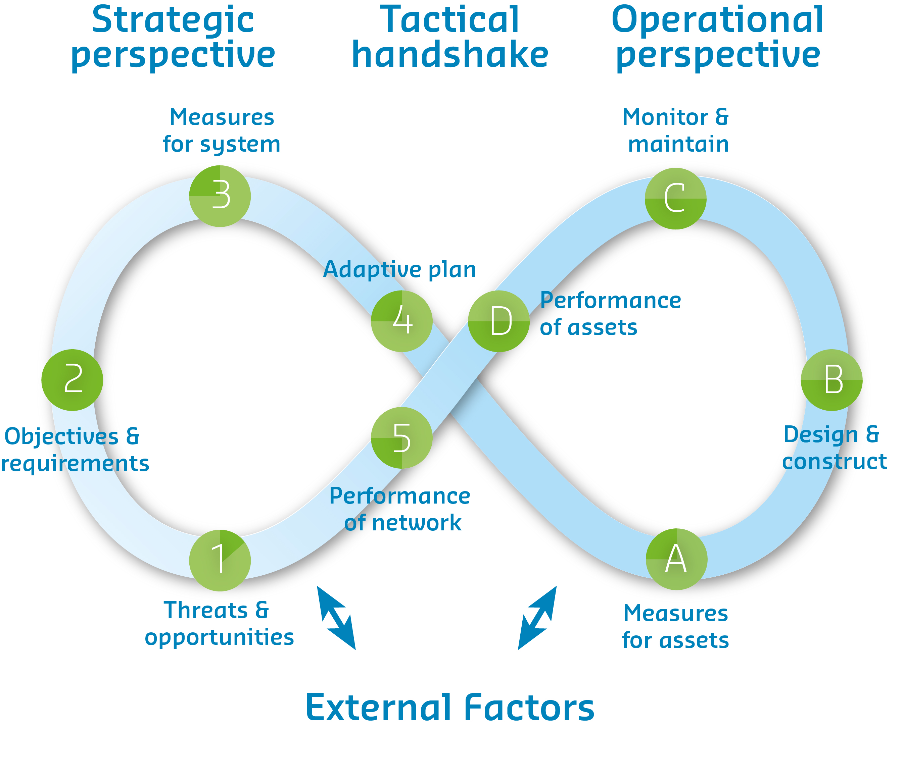

Slide 3
Top-down approach to planning
How will the science improve decisions?
Usual mode of engagement: Prediction - centric
  Science reduces the uncertainty affecting the decision
  E.g., Science: the most likely future condition is A
    Decision – under Future A, Option 1 is my best choice

Slide 4
Top-down approach to planning – under CC
Population and economical growth energy demand land use
Energy-economy models
Greenhouse gas emissions
carbon cycle models
Greenhouse gas concentration in the atmosphere
Global + regional climate models
Global/regional climate projections
Hydrologic + hydraulic modellen
Hydrologic effects
Measures
Water management

Slide 5
Dealing with climate uncertainty (explosion)
“ You have a problem, the climate is changing ! “
Decision maker
Hydrologist

Slide 6
Dealing with climate uncertainty (explosion)
“ How much….? “
Hydrologist
Decision maker

Slide 7
Top-down approach to planning
How will the science improve decisions?
Usual mode of engagement: Prediction - centric
  Science reduces the uncertainty affecting the decision
  E.g., Science: the most likely future condition is A
    Decision – under Future A, Option 1 is my best choice
Mode of engagement under climate change
  Science characterizes uncertainty (may increase)
  E.g., Science: here is a wide range of possible futures, and we’re not sure they delimit the true range
    Decision – um …

Slide 8
Quality and value of information
https://vimeo.com/135619214
Exercise: Explain the difficulty in communication

Slide 9
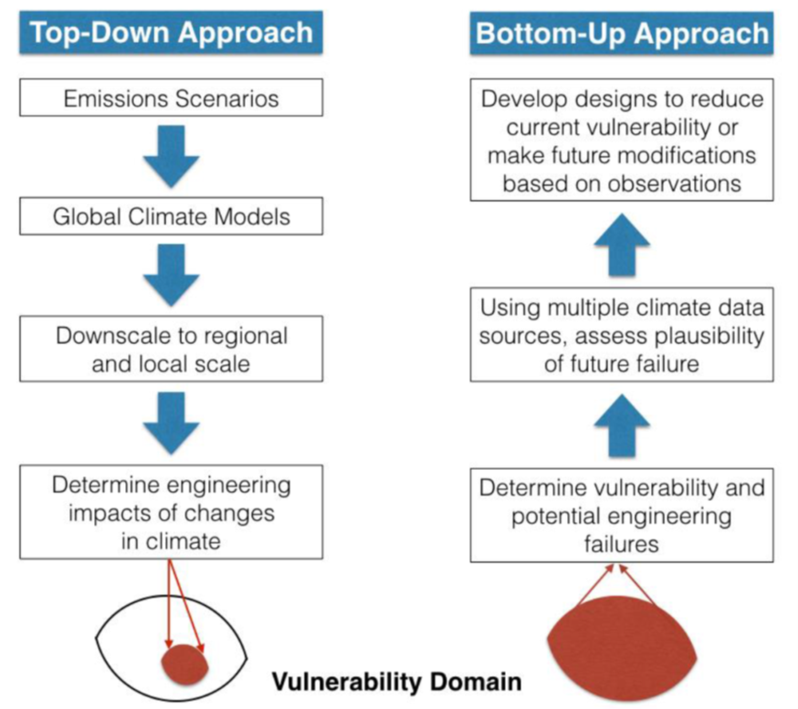
Top-down vs. bottom-up approach

Slide 10
Bottom-up approach
Bottom-up approach shifts emphasis from what we do not know (i.e. climate uncertainties) to what we do know (i.e. water management system)
CRIDA approach:
  Starts bottom-up
    building upon decision scaling and adaptation tipping points
  is risk based
  supports multi objective analysis
  promotes flexible strategies
    using adaptation pathways

Slide 12
1. Decision context
Decision context serves as a mechanism to determine performance metrics that will be stressed by manipulating the external drivers, which will help formulate a range of adaptation measures or strategies.

Slide 13
Performance metrics
Objectives
Desired
results
Performance
metrics
Outcomes of interest
Thresholds
Acceptable
values

Slide 14
Performance metrics
Objective | Performance metric | Threshold
Protect individuals from dying | Level of individual risk (based on the probability of dying) | 1 : 100.000 years
Reduce flood risk | Expected annual damages (EAD) | 100 MEuro
Reduce flood risk | Total costs of investments and EAD | Minimum
Prevent disastrous consequences | Maximum number of fatalities from one event | 1.000
Prevent disastrous consequences | Maximum economic damage from one event | %5 of GDP

Slide 15
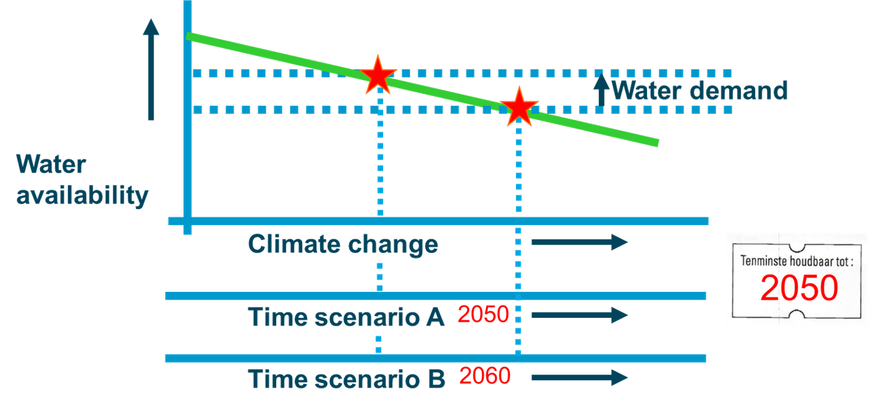
2. Bottom-up vulnerability assessment
Stress test current system/network or object

Slide 16
3. Formulate robust & flexible actions

Slide 17
How to develop pathways?

Slide 18
How to develop pathways?

Slide 19
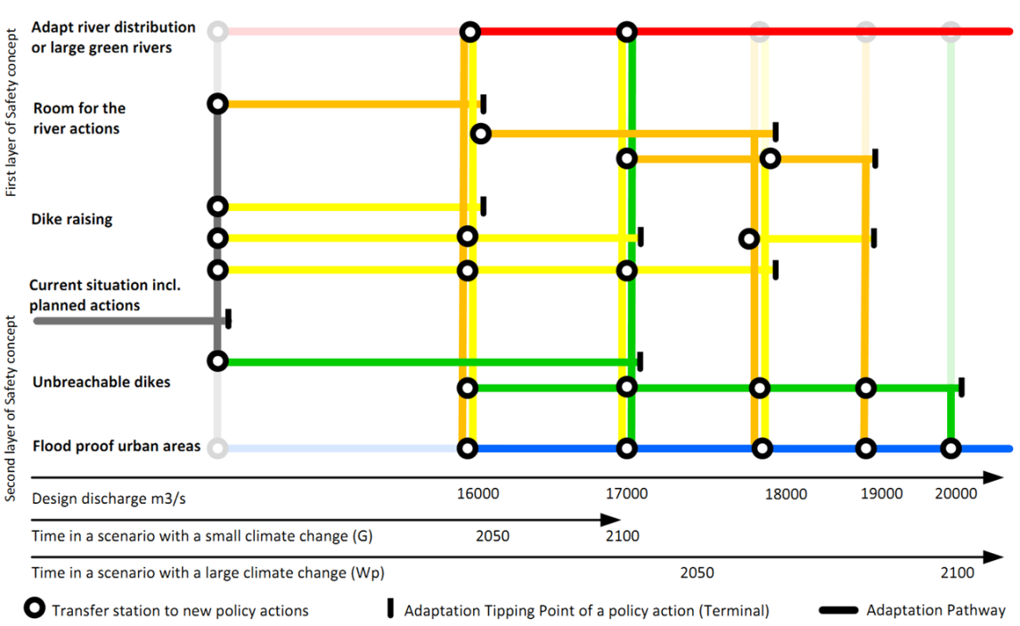
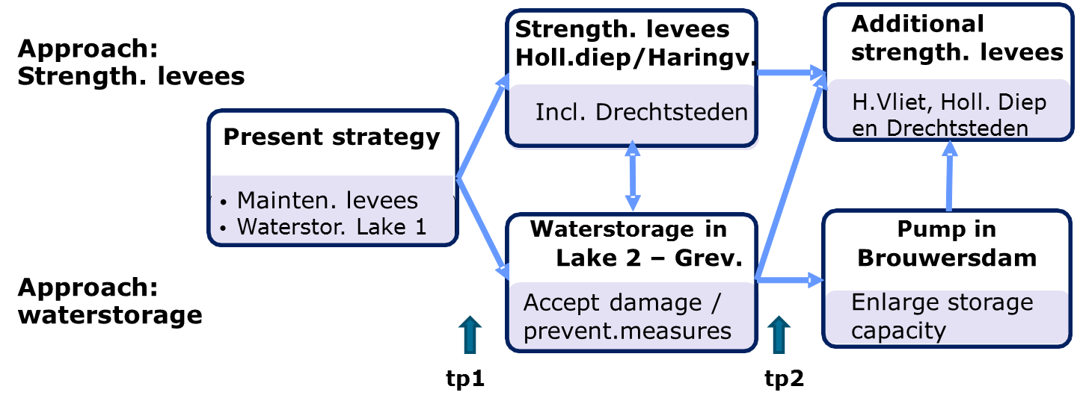
Design the adaptive plan
reiterate,
converge,
decide

Slide 20
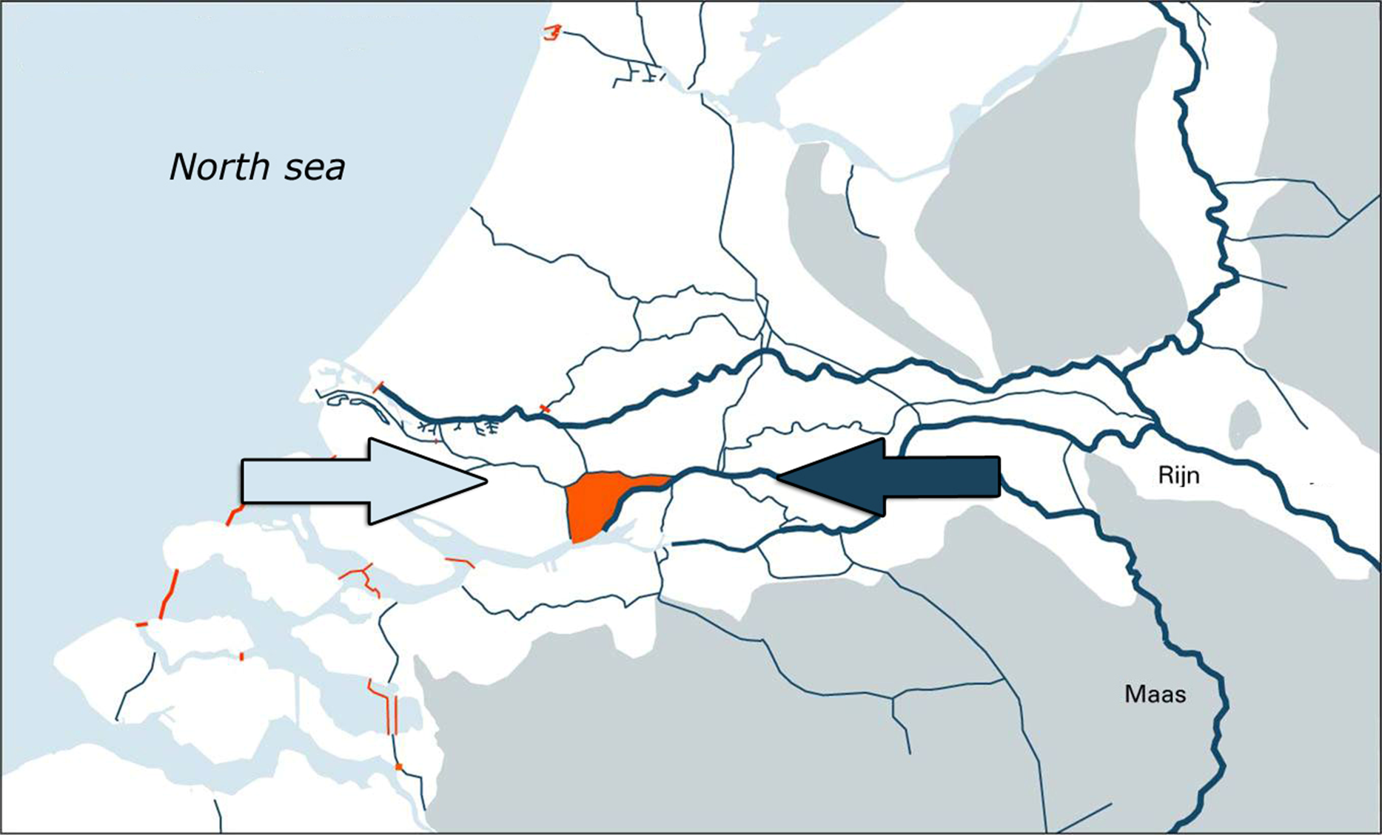
Application for Dordrecht, NL

Slide 21
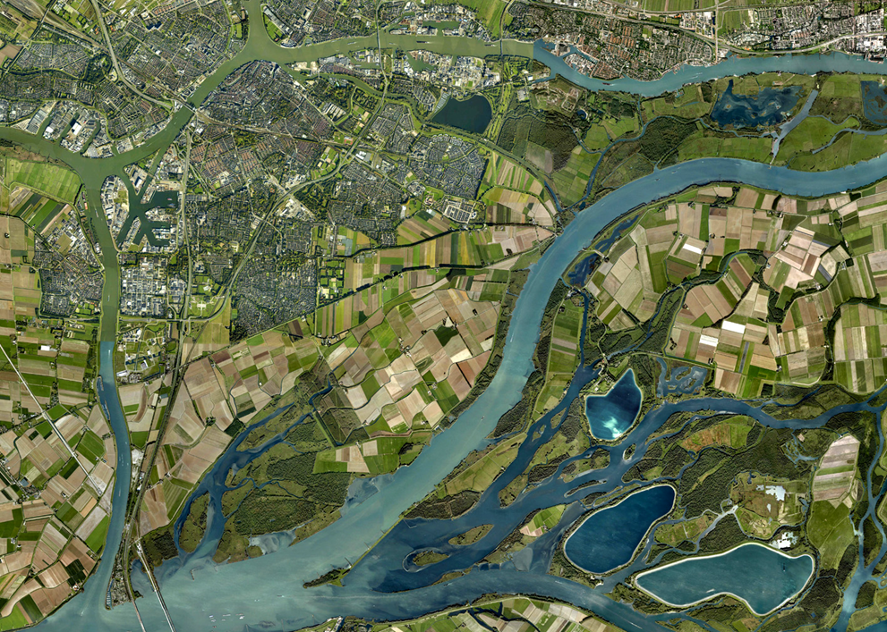
Recovery phase:
Impoldering
Historic centre

Slide 22
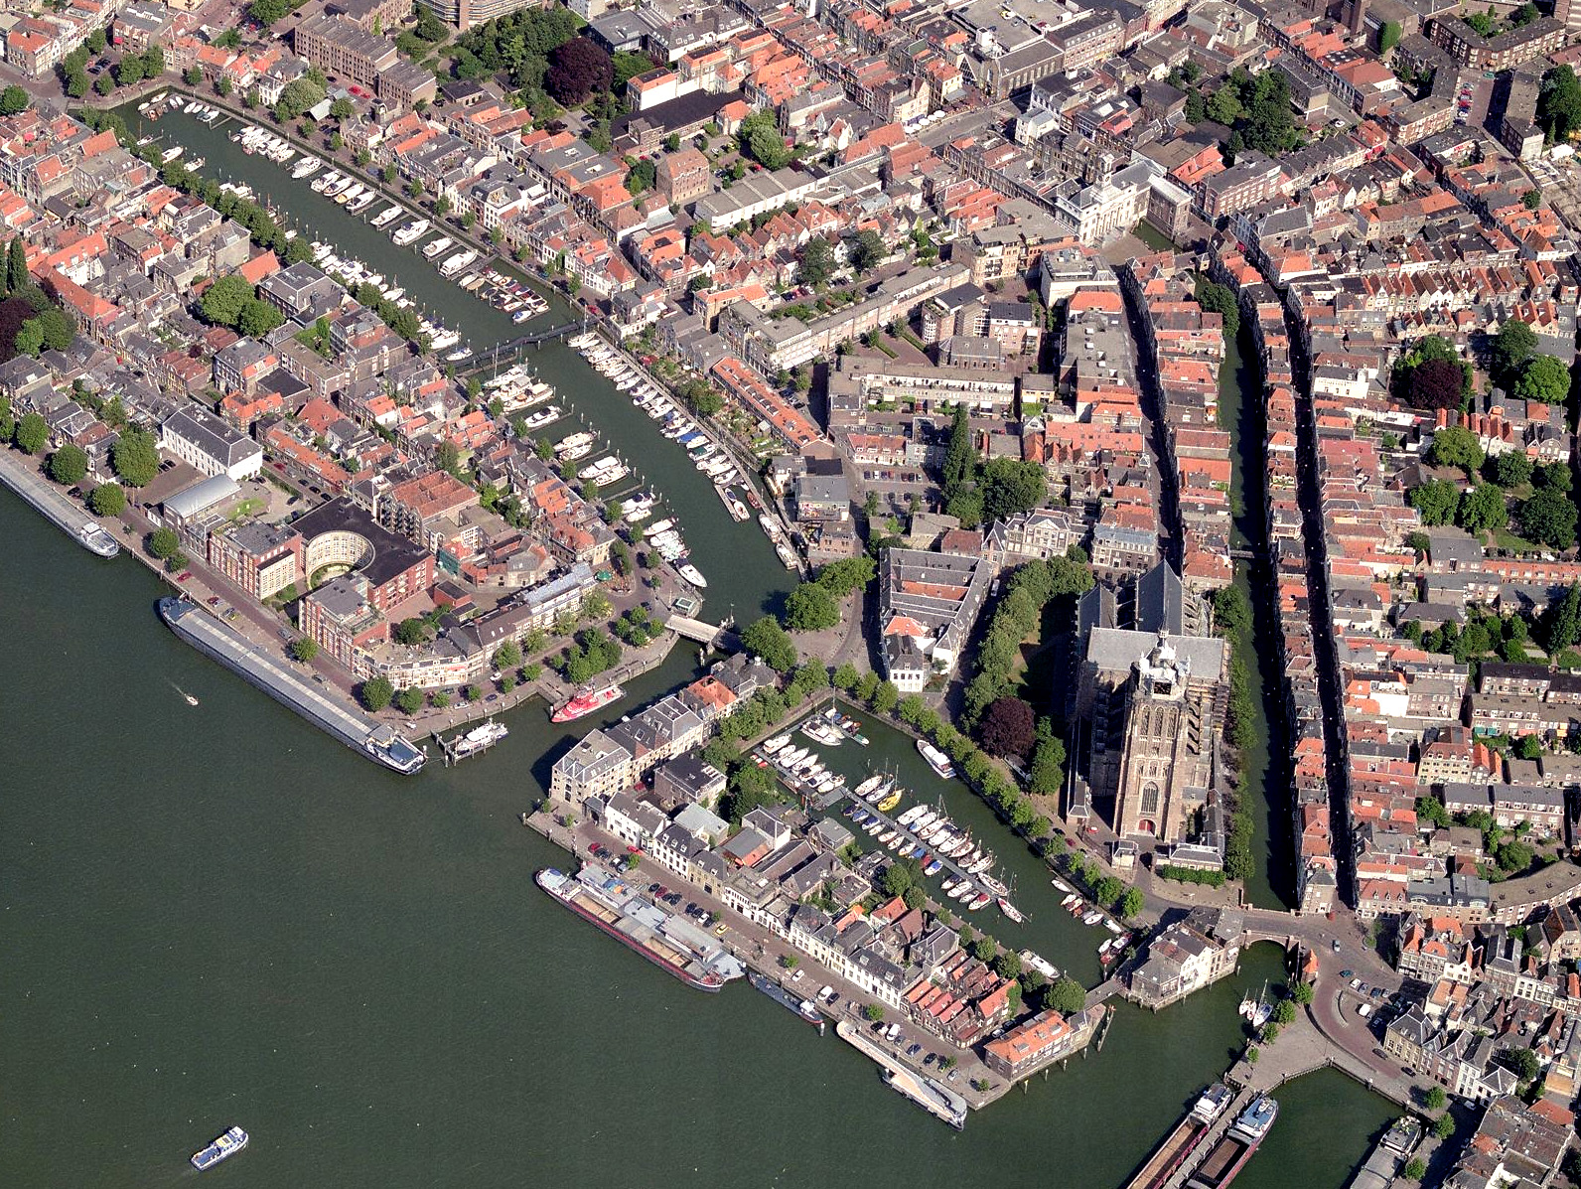
Voorstraat
Notes:
The Voorstraat dike
One of the oldest streets of Dordrecht
Part of primary water defense
Dike is not high enough anymore
Can we find a way to raise the dike body or do we need other solutions to protect the monumental part of the city?

Slide 23
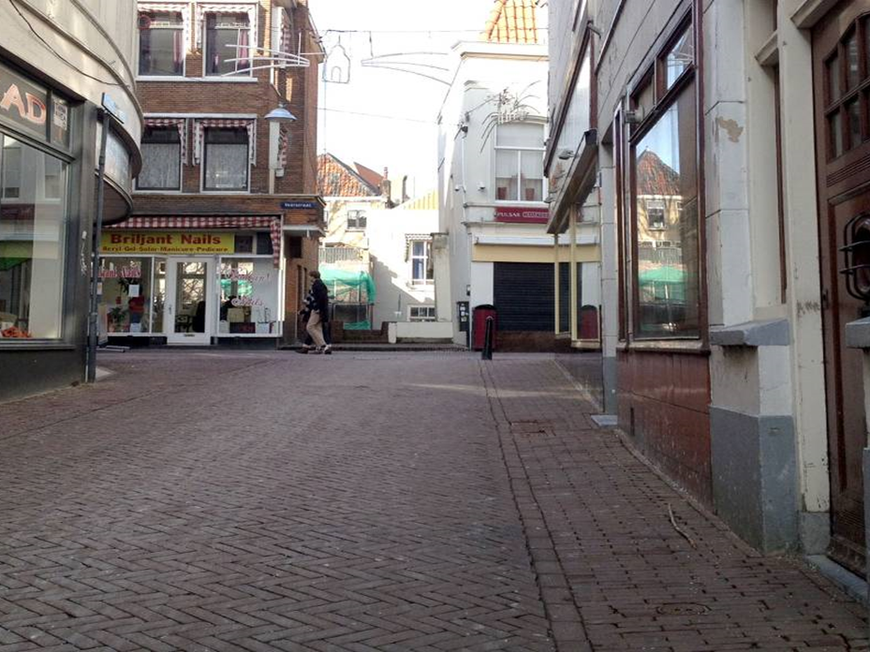
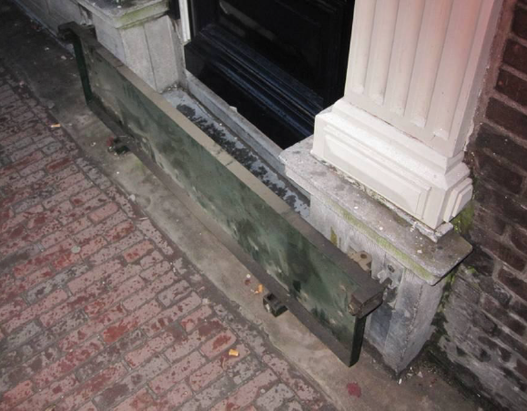
Voorstraat
Voorstraat
Notes:
The Voorstraat dike
One of the oldest streets of Dordrecht
Part of primary water defense
Dike is not high enough anymore
Can we find a way to raise the dike body or do we need other solutions to protect the monumental part of the city?

Slide 24
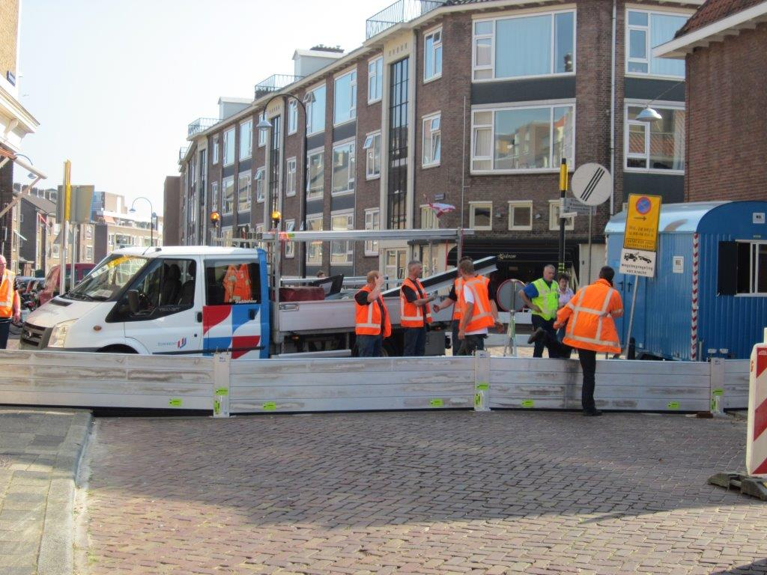
Voorstraat
Notes:
The Voorstraat dike
One of the oldest streets of Dordrecht
Part of primary water defense
Dike is not high enough anymore
Can we find a way to raise the dike body or do we need other solutions to protect the monumental part of the city?

Slide 25
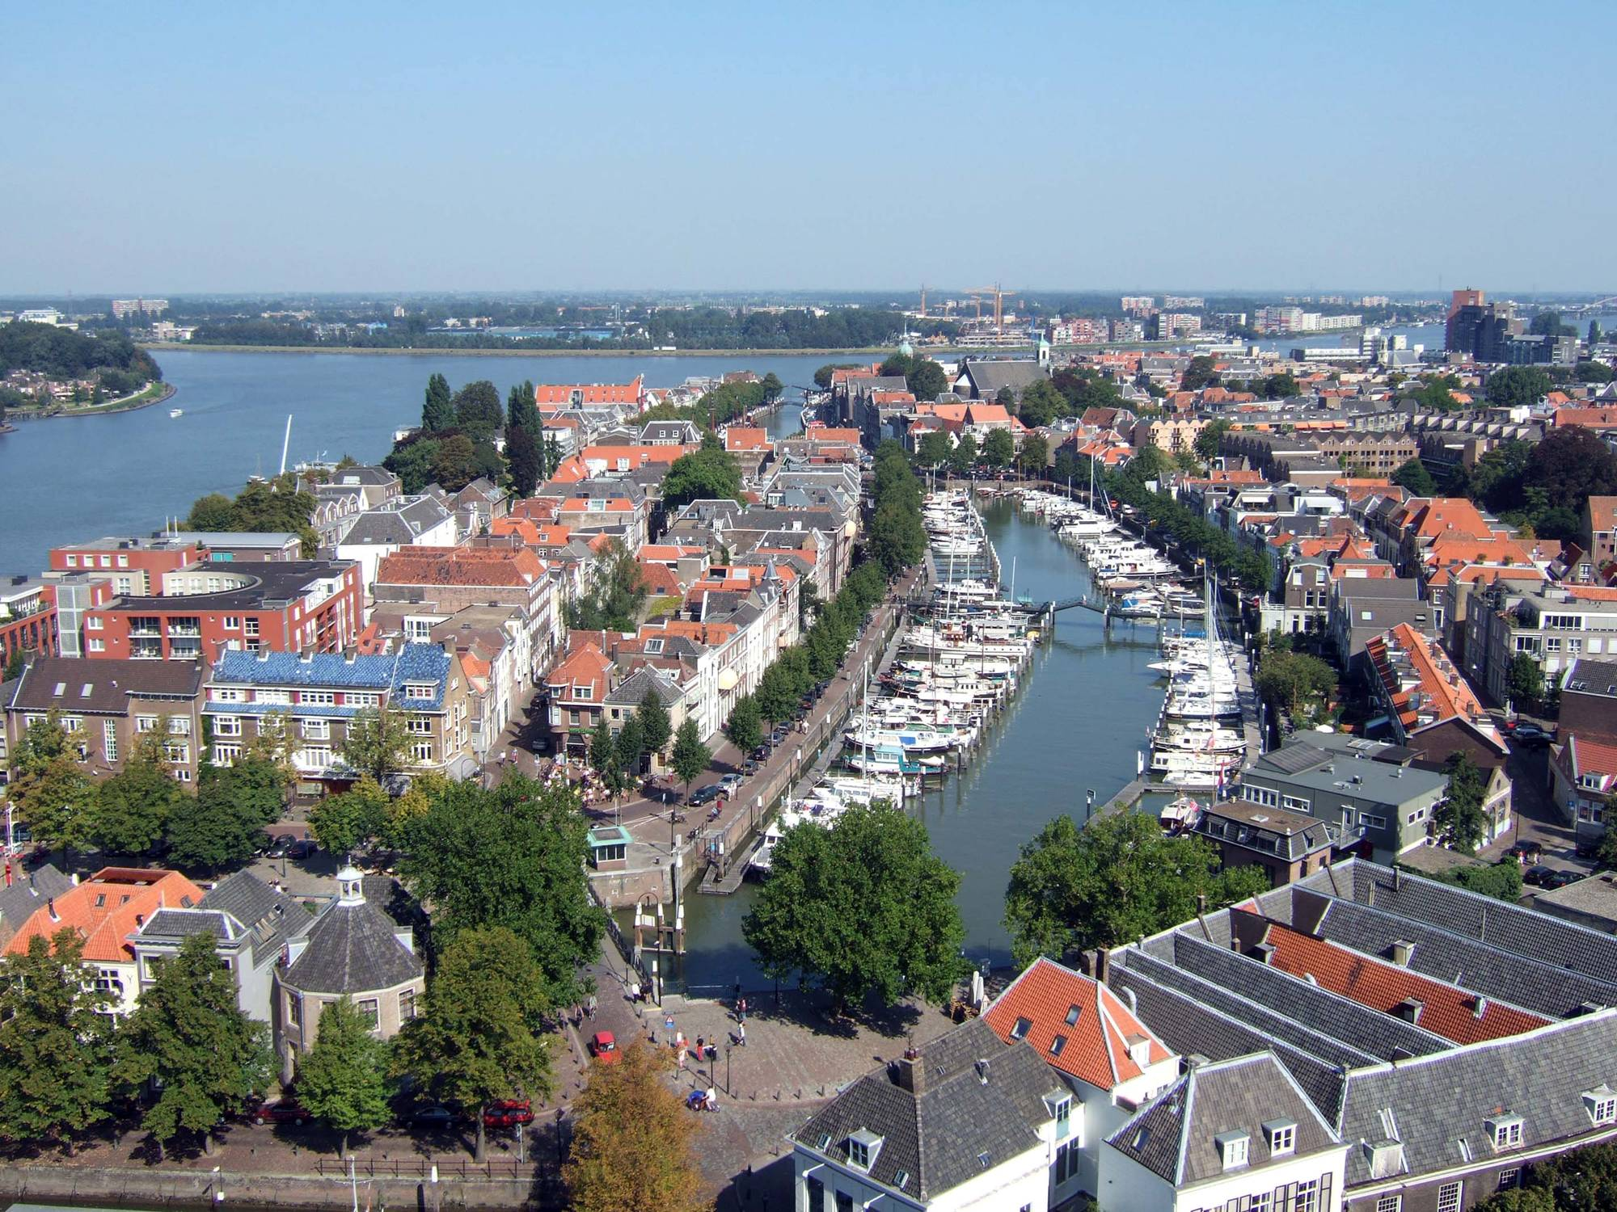
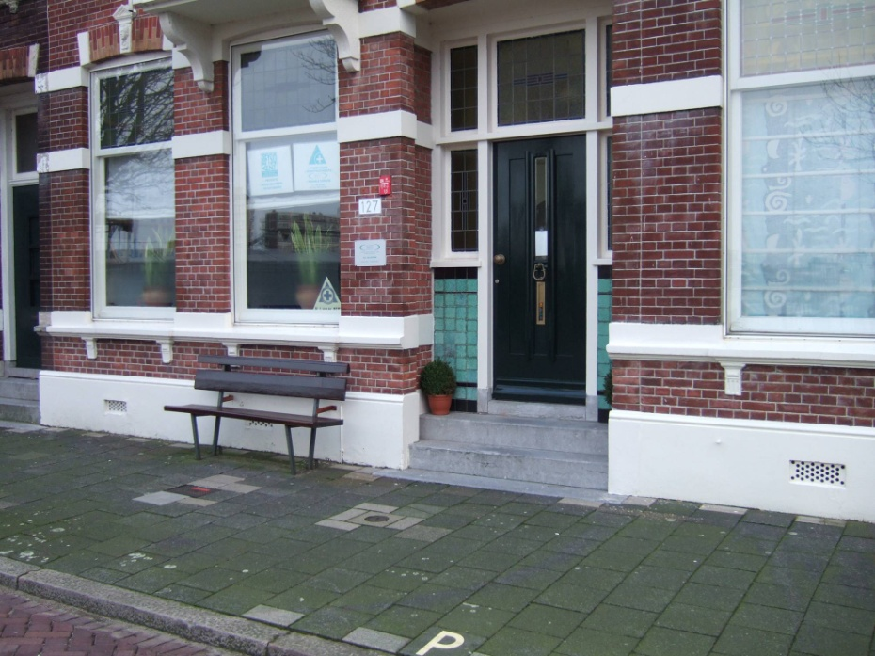
Historic port area
Notes:
Historisch havengebied Dordrecht

Slide 26
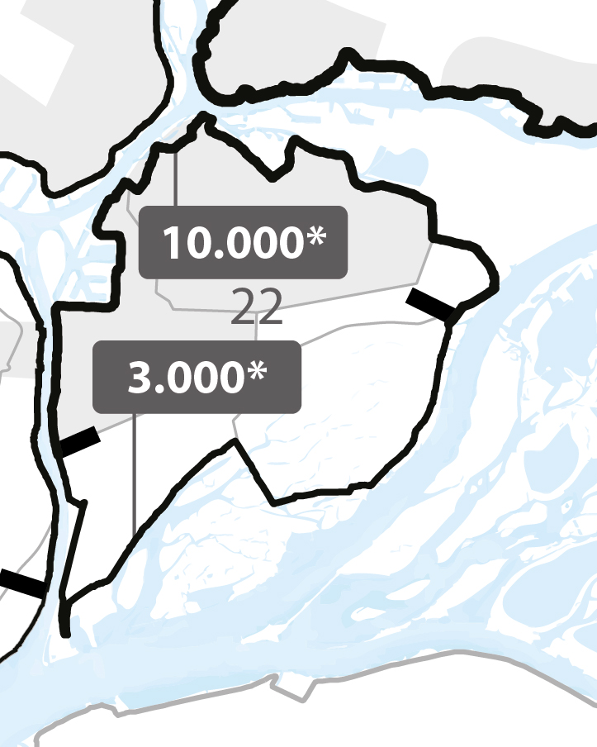
Setting objectives
For the system:
Objective: Protect individuals from dying
Performance metric: Probability of dying
Threshold: 1 : 100.000 years
For the object:
Objective: Protect from flooding
Performance metric: Probability of flooding
Threshold: 1 : 10.000 years

Slide 27
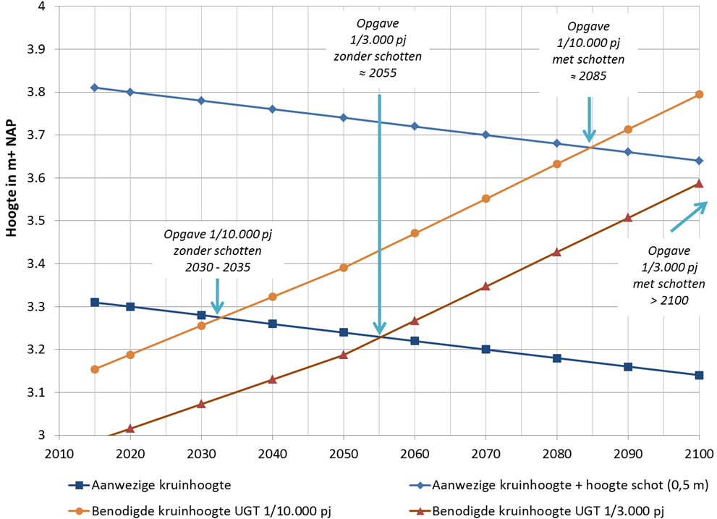
Flooding due to overtopping
Notes:
The Voorstraat dike
One of the oldest streets of Dordrecht
Part of primary water defense
Dike is not high enough anymore
Can we find a way to raise the dike body or do we need other solutions to protect the monumental part of the city?

Slide 28
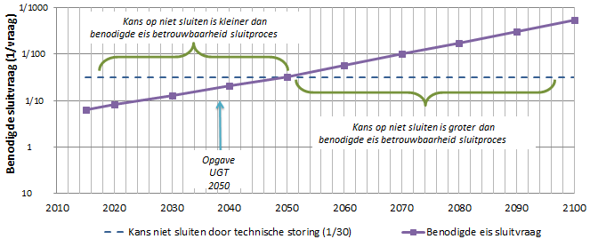
Flooding due to non closure

Slide 29
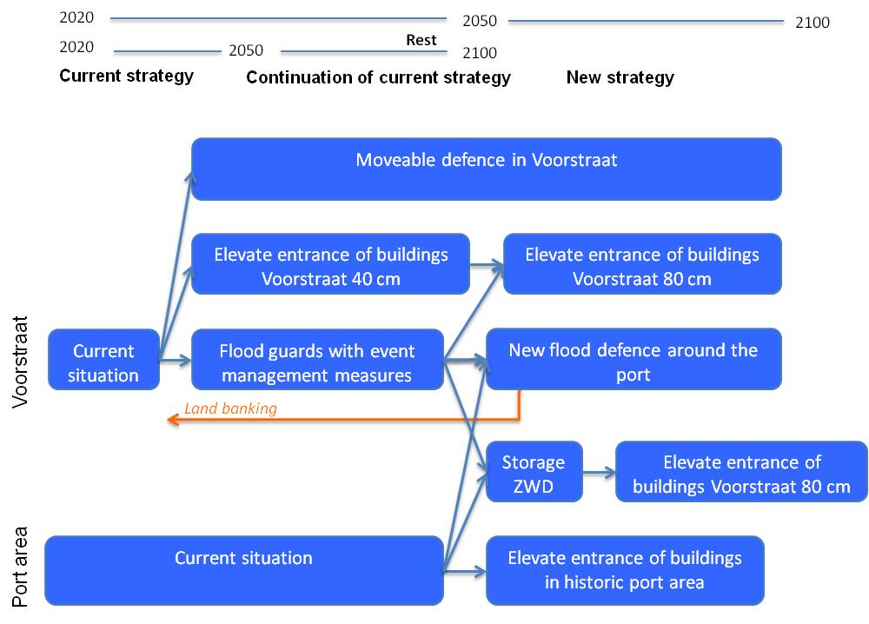
Adaptive plan for Voorstraat

Slide 30
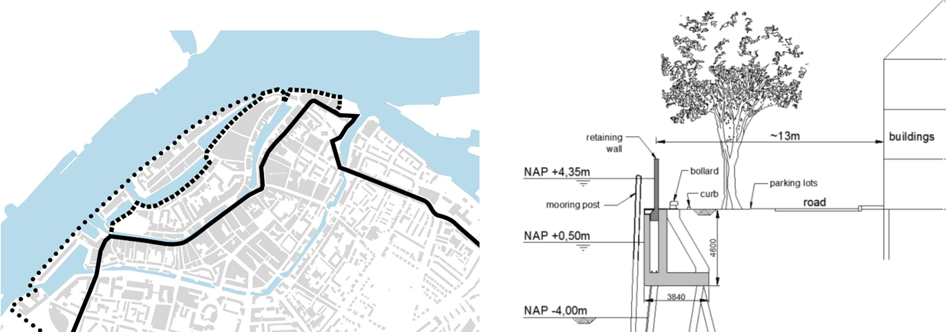
Mainstreaming protection of the port area
If the climate changes fast, build a new flood defence around the historic port area to replace flood defence Voorstraat

Slide 31
To conclude:
Adaptive design reduces the likelihood of regret choices, e.g. by creating a simultaneous decision point for the flood defence Voorstraat and the historic port area
Depending on the speed of climate change, a “simple” dike reinforcement (i.e. using flood guards) or an integrated solution (i.e. a new barrier) is preferred for the Voorstraat

Slide 33
Interactive session – Q 2
Define for your own pilot (object):
OBJECT:
OBJECTIVE:
PERFORMANCE METRIC:
THRESHOLD:
DRIVER:
10 min + 10 min feedback

Slide 34
Interactive session – Q 2
Define potential measures and their tipping point:
15 min + 15 min feedback
MEASURE | TIPPING POINT (YRS)
current object
COMBINED MEASURES | TIPPING POINT (YRS)

Slide 35
Interactive session – Q 3
Draw the pathways map for your object:
10 min

