Slide 1
Final Conference 8 September 2020
Key findings and learnings
Alex Søgaard Moreno, Project Manager at Mayor’s Department, City of Aalborg

Slide 2
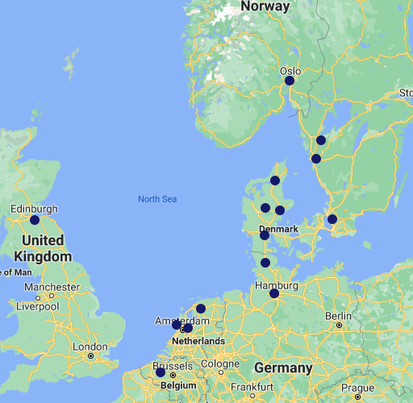
Partnership of 20 clusters, cities, regions and knowledge institutions from 7 countries
Focus on transnational cooperation and knowledge-sharing

Slide 3
Collaboration across borders
Cultural and political differences
Finding common ground and challenges
Bring people together
Trust
Showcases in the different cities and regions
Living Lab Concept

Slide 4
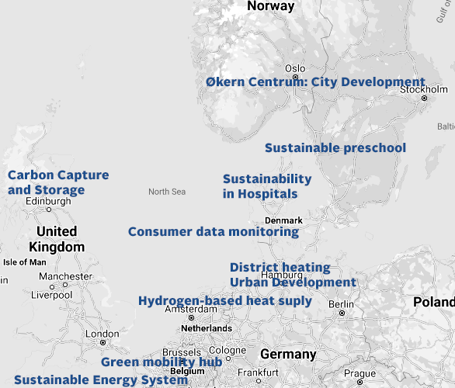
Living Lab
Different challenges.
Different solutions.

Slide 5
How do we push innovation in SMEs?
+700 participants
7 events
250 SME’s
30 possible collaborations
300 matchmaking meetings
Majority of public challenge owners
Demanding green solutions
Inspiration across sectors and borders
Living Labs are efficient tools for cooperation
HANDS ON RESULTS

Slide 6

Next steps
Transferability of results – making them available to others
Dialogue with the Joint Secretariat from the North Sea
Region Programme on content for the next programme
period 2021-2027
Maintain the relationship among the partners – trust
Use the tools from the toolboxes
Use the Living Lab concept – even though it’s now digital

Slide 7

Thank you for your attention

