Slide 1
Northern Connections Conference
Fredrik Hörstedt
Vice President for Innovation,
Chalmers University of Technology
Board member of the European Innovation Council,
European Commission
2020-09-08

Slide 2



Horizon Europe: evolution not revolution
Specific objectives of the Programme
Support the creation and diffusion
of high-quality knowledge
Strengthen the impact of R&I
in supporting EU policies
Foster all forms of innovation and strengthen market deployment
Optimise the Programme’s delivery for impact in a strengthened ERA
Pillar 1
Open Science
Pillar 2
Global Challenges and Industrial Competitiveness
Pillar 3
Open Innovation
European Research Council
Health
Inclusive and Secure Society
Digital and Industry
Climate, Energy and Mobility
Food and natural resources
European Innovation Council
Marie Skłodowska-Curie Actions
Clusters
European innovation ecosystems
European Institute of Innovation
and Technology
Research Infrastructures
Joint Research Centre
Strengthening the European Research Area
Sharing excellence
Reforming and Enhancing the European R&I system

Slide 3
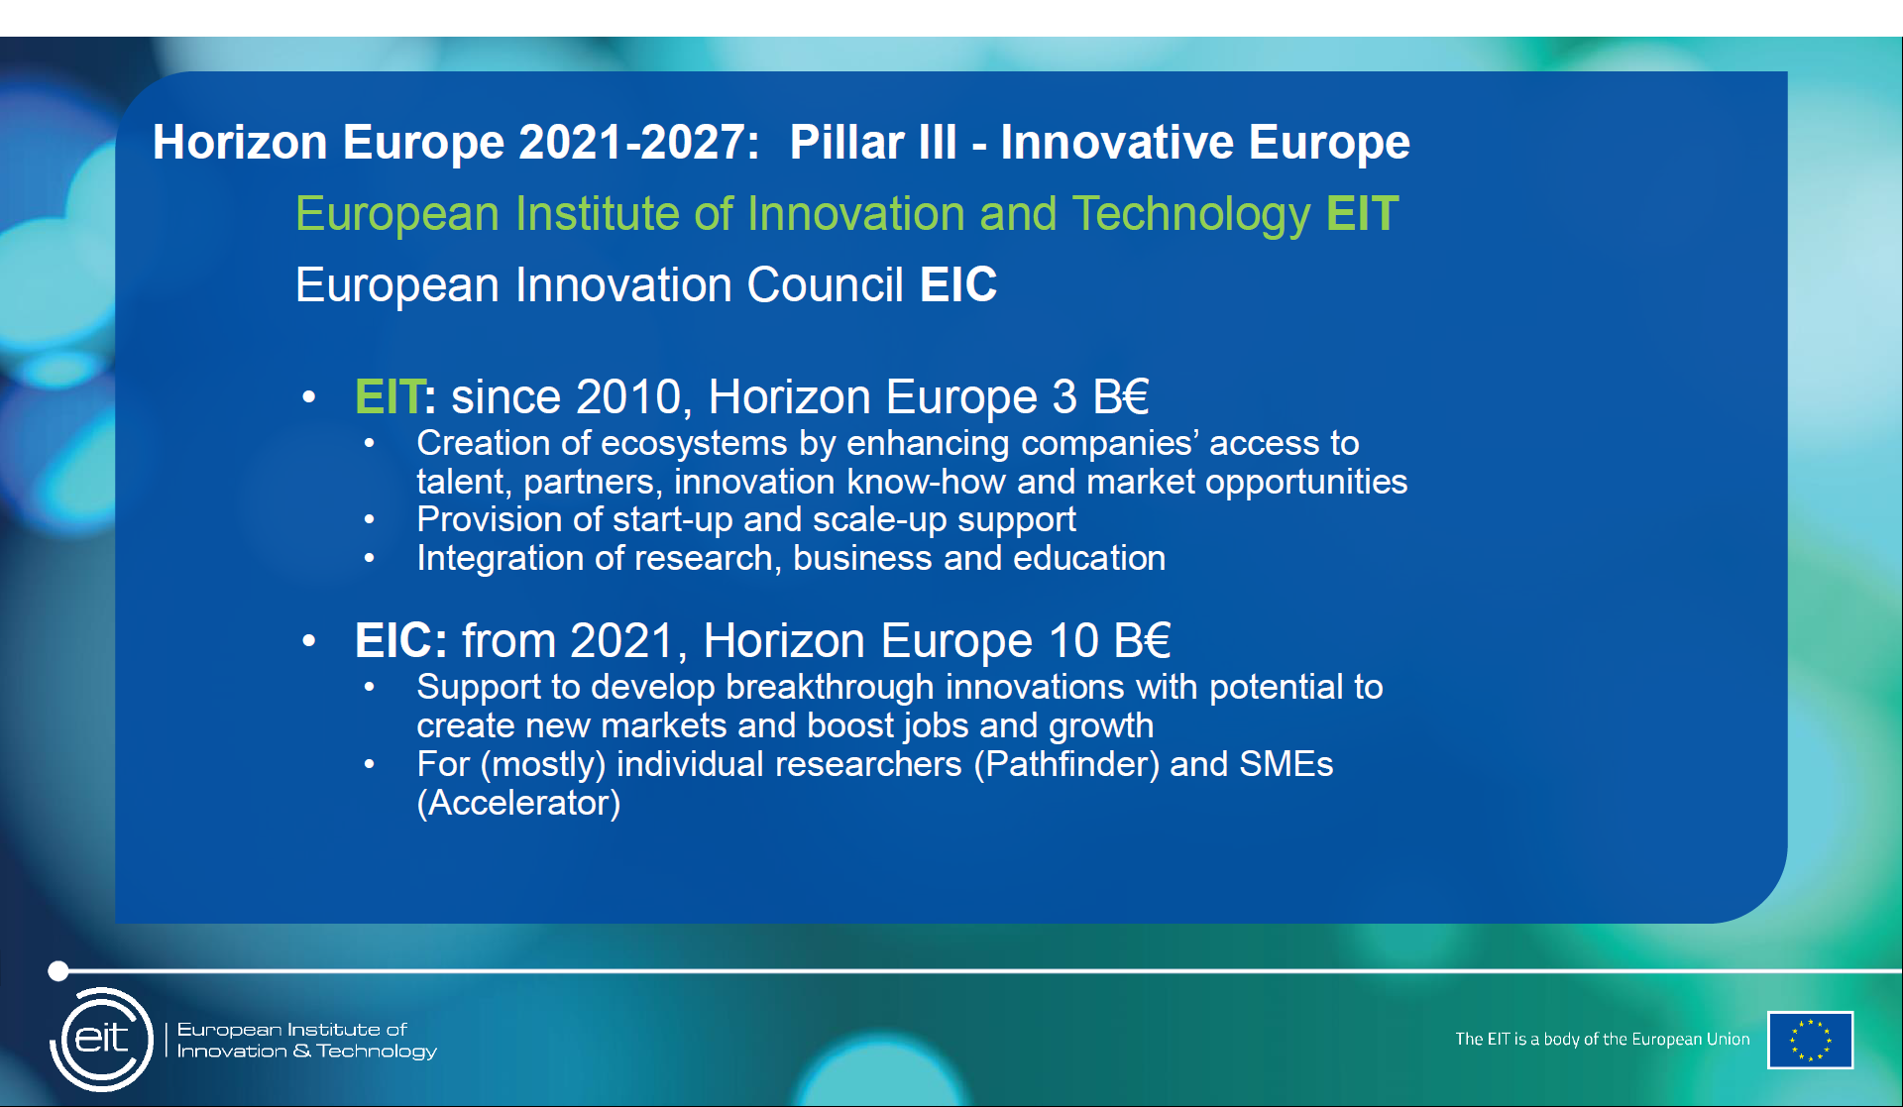

Slide 4
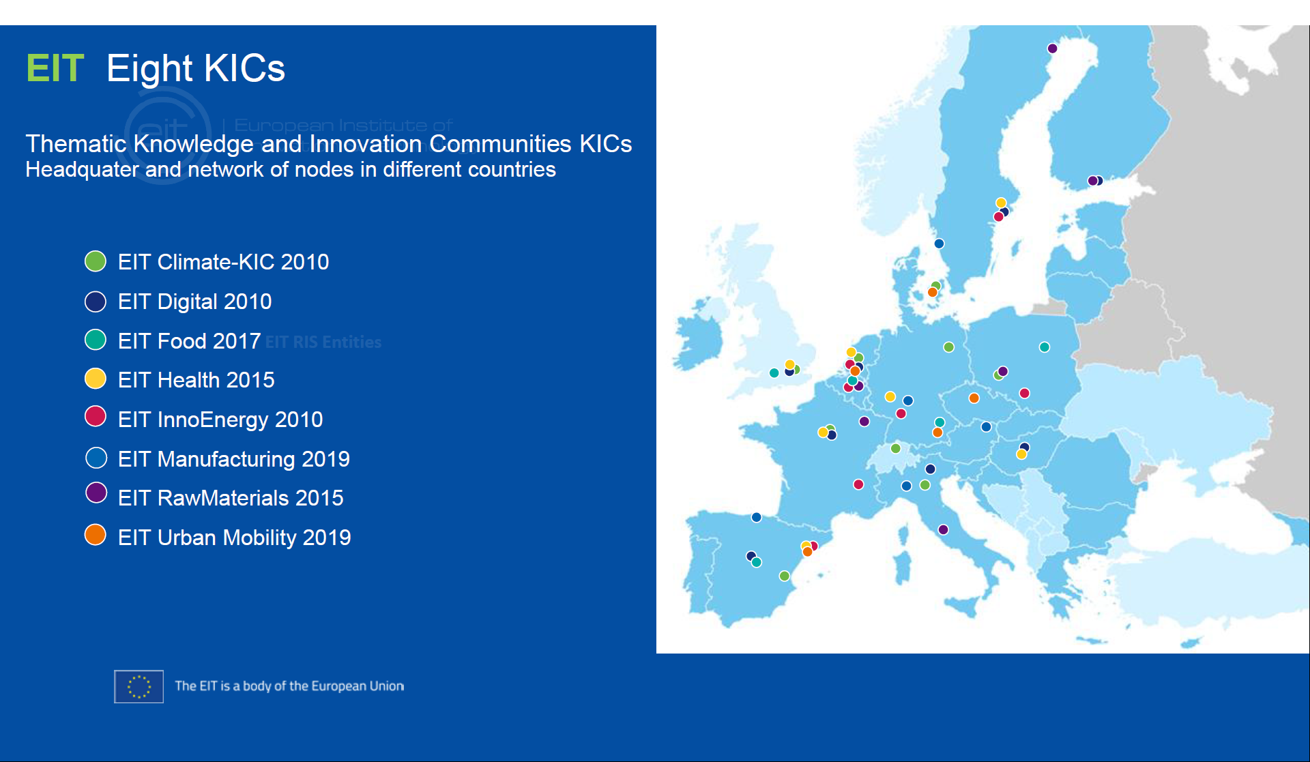

Slide 5
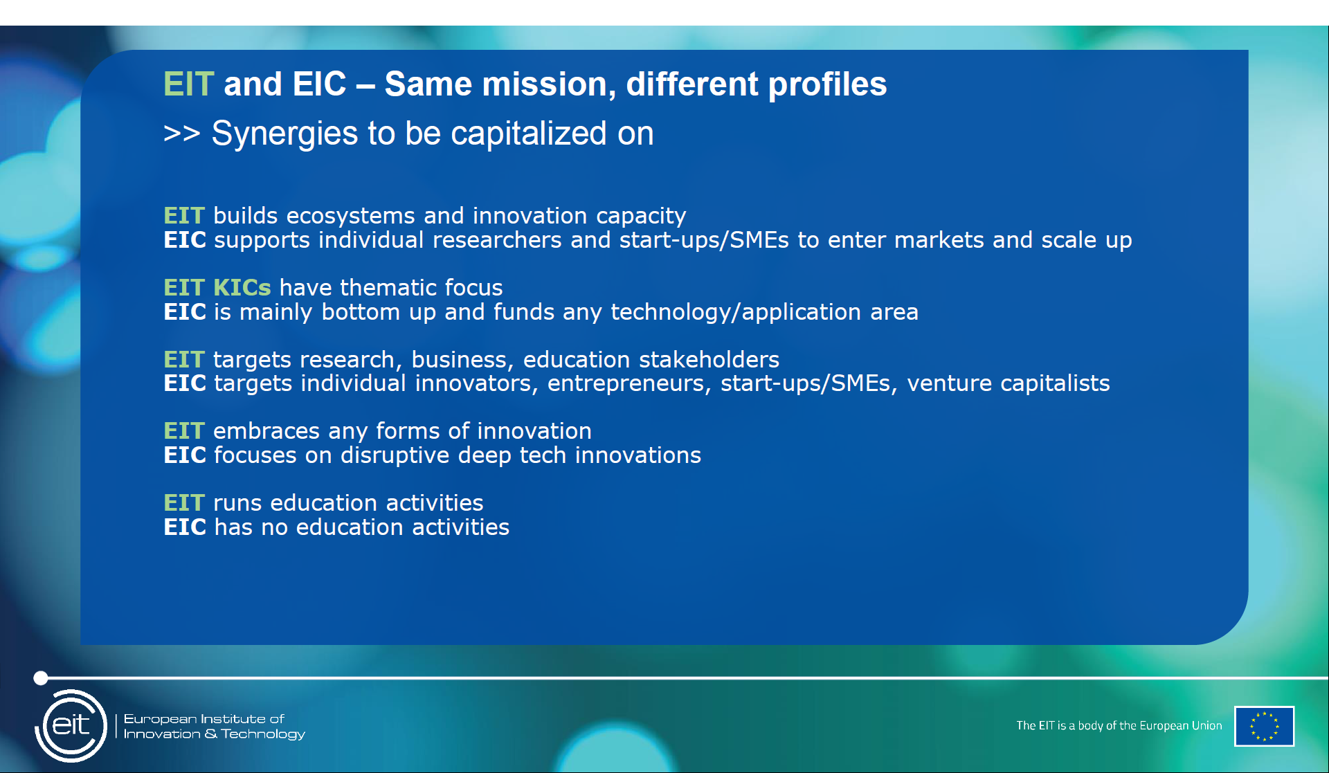
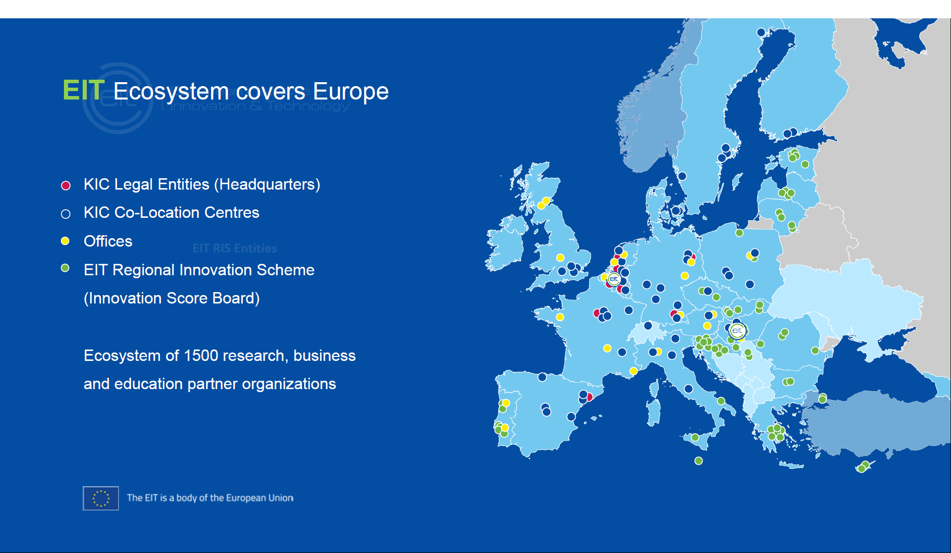

Slide 6
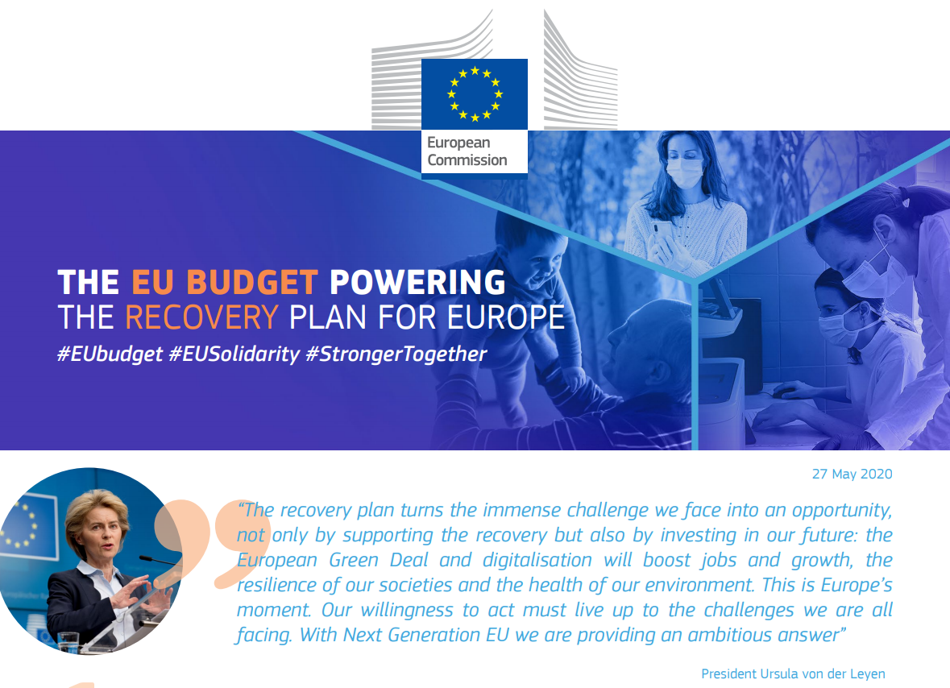
Notes:
Resolved in end of May
Next Generation EU of 750 billion EUR, targeted reinforcements of 1 850 billion EUR – in 2021-2027

Slide 7
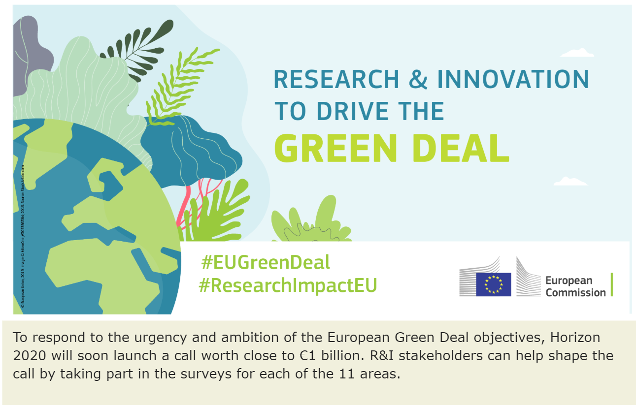
Notes:
The Green Deal is the recovery strategy, activities are upcoming soon
A major Green Deal call targeting research as well as innovation and impact opens in Sept
Could be an interesting platform to carry the Northern Connections collaboration forward

Slide 8
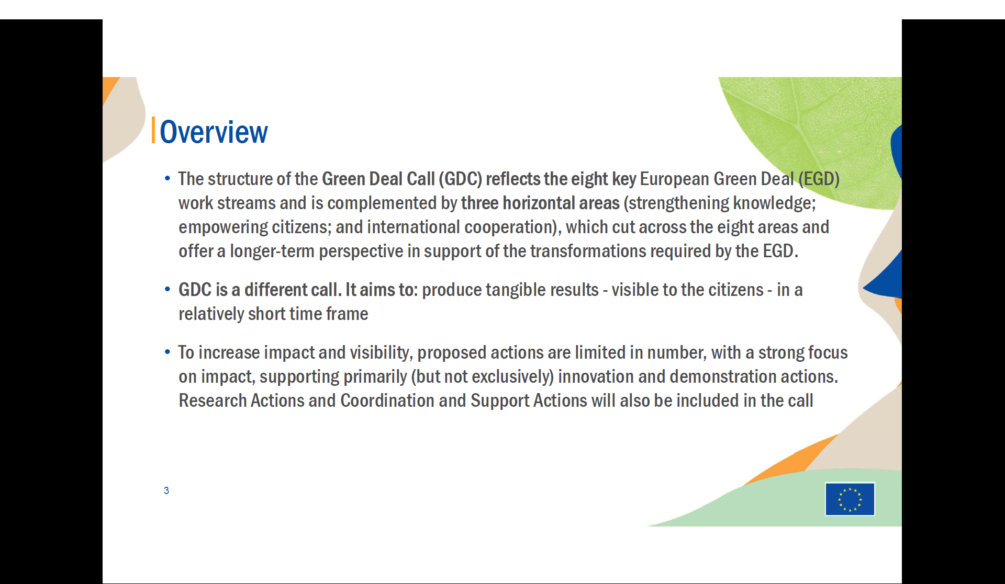

Slide 9
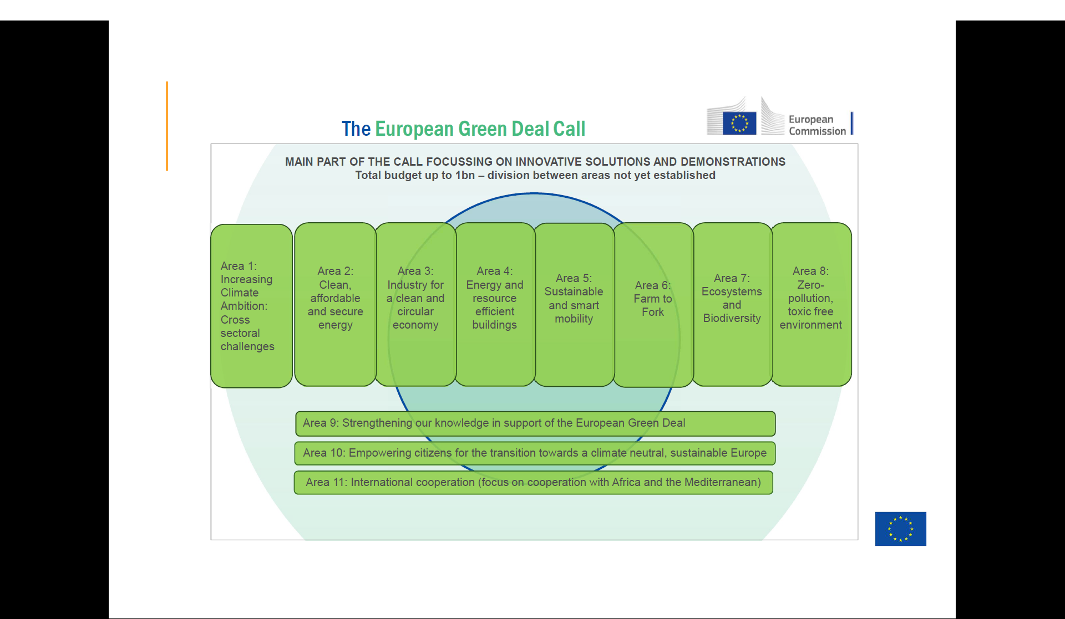

Slide 10
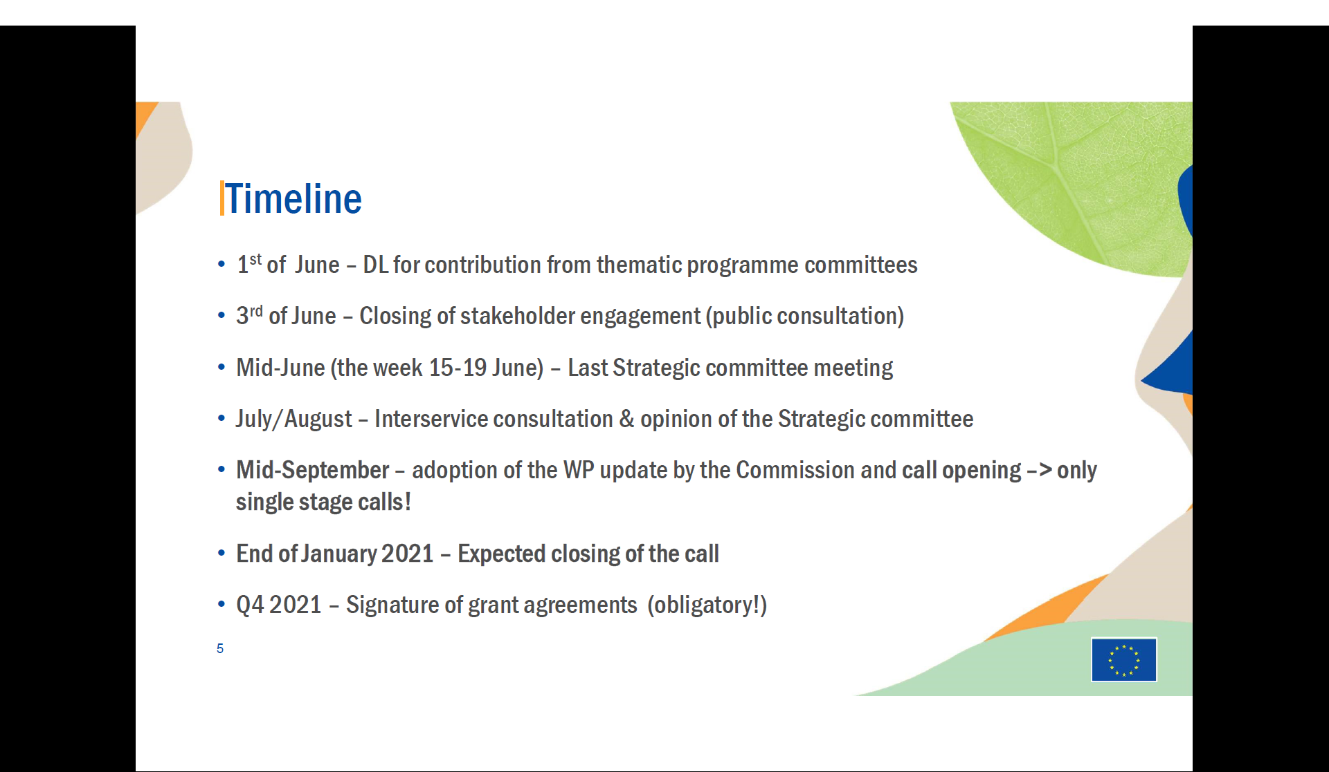

Slide 11
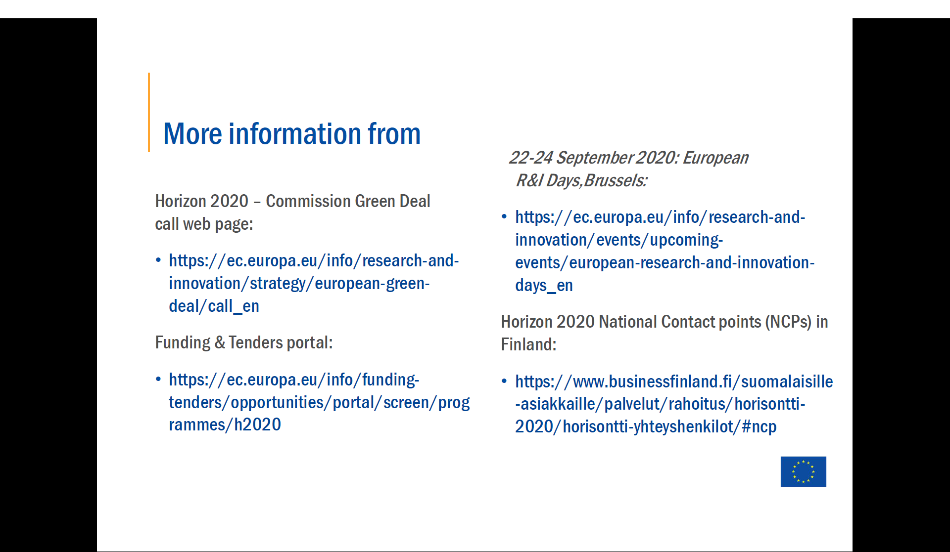

Slide 12
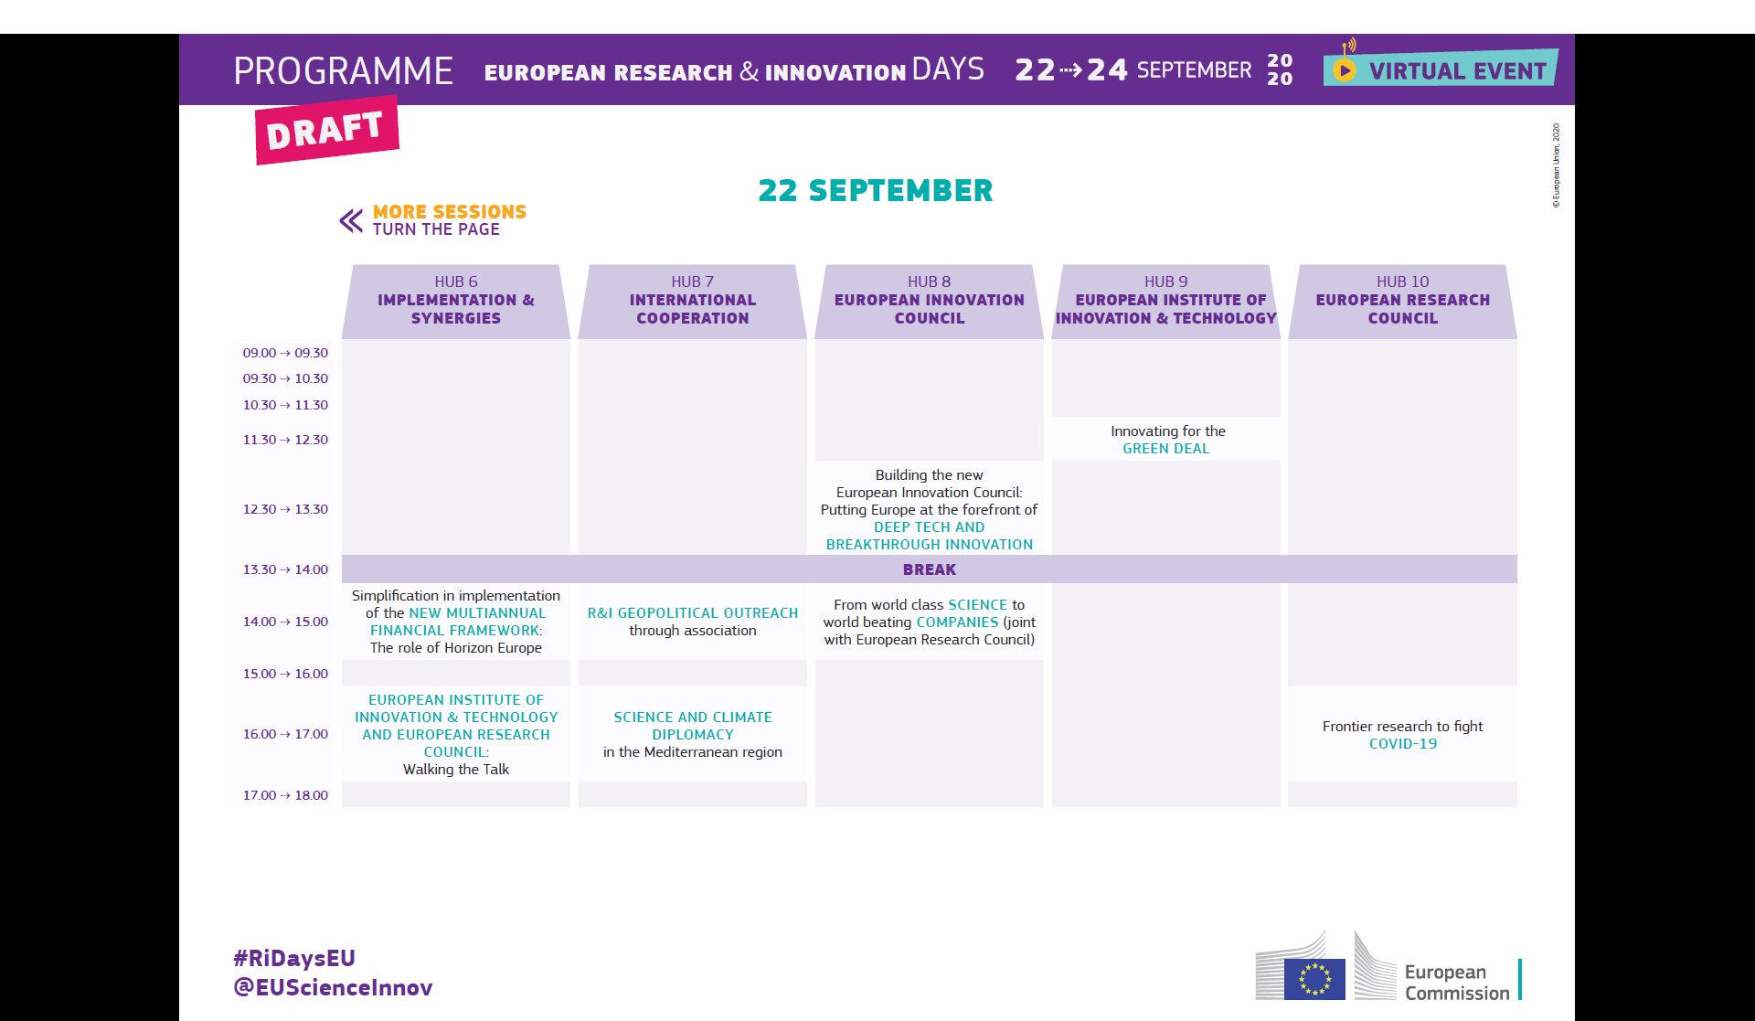

Slide 13
