Slide 1
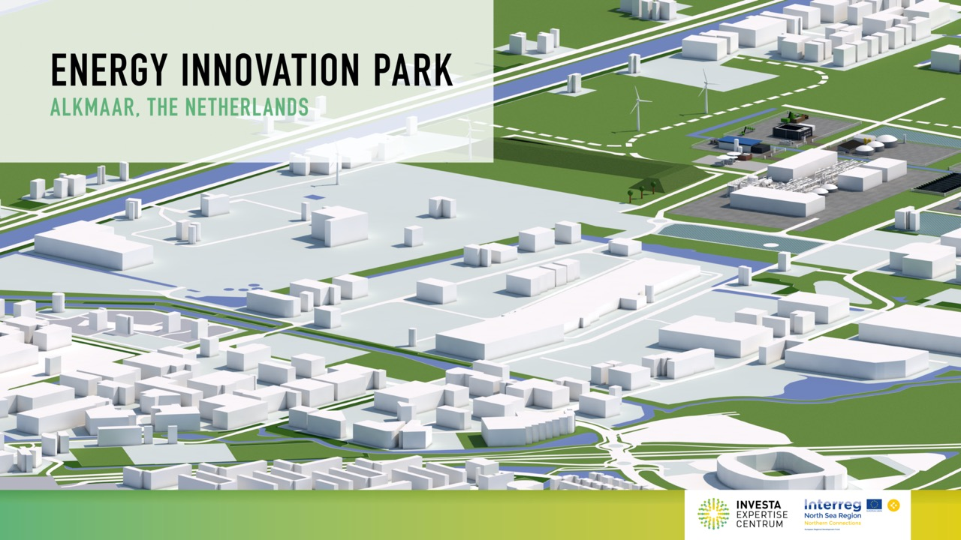

Slide 2
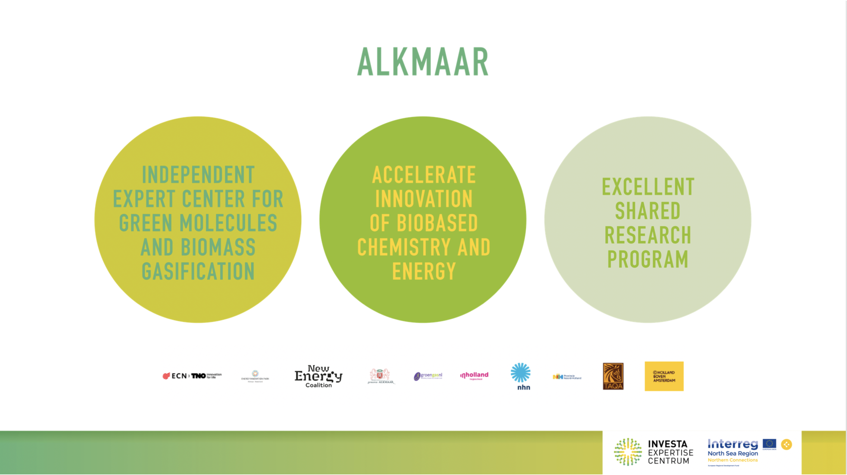

Slide 3
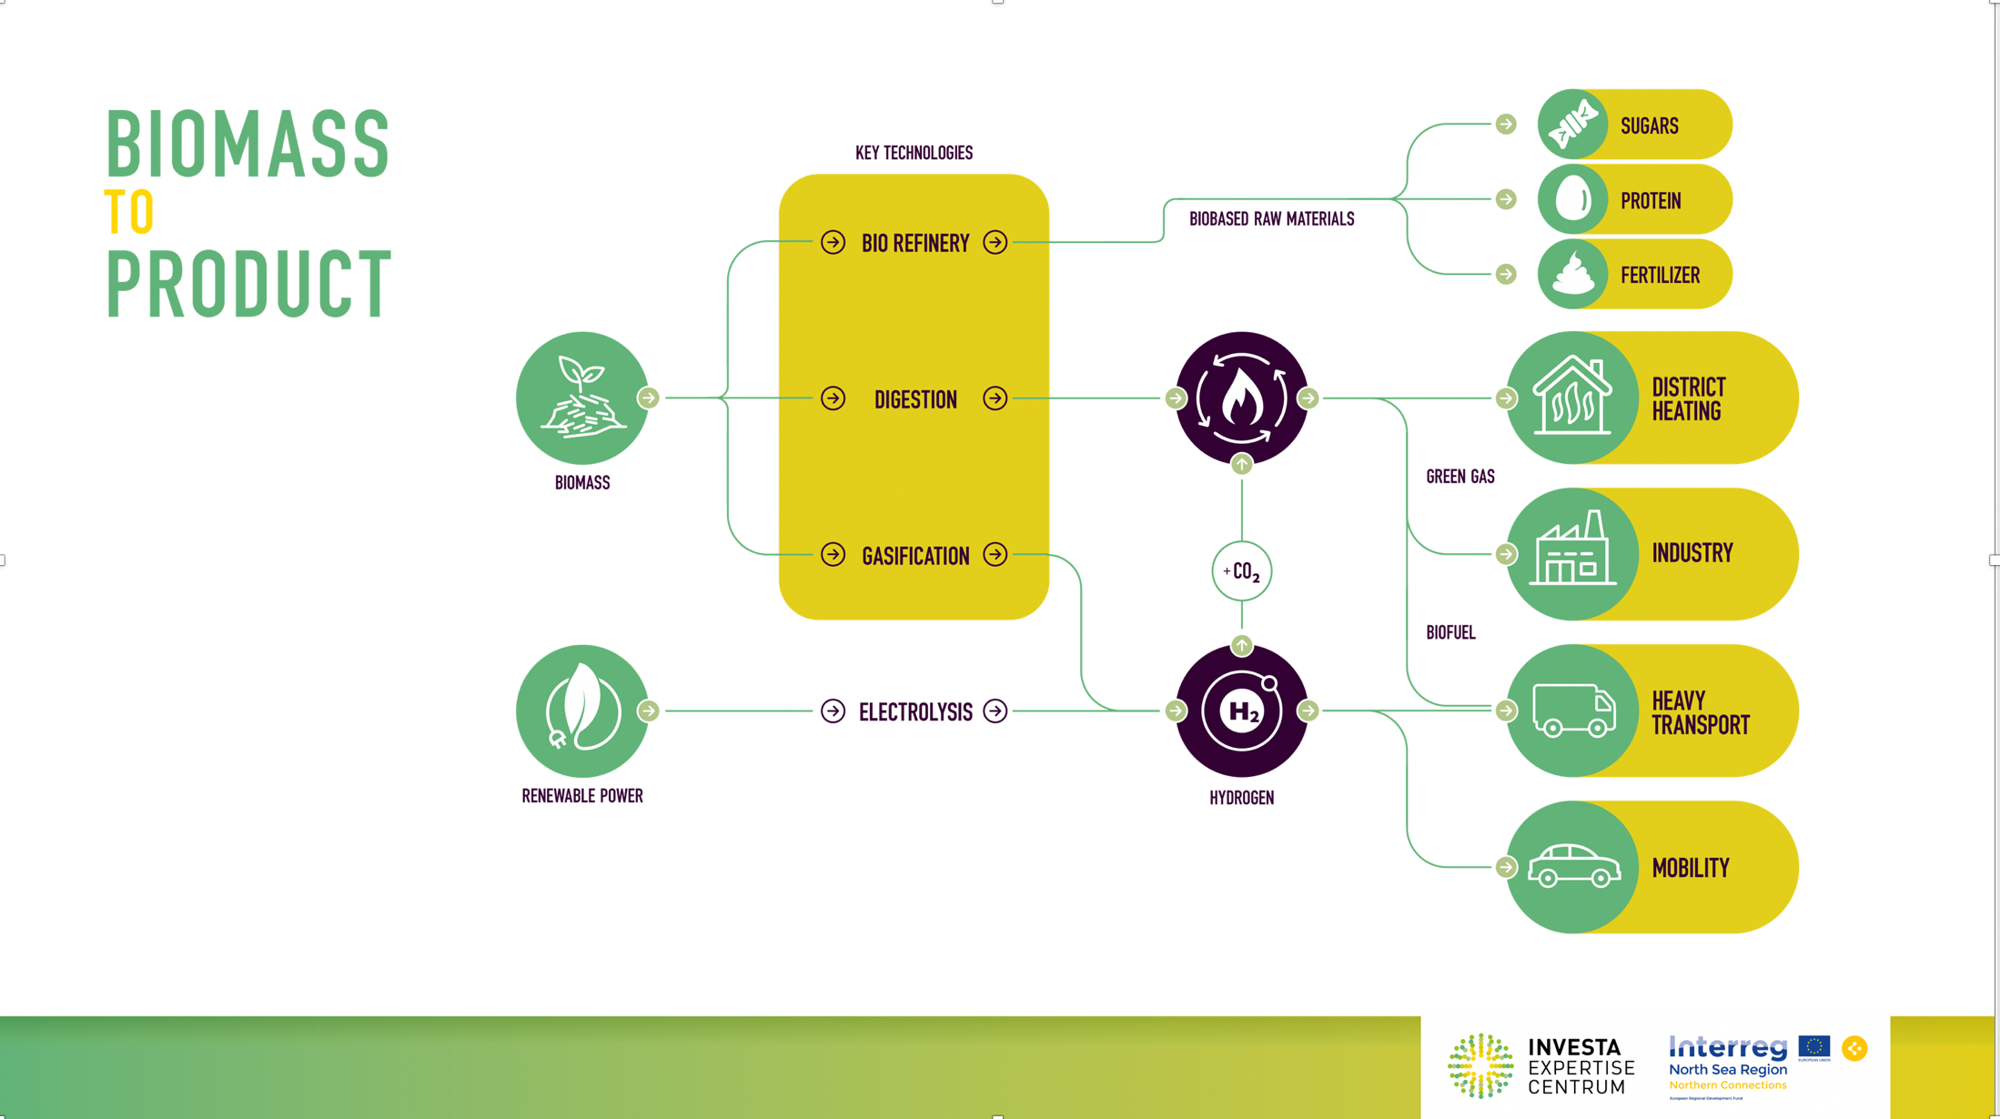

Slide 4
Progress InVesta
InVesta
  Well-filled project portfolio, 1st projects coming online
  InVesta Involved in several R&D-programs (TNO)
  Start building activities A.S.A.P.
  EFRO subsidy: funding for start of 4 project
In general National Policy
  More focus on renewable molecules for sectors that can not cope with electricity only
  Climate Agreement is facing public acceptance issues
  Huge discussion on use of biomass

Slide 5
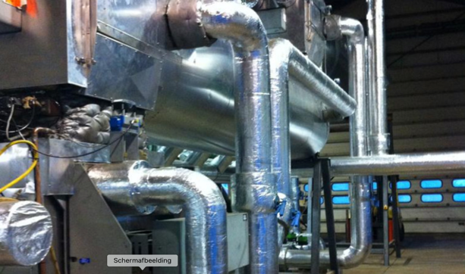
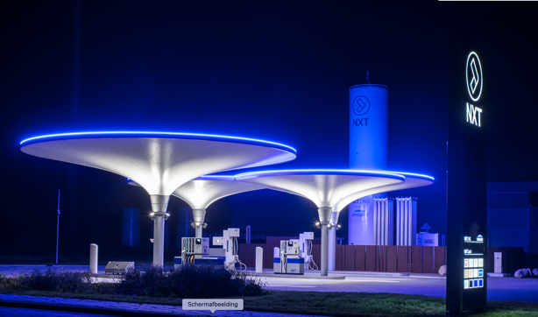
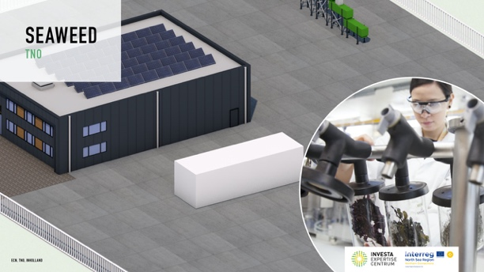
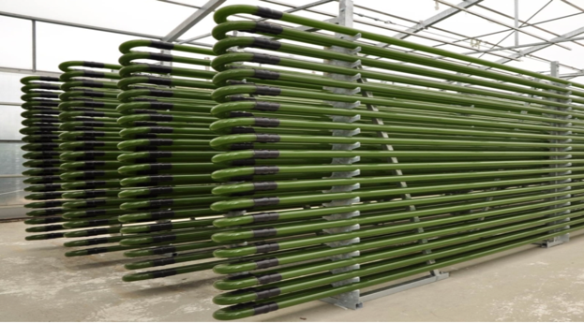
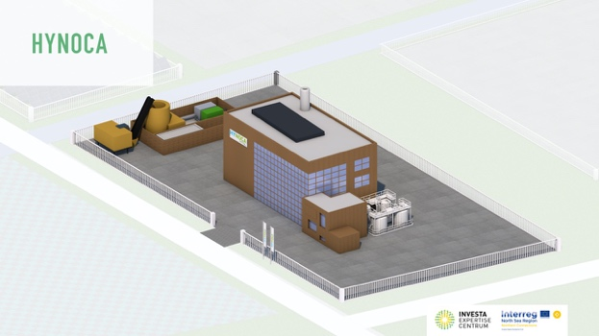
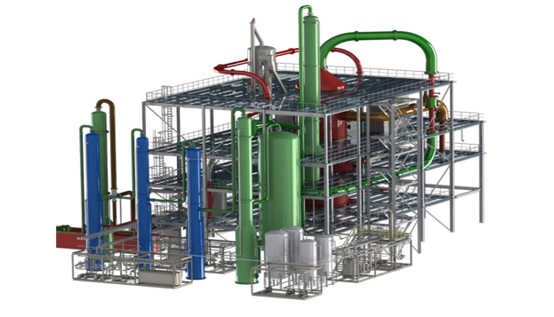
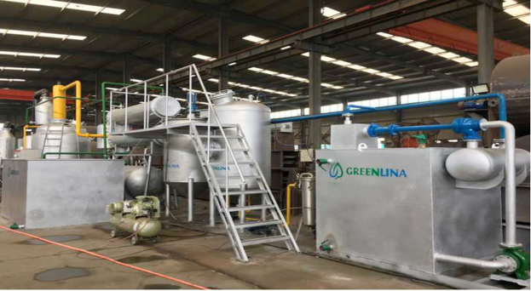
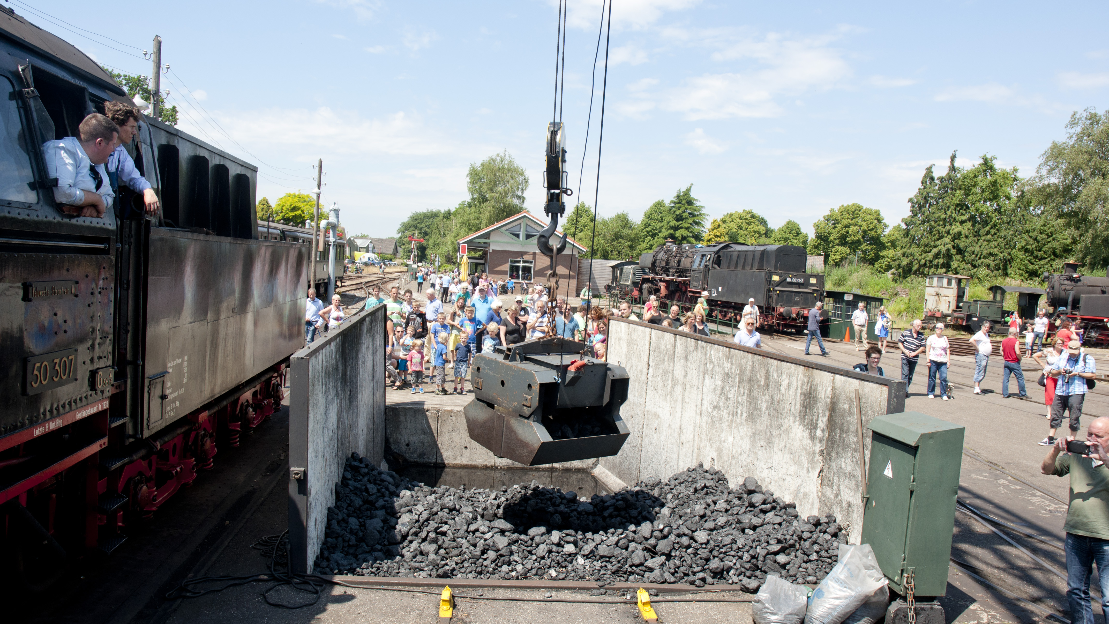
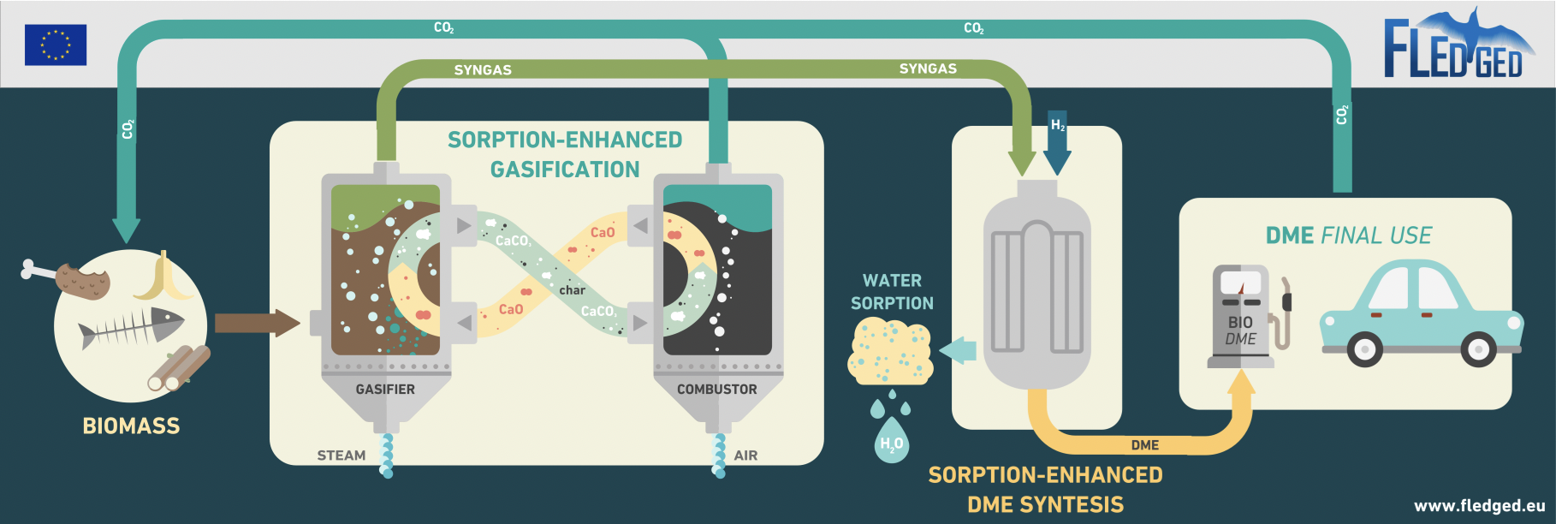
PROJECTS

Slide 6
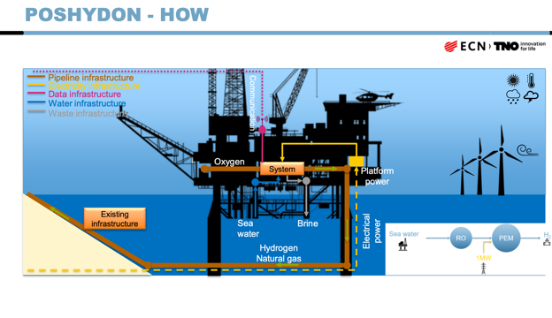
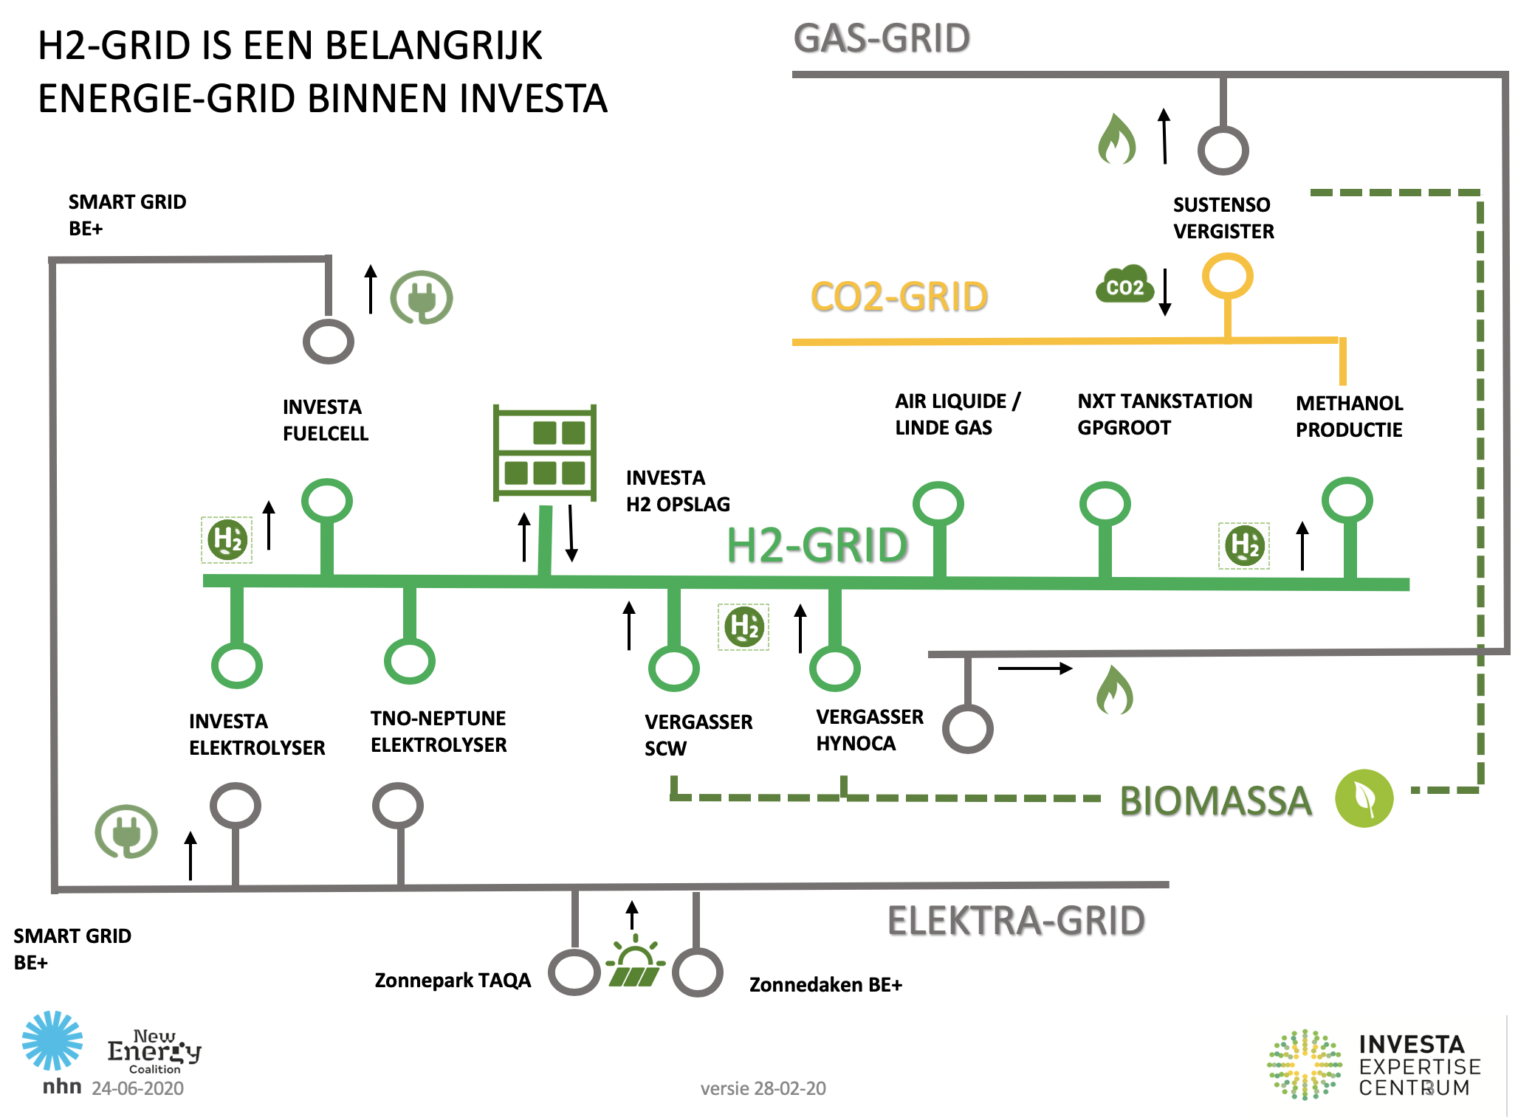
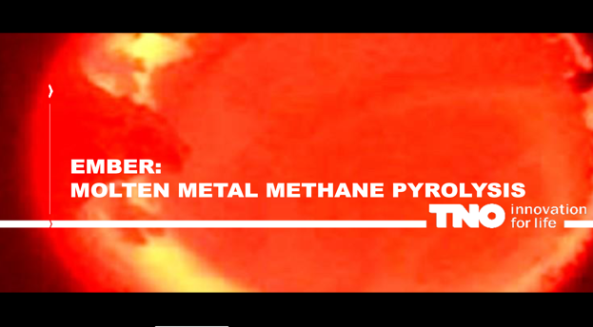
R&D-Programs

Slide 7
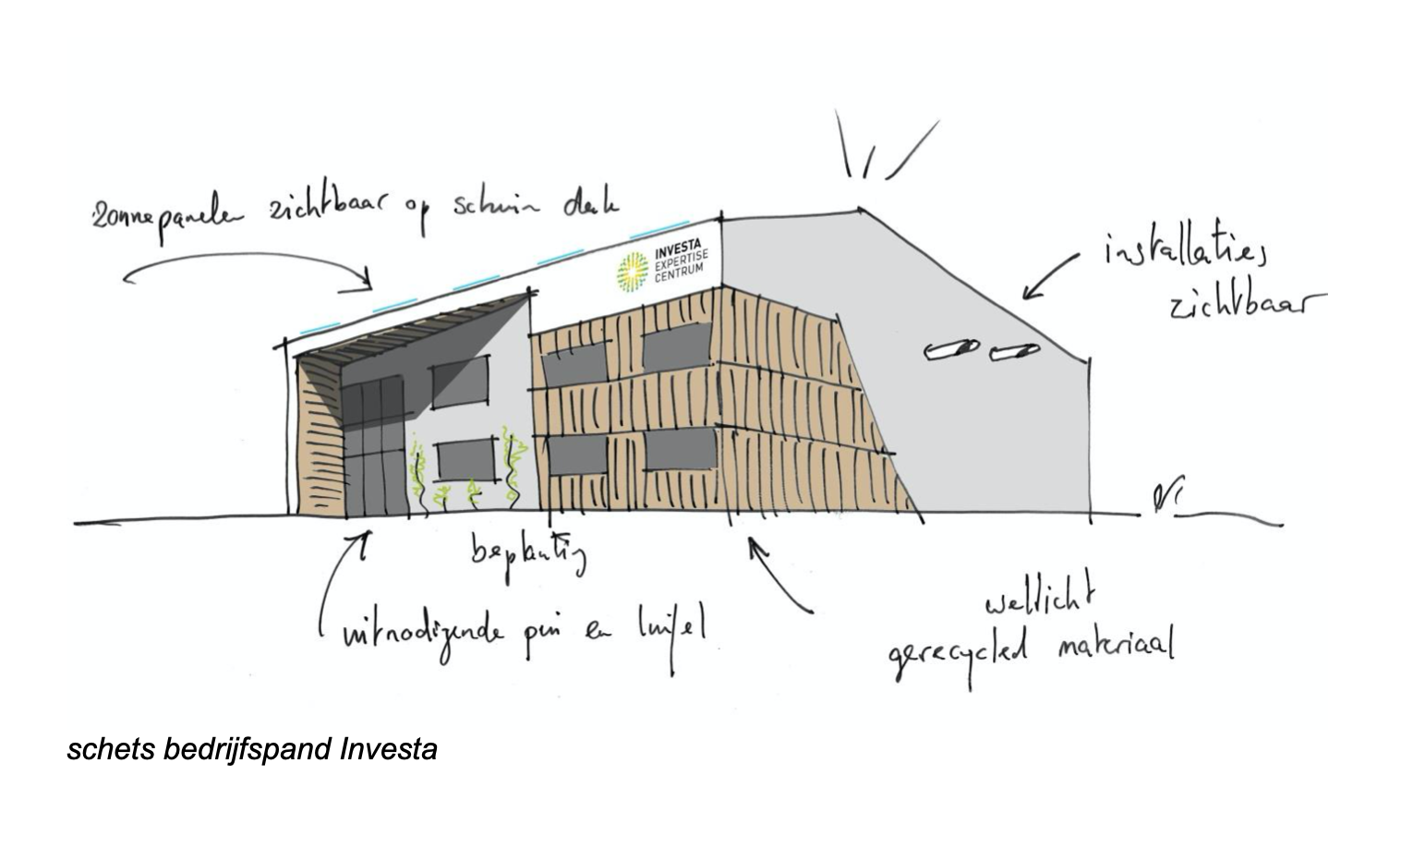
Start building activities InVesta
InVesta and projects work in parallel
New Building InVesta
First utilities contracted
  Green gas
  Heat network
  Electricity for projects
  Special facilities for projects

Slide 8
Next
Expanding facilities
  Hydrogen HUB Alkmaar
  CCU network
  Internal heat network
Increasing number of demo projects
Expanding InVesta international network via project such as Northern Connections
Let work together also after the project is finished!

