Slide 1



HITRANS
Pilot Project Updates
September 2020
MOVE Partner Conference
HITRANS

Slide 2
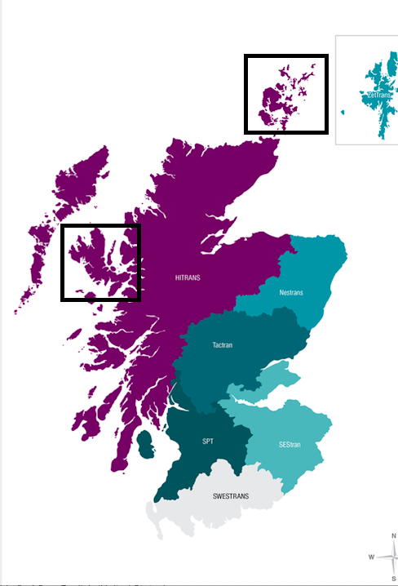
HITRANS MOVE Pilot Projects
Three pilots:
  Isle of Skye
  Culbokie
  eCargo Bikes (potential)
Common transport demand drivers:
  Seasonal Tourism (& public transport)
  Aging resident population (24% 65+)
  Pressures on health and social care provision
Co-creation
  Health Boards
  Local communities including Development Trusts
  Local Authorities
  Existing transport providers
  Carbon reduction
Notes:
Hitrans area made of 5 local authority areas two confirmed for Skye in Highland Council area focussing on the Sleat peninsula & the other in the Orkney Isles Council area focussing on St Margarets Hope and South Ronaldsay. Potential for a third area once Orkney budget is finalised.

Slide 3
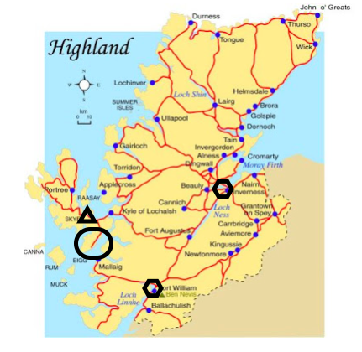
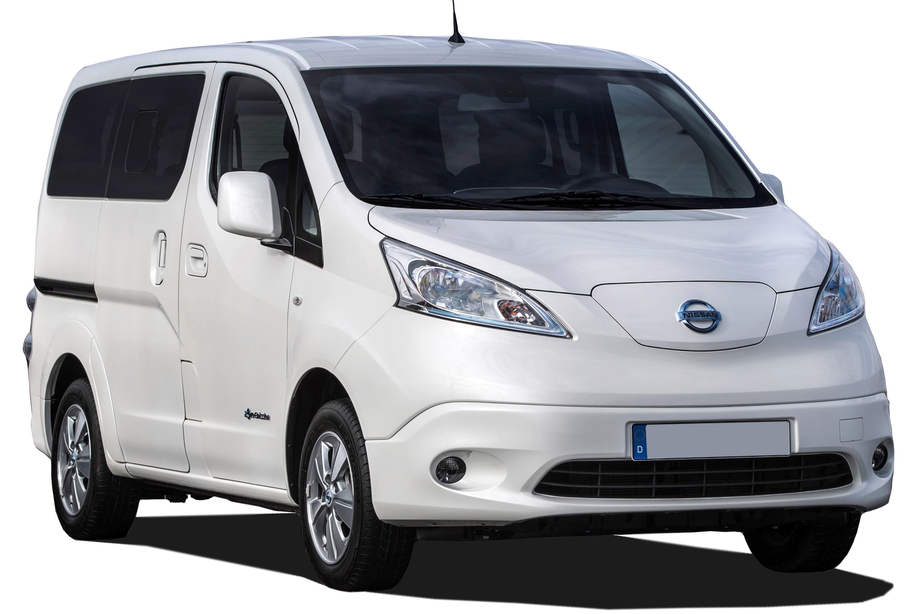
Skye Pilot Project
Located on Sleat peninsula pop 900
Service replacing existing contract
Operated by Sleat Development Trust on behalf of Local Authority
Combination of demand responsive and scheduled service.
Diesel vehicle to be replaced with ENV200 Combi Nissan EV with charge point
Current study with NHS to understand health demand and develop solutions to improve access to care
Aim to create framework that could be applied nationally
Technology – Patient booking, MaaS etc
Notes:
Sleat is a peninsula area where a circular type route with some deviations to serve all communities is proposed on a scheduled service as well as demand responsive.

Slide 4
Skye Pilot Project
Pre-Covid we were running two weekly pilot runs, one to the local shop and one to Kyle of Lochalsh, which has more shops and services and patronage was building momentum
Outbreak of Covid 19 saw a change in focus for the pilot on a temporary basis
The MOVE vehicle has been used to deliver groceries from the local shop to members of the community who had to shield/isolate, or who couldn’t get to the shops for other reasons.
Goods delivery has been very popular, and at its height was providing deliveries to 35 households a week
Delivery of the ENV200 to HITRANS local authority is complete and the livery of the vehicle is near completion, delivery date to Sleat is TBC but hopeful it will be September 2020.
Order has been placed for the slow charger at the Sleat Community Tranpsort hub which will be the nominated charger specifically for the MOVE vehicle. Installation date TBC estimated 6 weeks approximately. (6 hours full charge for ENV200)

Slide 5
Potential Pilot: eCargo Bike Trials
12 eCargo bikes to be trialled across 3 locations
Locations TBC but support from Orkney, Argyll & Bute, Moray & Highland
Initial positive discussions with councils, community organisations & BIDs
Target local businesses to promote modal shift from van/car deliveries to low carbon alternative
Increasing number of businesses offering deliveries due to Covid-19
Local authority Covid-19 interventions are making more space for people to walk & cycle safely in project areas – widening footpaths & creating dedicated cycle lanes
Early discussions with bike providers & recommendations from other RTP

