Slide 1


Mobility Oppurtunities Valuable to Everbody (MOVE)
Bikes and Trikes for Highland Carers (BTfHC)
NHS Highland Pilot
Tatyana Brown - RD&I Project Coordinator - NHS Highland
MOVE Partners Meeting - Virtual – 7-10 September 2020

Slide 2
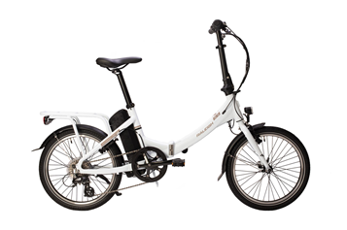

The Pilot aim
To provide an electric “pool bike” to General Practice surgeries with the goal of undertaking home visits by e-bike and to be borrow lower paid practice staff for commuting or at weekends thus reducing the car use

Slide 3
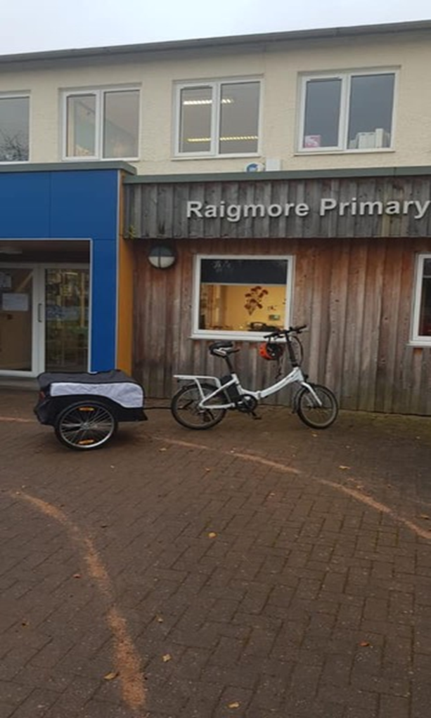
The Pilot objectives
Provide each participating practice with a good quality e-bike by August 2020
30% of home visits to be carried out by e-bike by summer 2021
80% of staff to have experienced riding the e-bike by summer 2021
20% of staff to have borrow the e-bike for trial of commuting by summer 2021

Slide 4
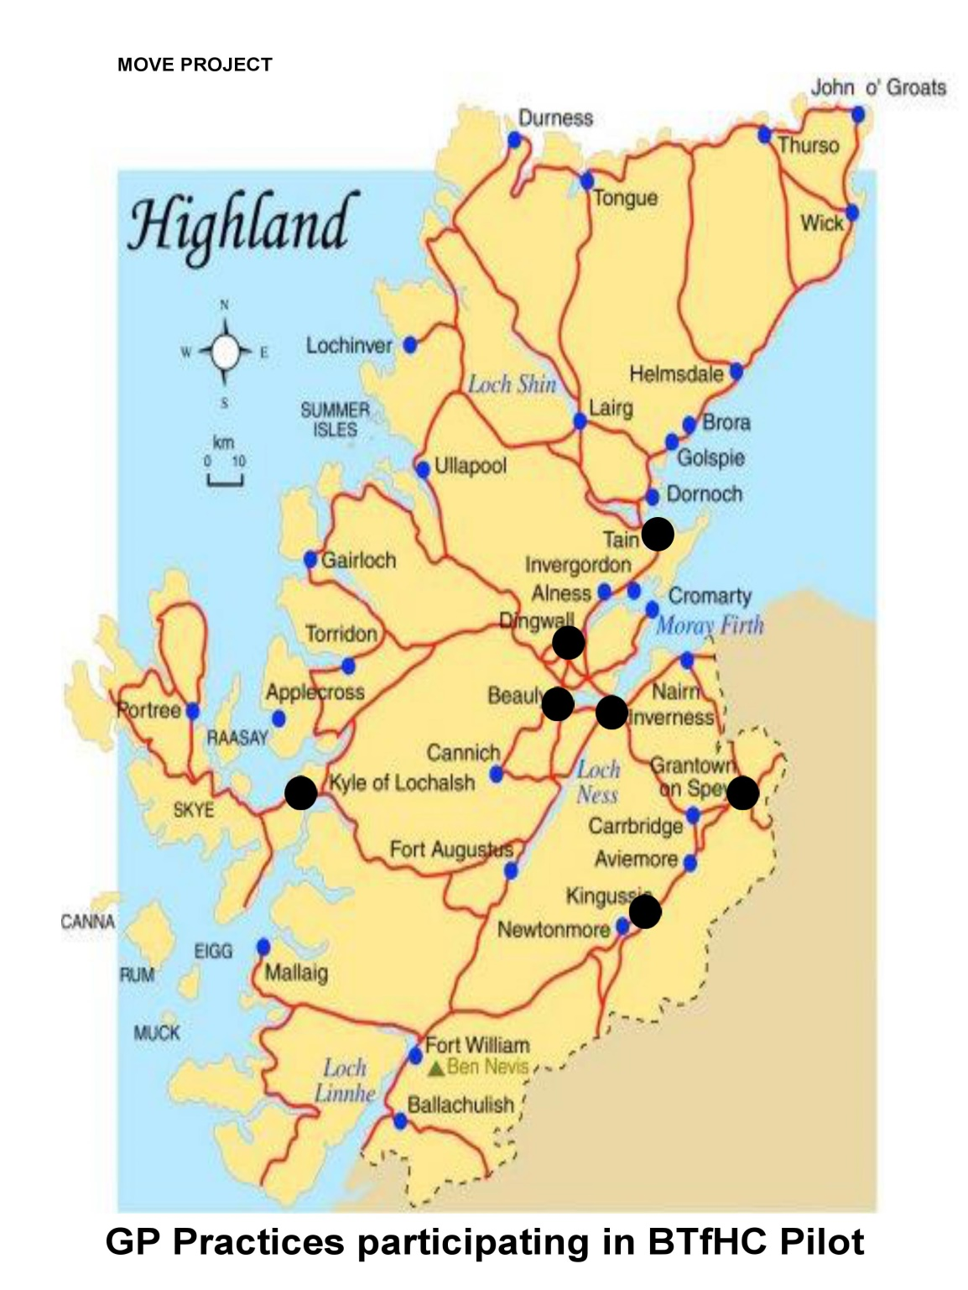
8 General Practice surgeries in Inverness and neighboring small towns are participating in the BTfHC Pilot
This consortia of GPs is committed to move toward sustainable transport
They are great places for active travel role modelling

Slide 5
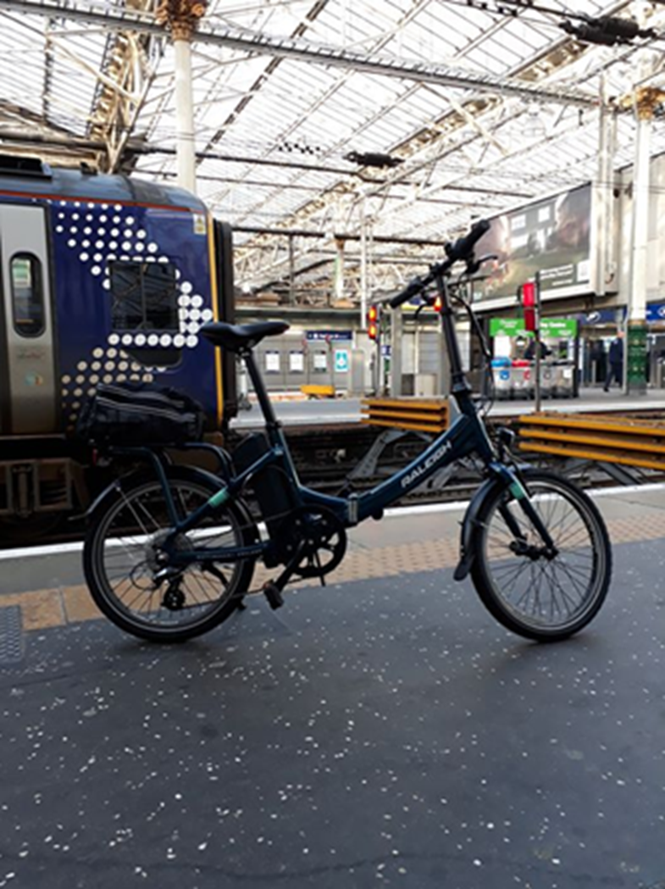
Benefits of the Pilot
Positive modelling of staff for patients
Overcoming barrier in moving towards low carbon emission transport
Fitter staff
Allow more staff to move towards e-bikes for home visiting or commuting
Building a positive experience of joined working by collaborating on the Pilot
Likely to have significant local positive media attention
Scalability

Slide 6
Specific challenges
Social inequalities: no easy access to e-bikes by low paid staff
Behaviour change barriers to modal shift: access to fast transport across short distances, getting sweaty
Public perceptions: acceptable means of transport for home visits in most non urgent situations
Staff fitness and wellbeing: most (>90%) commute short distances by car to work and have sedentary jobs

Slide 7
How the Pilot will solve these challenges?
Social inequalities: the Pilot would allow bike use optimisation by ensuring that staff could use the bike for commuting and at weekends
Behaviour change barriers to modal shift: good quality e-bike that manages hills well, staff education and buddying around safe root
Public perceptions: communication with patients about the Pilot using social media highlighting that emergency care will not be delivered by bike, but also highlighting the health benefits to staff in using the bike, thereby contributing to role modelling
Staff fitness and wellbeing: likely to increase % commuting regularly by bike >30% as staff identified wellbeing as their number one priority (staff survey)

Slide 8
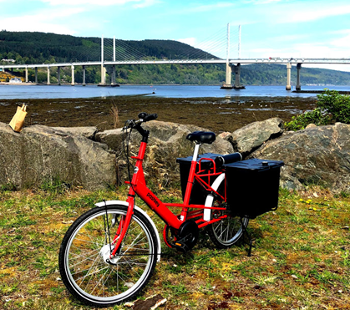
How will this be measured?
Staff travel surveys
Bike use log
Home visit log
Cycle counts
Comparison with non-participating practices locally (matched for demographics) through staff and patient travel surveys

Slide 9
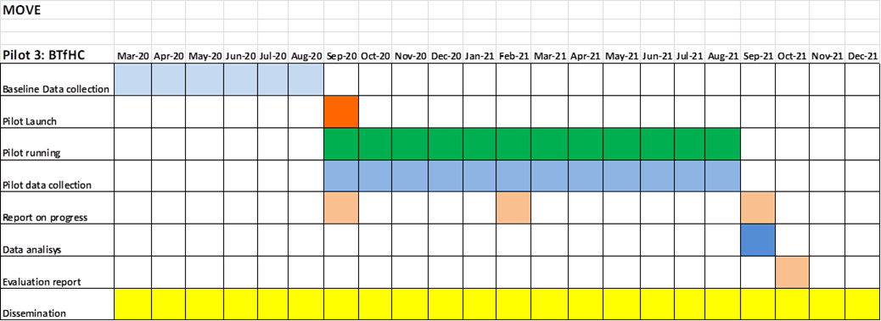
The Pilot timeline

Slide 10
The Pilot progress and problems
Progress:
8 foldable e-bikes have been bought and collected by participating GP surgeries by June 2020
Bikes computers fitted to bikes to collect a mileage data
The pilot website was launched www.bikesandtrikesforhighlandcarers.com that contains two questionnaires to collect baseline data and a feedback form.
Problems:
COVID-19 outbreak affected a bikes collection
Bikes computers for a mileage data collection weren’t fitted prior the bikes collection due to lockdown
Bikes usage for home visits during the COVID-19 pandemic are tricky due to Personal Protection Equipment usage

Slide 11
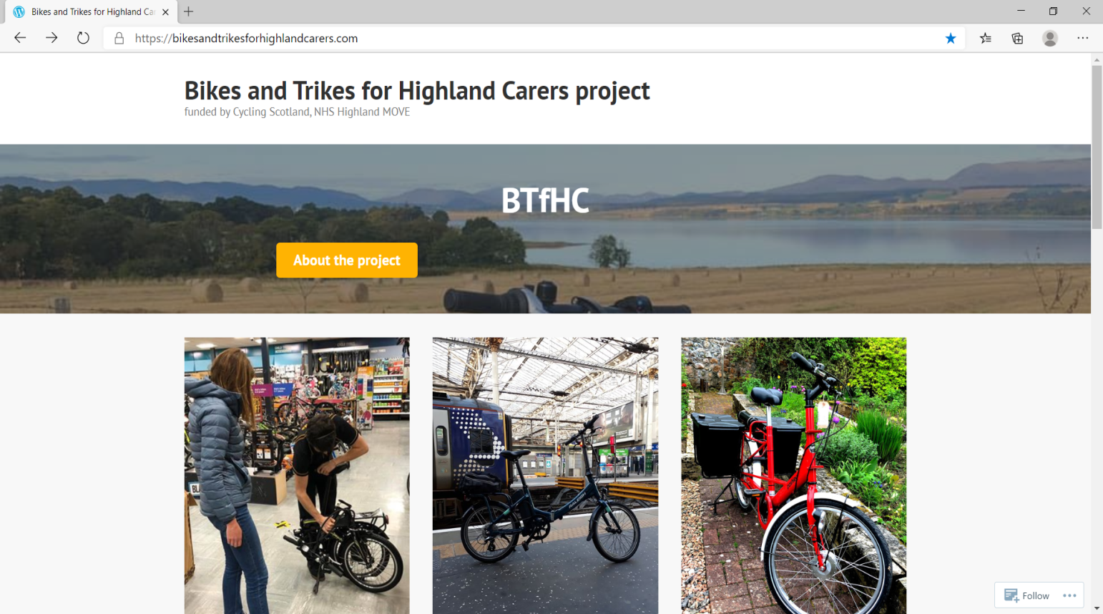
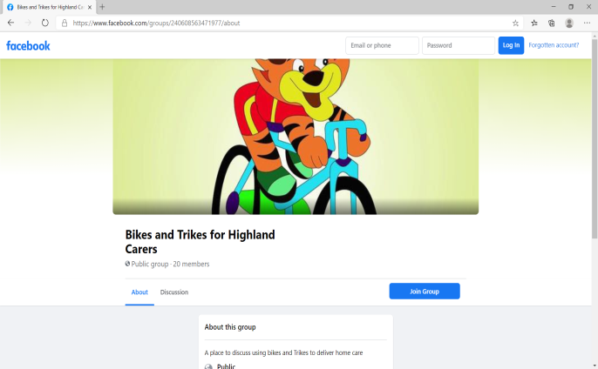
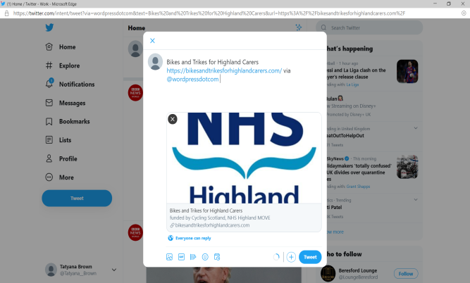

Communication and Dissemination of the Pilot
The Pilot website
Facebook
Twitter
Bike sticker

