Slide 1
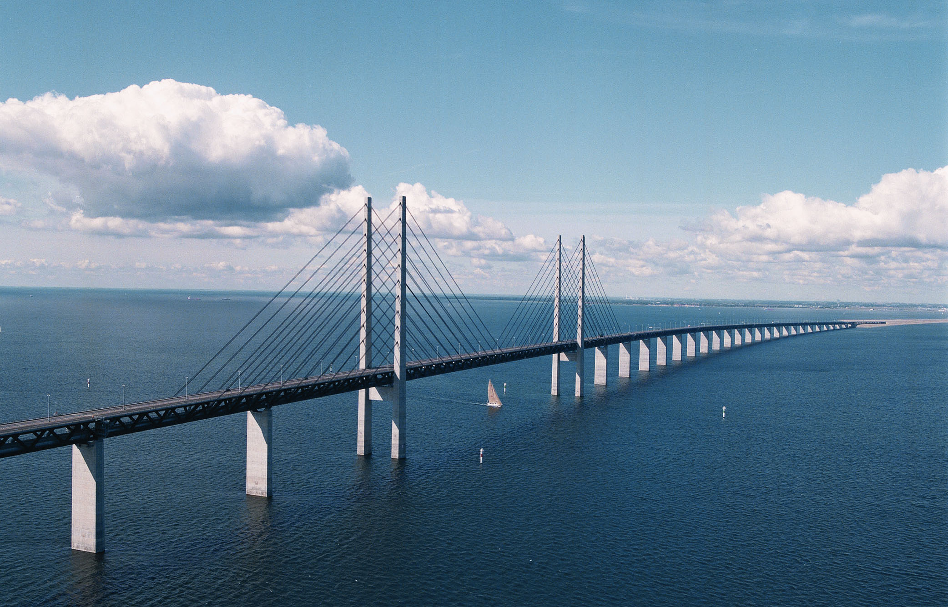






INTELLIGENT
MOBILITY
OF THE FUTURE
MOVE partner meeting
September 10 2020

Slide 2
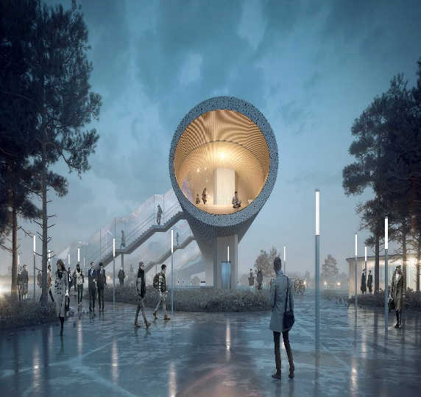
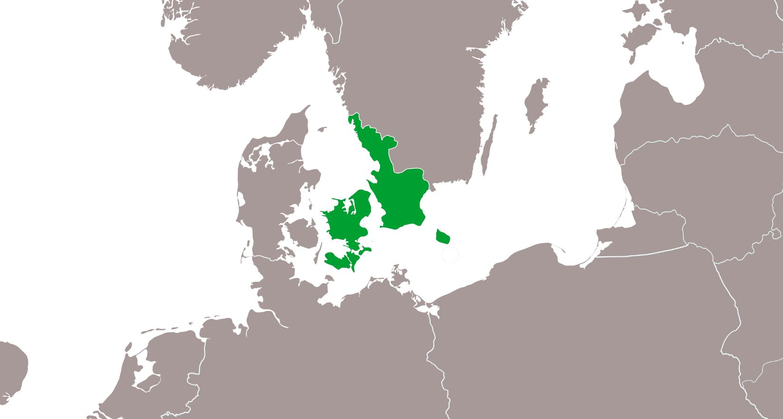


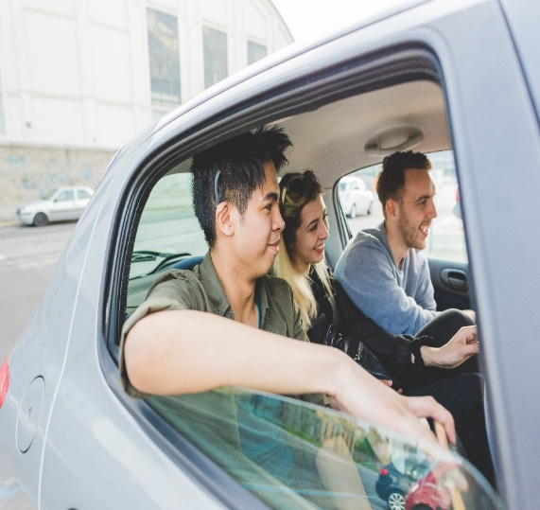

FUTURE
STATIONS
INTELLIGENT
TRAFFIC INFO
NEW
COLLECTIVE
MOBILITY IN THE
COUNTRY SITE
We want to develop, test and learn how new intelligent mobility solutions can enhance a more sustainable transportsystem.
FUTURE INTELLIGENT MOBILITY IN GREATER COPENHAGEN
d. 2. oktober 2018
Notes:
Hvad er udfordringen? Hvem har en udfordring?
Vi oplever at der bliver færre busser og droslet ned på betjeningen.
Der er teoretiske analyser af en mobilitetsfattigdom – der hvor folk har ingen eller kun en bil og ingen bus.
Men hvem oplever problemet? Og hvad er behovet?
Det er svært at finde dem der har et problem og som vil bruge en delebil.
Pointe 1.a.Vi skal have mere kvalitative undersøgelser og viden om hvem der konkret har et behov – hvilket behov.
Pointe 1.b. Bilafhængighed og øget bilbrug bliver et problem inde i byerne. Når man pendler fra by til land. Det skaber trængsel. Så vi skal have en indsats der går på at vi sætter bilen og skifter til mass-transit når vi skal ind i byerne.

Slide 3
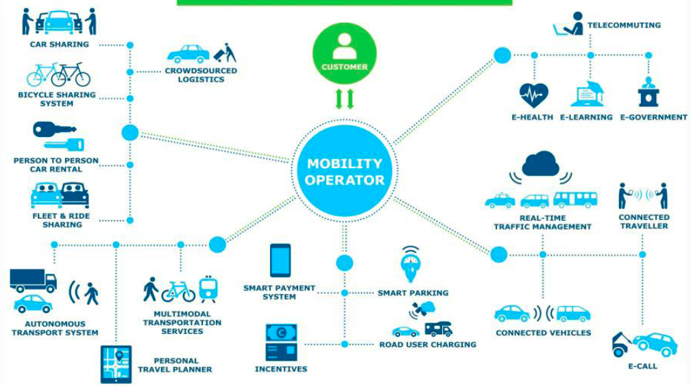
How to lead change?
How to cooperate between public and private sectors?
How to enhance the green and not be dependent on single car use?
What are our new role as planners?
Who own data and how can public authorities get hold of it?
What are the right solutions?
What data do we need to share and acces?

Slide 4

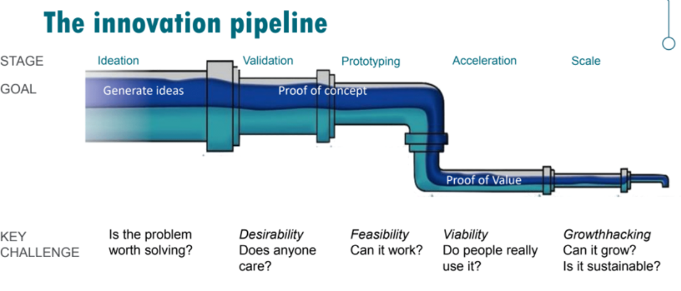
Users – citizens and the surroundings
Data availability
Public – private innovation contracts
Climate goals

Slide 5
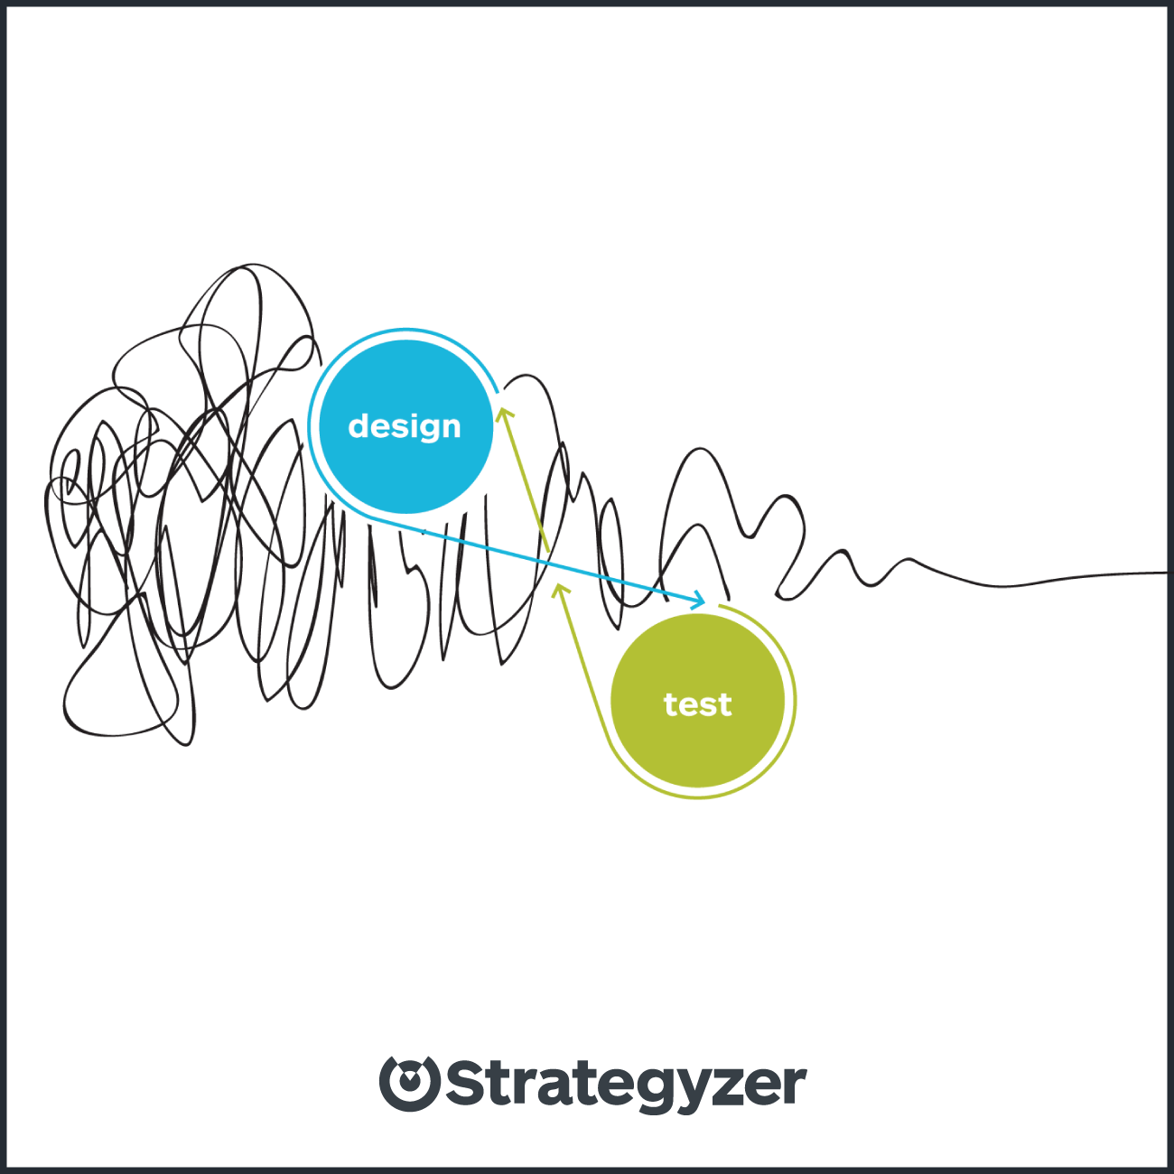
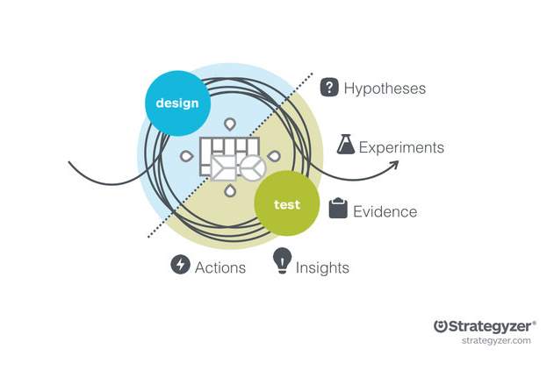
Notes:
Det kan godt være at man skal køre et par cirkler omkring design og test, før ideen er klar
Følelsen er ofte ikke få lineær/cirkulær

Slide 6
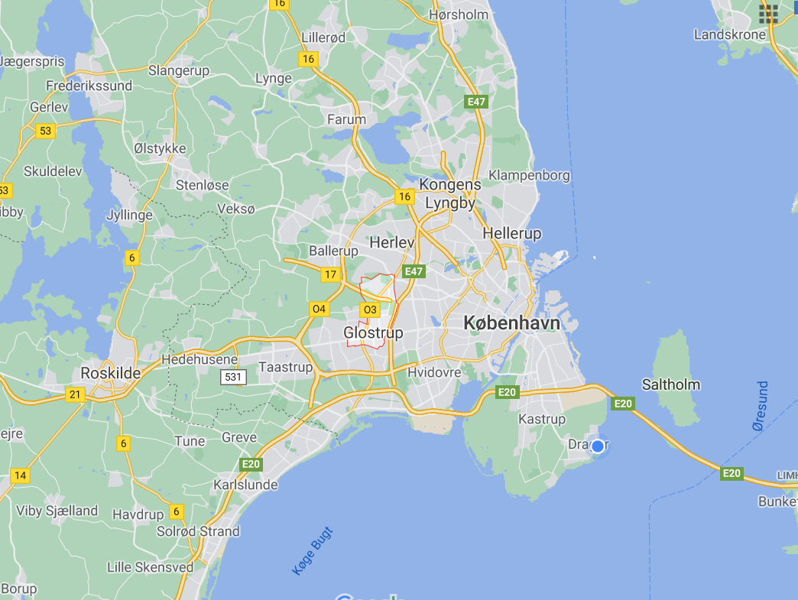

Slide 7
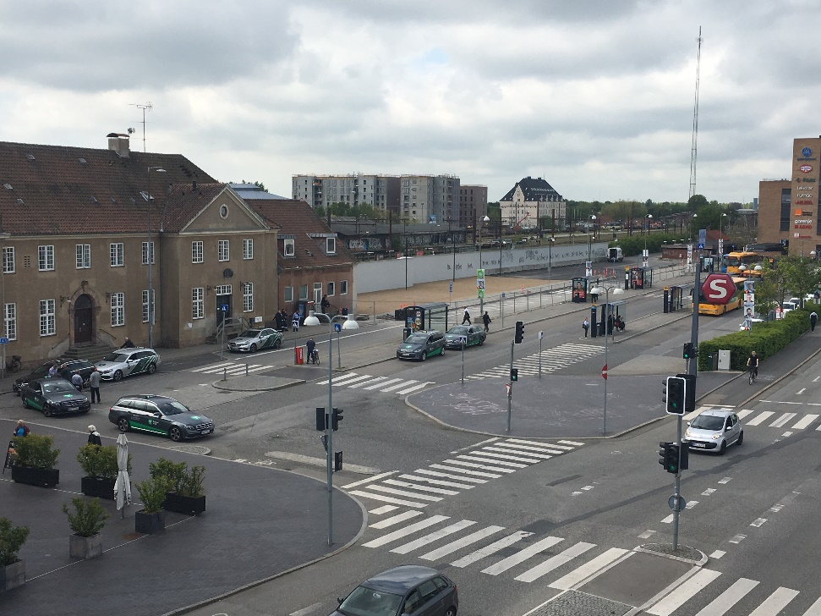
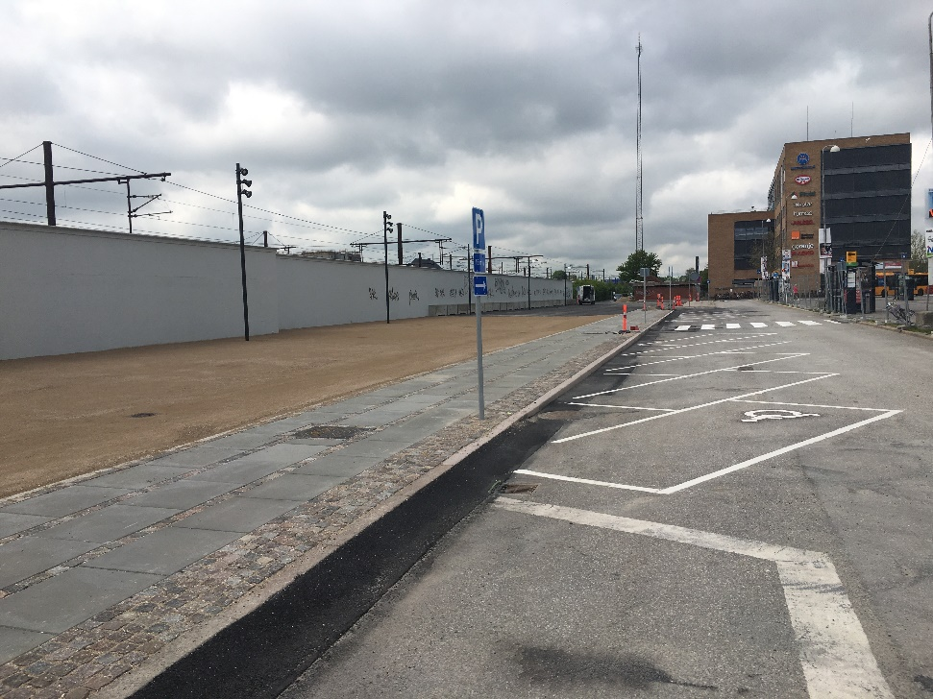
Testing and experimenting with citizens
Building lightrail

Slide 8
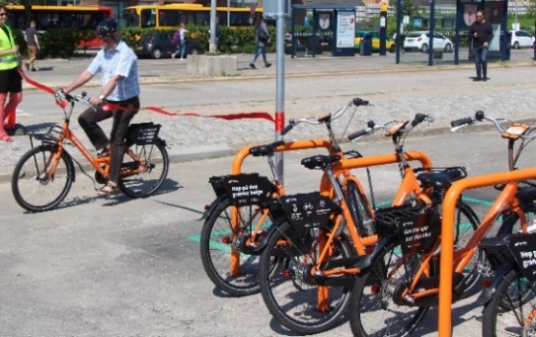
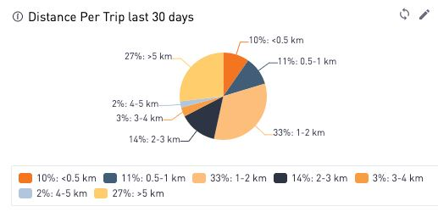
Use Case Glostrup Station
Test of last-mile solutions
Bike share system
Donkey Republic won the tender
Three years with public support
10 ordinary bikes + 10 e-bikes
9 hubs and Copenhagen (the network)
Pay as you go + membership fee 12 hours (50-50)
Preliminary conclusions
More bikes and hubs needed
Equal tarifs with Cph needed – no special price
  Distances:
  33% short local trips
  27% more than 5 km

Slide 9
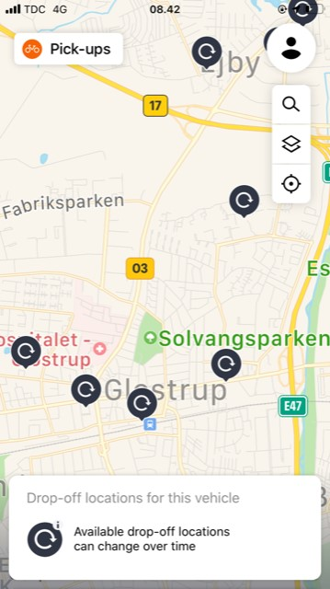
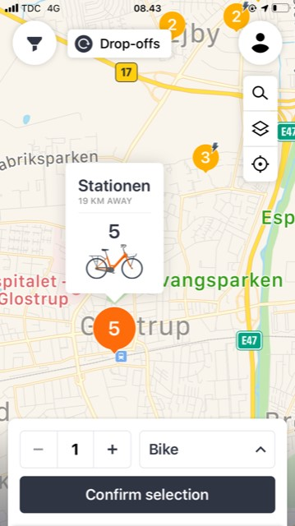

Slide 10
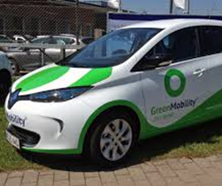
Car sharing – free floating
Charging infrastructure?
Parking issues?
Which car service?
GreenMobility – Corona uncertainties
User surveys next step

Slide 11
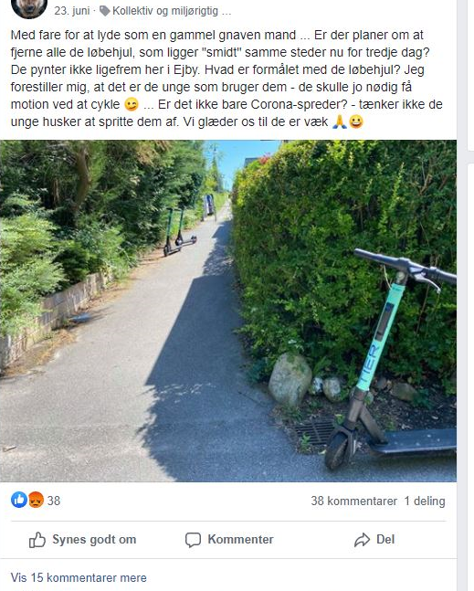
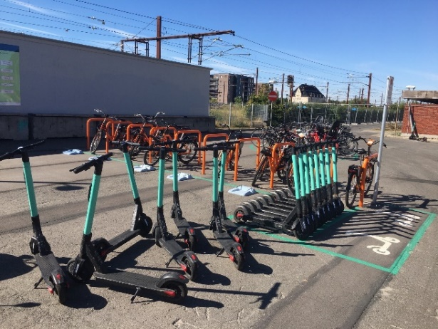
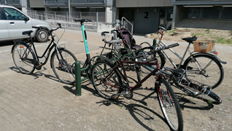
Electric Scooters
Political decision difficult
Speed limit in parks and city center down to walkin speed
Non-usable from midnight to 6 am.
6 months trial with Tier
150 scooters in total
Free floating system
Drop off zones
Maximum three days in one locations
Preliminary conclusions
Turbulent take-off
Very much activity on city’s Facebook
Tier staff daily on-site first two weeks
Adaptation period
High degree of use afternoon/evening (last mile)
Average trip 10 minutes
100 + daily trips
Economically viable?
Station drop-off

Slide 12
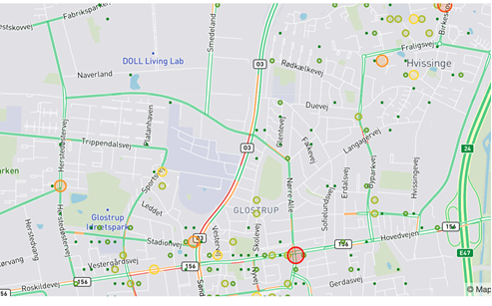
Where do people go? What are the use of e-scooters in the suburb?
Is there a need?

Slide 13
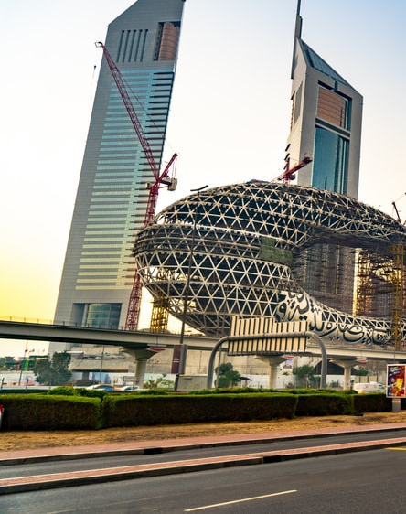
Learnings for the future stations
Prioritization of city spaces for multi hubs: Which are flexible and which are permanent?
Which business do we invite and what agreements – data, restrictions, space.
Competition how?
Transistion to new tech, how?
New and ‘old’ travellers?
Coordinating infrastructures?
Business models?
Ownership?

Slide 15

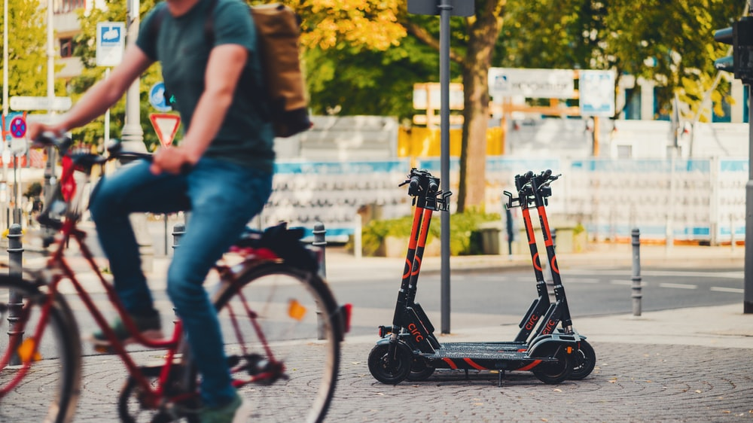
Greater Copenhagen Sustainable Mobility Forum
Mobility Across
17 partners + 17 network partners from three regions.
April 2020 – september 2022
Programme Manager Anna Thormann

Slide 16
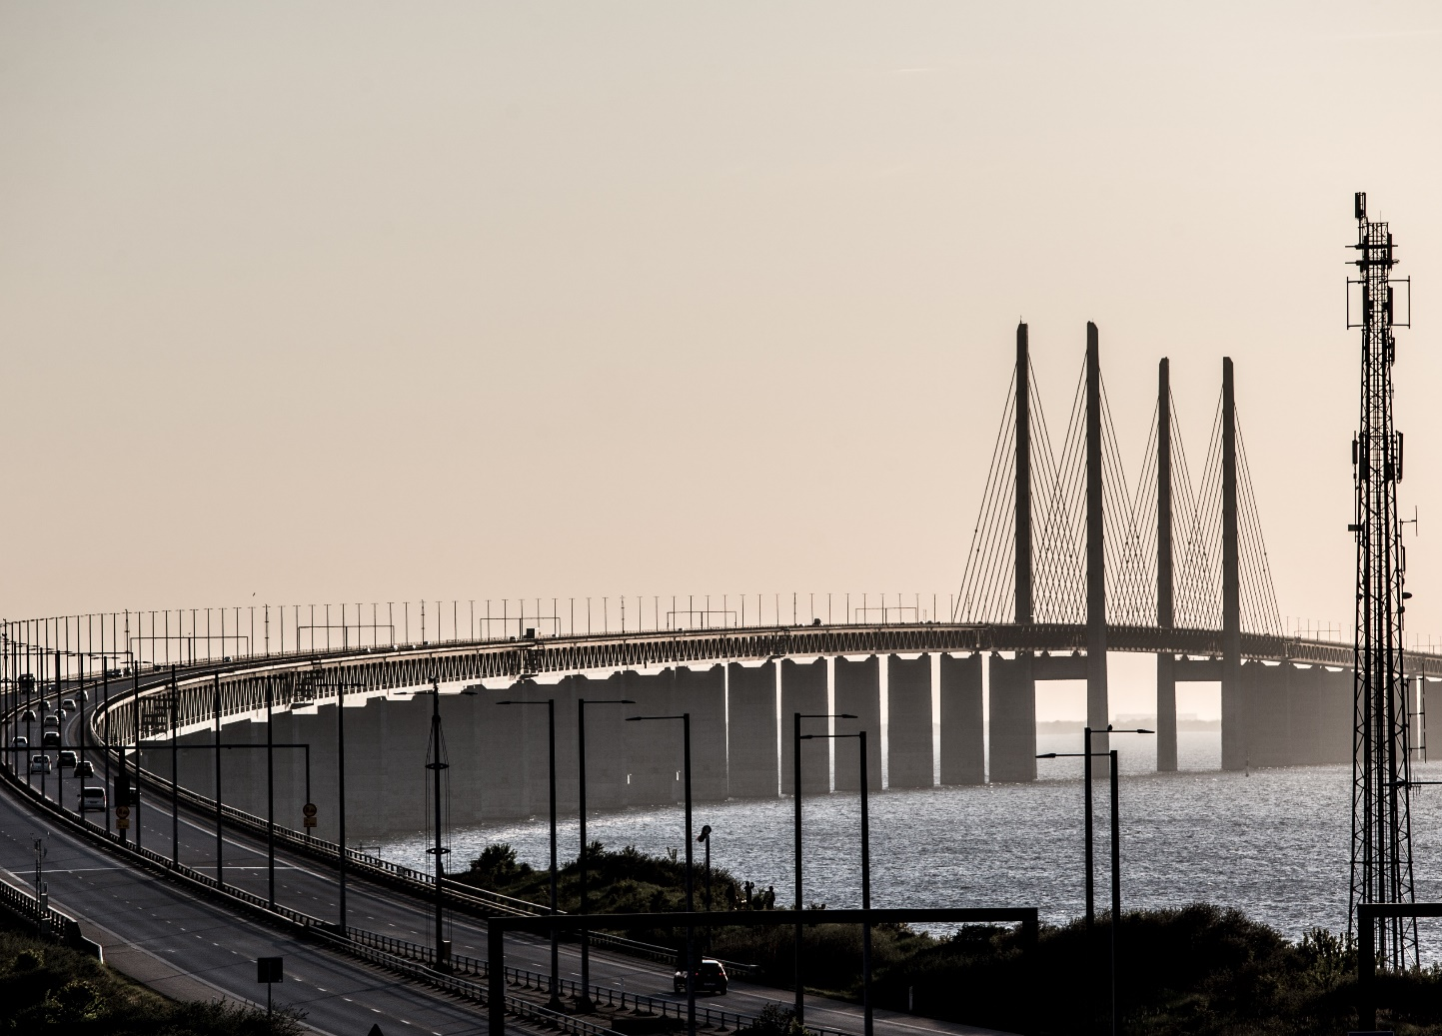
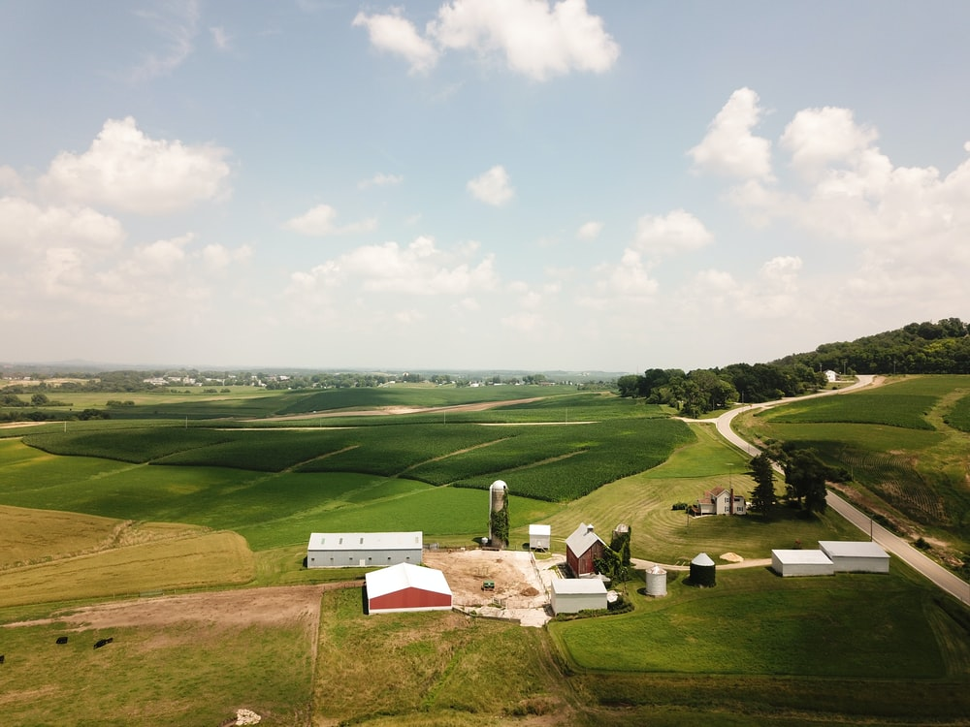
Mobility Across
ACROSS URBAN AND RURAL AREAS
ACROSS AUTHORITY BOUNDARIES
ACROSS PUBLIC, PRIVATE; RESEARCH and CIVIL SOCIETY
ACROSS TRANSPORT MODES
TOWARDS MOBILITY AS A SERVICE

Slide 17

Vision with a collaboration umbrella
Share and activate results from projects
Share strategies and scaling solutions
Continuing conversation
”More than a project – more than a conference”
Acitivies
Seminars
Masterclasses
Site visits with hackatons
Collecting project results
Gate 21
Innovation Skåne
Capital Region of Denmark
Notes:
Transport is being disrupted
Many new solutions and change in actors
1000s of pilots and projects
We need connectivity with sustainable modes

Slide 18

How to build a collaborating forum?
It is ”nice to” participate – how to make it a ”need to”?
It is only as good as the participants make it
It needs the right participants (important and different)
What are the mandate to make strategies /action plans?
How to continue it after the project run out?

Slide 19
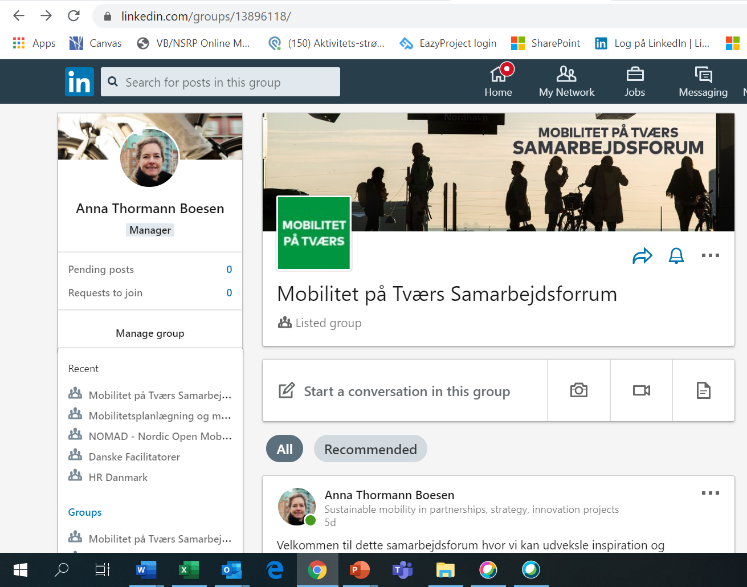
DISCUSSION
From Pilots to Scale?
Value from cross- country projects?

Slide 20

THANK YOU!

Slide 21
Mobility Crossover – new shared mobility across urban and rural regions
MOVE
FIMO – Final conference
Mobility Across
Share North – keynote?
LINC – autonomous shuttles as last mile solutions
Dates: may or june?
Time: 1,5 days?
Language: English
Breakouts: Can some of you host a break out?
Place: Gate 21 (50-100 persons) or virtual or hybrid.
Topics:
Innovation and co-creation with citizens
Discuss evaluation and business models

