Slide 1

Mobility Opportunities Valuable to Everybody (MOVE)
County of Northeim – sharing offers in rural areas
Yuliya Divivi
09/09/2020

Slide 2
Pilot project: Initial situation
Establishment of an e-car and e-bike sharing system in the city area in Northeim including building charging infrastructure
  3 e-carsharing stations
  4 e-bikesharing stations
the sharing systems should be usable by everyone, but especially by students
Landkreis Northeim
Stadt
Northeim

Slide 3
Pilot project: Groups involved
City of
Northeim
University
of
Göttingen
Northeim public utilities
County of
Northeim
ZVSN (Regional Public Transport Authority)
other
stake-holders
Housing companies

Slide 4
Pilot project: Cooperation, consequences/
changes
City of Northeim:
the city of Northeim provides space for parking the vehicles (+)
Public utilities
the public utilities provide the charging infrastructure for the e-cars (+)
the public utilities provide the charging infrastructure for the e-cars for a fee (monthly rates for charging stations) (+, -)
2 charging points will be used for the pilot project
1 charging point will be built
higher administrative costs (contracts, long decision ways etc.) (-)

Slide 5
Pilot project: Cooperation, consequences/
changes
University of Göttingen
the University of Göttingen therefore conducted a survey of students to what extent they are willing to use a sharing offer the result showed that the use of the sharing offers by the students is very price dependent (-)
  almost 50% of the students are willing to pay only 1,00 to 1,50 Euro per bike rental
  if this is set in relation with the minimum revenue that an operator requires per month for an e-bike,
  each bicycle would have to generate at least 5 rides per day to be economically viable in the long term
e-bike sharing system in the city of Northeim would therefore
not be operated at a cost-covering level

Slide 6
Pilot project: Cooperation, consequences/
changes
as an e-bike sharing system in Northeim cannot be operated economically and one of the main target groups would not use it, another practical solution had to be found
instead of an e-bike sharing system, a conventional bicycle rental system will to be set up in Northeim
Benefits
  the use is much cheaper
  this increases acceptance and frequency of use among students
  the lending and usage of such a system will be easier, which may help to attract other user groups
  in addition, the CO₂ balance would be better and the multimodal idea would remain
the changes made it necessary to shift budget lines from infrastructure investments to external consulting

Slide 7
Pilot project: State of affairs
The pilot project is not on the track at the moment due to:
the project is a new experience in the County of Northeim
no experience with the implementation of sharing-systems
long decision-making processes in the public administration
Covid-19
insufficient communication with stakeholders/ target groups etc
other obligations and tasks in public administration
very long (!) process of preparation of the tender documents

Slide 8
Timeline
Year | 2020 |  |  |  |  |  | 2021 |  |  |  |  |  |  |  |  |  |  |  | 2022
Month | July | August | September | October | November | December | Januar | February | March | April | May | June | July | August | September | October | November | December | January | February
final coordination with stakeholders; agreement on use of infrastructure/ charging points
order for the construction of a charging station at Northeim railway station
tender e-carsharing and bike sharing
preparation/ tender marketing campaign
completion of the e-carsharing and bike sharing stations / delivery e-cars and bikes
tender marketing campaign
start e-carsharing and bike sharing in the city of Northeim
implementation of marketing campaign first round (e-car and bike)
implementation of marketing campaign second round (only bikes)

Slide 9
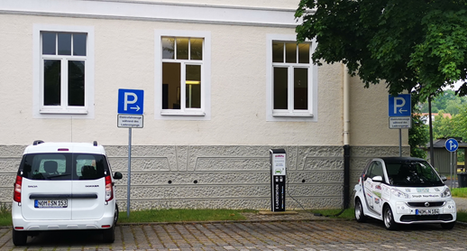
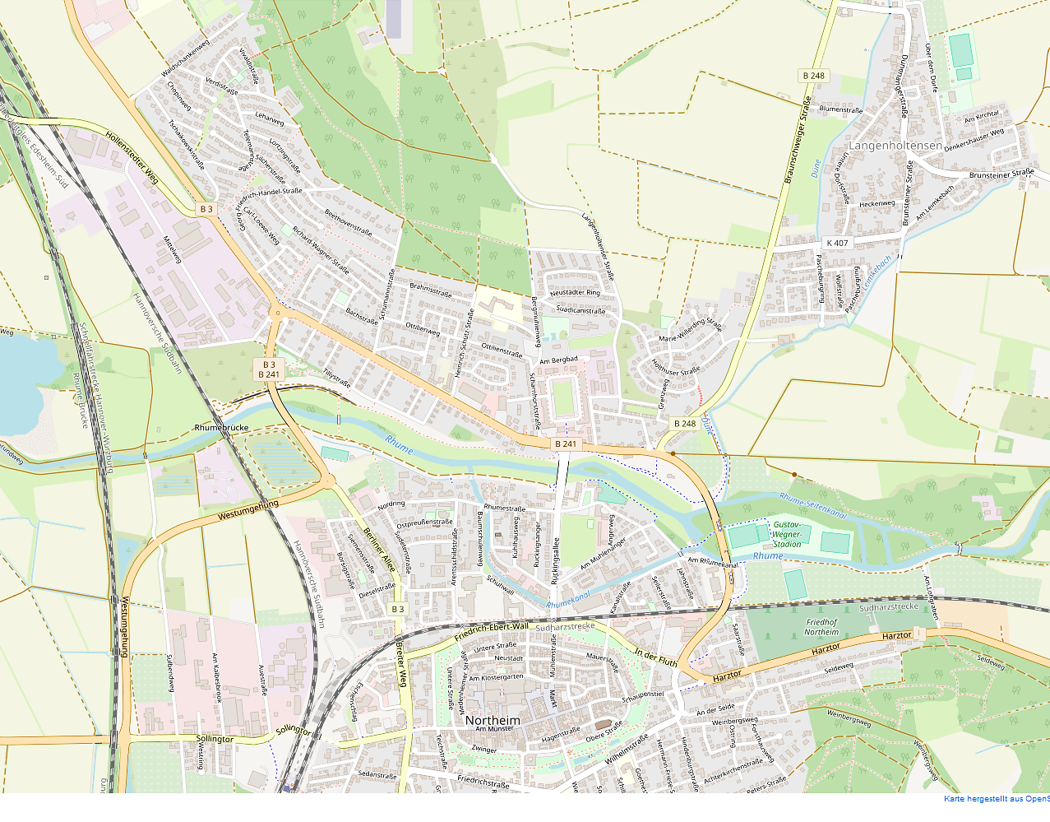
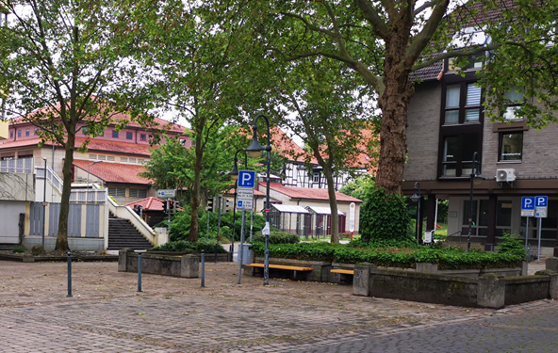
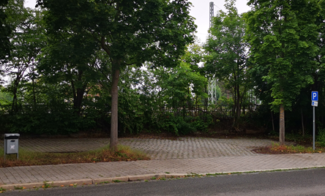
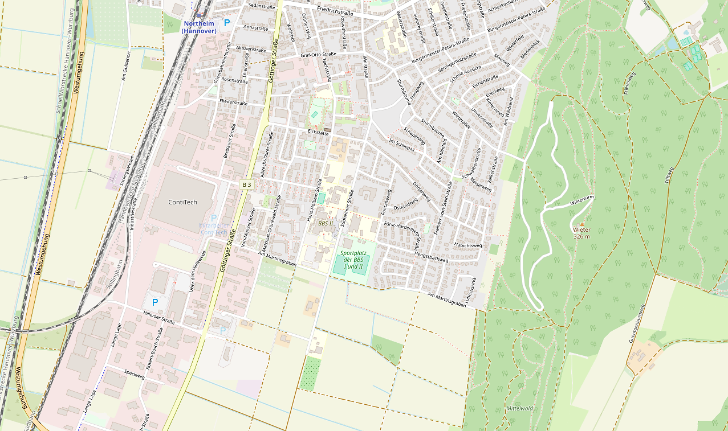
Stations e-car sharing system
City Hall
County of Northeim
Railway station Northeim

Slide 10
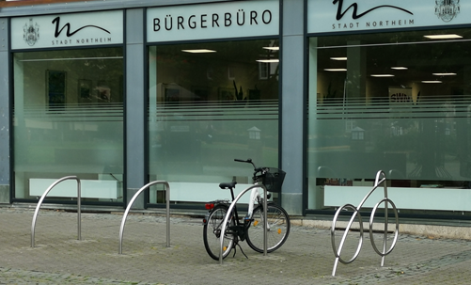
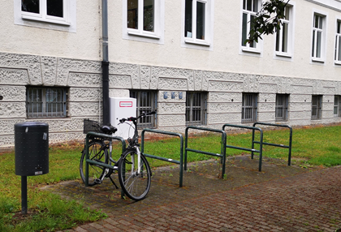
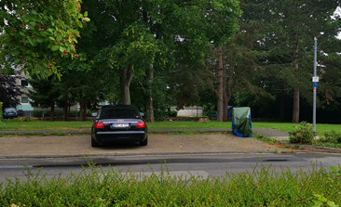
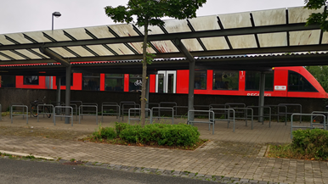
Stations bike sharing system
City center
City Hall
Student Apartments
Railway station Northeim

Slide 11
Q & A
Yuliya Divivi
Project assistent
County of Northeim

