Slide 1
A forward look at blockchain in the public sector
21 Jan 2021
Benjamin Welby
Policy Analyst
Digital Government and Data Unit
Open and Innovative Government, Public Governance Directorate

Slide 2
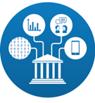
The OECD Blockchain Policy Centre
Events
Capacity Building
Partnerships
Guidance, Recommendations and Standards
Policy Research

Slide 3
The Blockchain Policy Centre in 2021
Further work on high level guidance about the responsible development and adoption of DLT
Publications:
Regulatory landscape for asset tokenization
Domestic and international implications of Central Bank Digital Coins and Stablecoins
Closer look at Decentralised Finance
Role of DLT in data governance

Slide 5
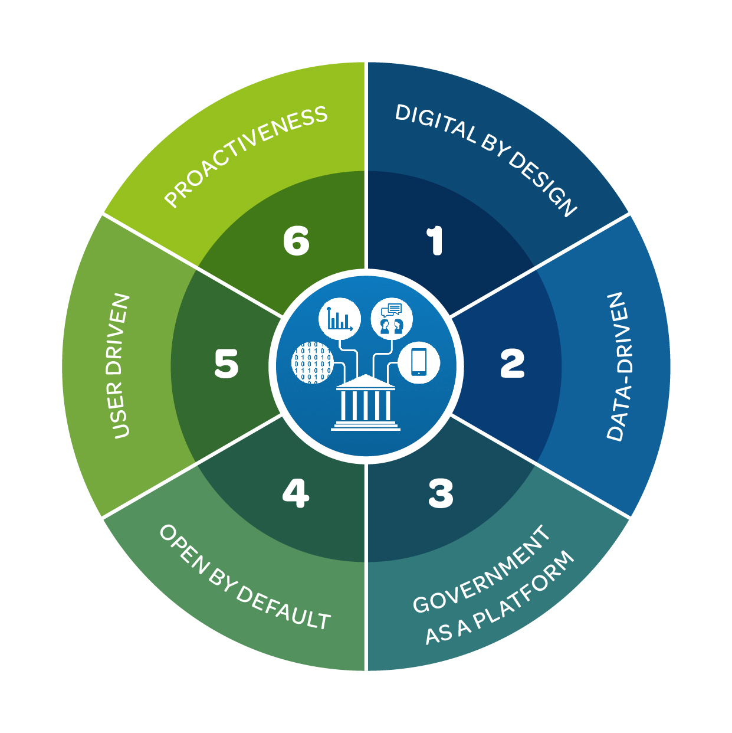
Digital government maturity and blockchain

Slide 6
Looking ahead at public sector blockchain
Blockchain had a lower profile in conversations in 2020

Slide 7
Looking ahead at public sector blockchain
Blockchain had a lower profile in conversations in 2020
Where DLT is viable, valuable and vital, teams are delivering, and will continue to do so

Slide 8
Looking ahead at public sector blockchain
Blockchain had a lower profile in conversations in 2020
Where DLT is viable, valuable and vital, teams are delivering, and will continue to do so
It’s important to rebuild trust in state institutions

Slide 9
Looking ahead at public sector blockchain
Blockchain had a lower profile in conversations in 2020
Where DLT is viable, valuable and vital, teams are delivering, and will continue to do so
It’s important to rebuild trust in state institutions
Can cross-border applications make the promise more certain?

Slide 10
Thank you!
Benjamin Welby
benjamin.welby@oecd.org
http://oe.cd/diggov
/
@bmwelby
@OECDgov
#digitalgov

