Slide 1
The uncertain promise of blockchain for government
OECD working papers on public governance no 43 report presentation report authors: juho lindman, jamie berryhill, benjamin welby, and mariane piccinin barbieri primary contact juho.lindman@ait.gu.se bling webinar, 21st jan
Full report available https://www.oecd-ilibrary.org/governance/the-uncertain-promise-of-blockchain-for-government_d031cd67-en

Slide 2
Juho Lindman
Current
  Director of University of Gothenburg Blockchain lab
  Associate Professor (Docent) of Applied IT (Informatics)
  Docent, University of Oulu, Openness of systems development and use
Visiting:
  2019 Harvard, Weatherhead Center, US
  2010 London School of Economics, UK
  2012, 2015 Stanford (Scancor), US
Earlier:
  Svenska Handelshögskolan HANKEN, Helsinki, Assistant professor in Information Systems Science (FLO)
  Aalto University, Helsinki, Department of Business Technology
Research interests
  Blockchain
  Software business, software development in organizations.
  Especially 3O’s : open source, open data and open access
Notes:
Thank you for a good slot to present

Slide 3
Information systems(University of Gothenburg)
With a faculty in the excess of 45, the division of information Iystems (IS) is one of the powerhouses of Swedish IS research. As one of the nodes in the Swedish Center for Digital Innovation (www.scdi.se), the division has seen a massive growth in both publishing, external capital and faculty members during the past two years, and continue to grow swiftly with the ambition to deliver increased excellence in education, research and outreach. The division is part of the Department of Applied IT at the University of Gothenburg, one of Northern Europes largest universities.

Slide 4



Slide 5
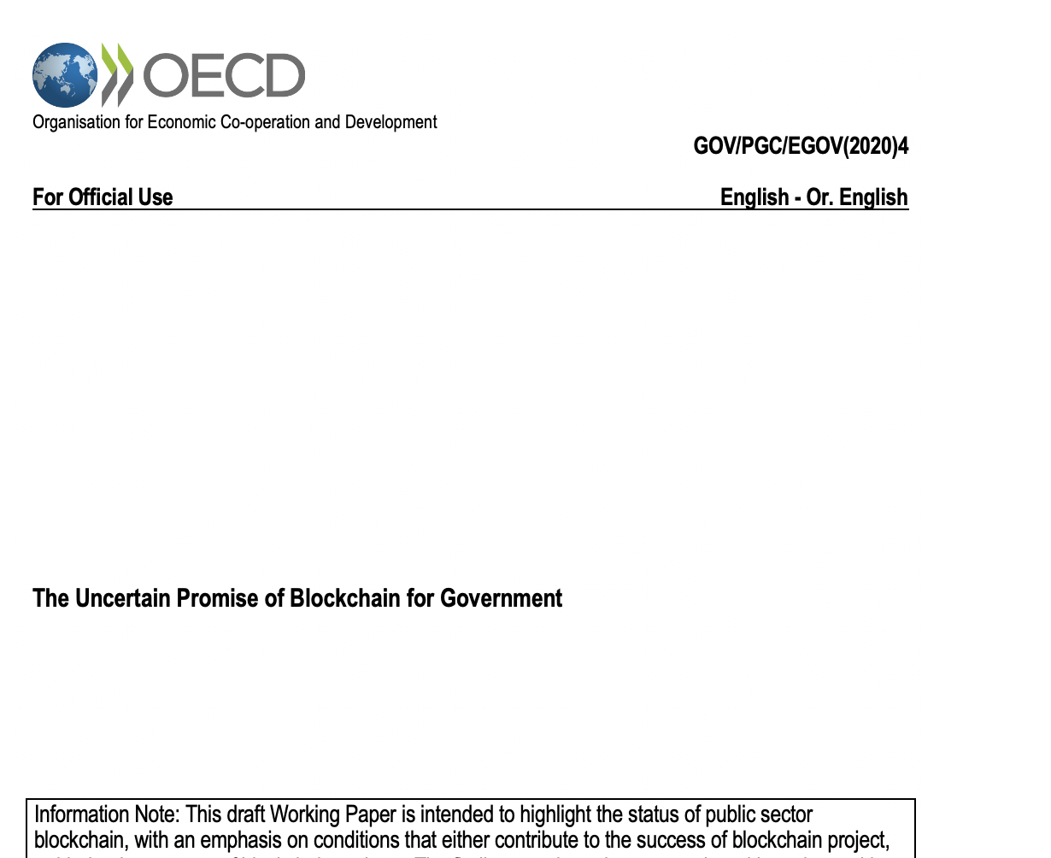

Slide 6
OECD working paper
OECD Working paper titled The Uncertain Promise of Blockchain for Government (2020)
  Released on the 19th Nov OECD Global Blockchain Policy Forum event in Paris/virtual
  Is a part of OECD’s Blockchain Policy Series
Earlier OECD work
  Observatory of Public Sector Innovations (OPSI)’s 2018 Working Paper Blockchains Unchained: Blockchain technology and its use in the public sector,
  Digital Government and Open Data Unit’s 2019 Working Paper State of the Art in the Use of Emerging Technologies in the Public Sector.
  etc

Slide 7
Abstract
In the public sector: still lack of clear use cases success – actual users, user data.
  Overblown blockchain hype has led public sector organizations to approach blockchain technology with increasingly unrealistic expectations.
  Scepticism is on the rise and it is becoming increasingly clear that this road is difficult and that success stories in this space are rare.
  So far, implemented blockchain projects have had minimal impact on the public sector. Most projects are stuck at the proof-of-concept, prototype, or pilot stage, or they have fizzled out entirely.
However, government decision makers will need to understand and continue to monitor this rapidly emerging technology closely.
  This working paper cuts through the blockchain hype to discuss the current state of the uncertain promise of blockchain for government.
  The report is designed especially for government decision makers to help them set their expectations related to blockchain technology and to understand many observed characteristics and practices of organisations and teams engaging in blockchain initiatives that still have quite a bit of potential, as well as the lessons learned from those that have struggled or not succeeded.

Slide 8
Working paper structure
Chapter 1 Introduction provides an overview of the current situation and an overall framework to evaluate the benefits of blockchain service for a particular need using the three Vs (viable, valuable, and vital) checklist as applied to blockchain and associated use cases.
Chapter 2 Ten myths about blockchain in the public sector lists common misconceptions and debunks commonly held myths about blockchains in the public sector to help the reader navigate this terrain.
Chapter 3 Blockchain project success and non-success factors discuss factors underlying project success and non-success at the project level.
Chapter 4 Organisational success: Organisational maturity measurement approaches the suitability and implementation of blockchain to improve public sector policies, processes and services.
Chapter 5 Conclusion and recommendations summarises the key findings of the report, and a series of appendices provide additional information.

Slide 9
Summary of empirical research
Overview of current state-of-the-art and experimentation
  Mostly secondary data on the different pilots
  Some primary, longitudinal data on specific experiments
  More questions about government - than blockchain
Currently strugling with questions
  on how to turn this into research efforts/projects
  and what specific part of this to continue

Slide 10
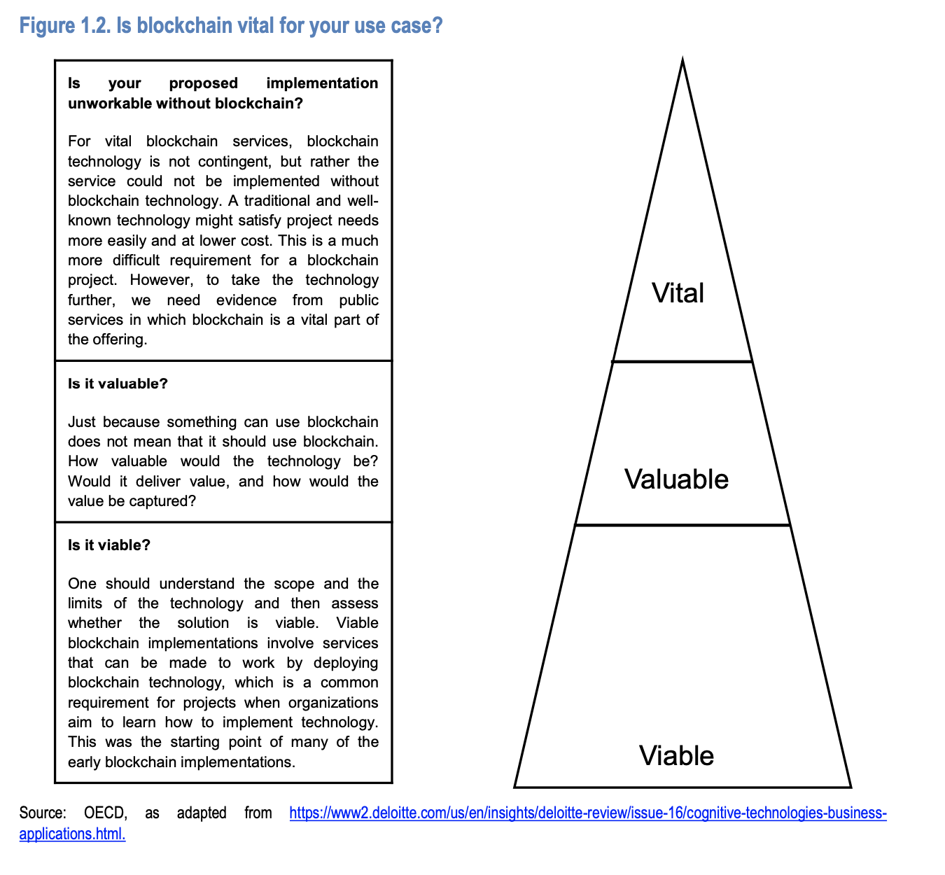
CH1

Slide 11
Chapter 2: Ten myths about public sector blockchais
(Public) blockchains are disrupting the public sector all around the world.
It is impossible to build successful blockchain applications for the public sector.
There is one obvious way to apply blockchain technology in the public sector.
If you build it, users will come.
If it is blockchain, it needs to be big and disruptive.
Nobody knows how blockchains are implemented.
Blockchain is a generic technological solution, similar to AI.
We are not tech people and should not care about detailed design decisions such as blockchain.
Results of blockchain projects contribute to blockchain knowledge.
Users are interested that services are based on blockchain.

Slide 12
Chapter 3: Focus of analyses
We focus on the following in detail:
Projects that have life cycles in which they move from limited pilots and experiments into service deployment to users (deployment). We are interested in those projects that have already launched (“gone live”) and obtained users.
Projects that have moved from limited testing to acquiring actual end users (use). In other words, the project’s user base is not limited to test users.
Users who have agreed to use the service (continued use) and for whom user engagement data are being accumulated.

Slide 13
Chapter 3: Factors contributing to success and non-success in blockchain projects
Factor | Type | Description
Clear value proposal | Success factor | The project must address a clear, specific business goal.
Appropriate technology | Success factor | The project must use appropriate technology.
Stakeholder management | Success factor | The project must identify and manage relevant stakeholders.
User focus | Success factor | The project must engage end users with the service’s design.
Experimentation | Success factor | The project must address problems encountered during implementation and pursue unforeseen opportunities.
Disruptiveness | Non-success factor | Disruptive projects are generally more complex and difficult to implement.
Limited scalability | Non-success factor | Projects related to services that do not scale might provide learning opportunities, but service deployment will be difficult.
Legal uncertainty | Non-success factor | Lack of clarity regarding the legal or regulative side hinders service deployment.

Slide 14
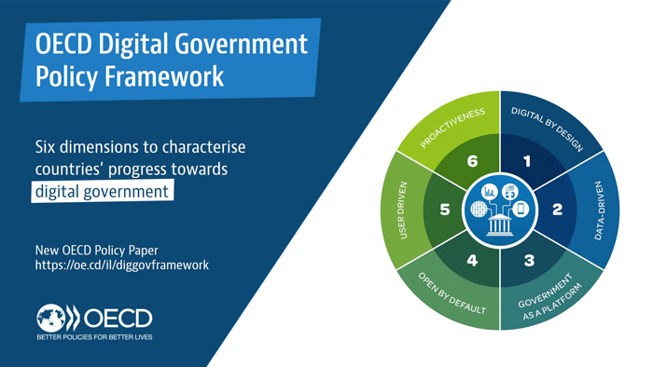
Chapter 4

Slide 15
Report take-aways
Is the blockchain solution viable, valuable, and vital for a particular service? (Chapter 1 Introduction)
Does a decision maker have enough general knowledge and realistic expectations related to blockchain? (Chapter 2 Ten myths about blockchain in the public sector)
Does the project take into account factors that lead to success and failure? (Chapter 3 Blockchain project success)
Is the organization blockchain-ready? (Chapter 4 Organisational success: Organisational maturity measurement)
Summary: How to drive a successful blockchain innovation project. (Chapter 5 Conclusion and recommendations)

Slide 16
Challenges / future research
Hype and polarizations in this space
How to research emerging tech:
  difficulties in comparing merits of blockchain implementations with other potential (or at least feasible) technologies in the public sector
  Technology-driven vs user-need -driven experimentation. Research issues with setting up of a “Dedidacted blockchain project”
  Collecting evidence related questions
  Data access –related issues (esp. to verify some of the wildest claims)
Role of (international) infrastructures
  vs. local experimentation

Slide 17
Questions / comments

Slide 18
Future work
How to leverage successful private-sector use cases, for example from supply chain and banking, to deliver public services?
What core parts of the blockchain should be delivered as private platforms and what as public infrastructures? How is this question decided for these services? Currently, it seems that each use case is resolved individually. This question becomes pressing when looking into, for example, the Estonian instance, where a number of core digital public services are relying on decentralized technology.
Is there tension between disintermediating the government as a public service provider and the idea of government earning trust via their democratic processes? It seems that current incremental blockchain implementations do not trigger this concern, but future disruptive ones might.
Should public sector actors prioritize evolutive or disruptive blockchains? Currently, it seems that evolutive approaches are prioritized and more risky disruptive projects do not seem as attractive.
Currently, there are several large-scale infrastructural projects underway based on this technology (EBSI is one such project in Europe, but globally there are a number of them). How are these services launched and collect user uptake.
What are the killer applications for public sector blockchain? Once we have them documented in a credible way, it is easier to leverage them for future blockchain success.

Slide 19
Appendix A: list of case studies
Groningen municipality (Netherlands) and Stadjerspas vouchers
BlockCerts (Malta) academic certification
Lantmäteriet (Sweden) and property transactions
Tel Aviv (Israel): Local currency
Voatz (US): Blockchain-based complementary distance voting
Estonian Information Systems Authority (RIA) and KSI Blockchain (Estonia)
Swedish unemployment agency and Axa insurance agency (Sweden): Digitalizing the unemployment certificate process
Government of Karnataka (India): Post matric scholarship attestation - with blockchain

