Slide 1
Dutch Blockchain Coalition
Peter Verkoulen
coalition manager

Slide 2
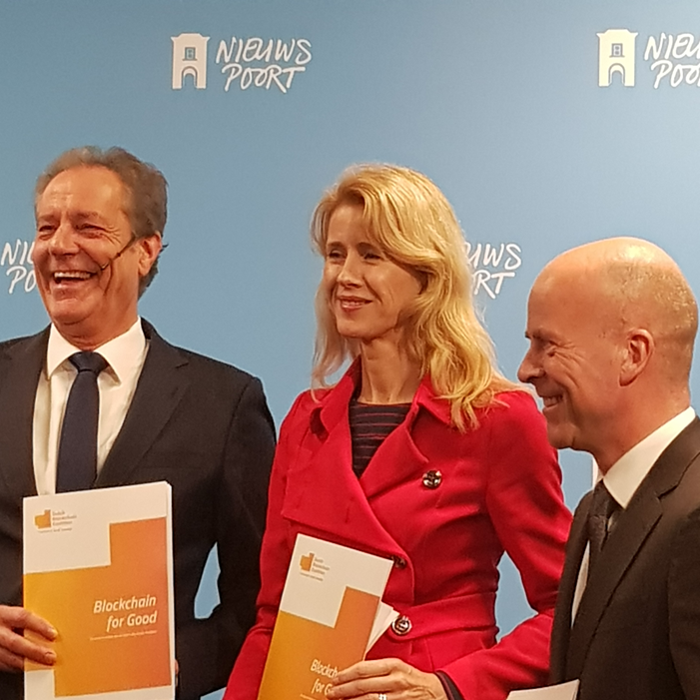
Blockchain for Good
The Dutch Blockchain Coalition officially launched March 30th, 2017.
Triple helix: large companies, ministries and governmental agencies and a wide selection of knowledge institutes collaborating intensively to realise common goals.
United in belief that blockchain requires connected communities
Goal: To create conditions for large scale blockchain applications. Secure, reliable and a benefit to society at large.

Slide 3
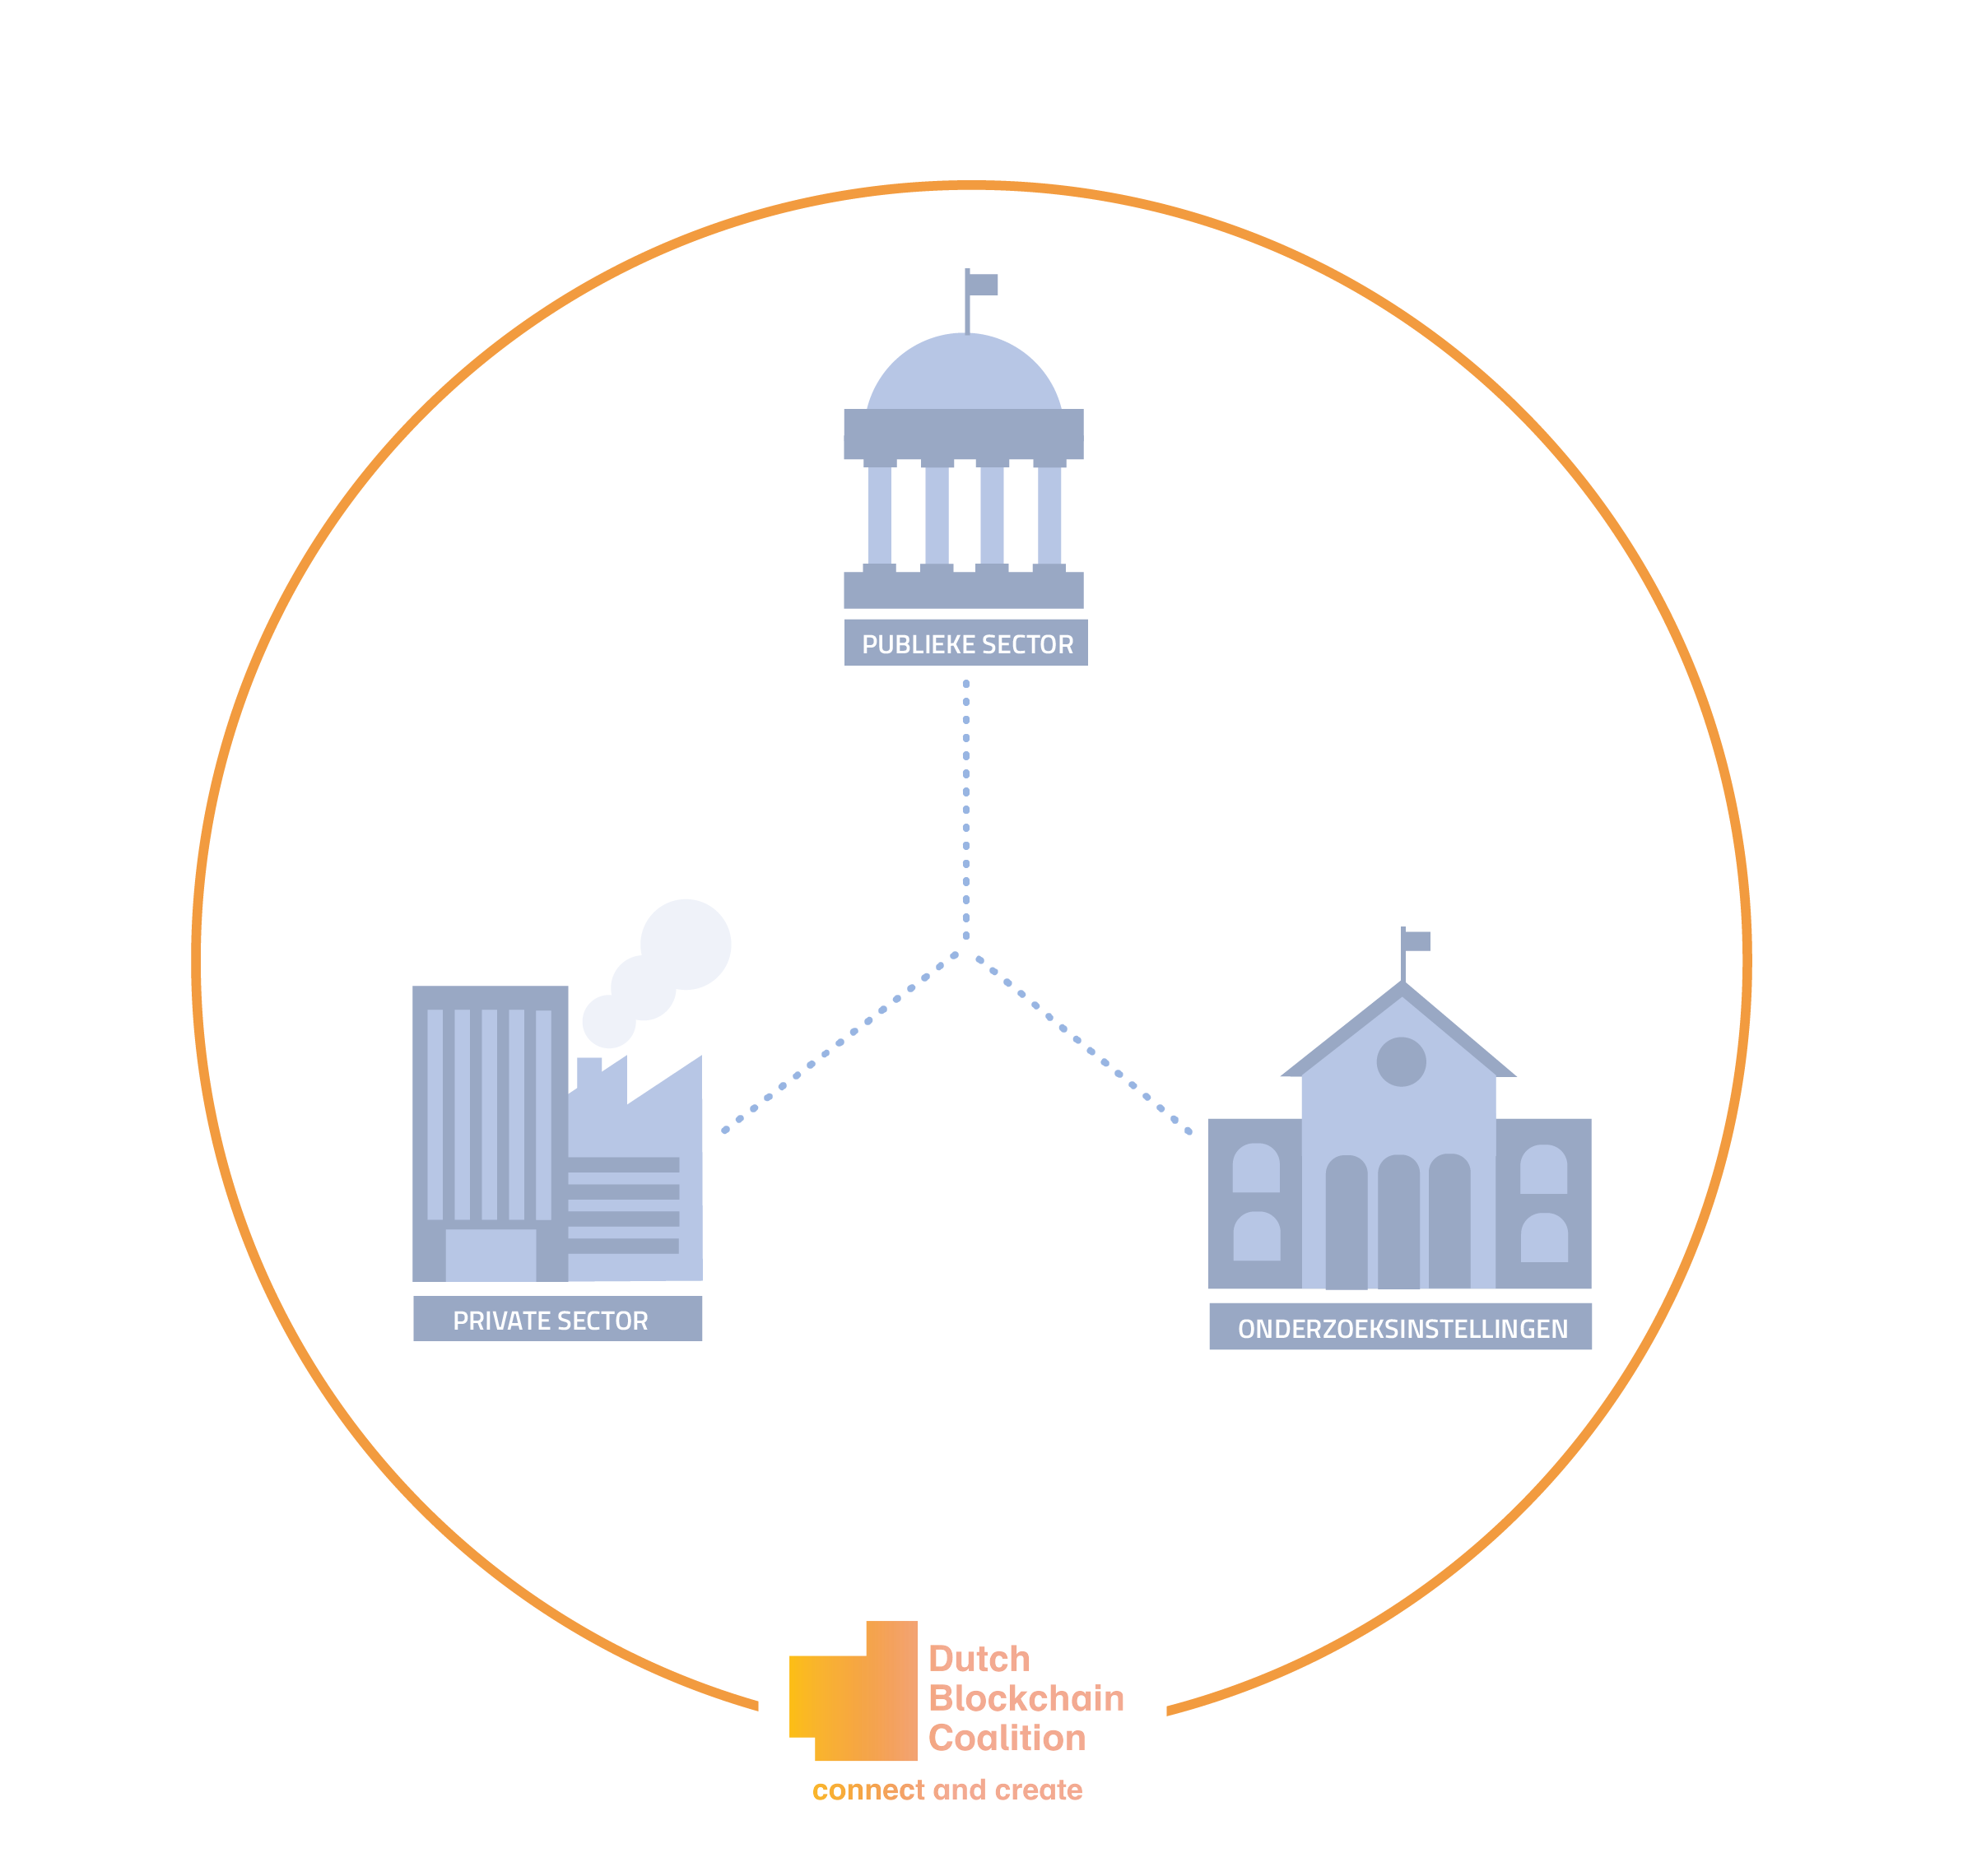
Blockchain for Good
Realize fully reliable and socially accepted Blockchain applications,
Create optimal conditions for Blockchain applications to be deployed,
Facilitate the use of Blockchain as a source of trust, well-being, prosperity and security for citizens, companies, institutions and government bodies.
This requires building and maintaining a multi-facet ecosystem

Slide 4
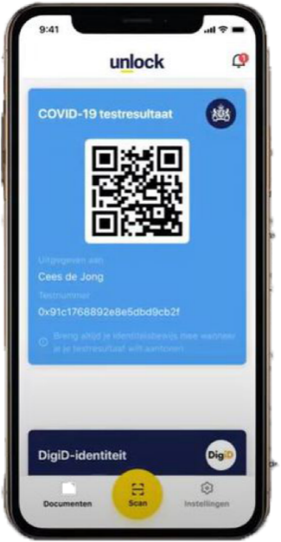
Working in three action lines
Use cases
  Self Sovereign Identity
  Logistics, pensions, mortgage, diploma’s, MaaS, Energy, CJIB
Working Groups
  Legal, governance & standardisation, scientific research
  Tokenization: https://www.2tokens.org/
Human Capital Agenda (HCA)
  On-line blockchain training
  Blockchain in a Day
  Train the Trainer
Check: https://dutchblockchaincoalition.org

Slide 5

Lessons Learned
Flexibility is crucial
Broadening ecosystems is necessary
Not only technical resources but also governance, legal, etc.
Such cases require pioneering, both in terms of content and collaboration
Initial experiments vs. deployment on larger scale
Competition versus collaboration
Solving societal problems vs trying to deploy blockchain

Slide 6







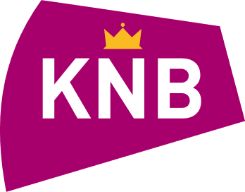

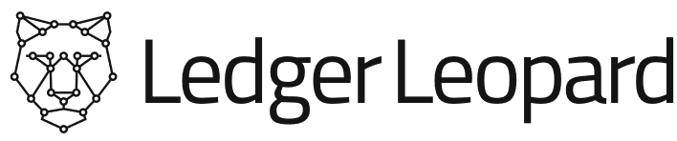



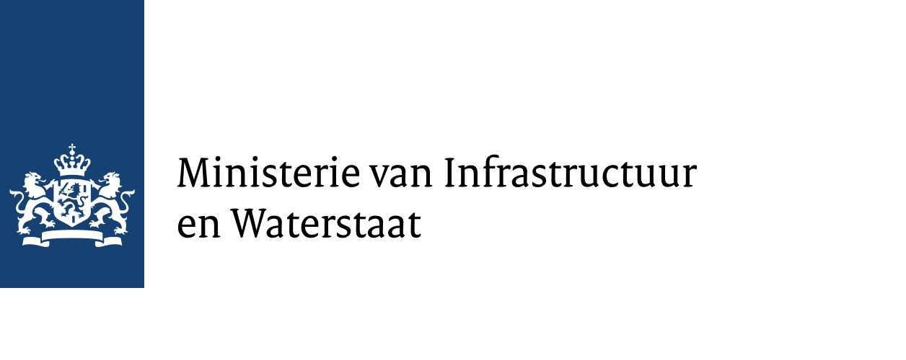




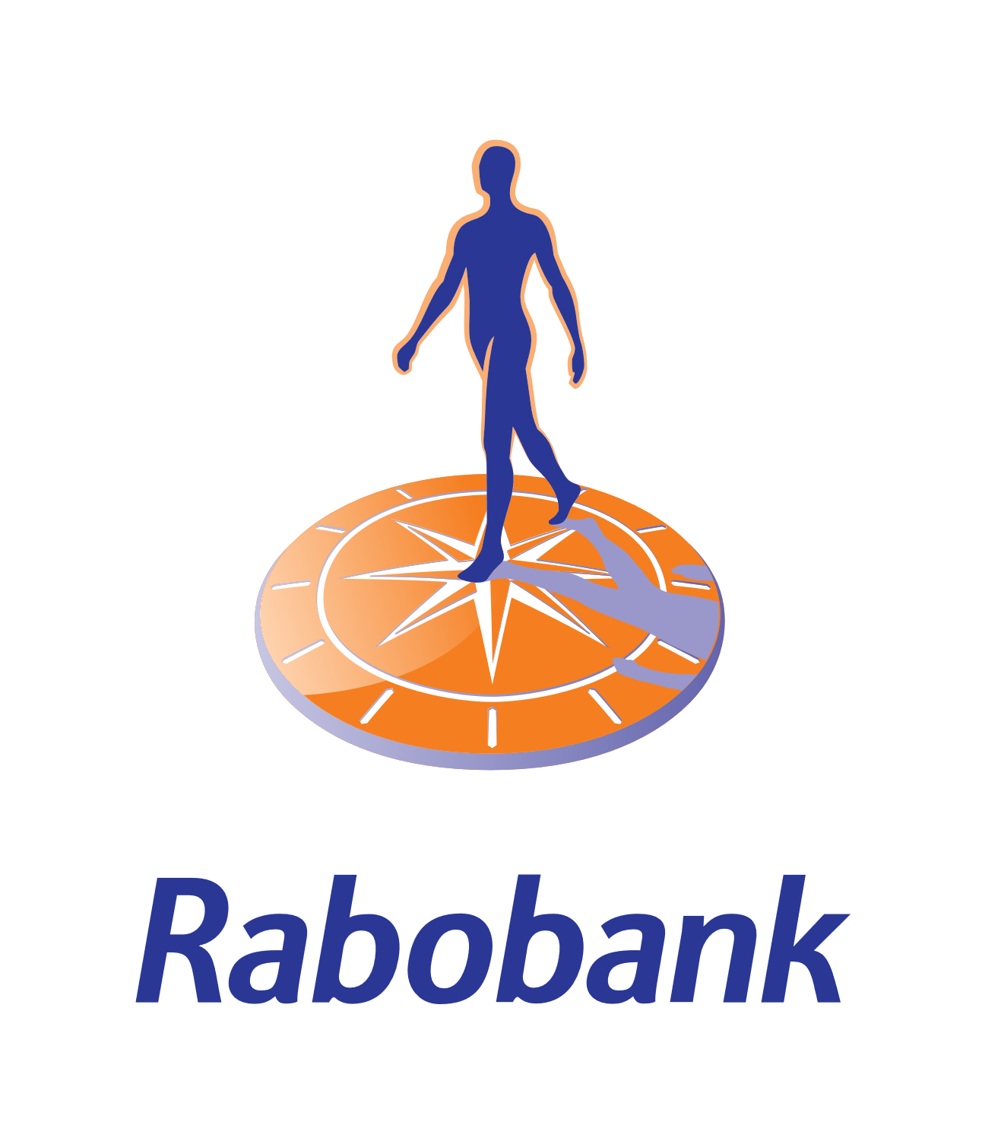





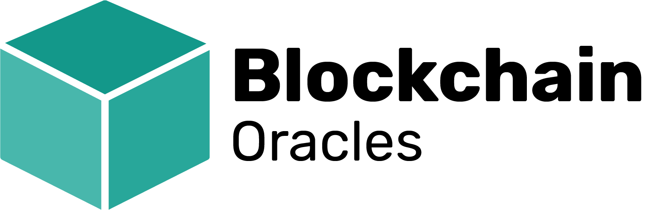
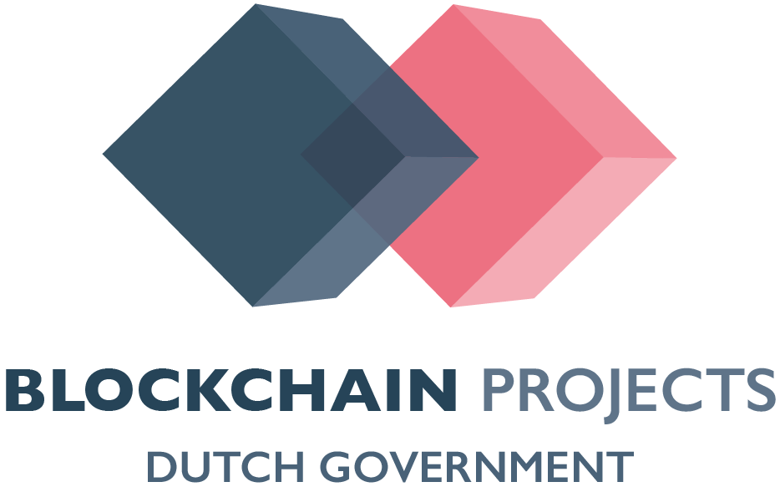













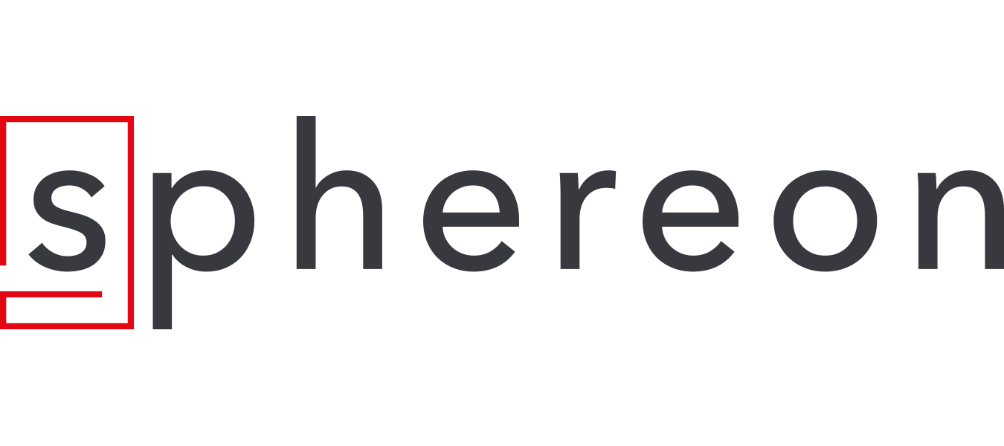








Kern
partners
Partners

