Slide 1
Road to Decarbonisation
Hydrogen Skills to Accelerate the Transition to Net Zero
06 October 2022
Rachel Tulloch: Sector Manager, Energy Transition & Transport
Scotland's colleges – delivering skills for the energy, engineering and construction sectors

Slide 2
About ESP
ESP is a collaboration of Scotland’s colleges and industry partners established to increase Scotland’s capability and capacity to deliver the right skills for the energy, engineering and construction sectors.
Our aim is to join up industry and colleges across Scotland's regions.
Vision: - A college sector working in partnership with government, agencies and industry to meet national and regional skills needs, maximising investment and job opportunities aligned with emerging technologies, the Climate Emergency and the Just Transition to Net Zero.

Slide 3
Climate Emergency Skills
Action Plan

Slide 4
The Climate Emergency
Net-Zero by 2045
In 2019, Scottish Government was the first Government in the world to declare a Climate Emergency, committing Scotland to become a net zero nation by 2045
A ‘green recovery’
In 2020, Scottish Government updated its Climate Change Plan to reflect the profound impact of the pandemic, committing to a ‘green recovery’ from COVID-19 which captures the opportunities of a just transition to net zero.
A Just Transition
The transition to a thriving and inclusive net zero economy is a transformational opportunity, however the pace and scale of the transition will bring with it risks and disruptions as communities, industries and supply chains adapt.
Green jobs and skills
Green jobs, skills, training and reskilling are at the centre of Government’s approach, driven by the Climate Emergency Skills Action Plan
Ensuring our workforce has the skills for the transition to net-zero
Delivering on Scotland’s Climate Change Plan
Embedding a partnership approach
Evidence-led

Slide 5
Understanding Green Jobs and Skills
Reaching net zero by 2045 requires
transformational change across the
economy and society, providing
opportunities for:
developing new, quality green jobs
embedding green and circular economy skills
increasing access to growing global green markets for Scottish businesses
stimulating regional growth
providing enhanced access to nature and the environment
Categories of ‘green job’
New and emerging: e.g. hydrogen cell technicians, urban miners | Existing: enhanced skills e.g. architects and environmental consultants | Existing: greater numbers e.g. insulation installers, energy assessors
Opportunities for growth
Energy transition Inc oil & gas, on and offshore wind, hydrogen, electricity, carbon capture and storage | Construction Inc retrofitting of housing and non-residential properties
Transport Inc road transport, railways, domestic aviation, shipping and aircraft support vehicles | Manufacturing with a focus on engineering
 | Agriculture and land use management Inc forestry

Slide 6
ESP & the College Response

Slide 7
Engineering
Leads Forum
Advance Manufacture Training Network
Automotive Training Network
Construction
Leads Forum
Energy Efficiency Training Network
Building Information Modelling Training Nework
Marine and Maritime Training Network
Transmission and Distribution Training Nerwork
Hydrogen Training Nework
Oil and Gas Training Network
SMART Metering Training Network
STEM
Leads Forum
Strategy Group
Wind Training Network

Slide 8
Building Capability and Capacity - Training Networks
Over 10 Training Networks
Adv Manufacture
Activity:
Curriculum
Capital Equipment
Industry Awareness
College Staff CPD
Wind
Hydrogen
Automotive
Marine & Maritime
Shared Resources
Heavy Duty Vehicle
Fab & Weld
Teaching resources
Specialist Equipment
Also involved in supporting economic development agencies, Scottish companies, inward investors etc

Slide 9
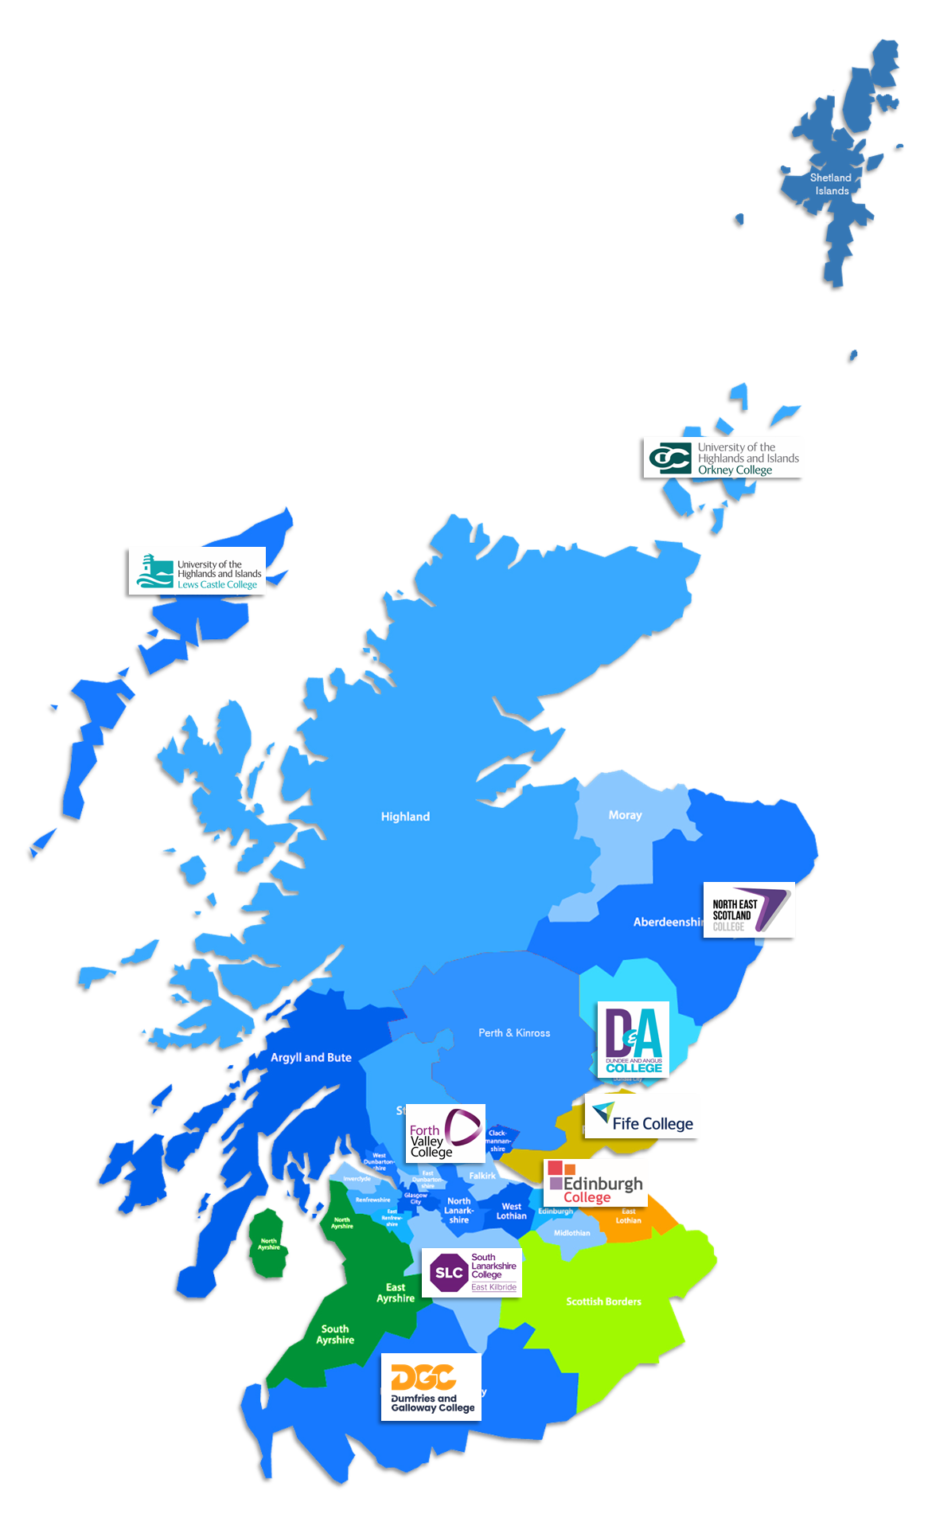
ESP – Hydrogen Training Network
Hydrogen Training Network
ESP’s Hydrogen Training Network was established in September 2019 to address the expected demand for hydrogen skills. Initially it is based around 9 colleges where hydrogen projects exist and with some expertise already in place.
Curriculum & Resources
Online Awareness Course
Hydrogen for Transport online course
Professional Development Award - Hydrogen: An Introduction for Technicians
Desktop Hydrogen Fuel Cell Trainers – Shared resource
Electrical Fundamental Desktop Trainers Shared resource
50KW Fuel Cell Trainer
Staff CPD
Programme for developing senior staff and college lecturers

Slide 10
Collaboration
Notes:
SHINE
TS Zero Emission Mobility Skills

Slide 11
Questions
Rachel Tulloch
Sector Manager – Energy Transition & Transport
rachel.tulloch@esp-Scotland.ac.uk
07812664912
Scotland's colleges – delivering skills for the energy, engineering and construction sectors

