Slide 1
Wrightbus Hydroliner
Introduction
Driving a greener future

Slide 2

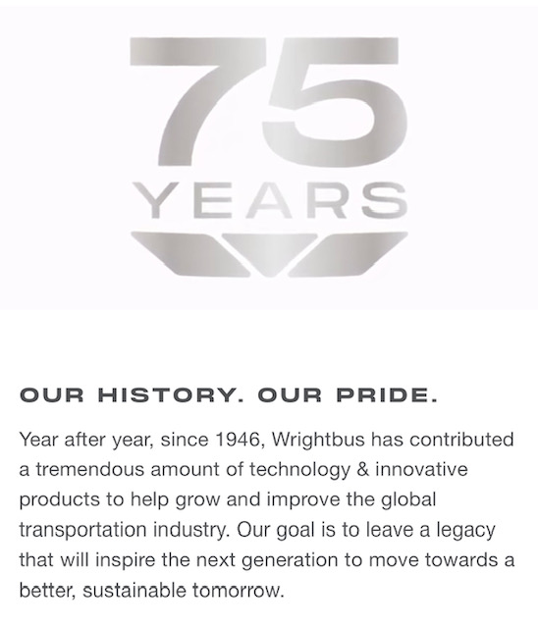
Wrightbus – Our History

Slide 3
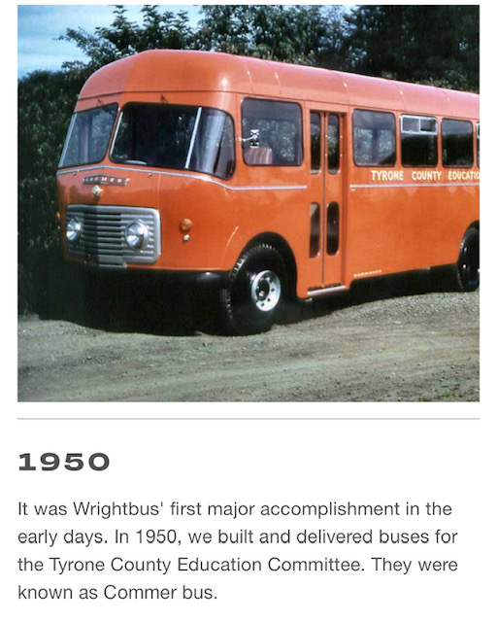
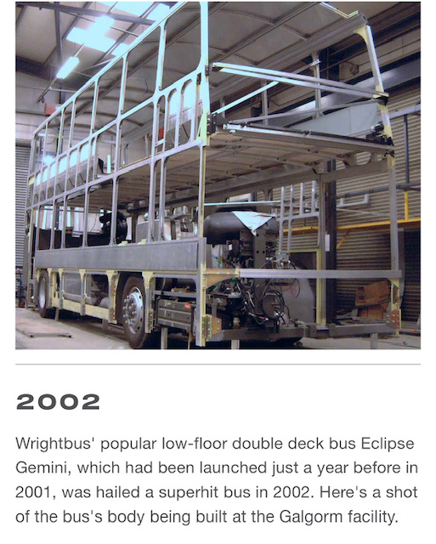
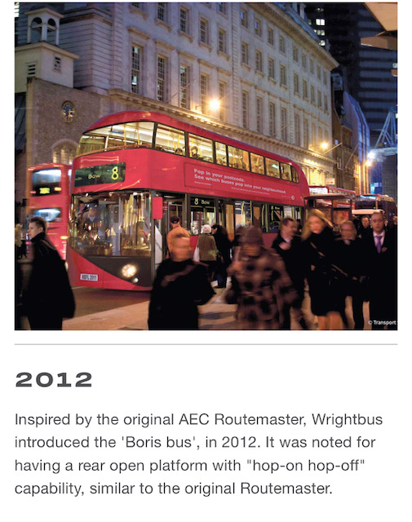
Wrightbus – Our History

Slide 4
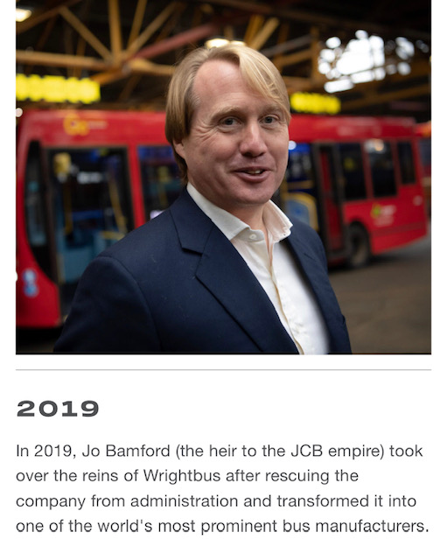
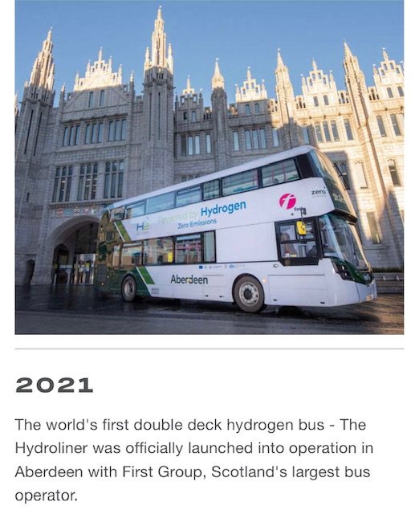
Wrightbus – Our History

Slide 5
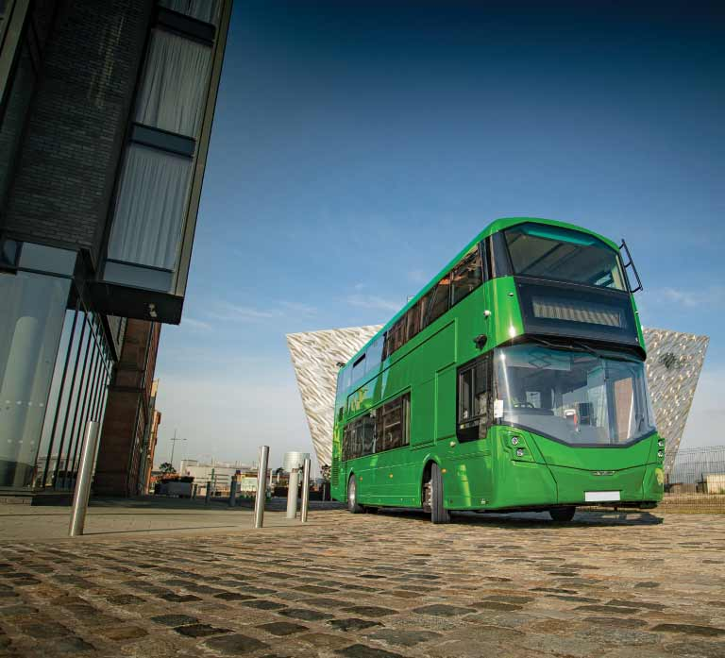
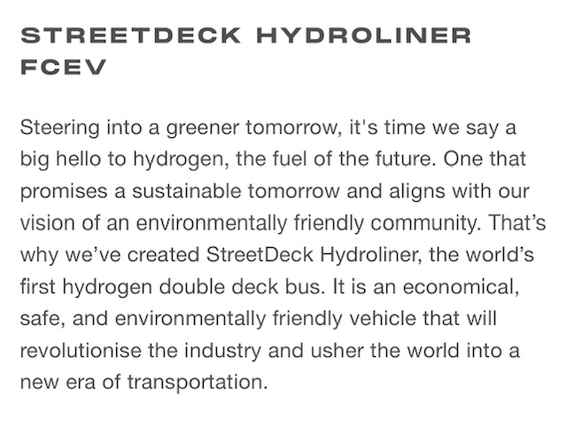
Wrightbus and the Streetdeck Hydroliner FCEV
Say hello to Hydrogen

Slide 6
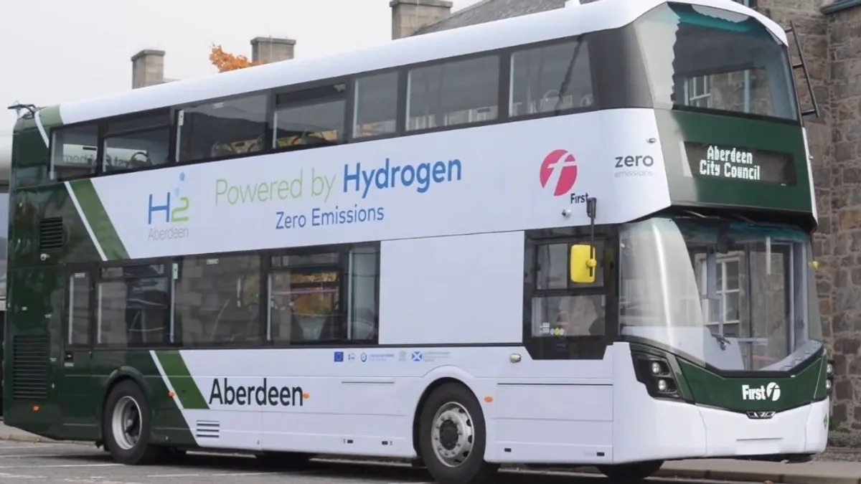
Wrightbus Streetdeck Hydroliner
The worlds First Hydrogen Powered Double Deck Bus
Wrightbus delivered the worlds first Hydrogen Powered Double Deck bus to Aberdeen in October 2020. The First of a fleet of 15 vehicles to be introduced into public service by First Bus in the City in January 2021

Slide 7
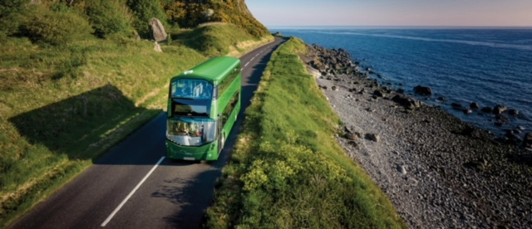

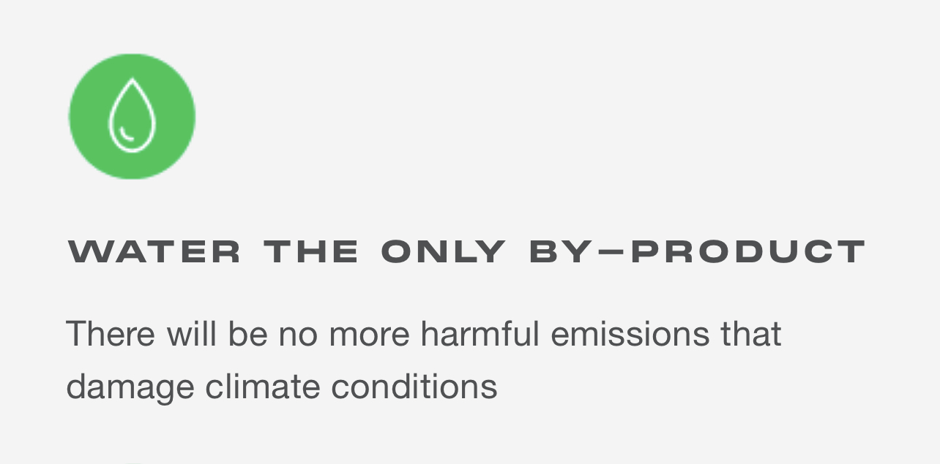
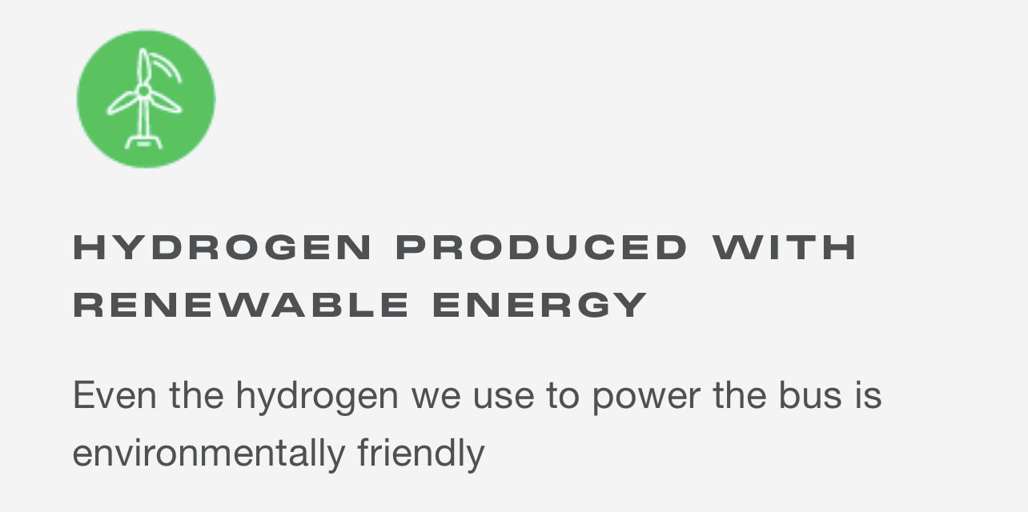
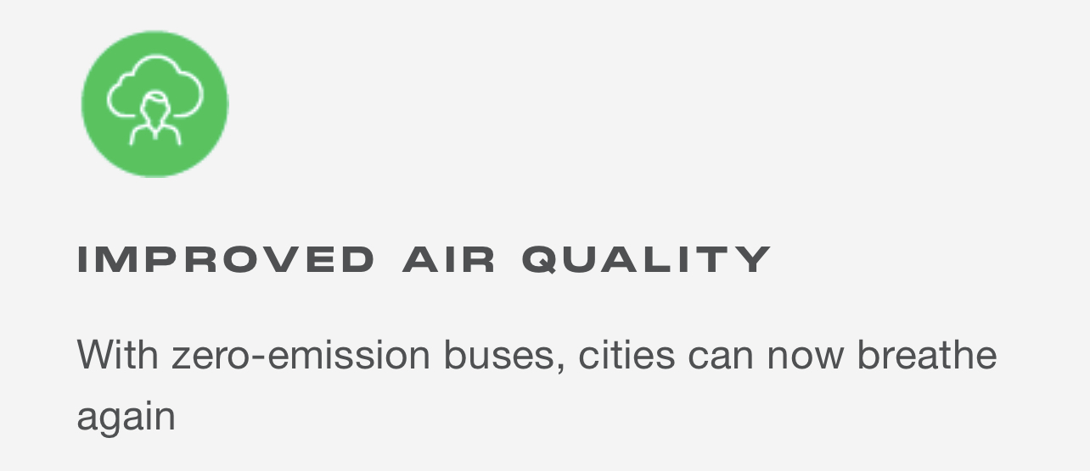
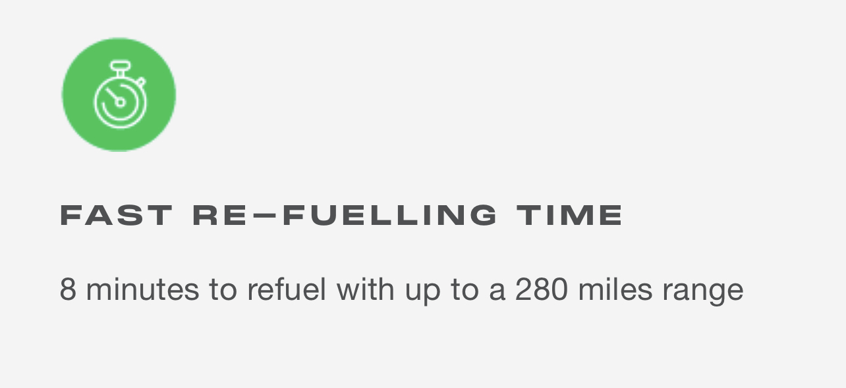
Wrightbus and the Streetdeck Hydroliner FCEV
The benefits of Hydrogen

Slide 8
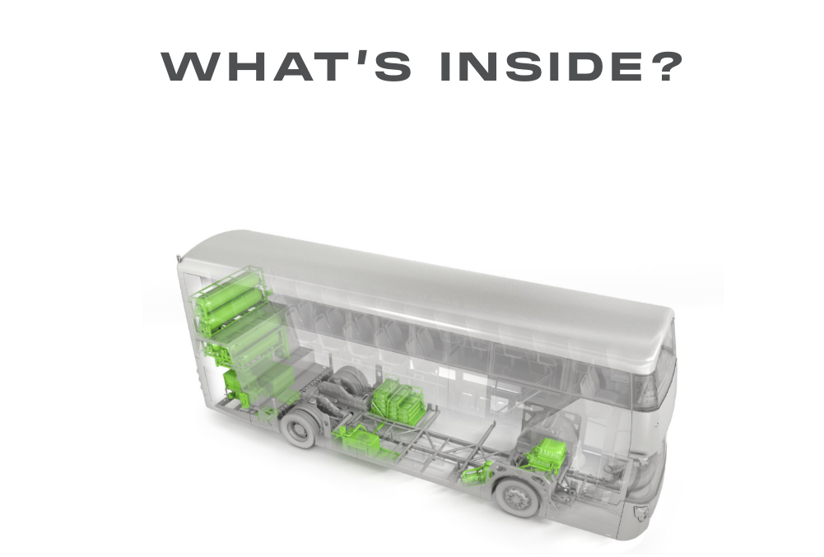

Slide 9
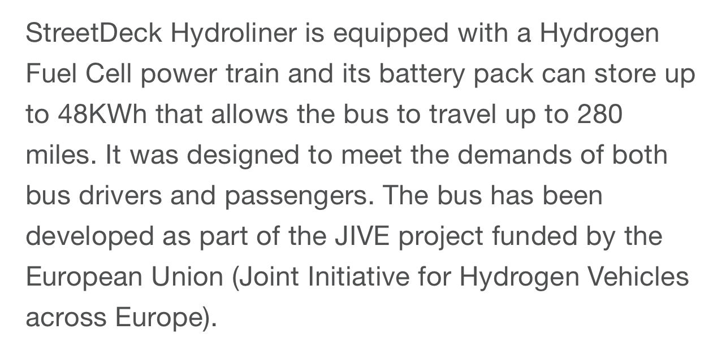

Slide 10
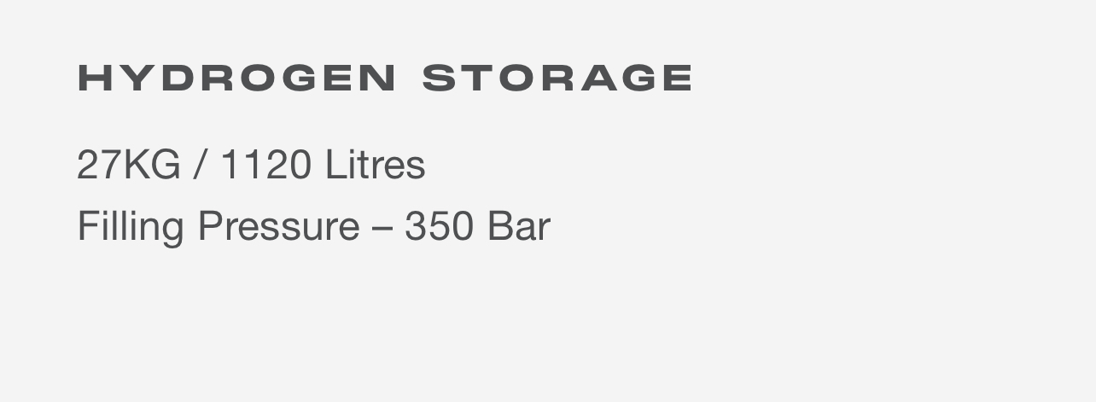
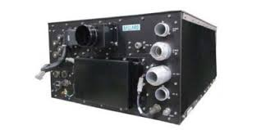
Ballard 85kW Fuel Cell

Slide 11
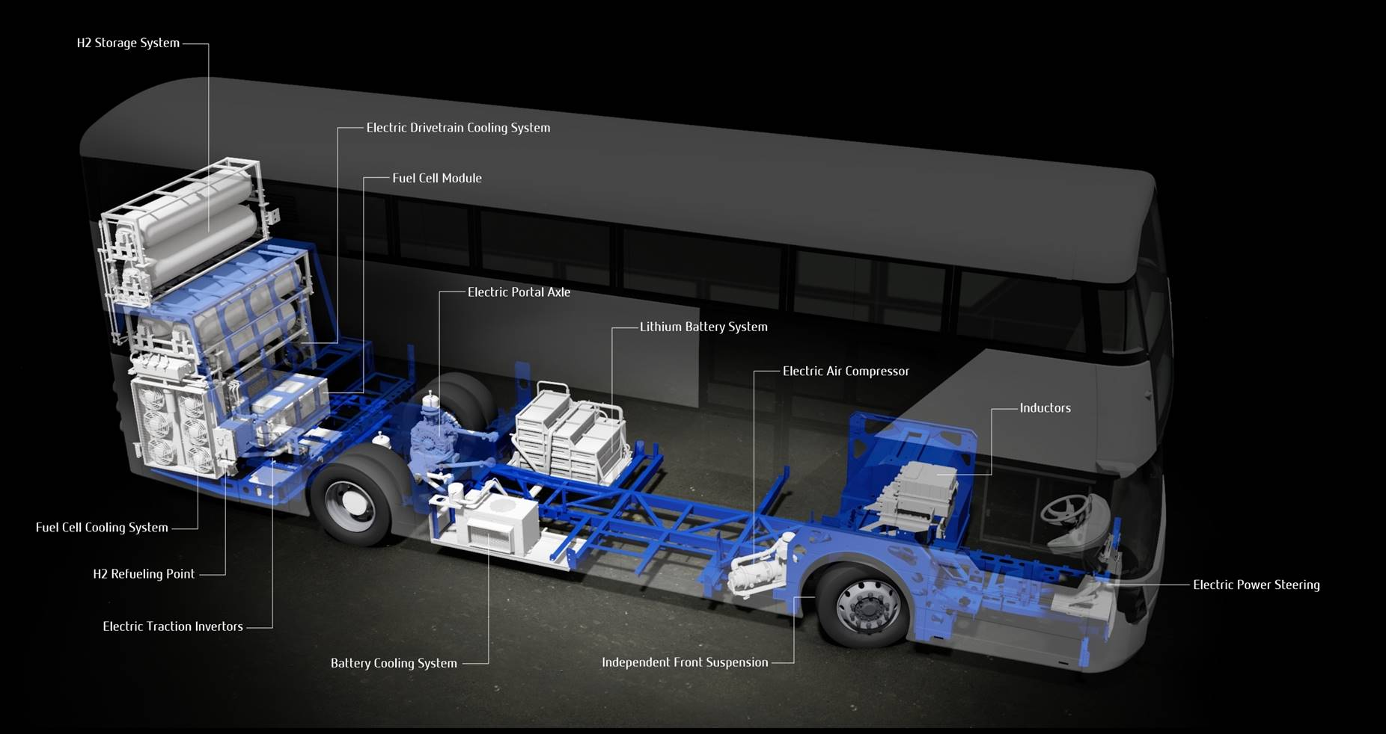
Streetdeck Hydroliner Component Overview

Slide 12
Thank You

