Slide 1
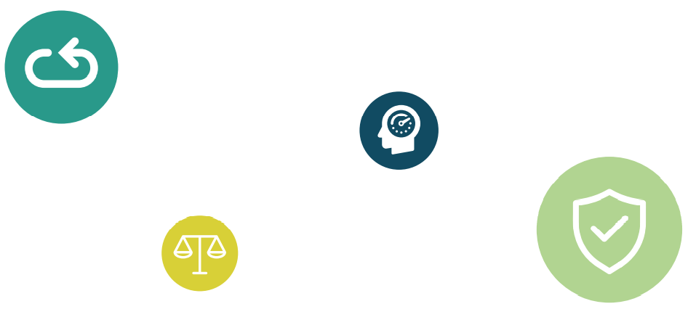
WORKSHOP GUIDANCE TO LEAD YOUR PROCUREMENT TEAM TOWARDS A CIRCULAR CHANGE MANAGEMENT ACTION PLAN
WORKSHOP SUPPORT SLIDES

Slide 2
AGENDA
09u00-09u15 Welcome & introduction 09h15-10h00 Stakeholder mapping and decision lines 10h00-10h30 Bottlenecks – What makes it difficult to buy sustainably/circularly today? 10h30-10h45 Break 10h45- 12h20 From current behaviour to desired behaviour – What actions are needed to achieve this behaviour? 12h20-12h30 Conclusions

Slide 3
COM B model
Capability
Can this behavior be accomplished in principle?
Physical
Psychological
Opportunity
Is there sufficient opportunity for behavior to occur?
Social
Physical
Target behavior
Motivation
Is there sufficient motivation for the behavior to occur?
Automatic
Reflective

Slide 4
TOWARDS ACTIONS FOR BEHAVIOURAL CHANGE
1. Objectives
2. Behaviour towards objectives
3. Support
The change you want to see. The final result you want to achieve.
The behavior that determines the goals you want to achieve.
The support needed to achieve the behaviour towards objectives (time, funding, knowledge, decision-making power,...)
Notes:
GOAL:
A first step: to be able to formulate your targets
Then see clearly what target behaviour is necessary to reach your goals (and what are bottlenecks to reach the desired target behaviour?)
Finally: to adress challenges and provide the necessary support.

Slide 5
The procurement process
Stakeholder mapping & decision lines
 | Setting requirements | Market engagement | Specification and tendering | Evaluation of the offers | Contract management
 |  |  |  |  | Evaluation
Simple procedure
Complex procedure goods – services - projects
Complex procedure building projects

Slide 6
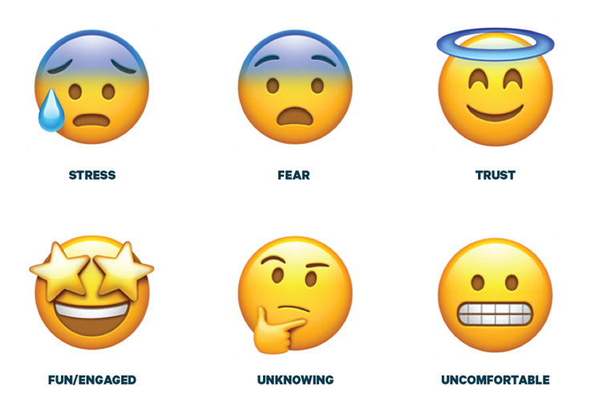
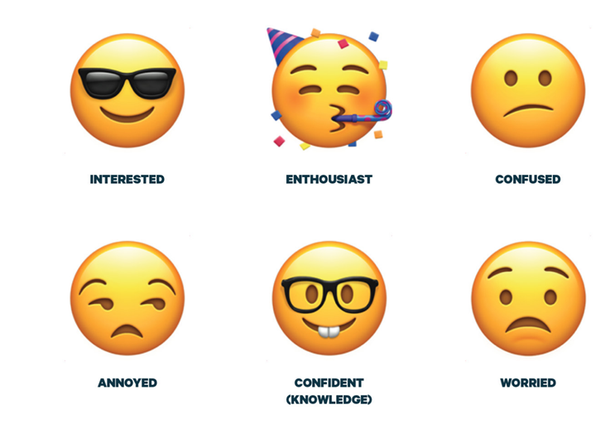
CURRENT BEHAVIOR?

Slide 7
DESIRED BEHAVIOR
MOTIVATION
SKILLED
TRUST
KNOWLEDGE
COOPERATION
SUPPORT

Slide 8
From current behavior to desired behavior
Role | Objective | Current emotions and beahavior | Desired behavior | Necessary actions and support that generate capacity – opportunity and motivation
Role X
Role Y
Role Z
Eg. motivated
Eg. Trusting

Slide 9
WHAT GETS ATTENTION GROWS...

Slide 10
The procurement process
Stakeholder mapping & decision lines
 | Setting requirements | Market engagement | Specification and tendering | Evaluation of the offers | Contract management
 |  |  |  |  | Evaluation
Simple procedure
Complex procedure goods – services - projects
Complex procedure building projects

Slide 11
From current behavior to desired behavior
Role | Objective | Current emotions and beahavior | Desired behavior | Necessary actions and support that generate capacity – opportunity and motivation
Role X
Role Y
Role Z

