Slide 1


CATCH
DST-Tool-Training on climate change adaptation
Opening
Helge Bormann
Jade Hochschule

Slide 2


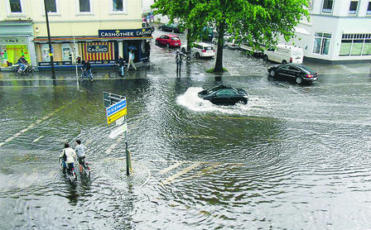
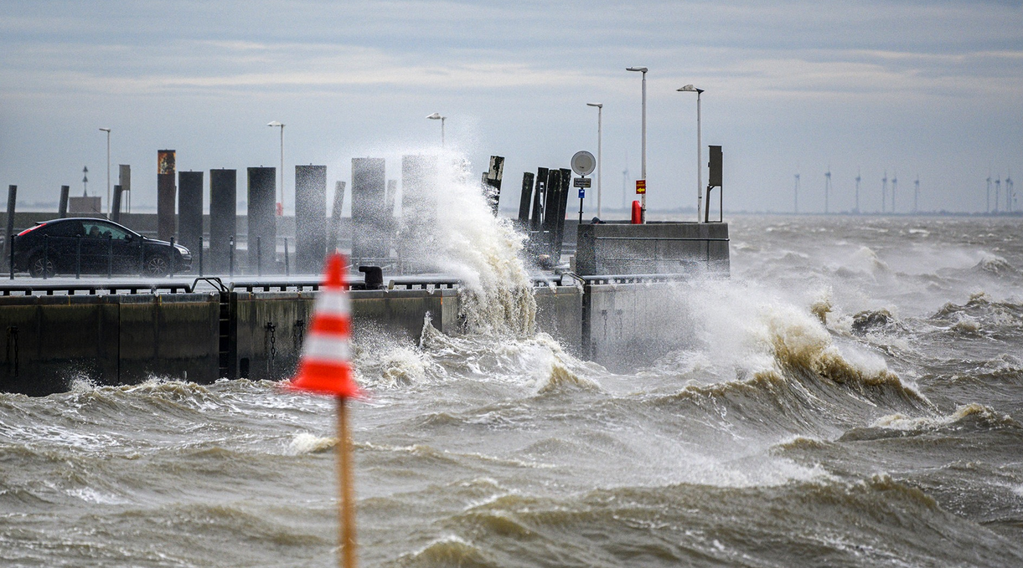
CATCH
Climate change challenges
www.nwz-online.de; www.ndr.de
Adaptation to climate change seems to be urgently required!

Slide 3
CATCH
The CATCH project
CATCH stands for
‘water sensitive Cities: the Answer To CHallenges of extreme weather events’
The main objective of CATCH is
To assist midsize cities becoming water resilient
CATCH activities are
To help (midsize) cities in developing adaptation strategies
To run pilot studies building good practice examples
To guide cities towards successful climate adaptation
To build a decision support tool helping the cities
To enable networking among midsize cities
CATCH is funded by the EU-Interreg VB North Sea program (2017-2022)

Slide 4
CATCH
Specific needs of midsize cities
Support for climate change adaptation action is required, because…
… midsize cities often…
Suffer from a lack of expertise in dealing with climate challenges in an integrated manner,
Don’t have enough manpower to develop and implement a thorough climate adaptation strategy,
Available budgets tend to be lower and there will only be few opportunities to make large investments for climate change adaptation.
→ The CATCH climate adaptation tool helps to overcome such potential deficiencies!
CATCH is funded by the EU-Interreg VB North Sea program (2017-2022)

Slide 5
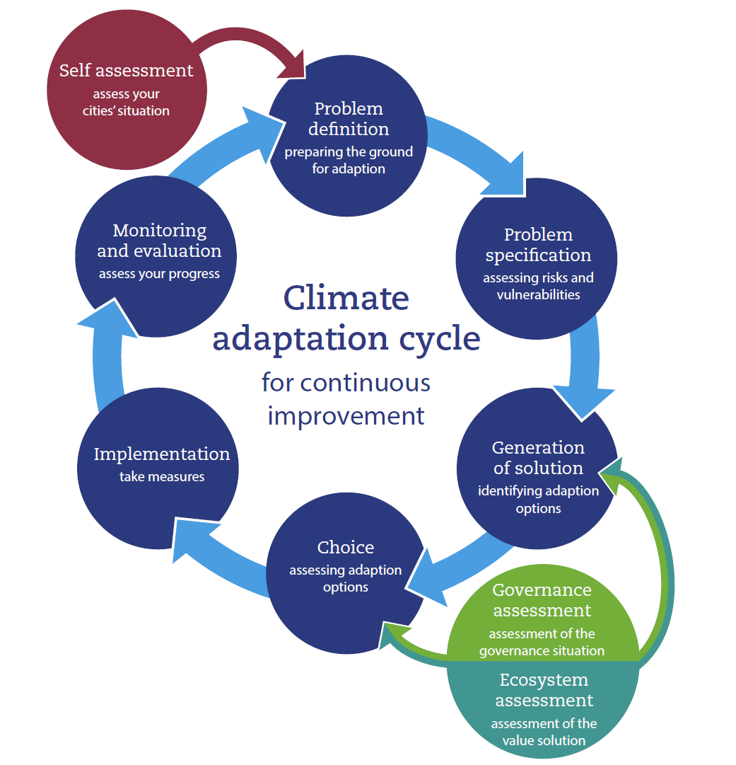
The DST
Tool overview

Slide 6
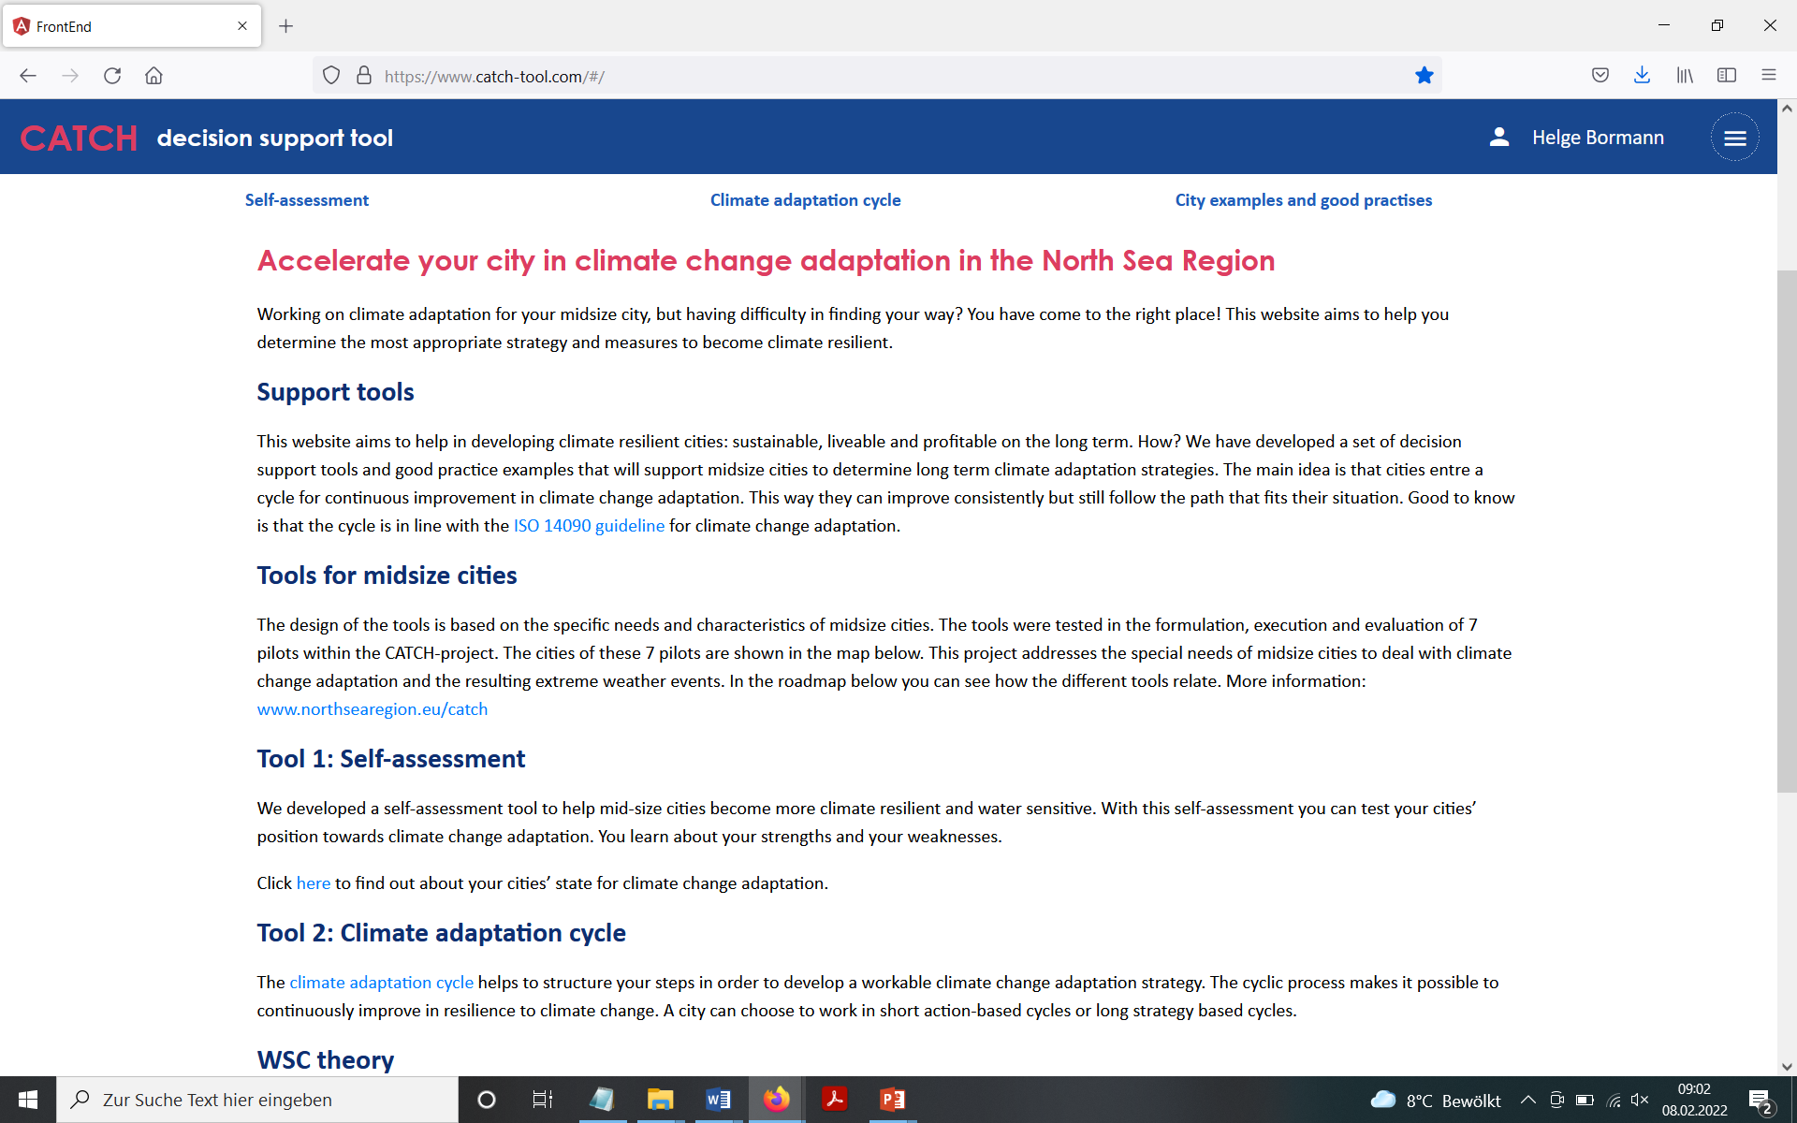
The DST
Tool overview

Slide 7
General setting
Structure of the tool training
 | Topic
Opening | Introduction
Module 1 | Regional climate change, adaptation, framework
Module 2 | Perception of regional adaptation needs and capacities of the participants
Module 3 | WSC theory, self-assessment
Module 4 | Climate adaptation cycle: steps 1-3
Module 5 | Climate adaptation cycle: steps 4-6
Module 6 | GAT and ECO
Module 7 | Hands on tool session, good practice examples
Module 8 | Regional pilot (e.g., OOWV Oldenburg)
Module 9 | Reflection and Evaluation
Closing

Slide 8
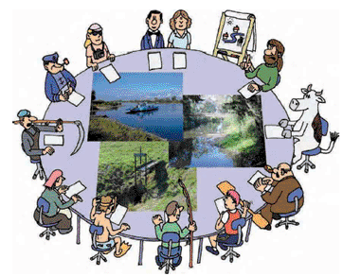
Introduction round
Getting to know each other
Please tell us
Who you are…
From which organization…
Why you are here…
What you expect…
www.wise-rtd.info

