Slide 1


CATCH
DST-Tool-Training on climate change adaptation
Regional climate change, adaptation needs
Helge Bormann
Jade Hochschule

Slide 2


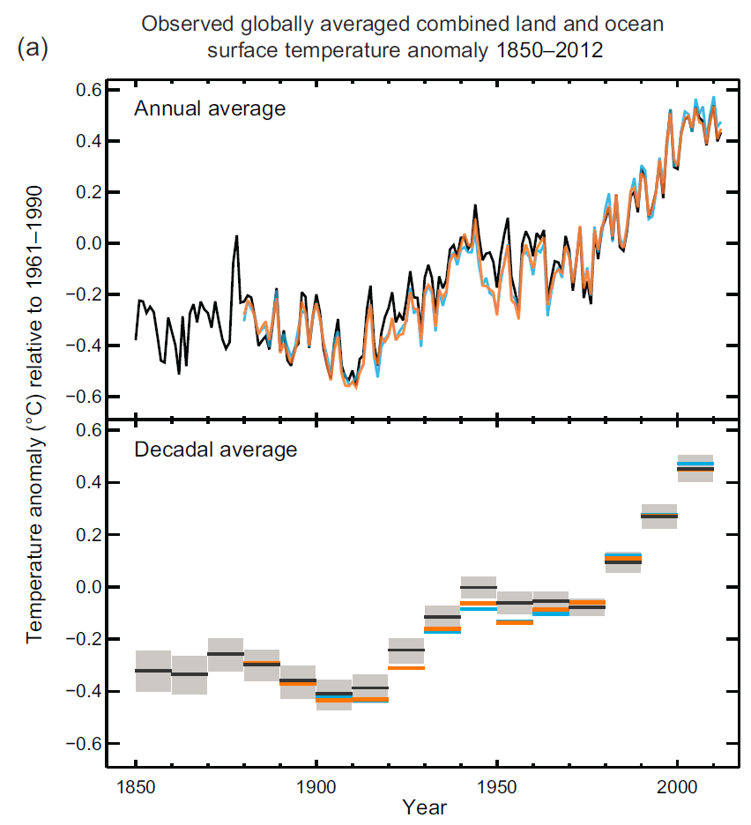
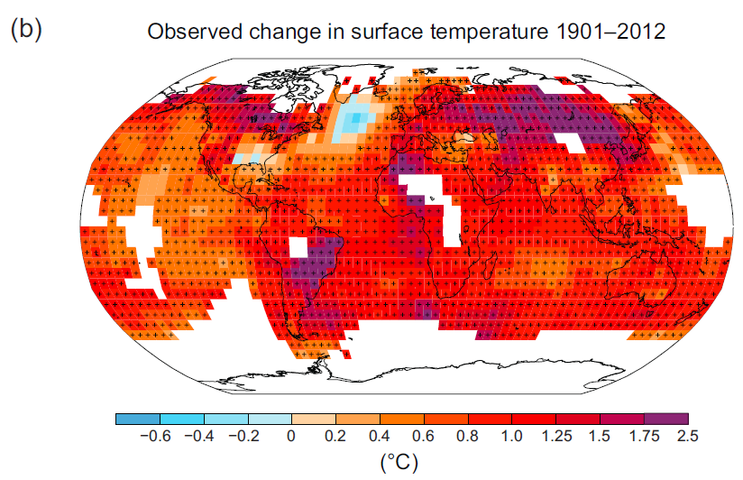
Regional climate change
Global change – IPCC
Observed global warming (history)
IPCC (2013)

Slide 3
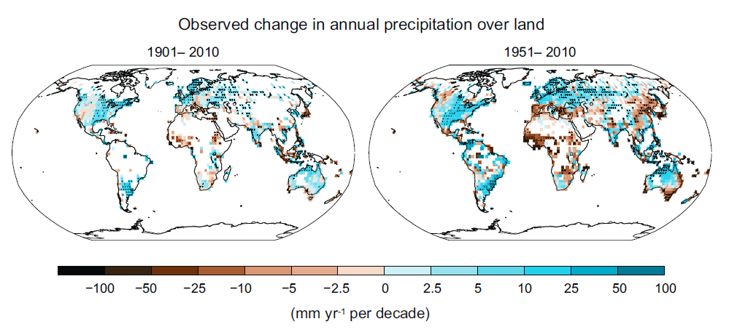
Regional climate change
Global change – IPCC
Observed change in precipitation
IPCC (2013)

Slide 4
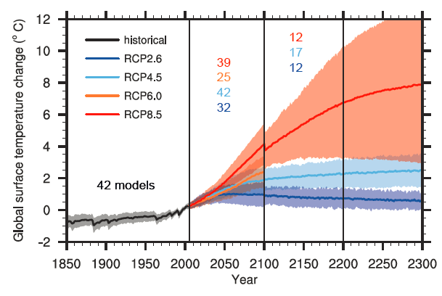
Regional climate change
Global change – IPCC
Projected global warming (future)
www.ipcc.ch

Slide 5
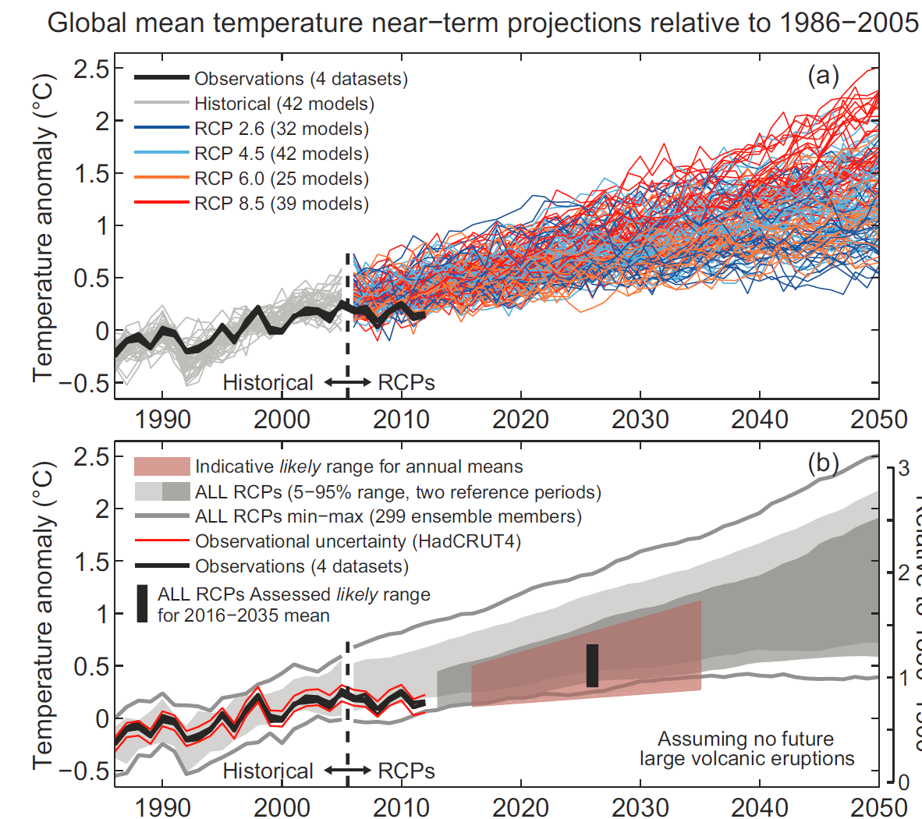
Regional climate change
Global change – IPCC
Projected global warming (uncertain future)
IPCC (2013)

Slide 6
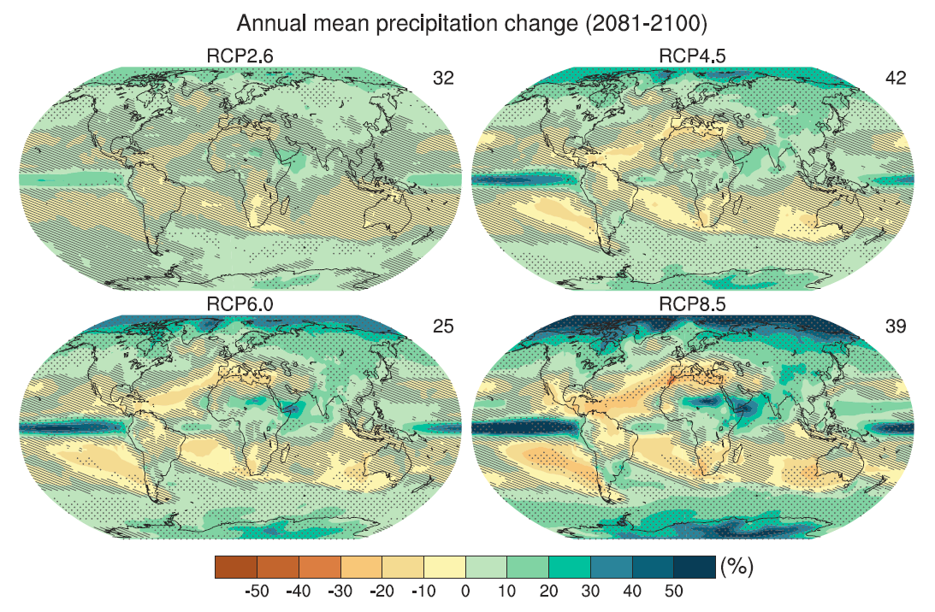
Regional climate change
Global change – IPCC
Projected change in precipitation
IPCC (2013)

Slide 7
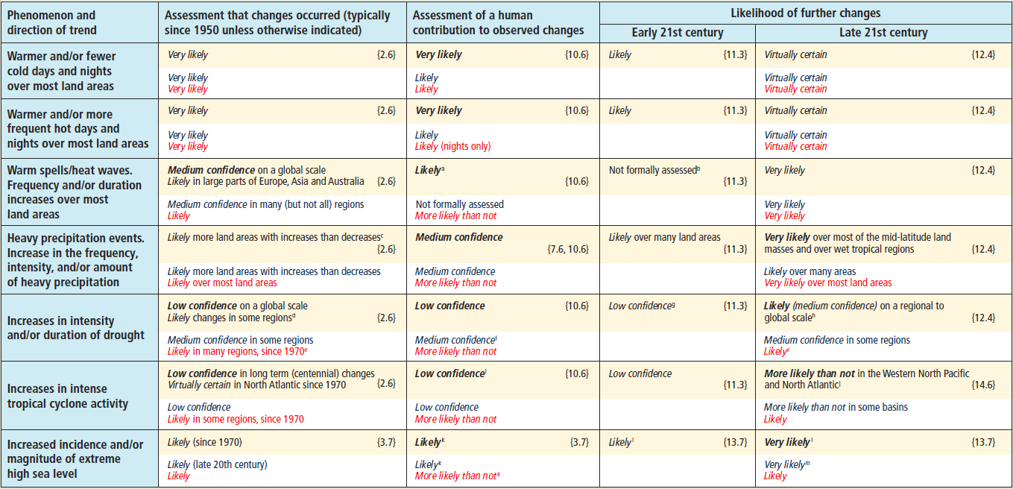
Regional climate change
Global change – IPCC
Extreme events
IPCC (2013)

Slide 8
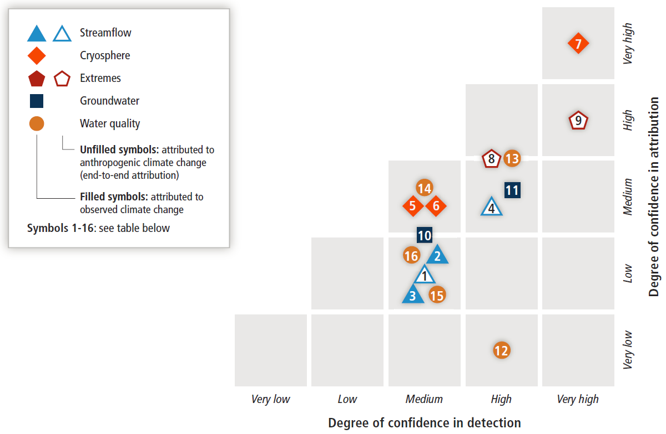
Regional climate change
Global change – IPCC
Water related extreme events
IPCC (2014)

Slide 9
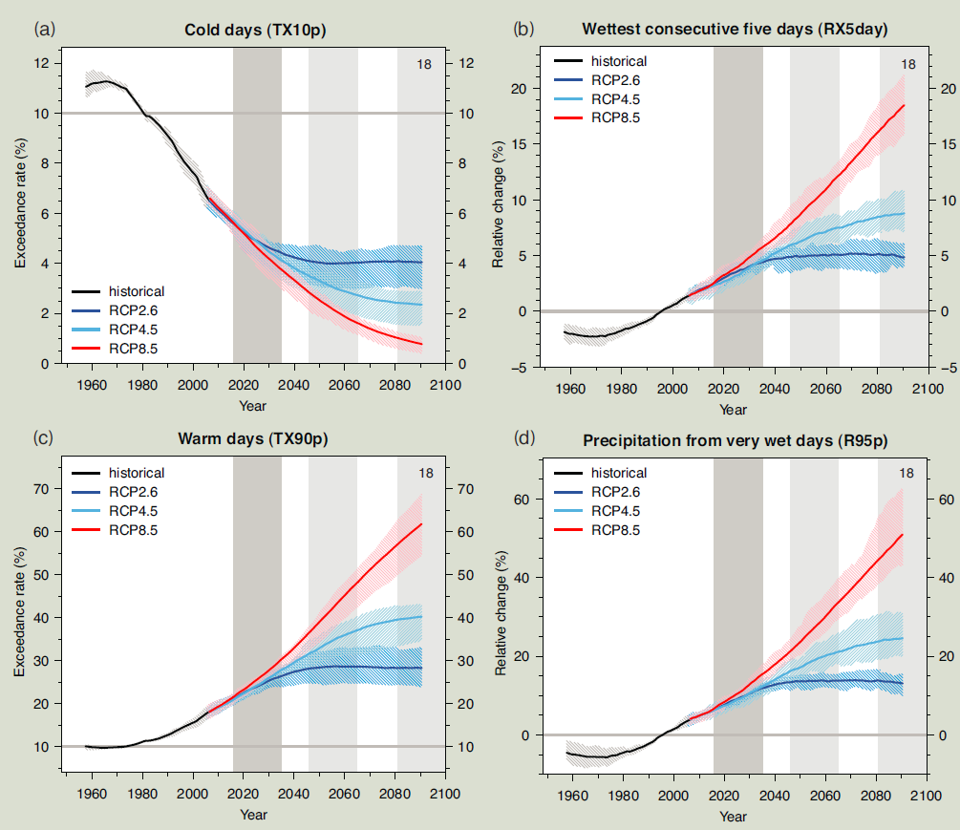
Regional climate change
Global change – IPCC
Extreme events
IPCC (2013)

Slide 10
Regional climate change
Global change – IPCC
Sea level rise
IPCC (2019)

Slide 11
Regional climate change
What happens on the regional scale?
National and regional analyses and reports are available
Observed and predicted trends are similar for regional warming and sea level rise
Specific patterns are observed and projected for precipitation
Temperature
Weser-Ems region
Bormann et al. (2020)

Slide 12
Regional climate change
What happens on the regional scale?
National and regional analyses and reports are available
Observed and predicted trends are similar for regional warming and sea level rise
Specific patterns are observed and projected for precipitation
Sea level rise
German bight
Bormann et al. (2020)

Slide 13
Regional climate change
What happens on the regional scale?
National and regional analyses and reports are available
Hydrological impact studies (runoff generation in low lying areas)
Runoff
generation
East Frisia
Bormann et al.
(2020)

Slide 14
Regional climate change
What happens on the regional scale?
National and regional analyses and reports are available
Hydrological impact studies (sluice hours for drainage)
Drainage
potential
East Frisia
Bormann et al.
(2020)

Slide 15
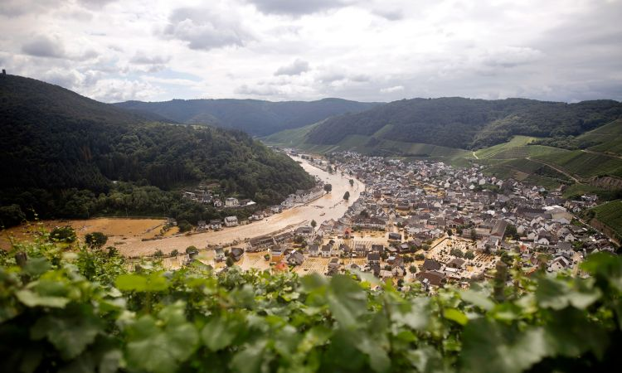
Regional climate change
The sense of urgency
The flooded village of Dernau after the night of the disaster in July 2021; www.deutschland.de

Slide 16
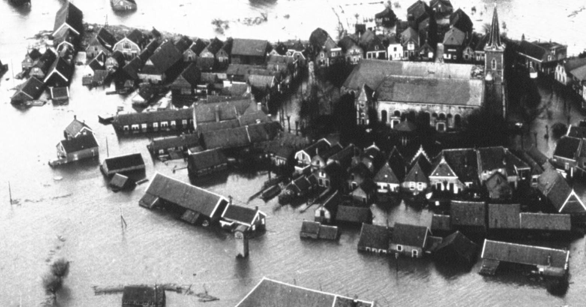
Regional climate change
The sense of urgency
The flood of 1953 in Zeeland (The Netherlands); www.rijkswaterstaat.nl

Slide 17
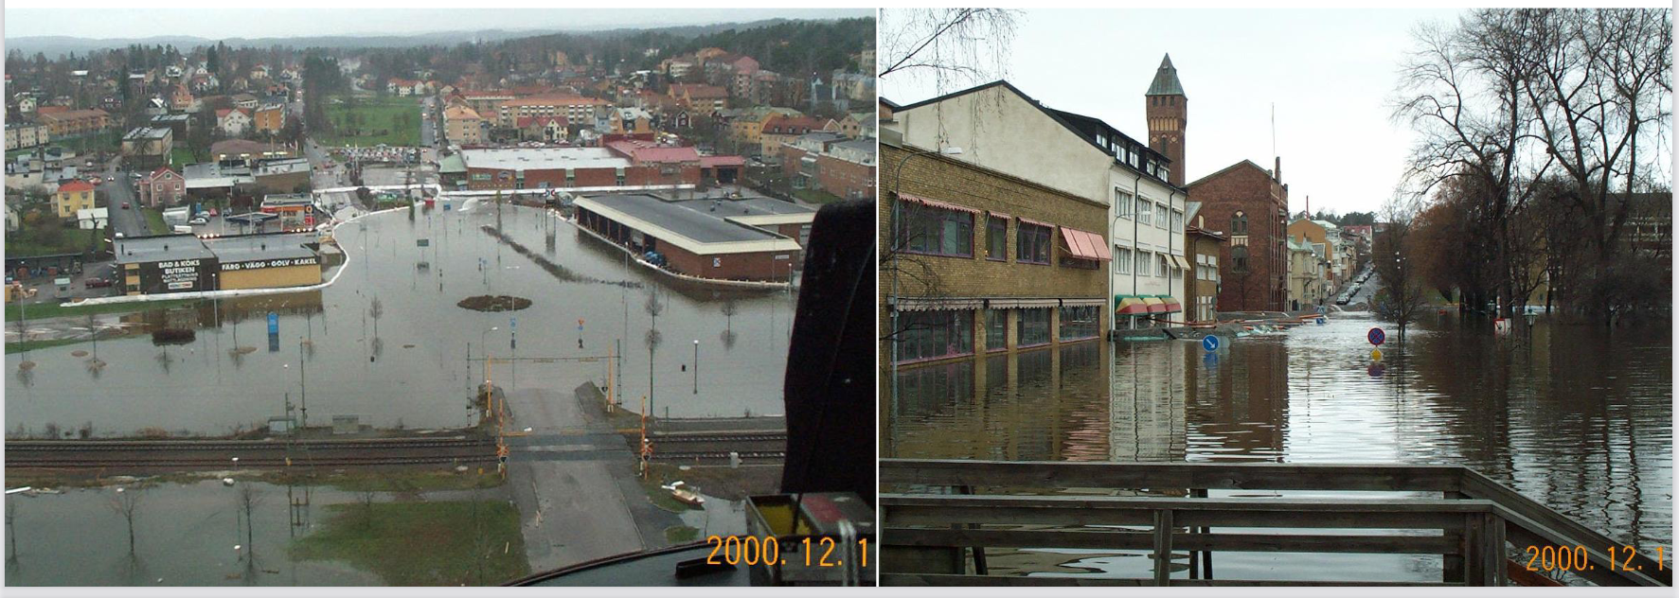
Regional climate change
The sense of urgency
Arvika lake flooding in year 2000 (Sweden); northsearegion.eu

Slide 18
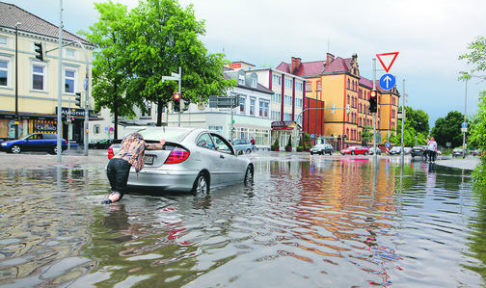
Regional climate change
The sense of urgency
Heavy rainfall in Oldenburg (Germany) in 2012; www.nwzonline.de

Slide 19
Regional climate change
Climate change makes adaptation necessary
Clear indication of climate change
Early adaptation is recommended to reduce damages and cost

Slide 20
Regional climate change
Climate change makes adaptation necessary
Effective adaptation according to IPCC (2014)
Place- and context-specific
Reducing vulnerability and exposure to present climate variability
Consider societal values, objectives, and risk perceptions
Incentives for anticipating and reducing impacts
Constraints:
Pure planning
Available budgets are not sufficient
The CATCH climate adaptation tool aims at compensating such constraints and supporting successful climate change adaptation!

