Slide 1


CATCH
DST-Tool-Training on climate change adaptation
The self-assessment of cities,
based on the Water Sensitive City theory
Helge Bormann
Jade Hochschule

Slide 2


The Water Sensitive City Theory
An approach from Australia
Historical background
Assumption of the development of a socio-technological regime (over time)
Cities started with sectoral solutions, addressing the (at that time) most important socio-cultural drivers:
- water supply systems
- sewage schemes, responding to health issues
- drainage and channelization, responding to flood events
Later, integrative solutions were needed to tackle new challenges (e.g., water quality issues)
Such development needs to go further to be able to address limited resources and climate change adequately
→ Description of city states, following this development

Slide 3
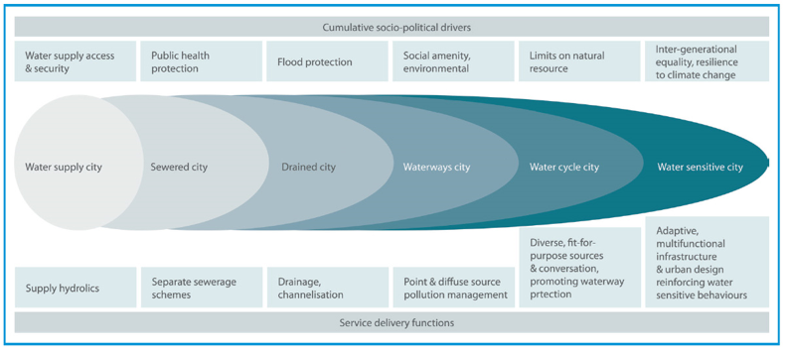
The Water Sensitive City Theory
An approach from Australia
The transition scheme
Wong and Brown (2008)

Slide 4
The Water Sensitive City Theory
An approach from Australia
The different pillars - three principles that help cities to evolve from an engineered urban water system to an integrated adaptive and climate resilient water system
Cities as water supply catchments: The urban water system is often part of a larger catchment area. The intensive exploitation of the urban landscape resulted in the progressive decrease of the natural water system to the detriment of the surrounding region. The goal is to restore the water balance within these regions.
Cities providing ecosystem services: The same water that poses the biggest threat to society also brings life and energy to the cities. Ecological services are the benefits that people derive from ecosystems. A river area for instance can be used multifunctional for flood protection, groundwater recharge, recreation and for the improvement of the quality of live.
Cities comprising water sensitive communities and networks: The implementation of integrated solutions requires improved perception of the benefits from decision makers, businesses and the public across multiple constituencies and levels of governance. Therefore collaboration is a key.

Slide 5
The Water Sensitive City Theory
An approach from Australia
Why is such approach useful for climate change adaptation?
Climate change adaptation needs to be…
Integrative
Holistic
Flexible
Social
Anticipating
…
Nature based
…

Slide 6
The Water Sensitive City Theory
An approach from Australia
Adjusting the approach to the North Sea Region conditions
Focusing on current challenges across the NSR
Consider also possible future challenges of the NSR
More Floods than droughts in history
Increasing flood risk in future
May be more droughts in future
Water quality issues
…
→ Reflecting on such regional characteristics in the city self assessment

Slide 7
The Water Sensitive City Theory
An approach from Australia
Indicators for the three pillars
Cities as water supply catchments:
- Evaluating space for infiltration and water storage
- Analysing existing water infrastructure and maintenance
- Checking availability of hazard and risk maps
Cities providing ecosystem services:
- Evaluating the qualitative and quantitative status of urban water bodies
- Assessing the status of urban habitats and green-blue structures
- Protecting vulnerable parts of the urban system
Cities comprising water sensitive communities and networks:
- Evaluating organization and regulation on urban scale
- Analysing the urban governance
- Assessing participation and (risk) awareness

Slide 8
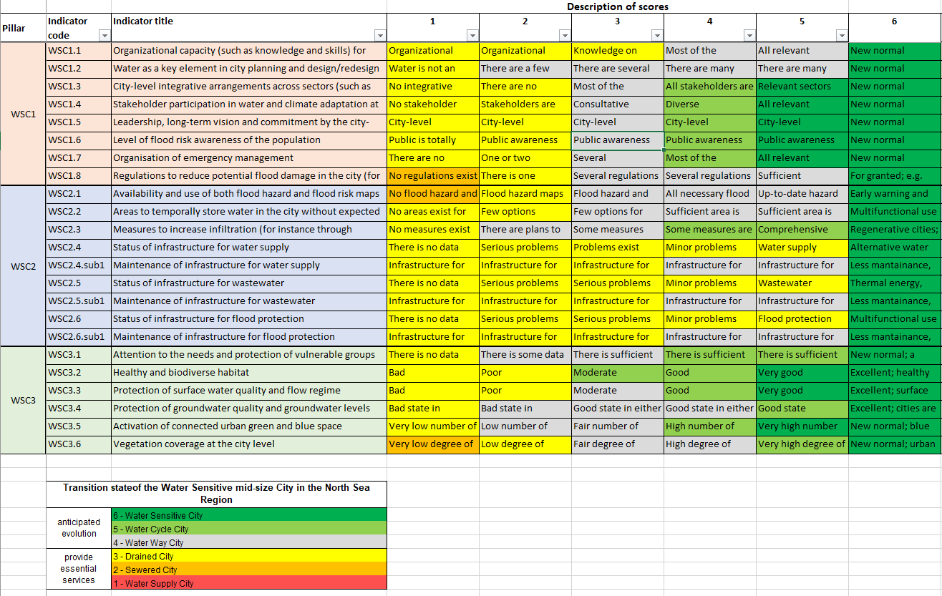
The self assessment
Using the WSC approach for a self assessment
Catalogue of questions for the three pillars

Slide 9
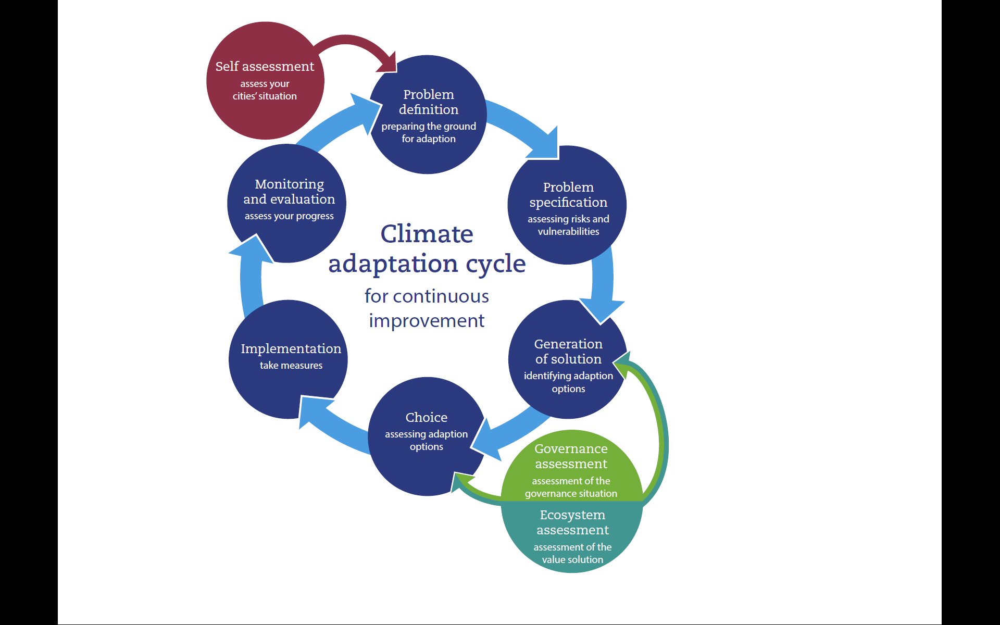
The self assessment
CATCH Tool

Slide 10
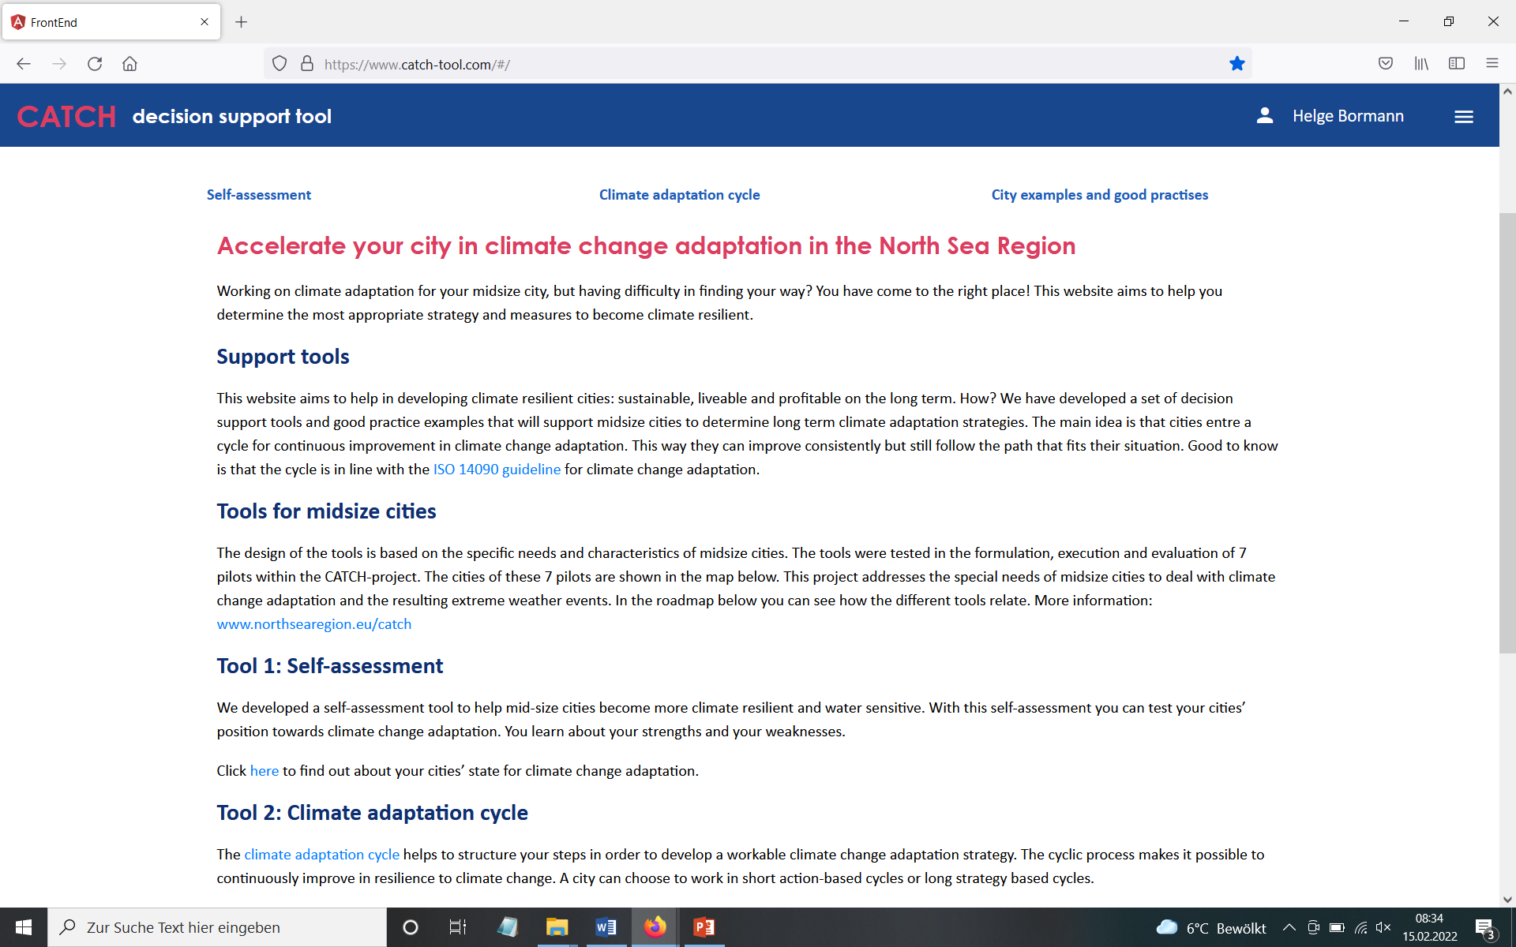
The self assessment
CATCH Tool

Slide 11
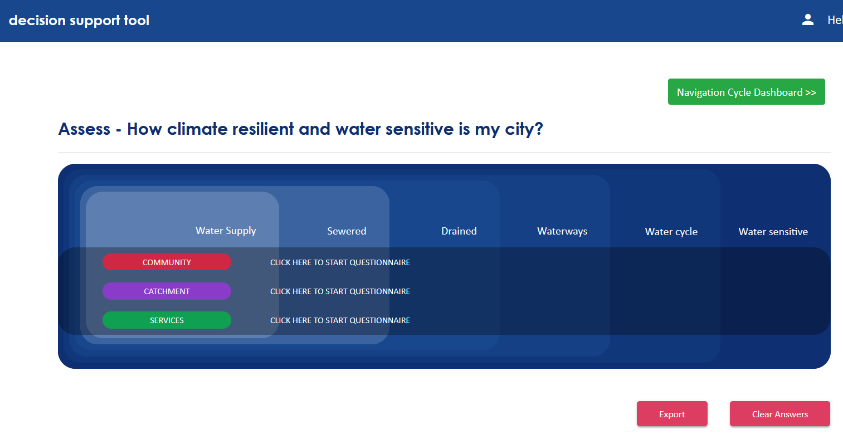
The self assessment
CATCH Tool
Assessing the state for the three pillars of WSC

Slide 12
The self assessment
CATCH Tool
Answering questions by selecting pre-defined answer
Cities as water supply catchments:
→ 9 questions
Cities providing ecosystem services:
→ 6 questions
Cities comprising water sensitive communities and networks:
→ 8 questions

Slide 13
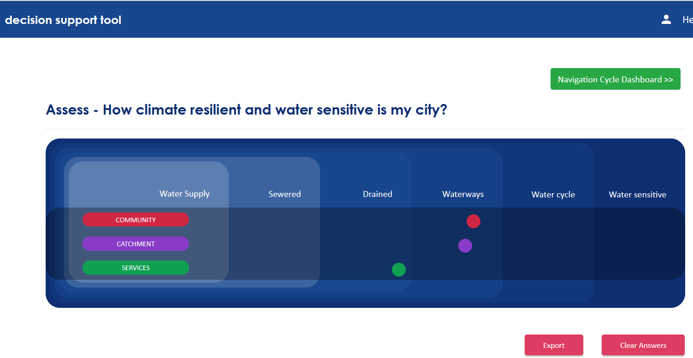
The self assessment
Results: Strengths and weaknesses
CATCH transition scheme

Slide 14
The self assessment
Results: Strengths and weaknesses
Reporting function

Slide 15
The self assessment
Results: Benchmark
City C
City A
City B

Slide 16
The self assessment
Using the results in the climate adaptation cycle
Focus on weaknesses and integration
E.g., indicators with lowest scores
E.g., pillars with lowest scores
→ Potential for improvement

