Slide 1


CATCH
DST-Tool-Training on climate change adaptation
The climate adaptation cycle: steps 1-3
Helge Bormann
Jade Hochschule

Slide 2


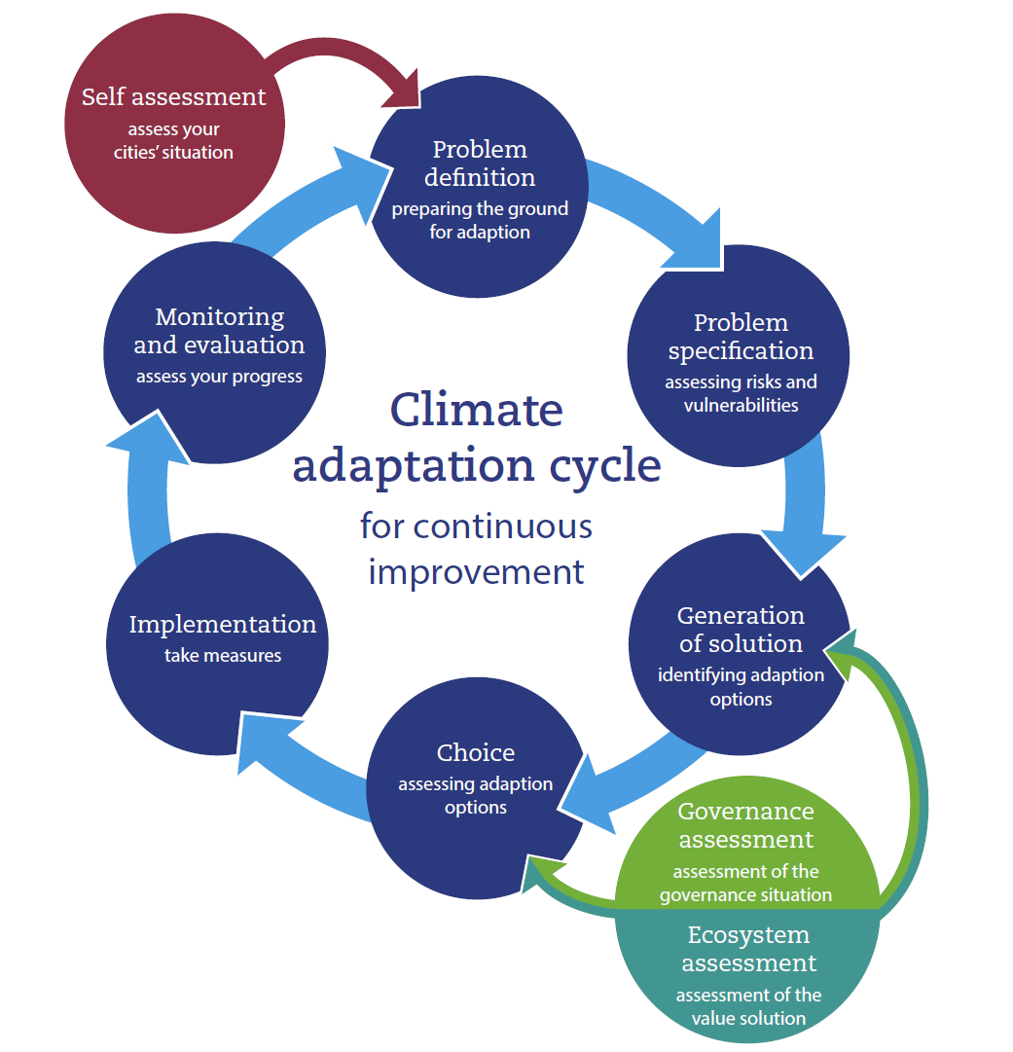
The climate adaptation cycle
CATCH Tool

Slide 3
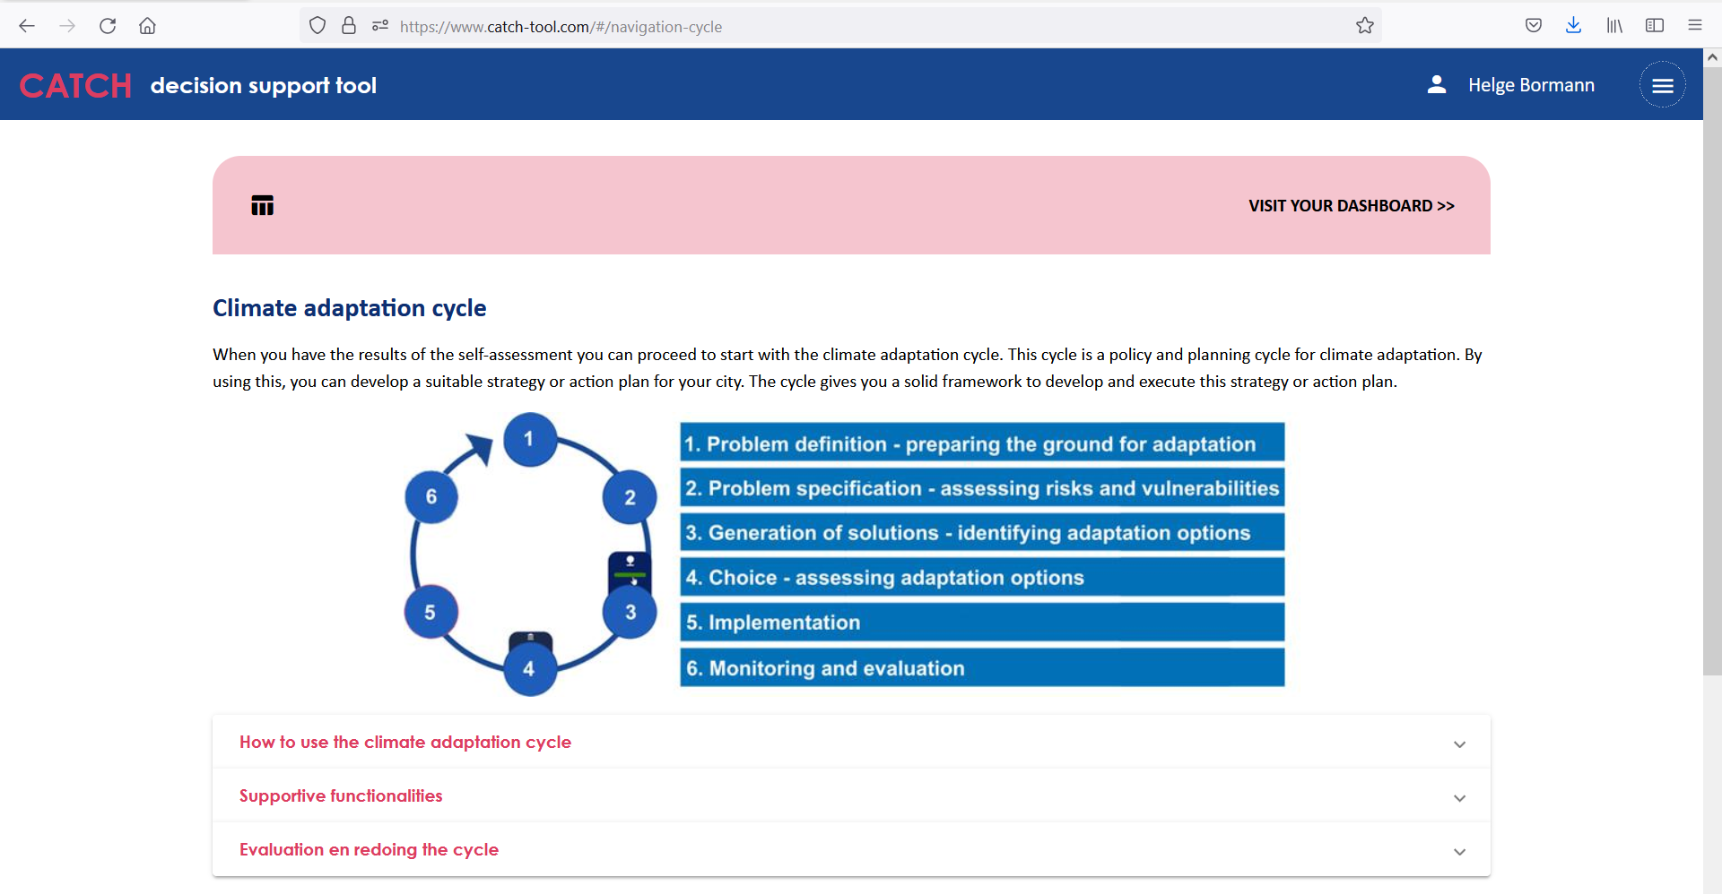
The climate adaptation cycle
The CATCH www-site

Slide 4
The climate adaptation cycle
General objectives
Guiding you trough the climate adaptation process by
Asking simple questions on your city status concerning climate adaptation
Giving recommendations for the further adaptation process
Providing explanatory material for all steps of the adaptation cycle
Providing good practice examples from by
Good practice examples from CATCH pilot cities as well as from other “front runner” cities / organisations

Slide 5
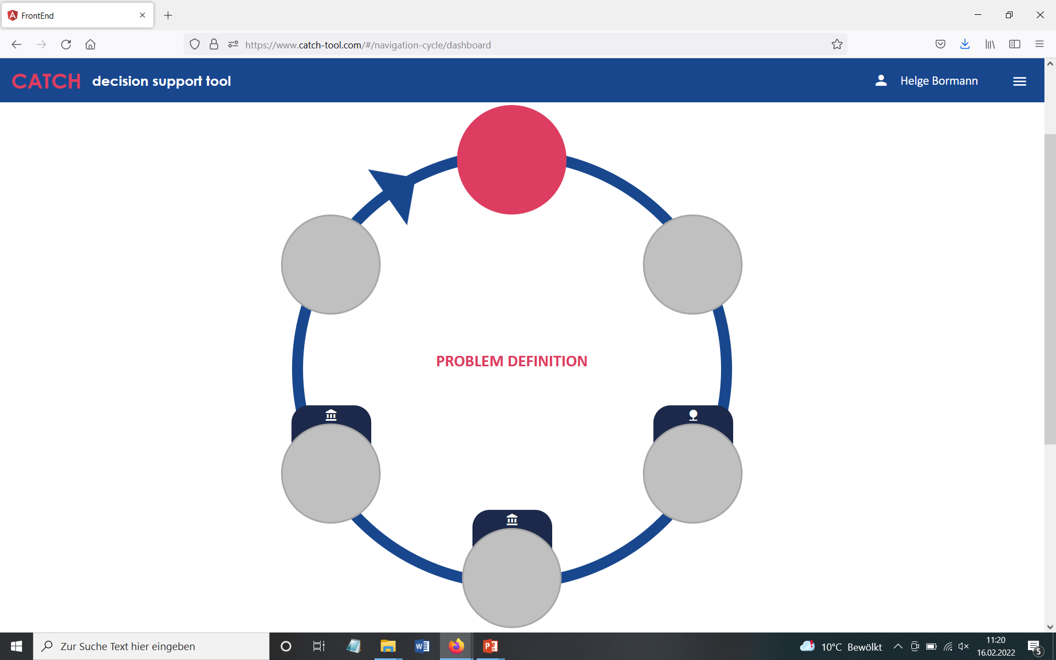
The climate adaptation cycle
The CATCH www-site: step 1

Slide 6
The climate adaptation cycle
Step 1: Problem analysis
Objectives of step 1
Defining the main climate change related hazard / risk of your city
Identifying the formation of historic events
Checking available data bases

Slide 7
The climate adaptation cycle
Step 1: Problem analysis
Process and recommendations

Slide 8
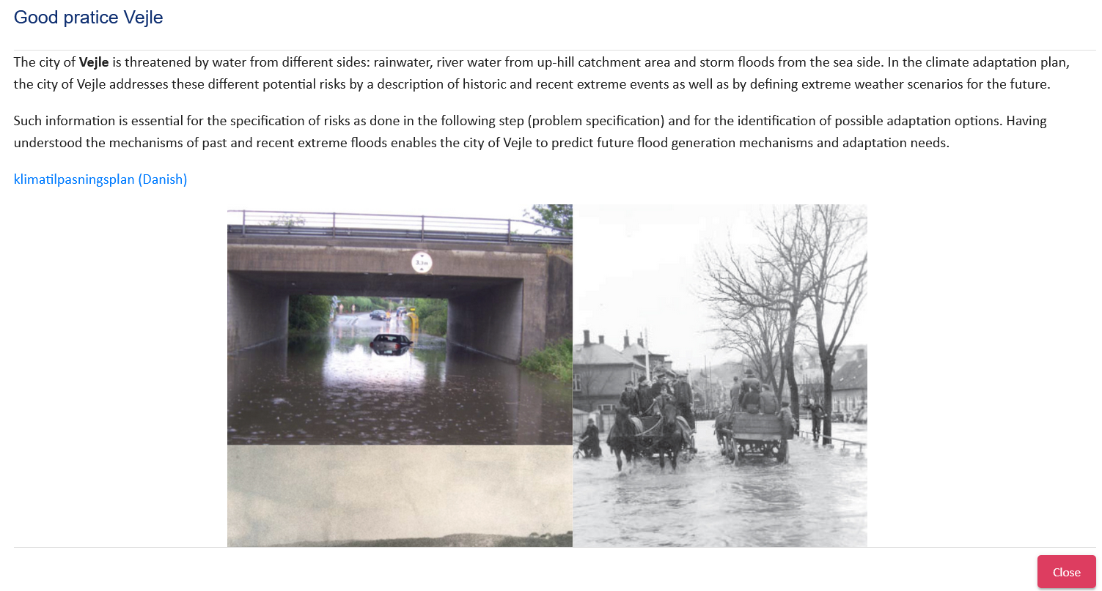
The climate adaptation cycle
Step 1: Problem analysis
Good practice example Vejle (Denmark)

Slide 9
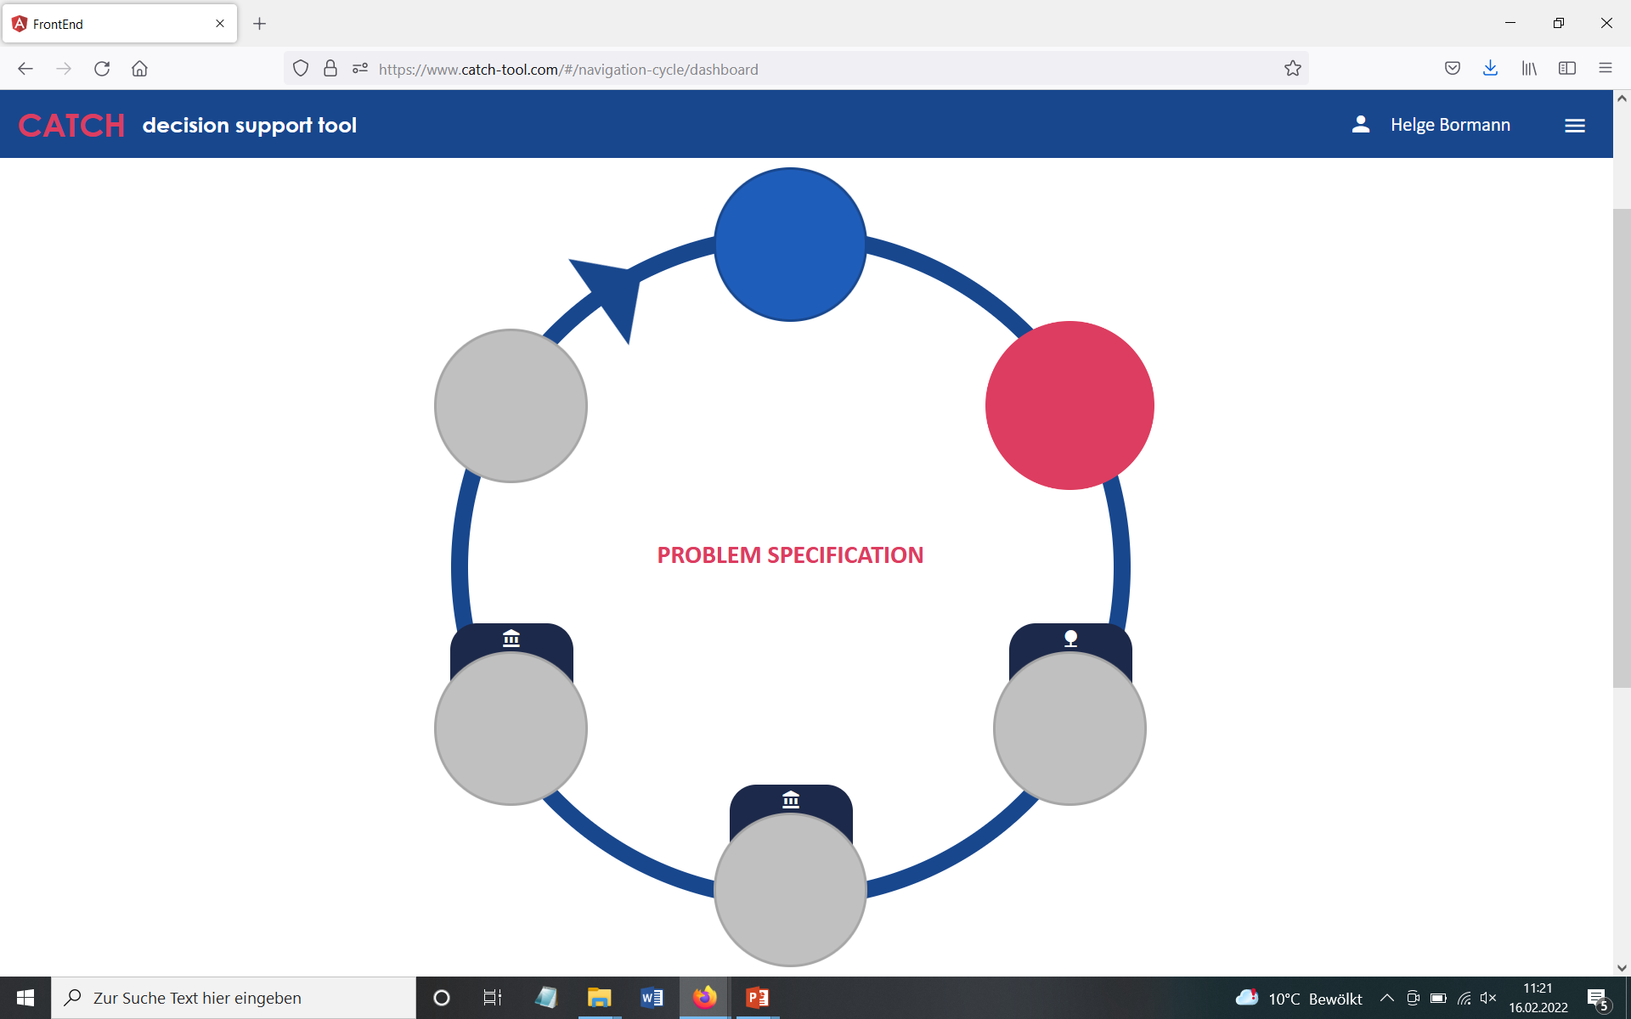
The climate adaptation cycle
The CATCH www-site: step 2

Slide 10
The climate adaptation cycle
Step 2: Problem specification
Objectives of step 2
Check availability of analyses quantifying potential climate change related risks
- e.g. climate impact analyses
- hazard and risk maps according to EU regulations
Determine sense of urgency of adaptation
Provide links to good practice such as available checklists and procedures

Slide 11
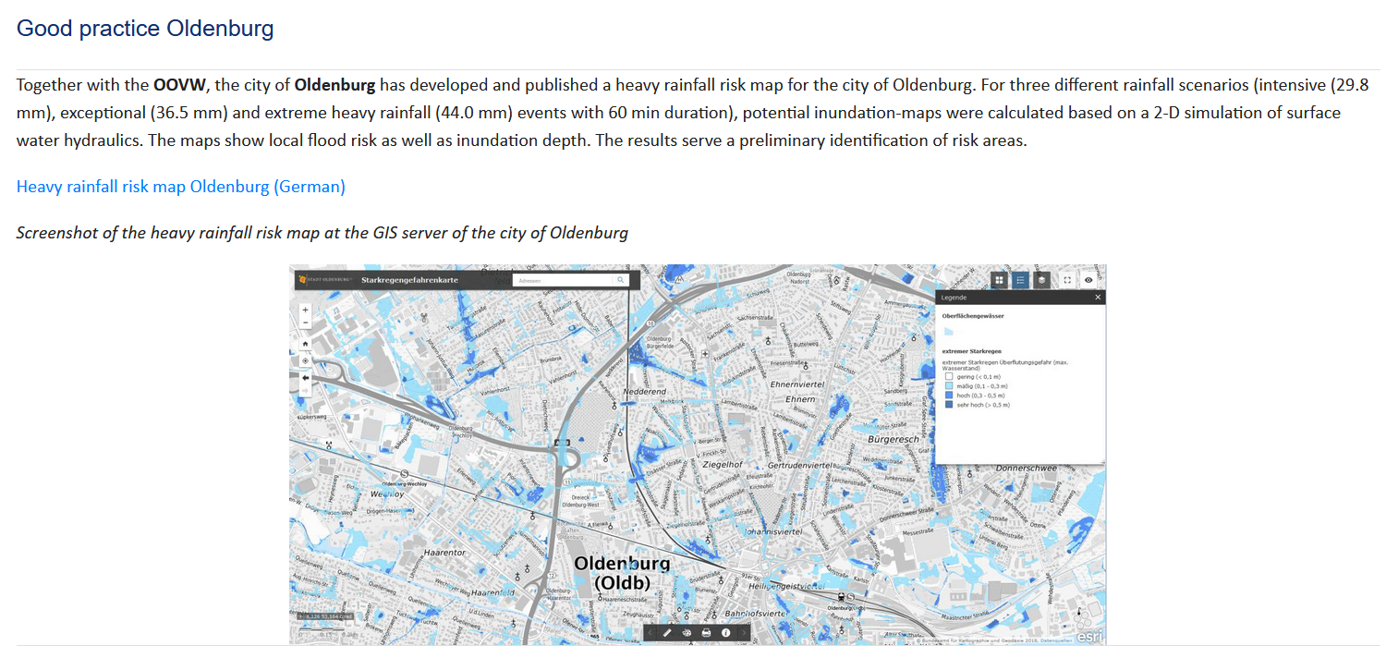
The climate adaptation cycle
Step 2: Problem specification
Good practice example Oldenburg (Germany)

Slide 12
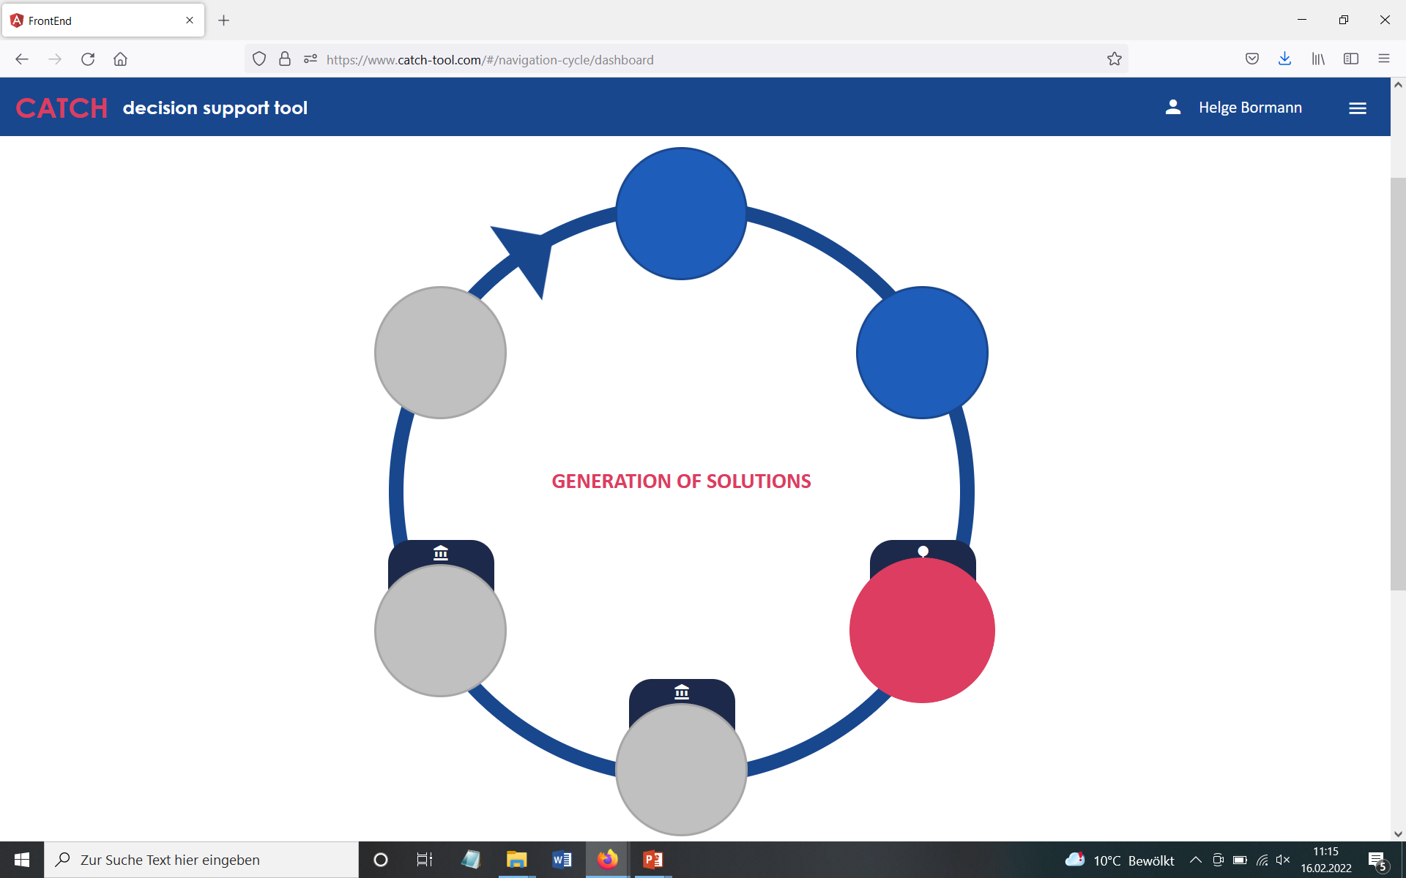
The climate adaptation cycle
The CATCH www-site: step 3

Slide 13
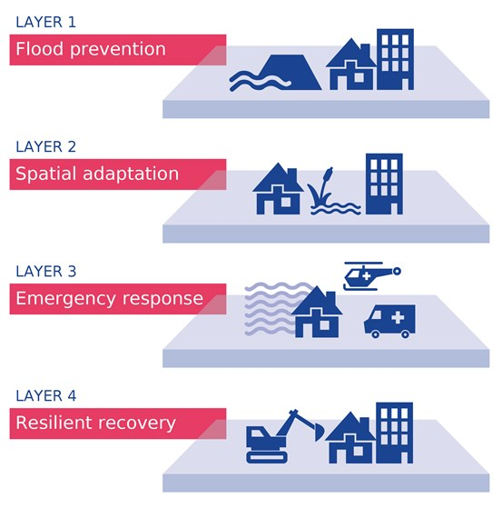
The climate adaptation cycle
Step 3: Generation of solutions
Objectives of step 3
Identify possible strategies / adaptation options to cope with climate change in your city, considering the whole spectrum of measures
Consider whom to involve
Consider nature based solutions
https://northsearegion.eu/frames/

Slide 14
The climate adaptation cycle
Step 3: Generation of solutions
Good practice example Vejle (Denmark)
Set of solution options, including
- water retention
- multifunctional areas
- green city structures
- pumping station
- catchment management
Options can be easily embedded in the available climate adaptation strategy

Slide 15
The climate adaptation cycle
Step 3: Generation of solutions
Additional helpful tools for this step
Governance assessment: analyzing the local / regional governance system
→ Identify additional important stakeholders
→ Understand decision making processes
→ Discover restrictions in your local / regional system
Ecosystem Services assessment
→ Understand the values of urban ecosystems / blue-green structures
→ Integrate the approach into planning processes
Direct links to the GA and the EA are provided in the adaptation cycle
(for details on GA and EA see module 6)

Slide 16
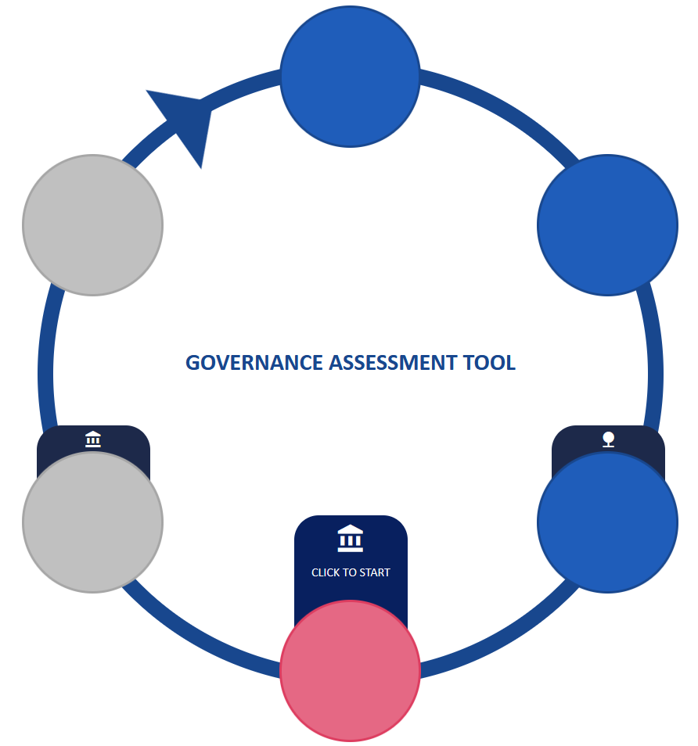
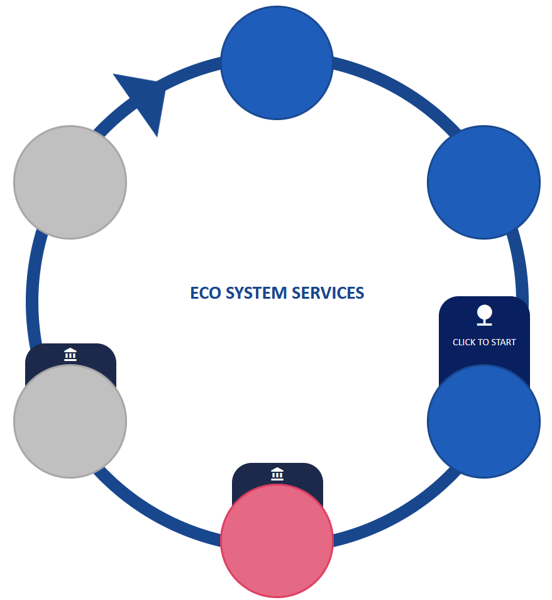
The climate adaptation cycle
Step 3: Generation of solutions
Additional helpful tools for this and following steps
Governance assessment
Ecosystem services assessment

