Slide 1


CATCH
DST-Tool-Training on climate change adaptation
The climate adaptation cycle: steps 4-6
Helge Bormann
Jade Hochschule

Slide 2


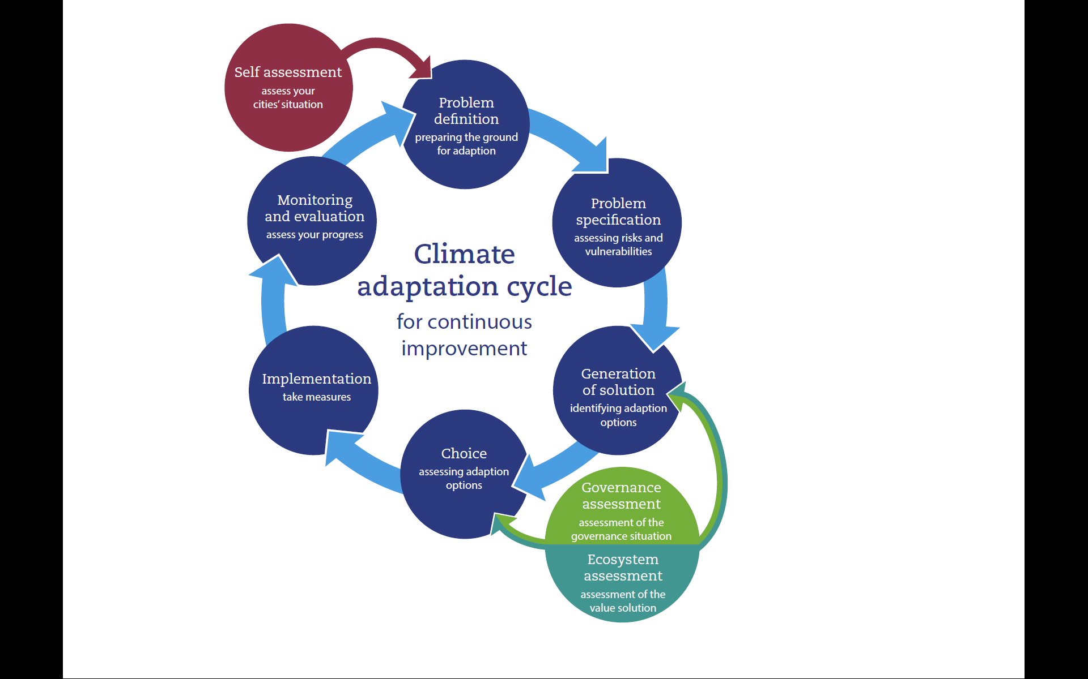
The climate adaptation cycle
CATCH tool

Slide 3
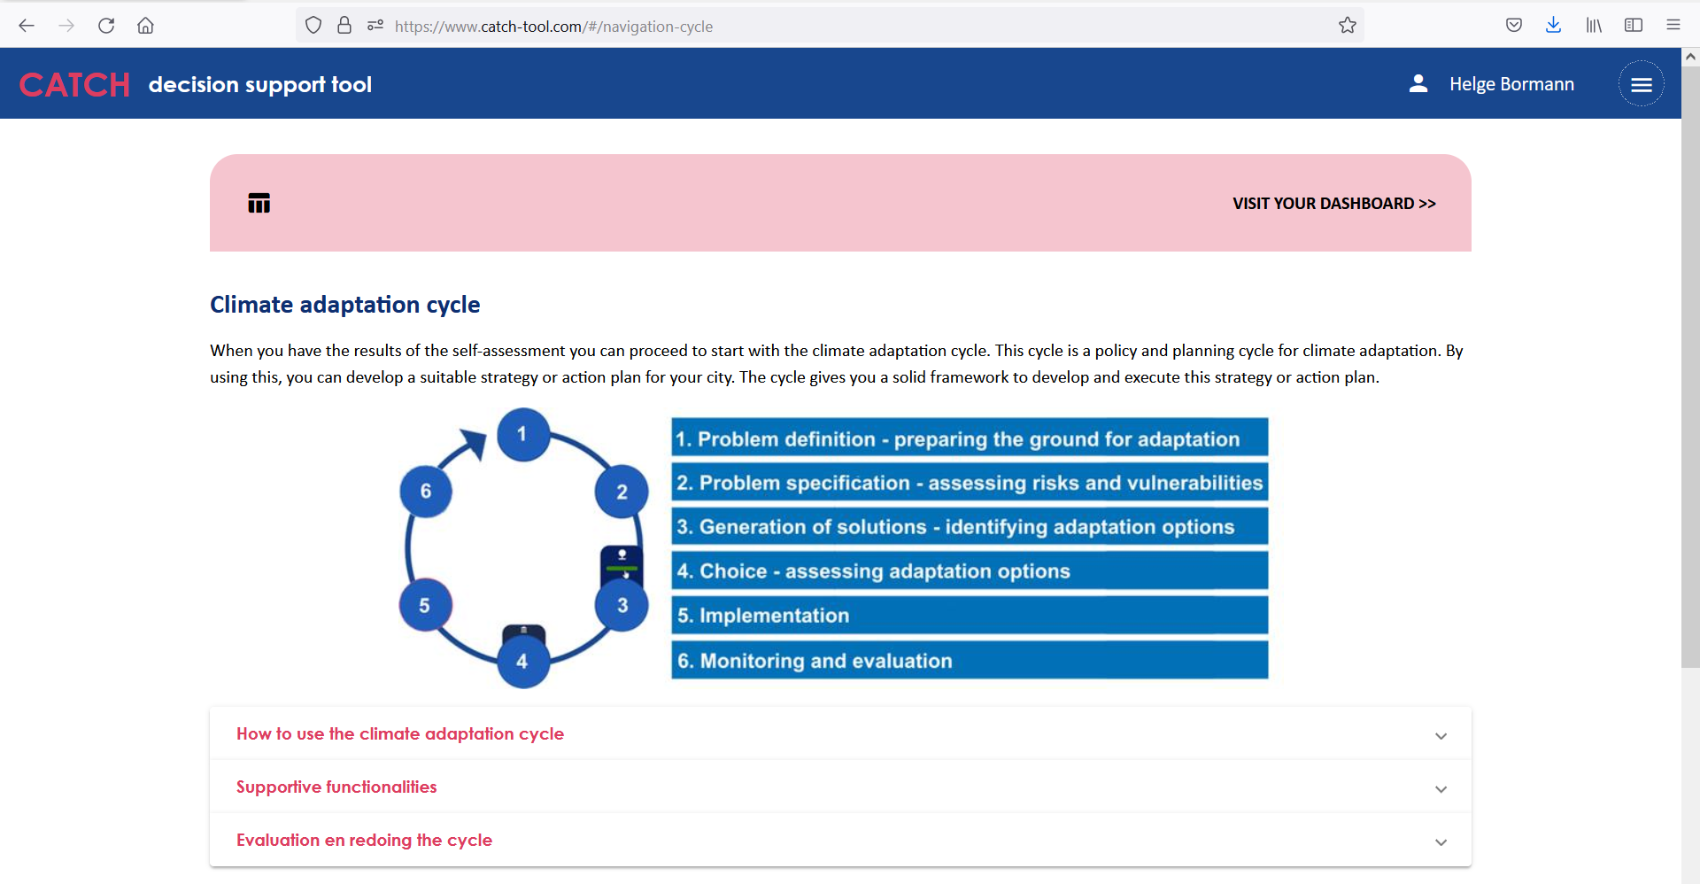
The climate adaptation cycle
The CATCH www-site

Slide 4
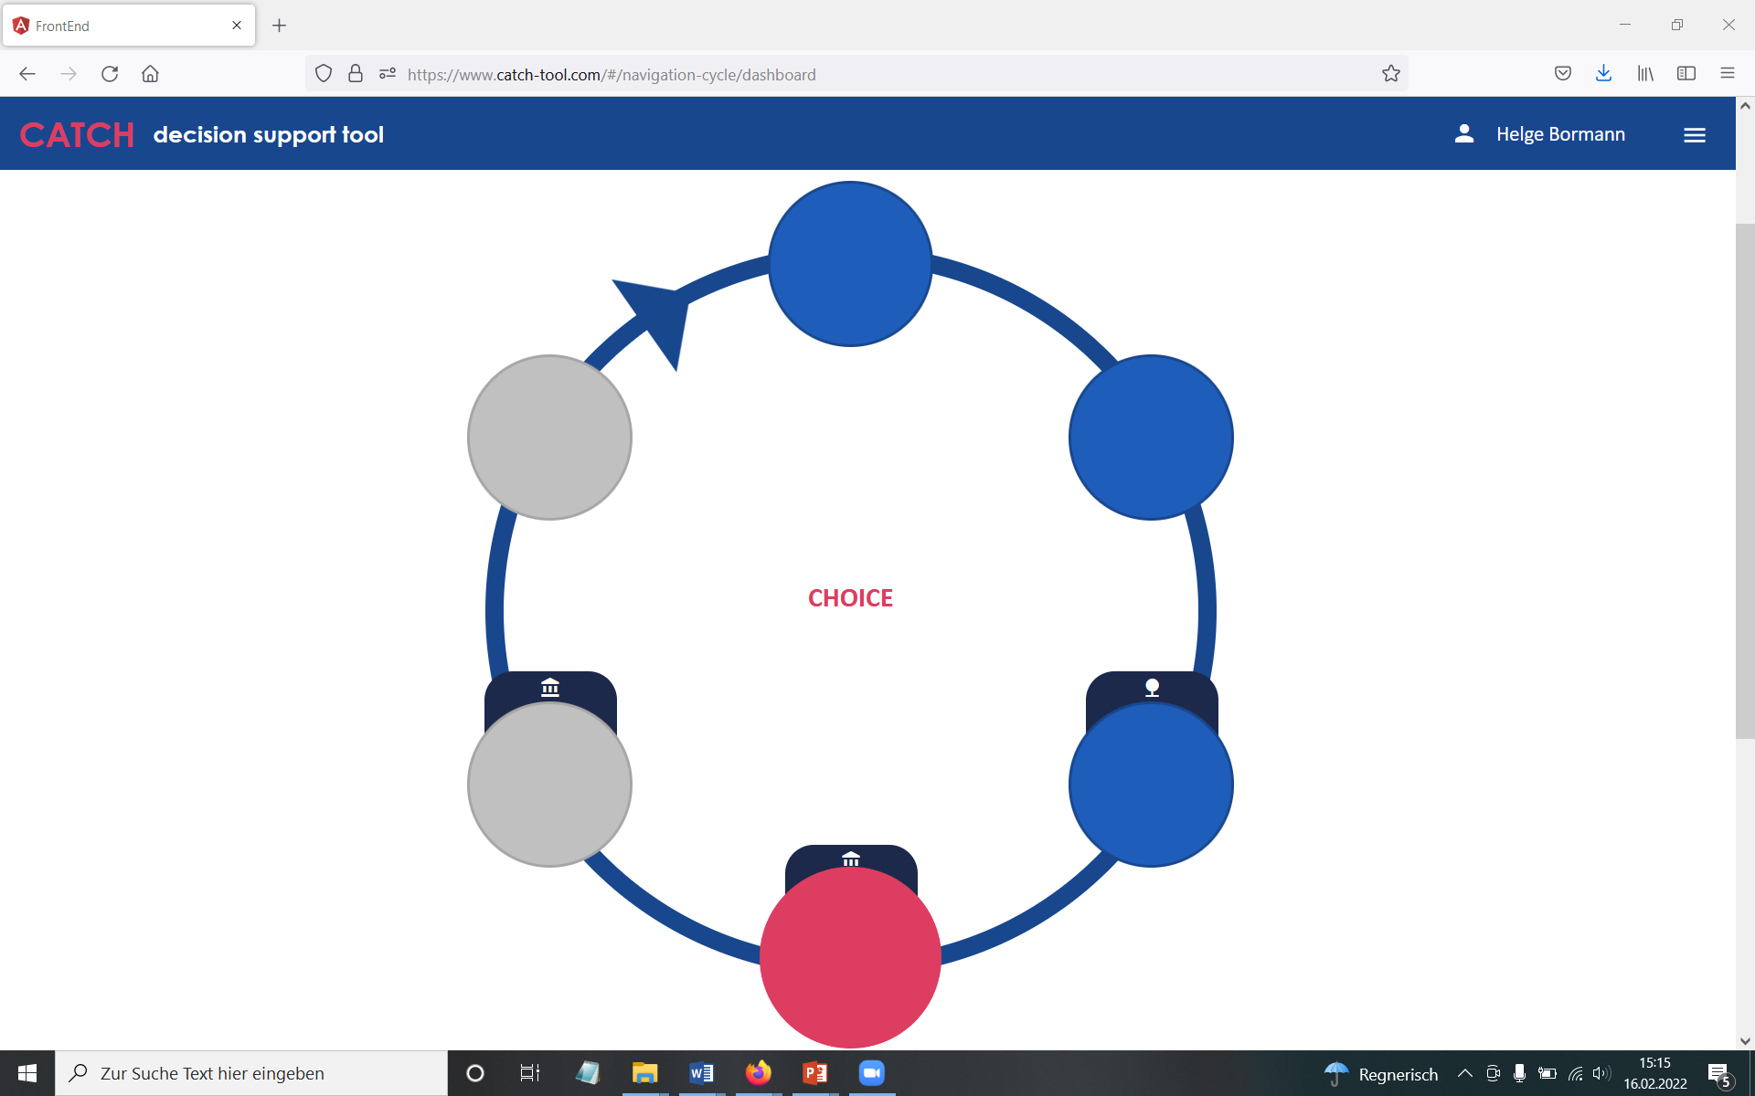
The climate adaptation cycle
The CATCH www-site: step 4

Slide 5
The climate adaptation cycle
Step 4: Choice of a climate adaptation measure
Objectives of step 4
Supporting the choice of the most suitable adaptation solution
Drawing the attention on
- The important stakeholders
- An adequate time horizon
- Solutions achieving max. potential synergies
→ Helping to find suitable indicators for a good decision

Slide 6
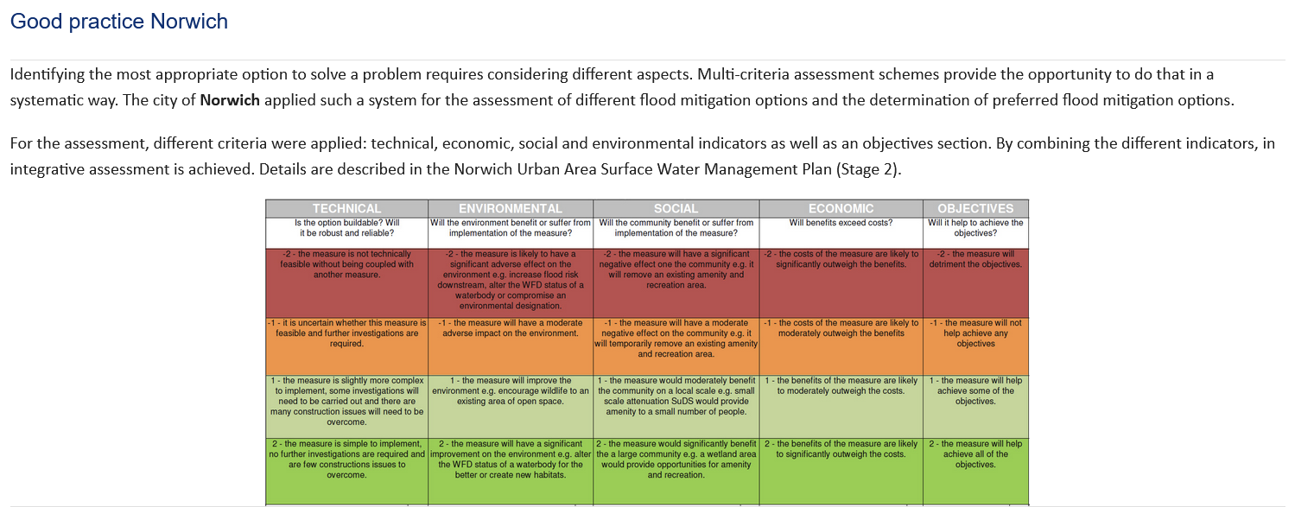
The climate adaptation cycle
Step 4: Choice of a climate adaptation measure
Good practice example
A multi-criteria assessment applied in Norwich (UK)
Considering technical, environmental, social and economic indicators

Slide 7
The climate adaptation cycle
Step 4: Choice of a climate adaptation measure
Important to consider:
Governance assessment: analyzing the local / regional governance system
→ Identify additional important stakeholders
→ Understand decision making processes
→ Discover restrictions in your local / regional system
Ecosystem Services assessment
→ Understand the values of urban ecosystems / blue-green structures
→ Integrate the approach into planning processes
Direct links to the GA and the EA are provided in the adaptation cycle
(for details on GA and EA see module 6)

Slide 8
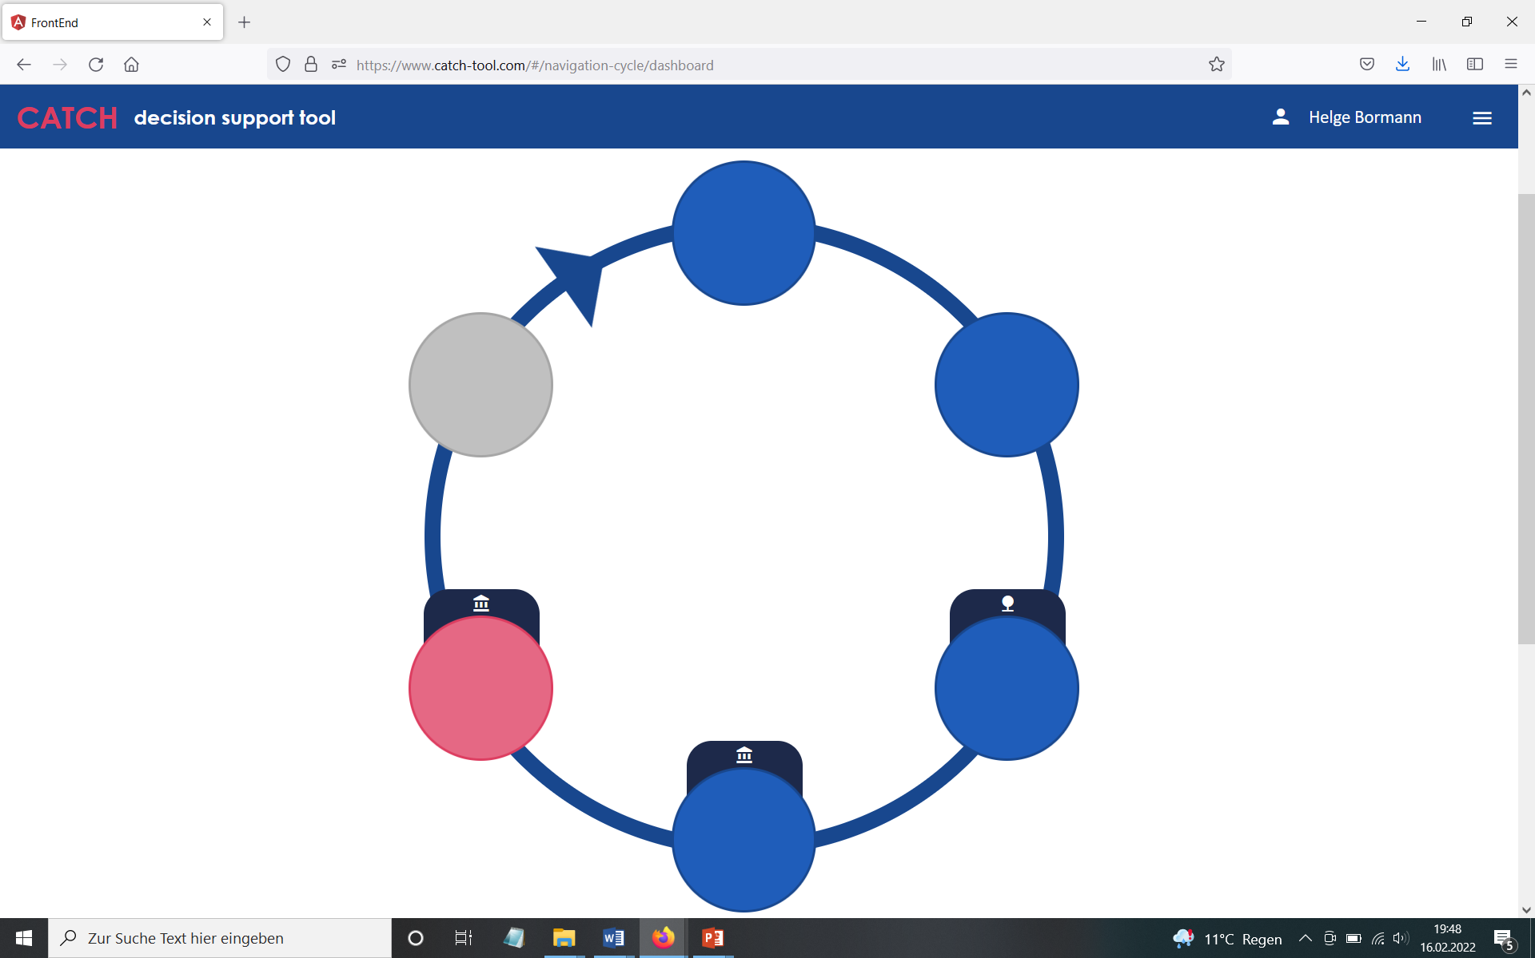
The climate adaptation cycle
The CATCH www-site: step 5

Slide 9
The climate adaptation cycle
Step 5: Implementation phase
Objectives of step 5
Assisting a smooth implementation process
Focus here is not in technical issues but on communication
Optimize communication to prevent obstruction
Involve actors, inform the public
→ Consider do’s and don’ts if available

Slide 10
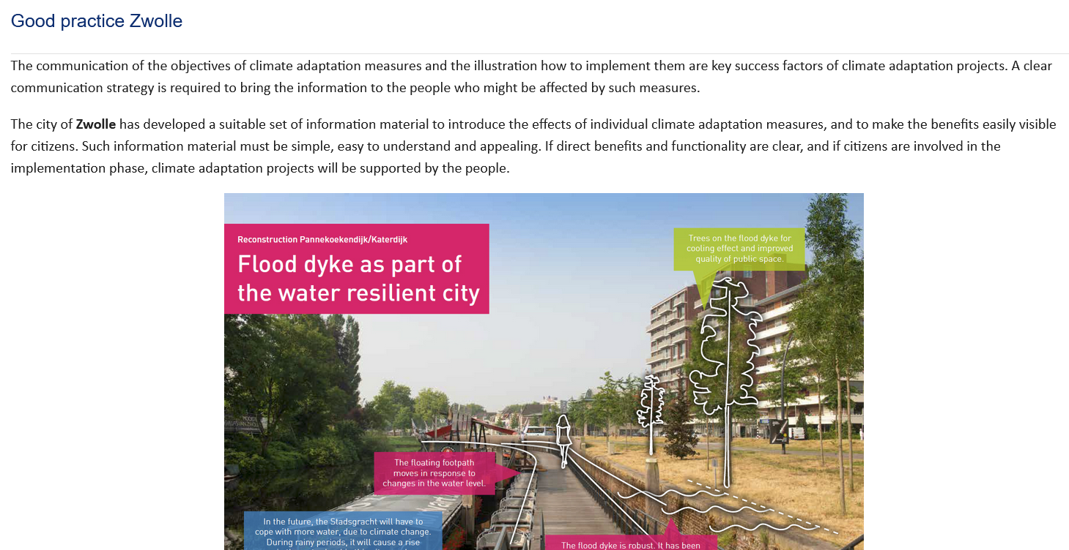
The climate adaptation cycle
Step 5: Implementation phase
Good practice example
Zwolle (The Netherlands) climate adaptation communication material

Slide 11
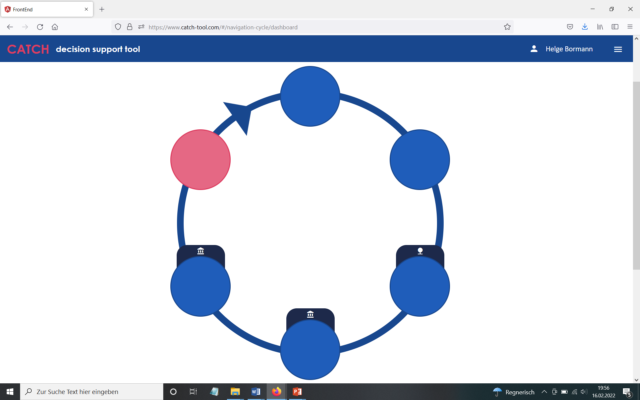
The climate adaptation cycle
The CATCH www-site: step 6

Slide 12
The climate adaptation cycle
Step 6: Evaluation and Monitoring
Objectives of step 6
Monitor and evaluate the intended and unforeseen consequences
Essential for the identification of further development options and strategic adjustments
CATCH self-assessment can be used as evaluation tool

Slide 13
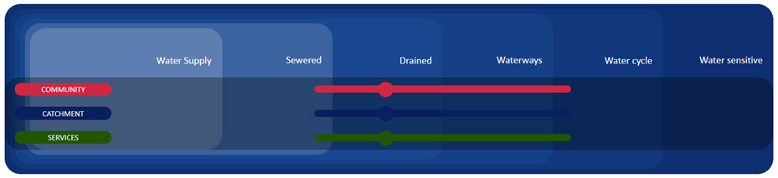
The climate adaptation cycle
Step 6: Evaluation and Monitoring
Good practice example
CATCH city self assessment
Assessment of the current state for the three pillars of the WSC concept

Slide 14
The climate adaptation cycle
New challenges emerging?
Adjustment in scale or
level of integration required?
→ Redo the climate adaptation cycle
Additional information on governance
And/or ecosystem services needed?
→ Apply GA and/or EA

