Slide 1


CATCH
DST-Tool-Training on climate change adaptation
Governance assessment and ecosystem services assessment
Helge Bormann
Jade Hochschule

Slide 2


The governance assessment
What is governance, why is it important
The 5 dimensions of governance:
Levels and scales
Actors and networks
Problem perceptions and ambitions
Policy styles and instruments
Responsibilities and resources
→ The four indictors completeness, coherence, flexibility and pressure for change are applied to characterize the dimensions of governance.

Slide 3
The governance assessment
What is governance, why is it important
GAT looks at…
Social and administrative levels
Stakeholder involvement
Existing uses of the urban space, competing ambitions
Available policy instruments such as laws, regulations and white papers (time lines, …)
Responsibilities
Resources such as money, rights, expertise and support

Slide 4
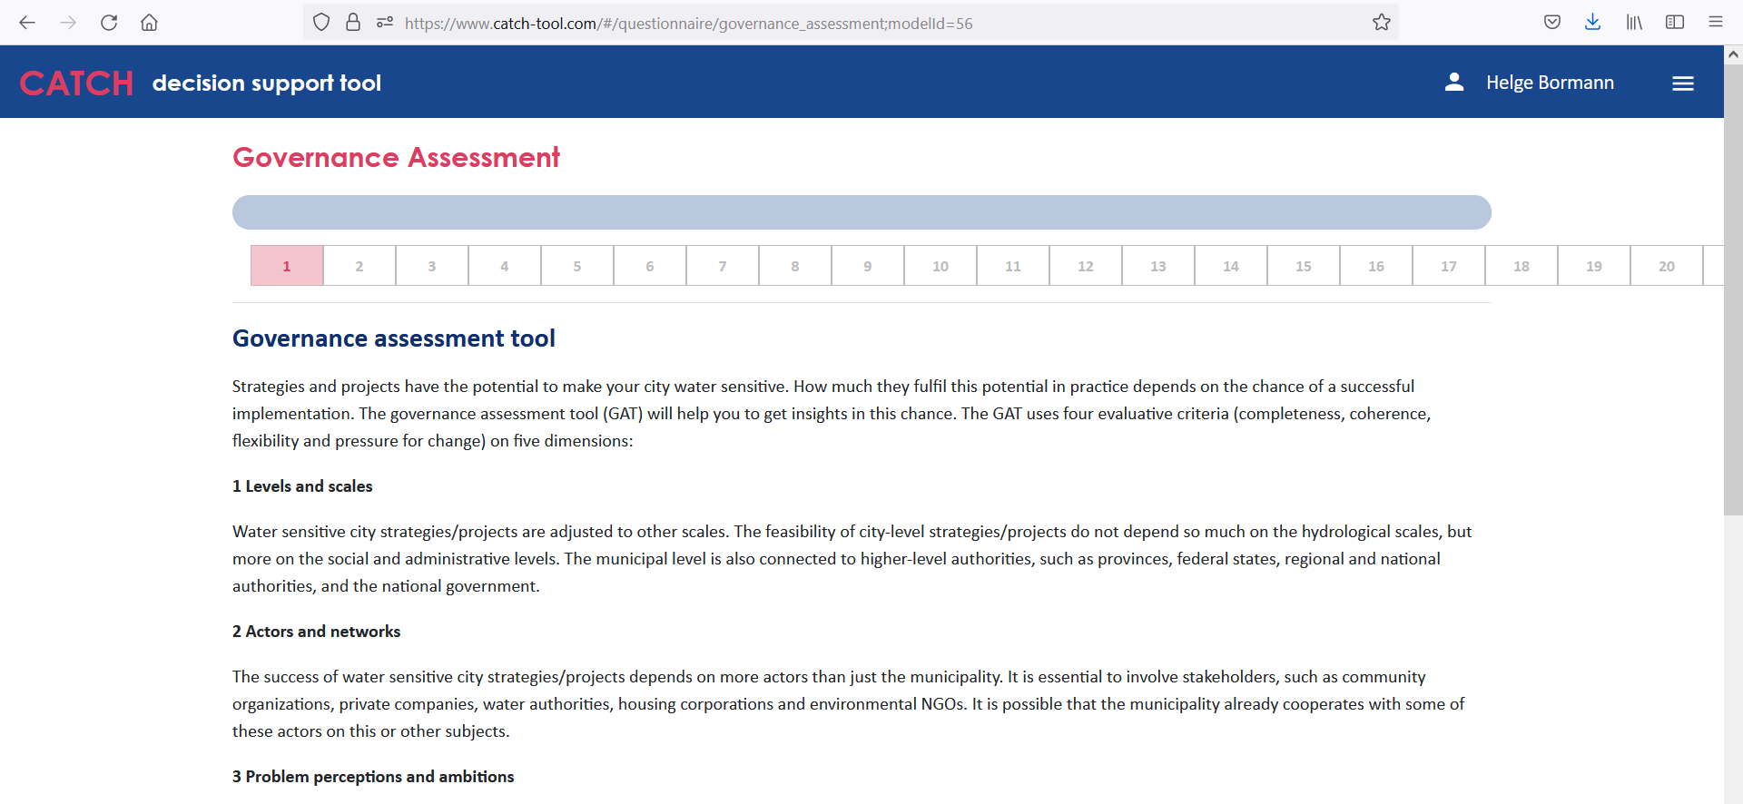
The governance assessment
How to identify strengths and weaknesses
The questionnaire
20 questions ask for all combinations of the 5 dimensions and 4 criteria
Pre-defined answers can be selected

Slide 5
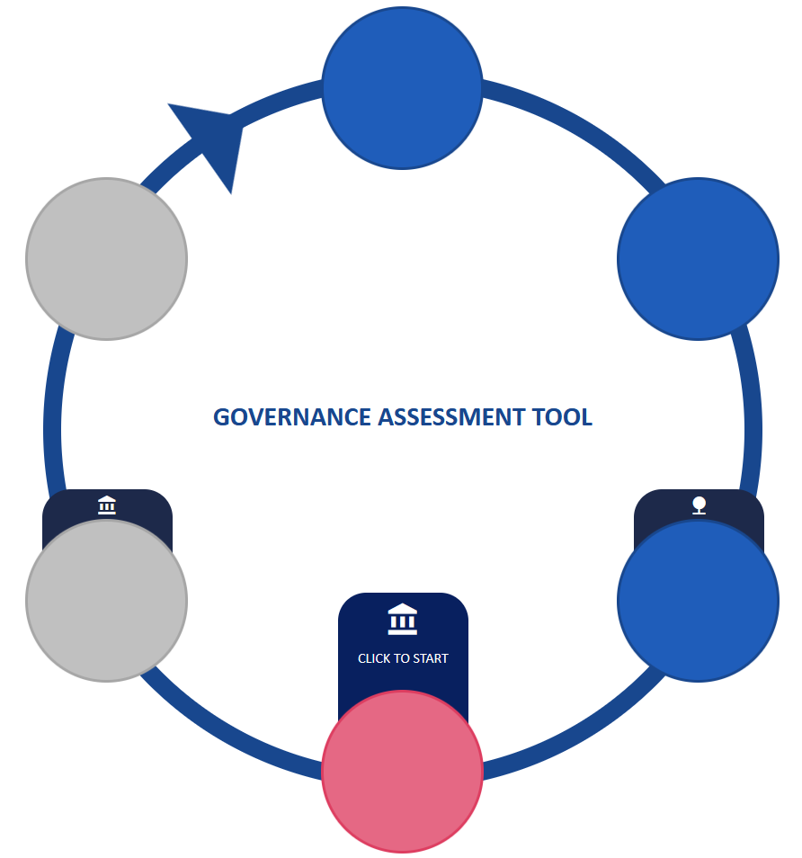
The governance assessment
The CATCH www-site
Access GAT via the climate adaptation cycle

Slide 6
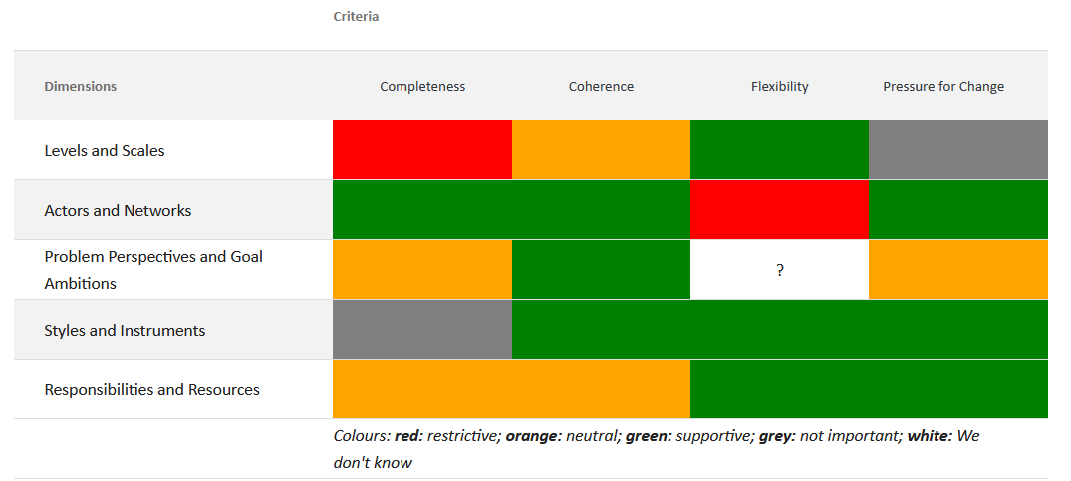
The governance assessment
The resulting traffic light system

Slide 7
The governance assessment
Recommendations in the reporting system
“annex 2”
Supportive answers: governance supports successful implementation
Neutral answers: no supporting, but also no hindering aspects; any developments or possible action?
Restrictive answers: attention (and action) is needed; governance restricts implementation
Don’t know answers: gather more information, consult colleagues
This is not important answers: be self-critical, if such answer is given too frequent

Slide 8
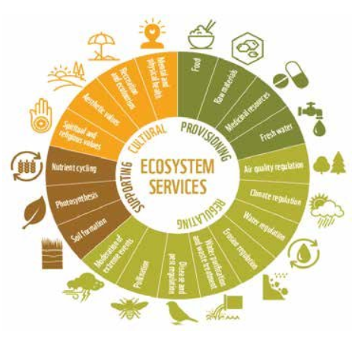
The ecosystem services assessment
What are ecosystem services, why are they important
The main principles
Benefits that human populations obtain from ecosystem functions.
Four categories (Millenium Ecosystem Assessment):
- Regulating services such as the control of climate, floods, droughts
- Provisioning services, like the production of materials, food
- Cultural services, such as recreational benefits
- Supportive services, such as primary production
WWF, 2016

Slide 9
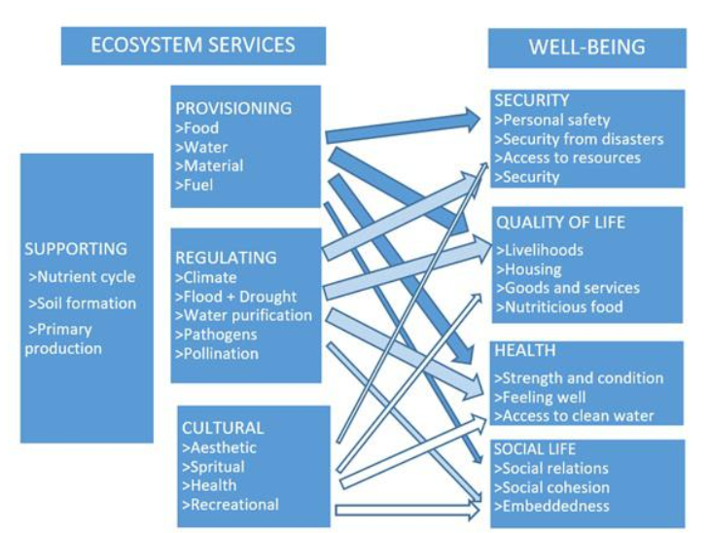
The ecosystem services assessment
What are ecosystem services, why are they important
The main principles
In urban planning the first types receive most attention.
Paying attention to eco-system services is important because of the relationships with the wellbeing of the citizens.

Slide 10
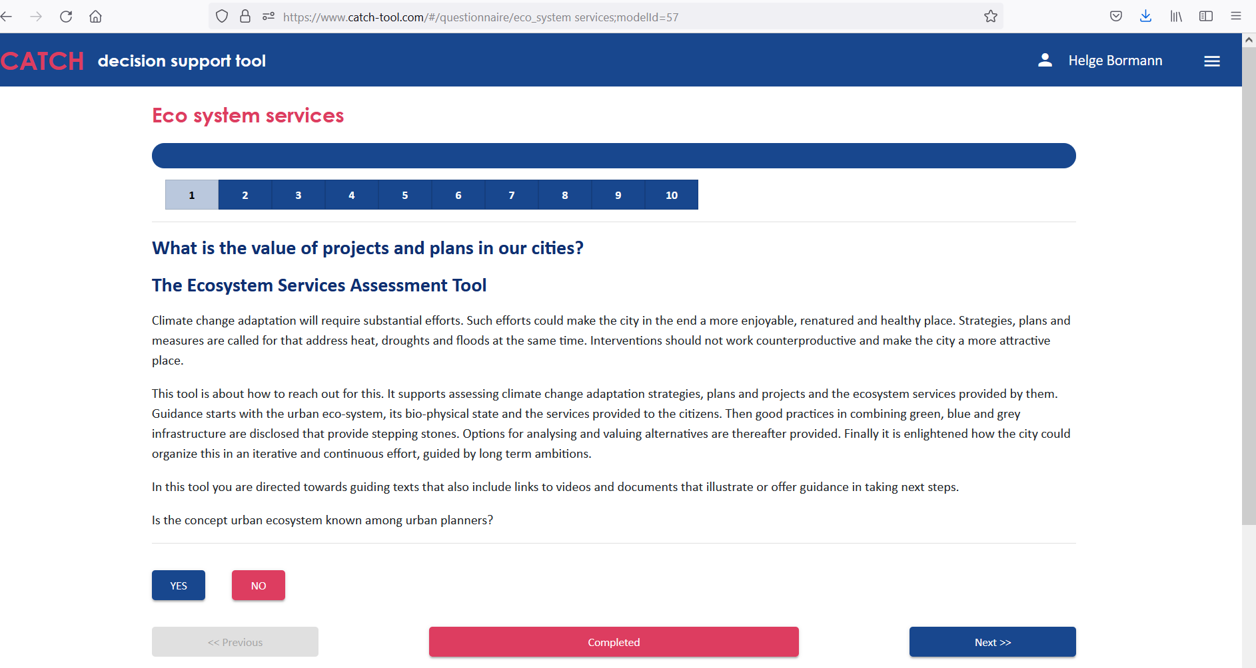
The ecosystem services assessment
How to identify strengths and weaknesses
The questionnaire: 10 yes/no questions

Slide 11
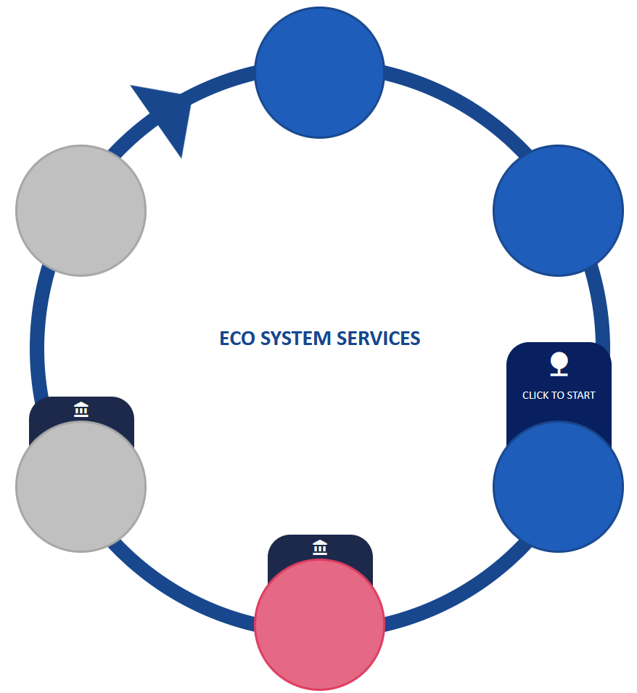
The ecosystem services assessment
The CATCH www-site
Access EA via the climate adaptation cycle

Slide 12
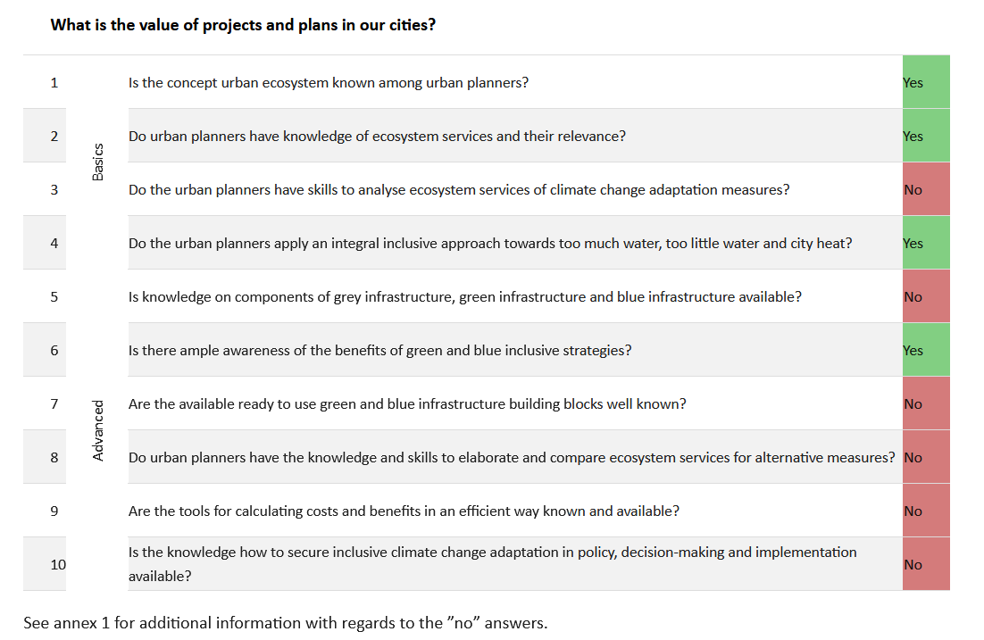
The ecosystem services assessment
Reporting on your answers

Slide 13
The ecosystem services assessment
Recommendations in the reporting system
“annex 1”
No answers: Reading the provided material and using the links will help
- to raise awareness and knowledge (questions 1-3)
- to raise knowledge and advance skills in combining green, blue and grey
infrastructure (questions 5-7)
- to communicate the benefits for inclusive climate adaptation measures
(questions 8,9)
- to anchor integral and inclusive climate adaptation in the structure and culture
of the organization (question 4,10)

Slide 14
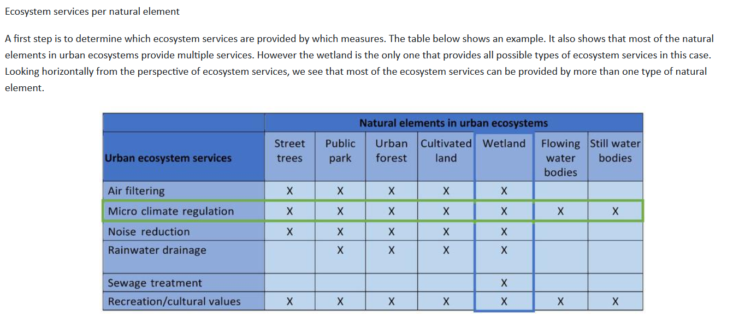
The ecosystem services assessment
Guiding material based on your answers
Example: Ecosystem services per natural element

