Slide 1


CATCH
DST-Tool-Training on climate change adaptation
Hands on tool session,
good practice examples from the CATCH pilots
Helge Bormann
Jade Hochschule

Slide 2


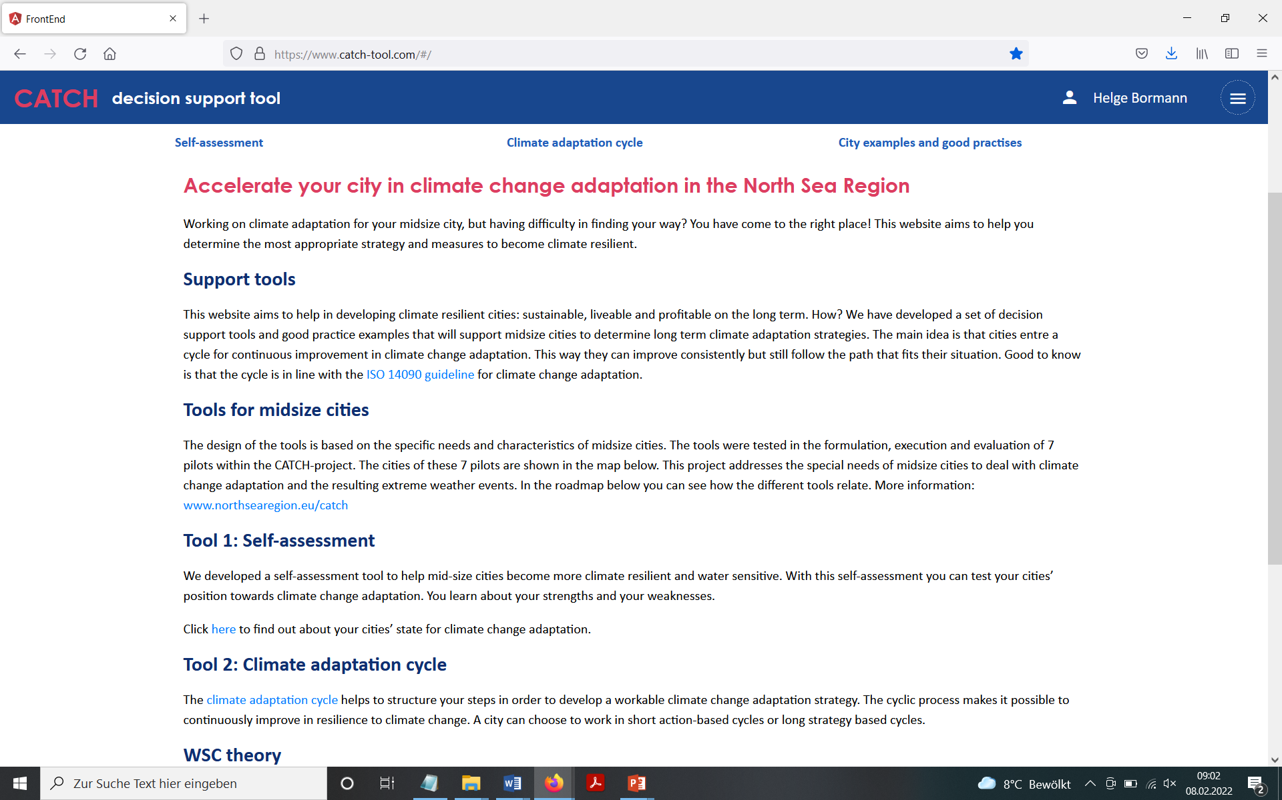
The CATCH tool
The CATCH www-site

Slide 3
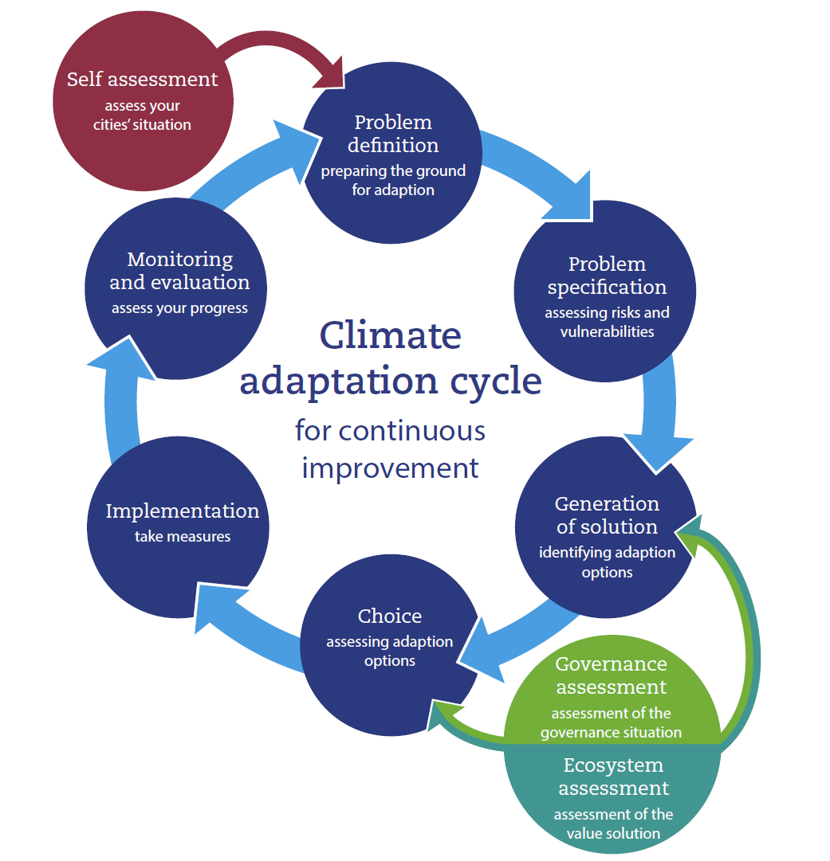
The CATCH tool
Play with the tool!
Apply all parts (sequentially)
Self assessment
Climate adaptation cycle
Governance assessment
Ecosystem services assessment
Please write down your feedback ;-)
Detailed feedback is welcome also in the final module

Slide 4
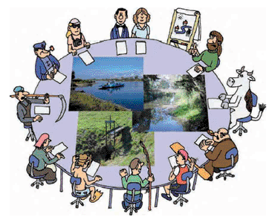
The CATCH tool
Explore the tool in small groups (60 min)
Recommendations from internal tool testing sessions:
Build an interdisciplinary team
Select a spatiotemporal scale and keep it consistent (e.g., pilot scale for short-term adaptation; or city scale for long-term adaptation).
Keep the full spectrum of different interest in mind, including policy/management
Consider further iteration(s) if you are not satisfied
www.wise-rtd.info

Slide 5
The CATCH tool
First feedback from the hands on session?
Detailed feedback is welcome also in the final module!
On technical issues
On the content
On the training

Slide 6
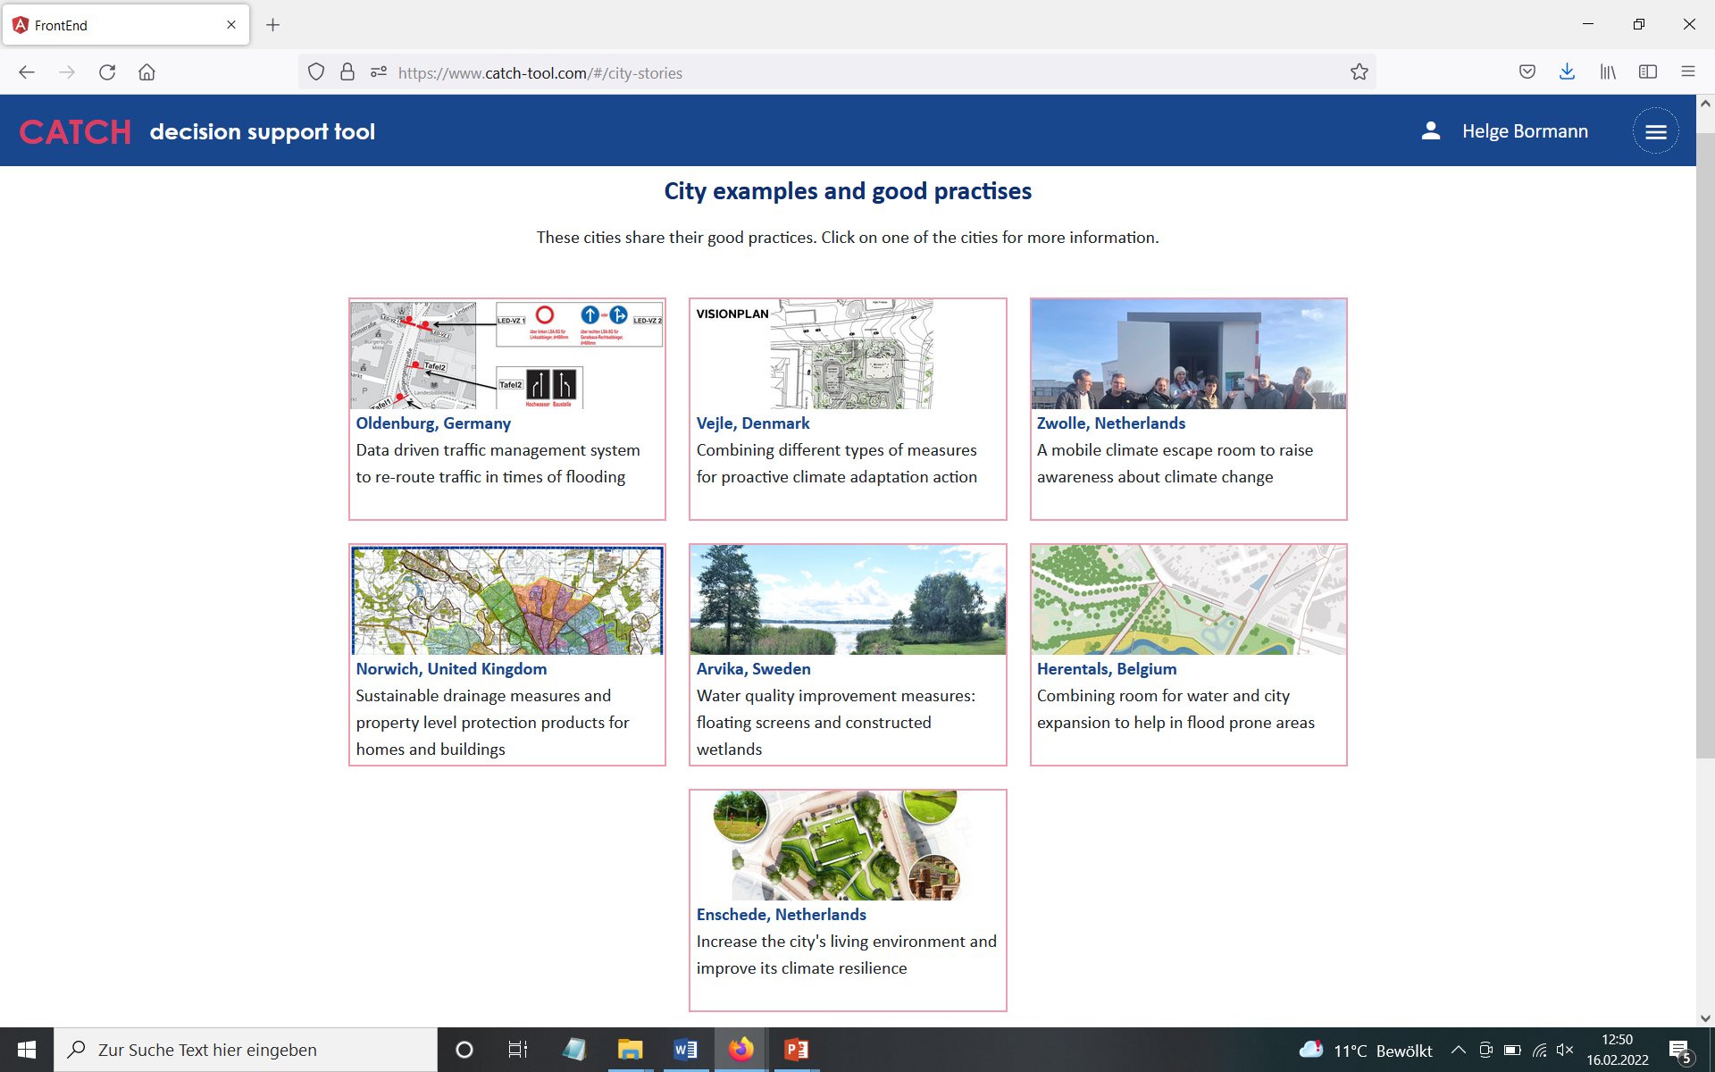
Good practice examples from CATCH pilots
Get inspired by the CATCH www-site
The pilot cities

Slide 7
Good practice examples from CATCH pilots
Get inspired!
Spatial planning alternatives for flood planes in Herentals (Belgium)
Comparative planning alternatives
for an urban flood plane

Slide 8
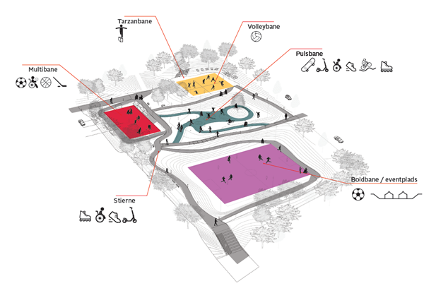
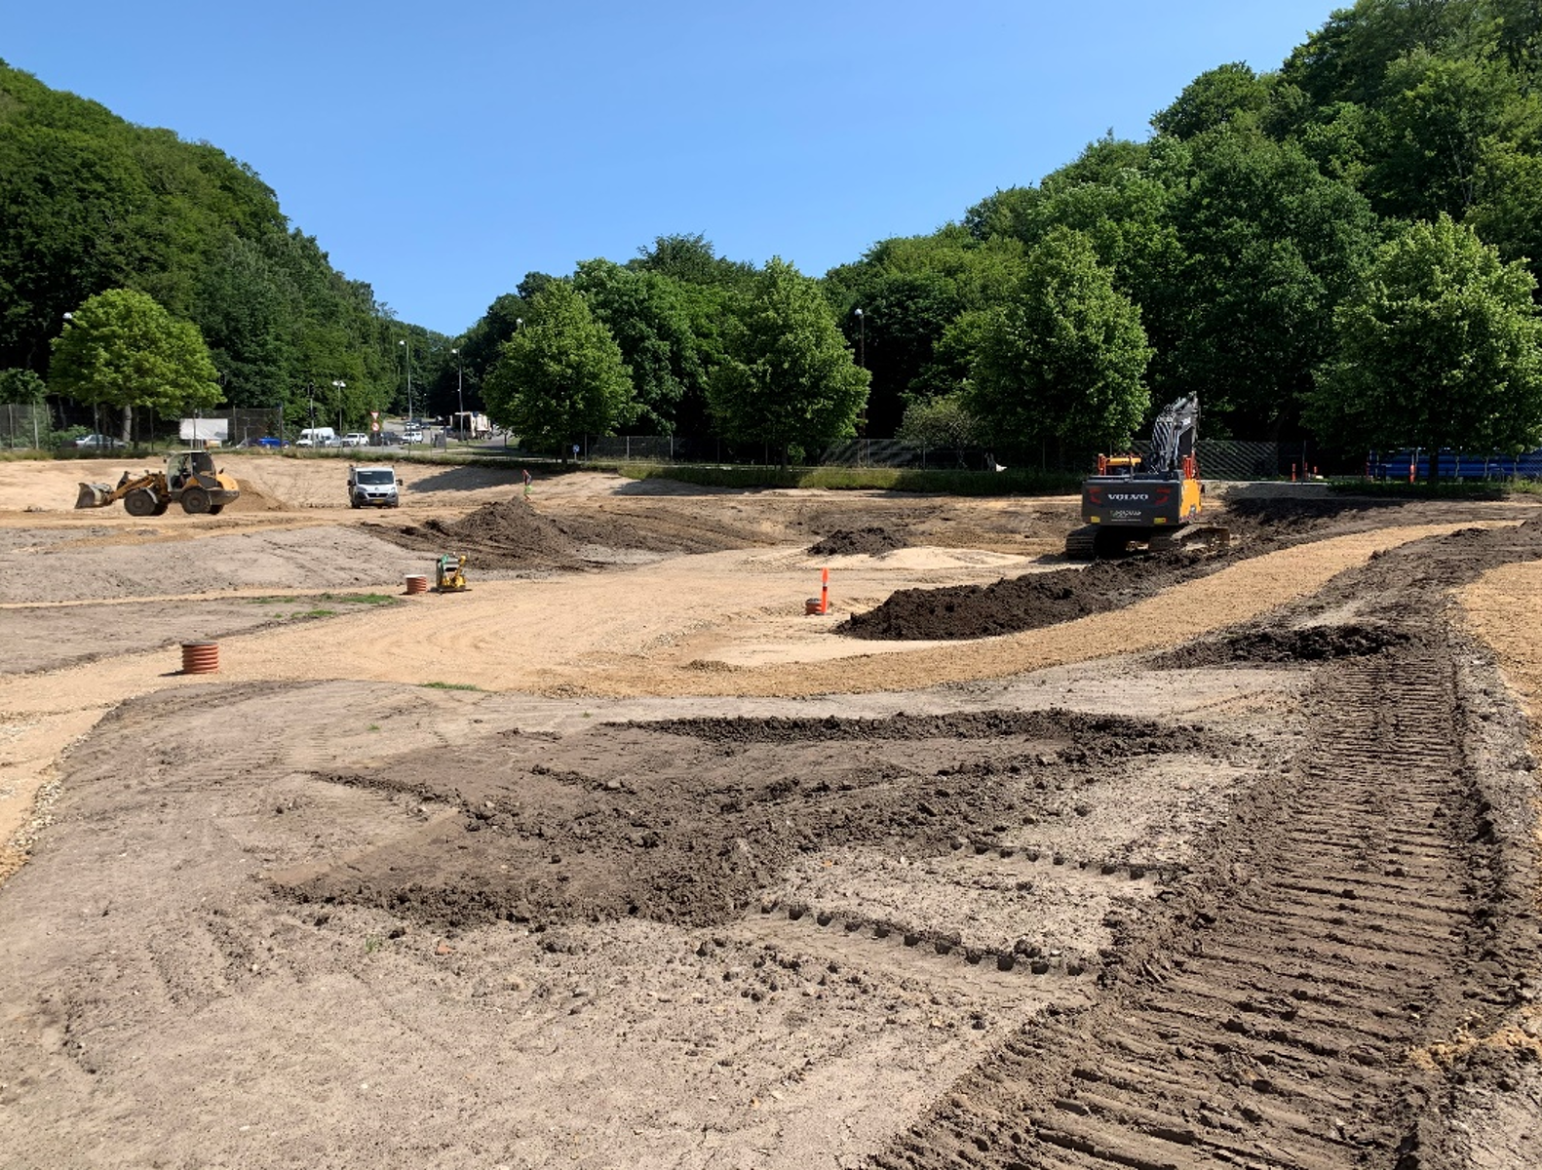
Good practice examples from CATCH pilots
Get inspired!
Urban water retention in Vejle (Denmark)
Sportsground for retention
Multifunctional area

Slide 9
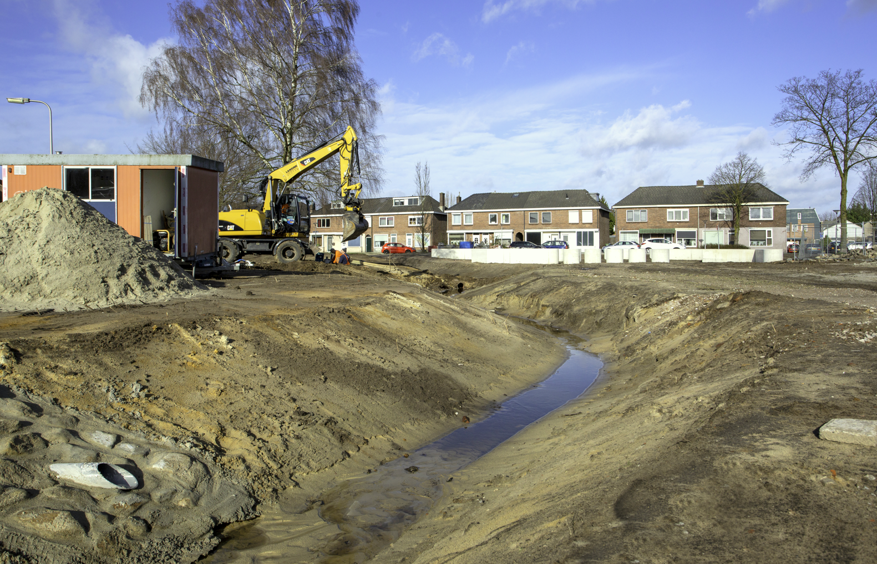
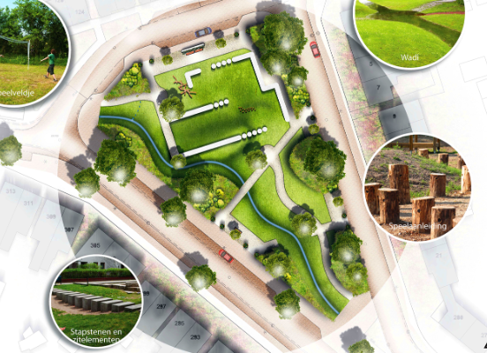
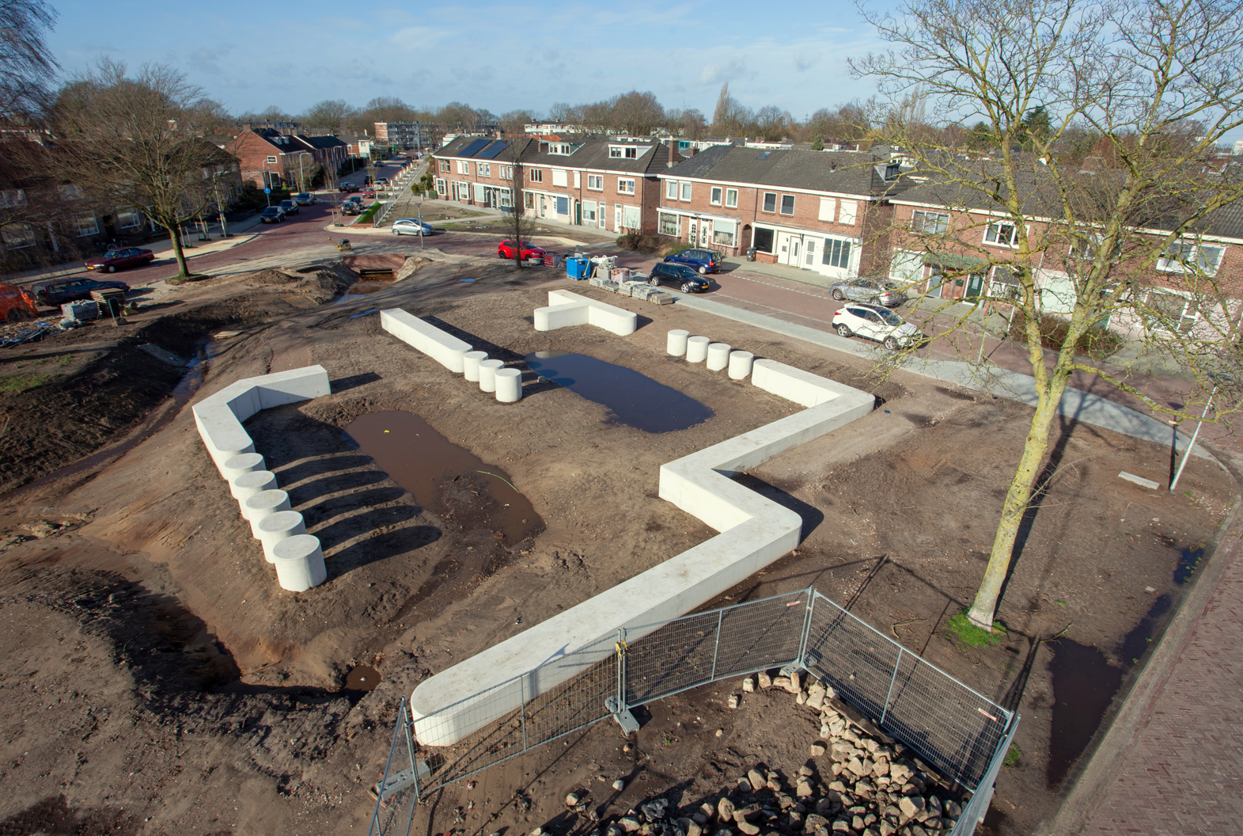
Good practice examples from CATCH pilots
Get inspired!
Urban water course and retention in Enschede (The Netherlands)
Multifunctional area
Combining recreation and retention

Slide 10
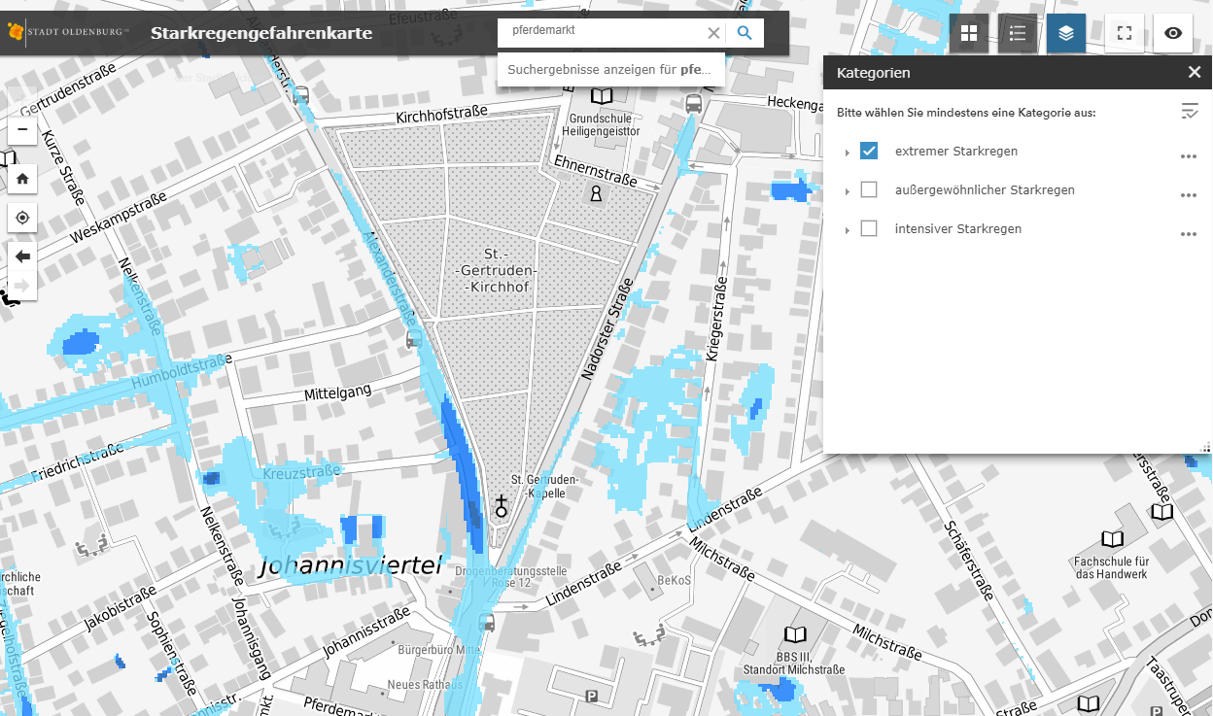

Good practice examples from CATCH pilots
Get inspired!
Traffic redirection in Oldenburg (Germany) in case of flooding
https://gis4ol.oldenburg.de/Starkregengefahrenkarte/index.html

Slide 11

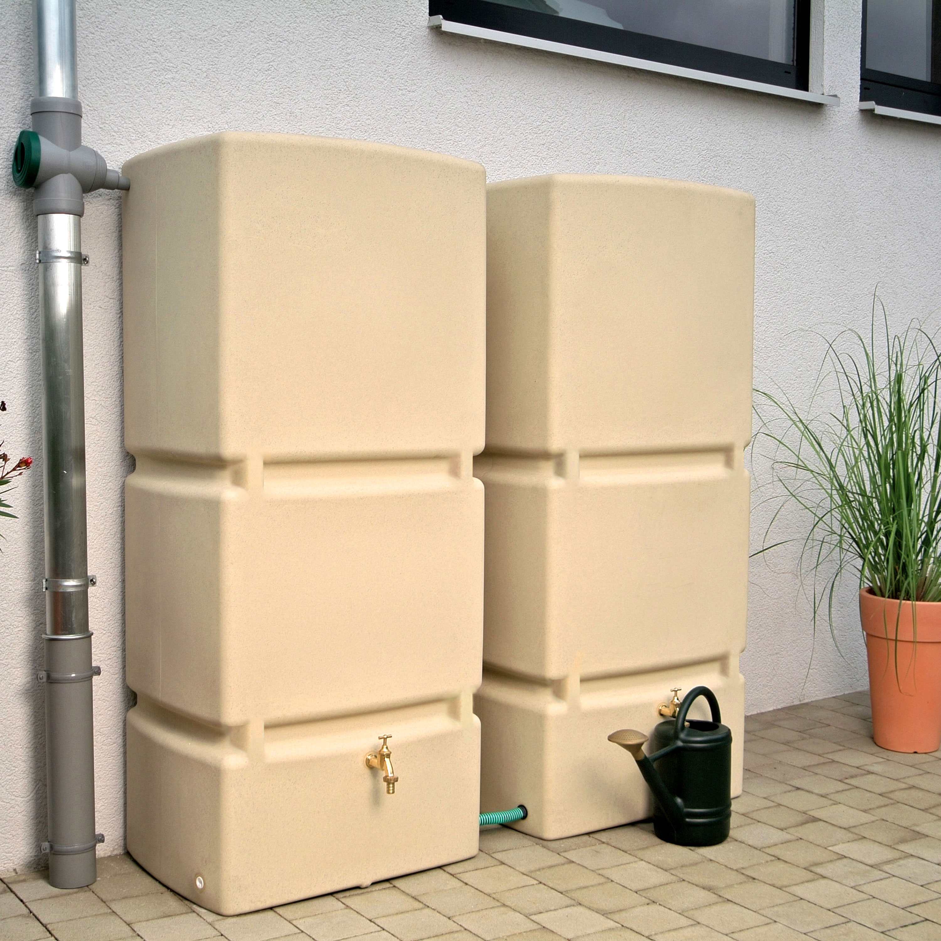
Good practice examples from CATCH pilots
Get inspired!
Free water butts on private ground in Norwich (UK)

Slide 12
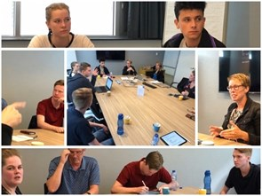
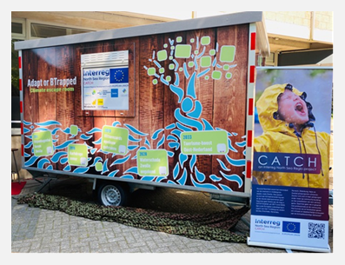
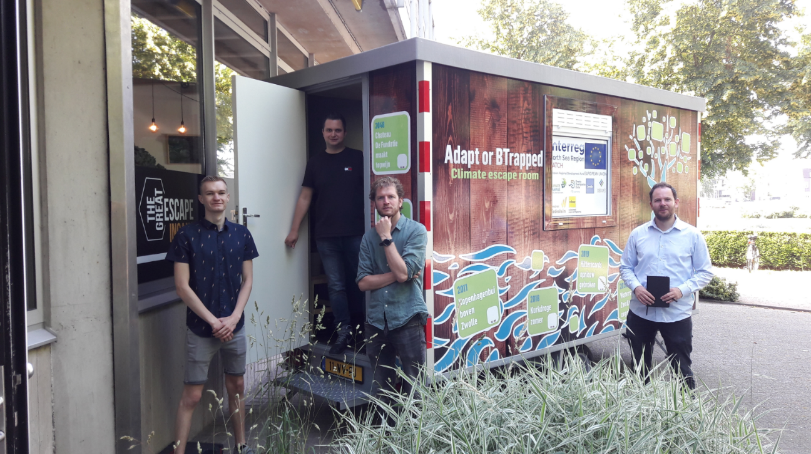
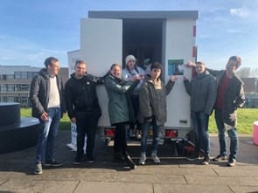
Good practice examples from CATCH pilots
Get inspired!
Awareness raising in Zwolle (Netherlands): A climate mobile escape room

Slide 13
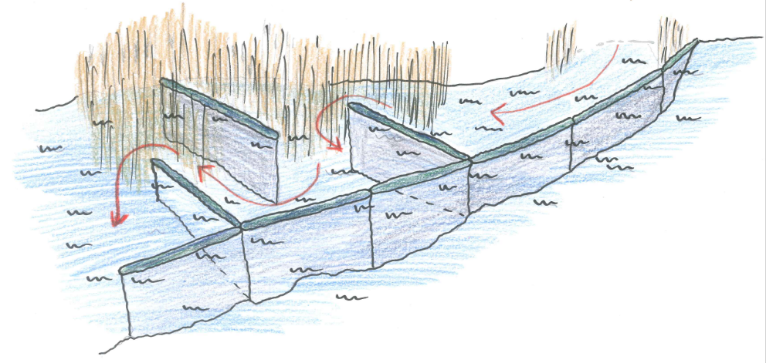
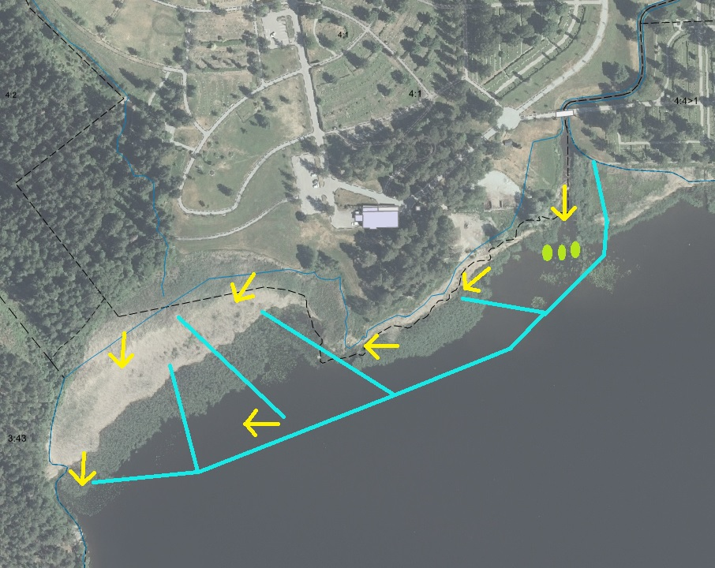
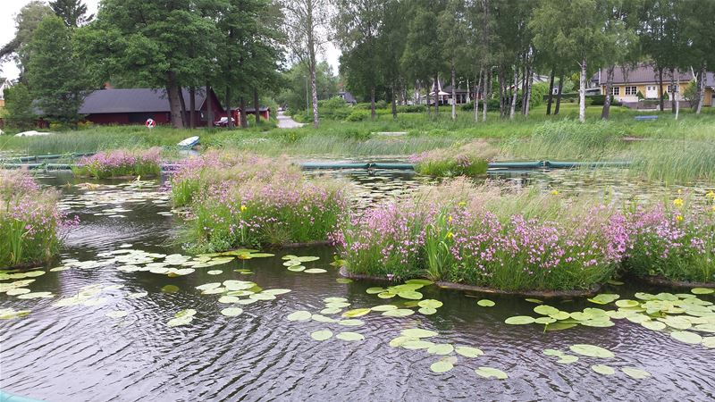
Good practice examples from CATCH pilots
Get inspired!
Sediment traps in Arvika (Sweden) against lake pollution

