Slide 1


CATCH
DST-Tool-Training on climate change adaptation
A regional CATCH pilot
Traffic redirection in Oldenburg, OOWV
Helge Bormann
Jade Hochschule

Slide 2


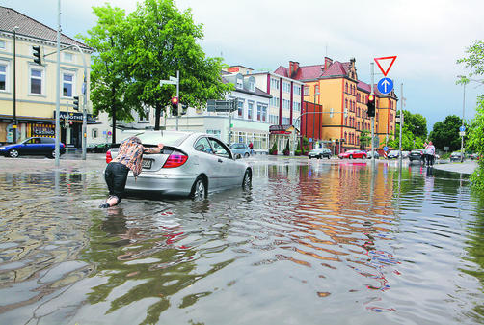
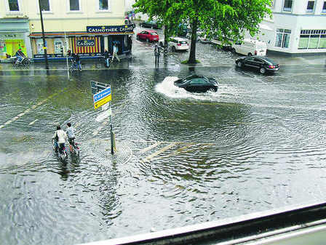
The Oldenburg CATCH pilot
Traffic redirection in Oldenburg (Germany) in case of flooding
The challenge
Frequent urban flooding due to heavy rainfall events
Source: https://www.nwzonline.de

Slide 3
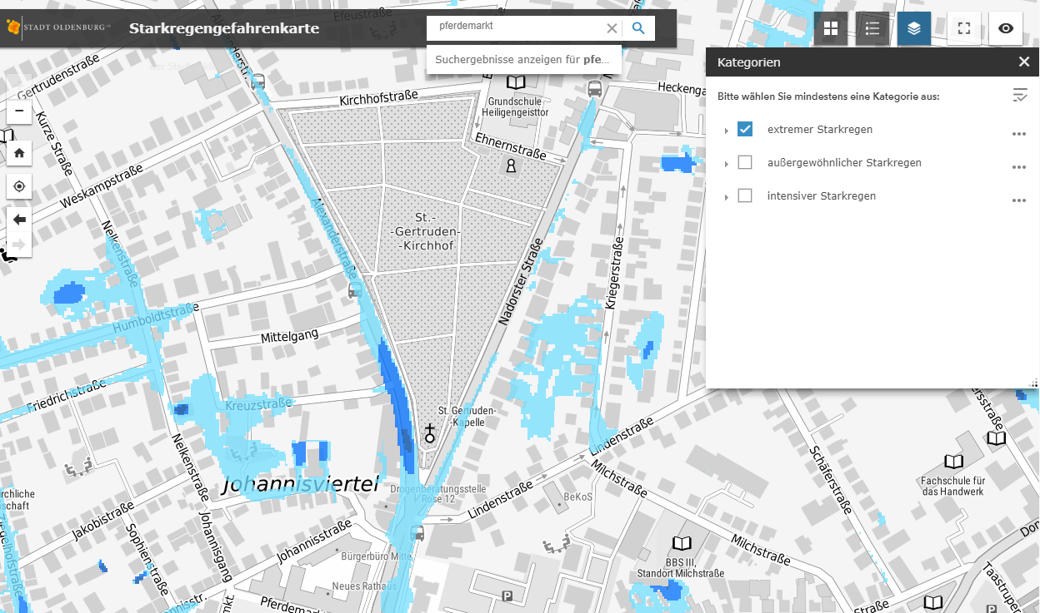

The Oldenburg CATCH pilot
Traffic redirection in Oldenburg (Germany) in case of flooding
The pilot approach
Local traffic redirection in case of heavy rainfall
Source: https://gis4ol.oldenburg.de/Starkregengefahrenkarte/index.html; © Bundesamt für Kartographie und Geodäsie

Slide 4
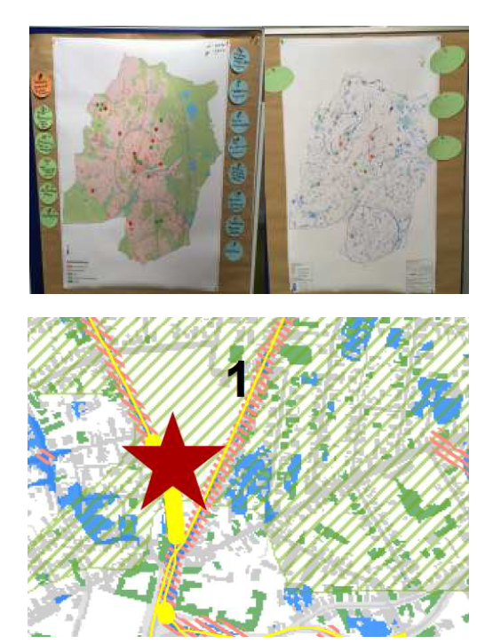
The Oldenburg CATCH pilot
Traffic redirection in Oldenburg (Germany) in case of flooding
Partners to be involved
City of Oldenburg: traffic department
Citizens → communication strategy, citizen involvement
Source: Dr. Pecher AG

Slide 5
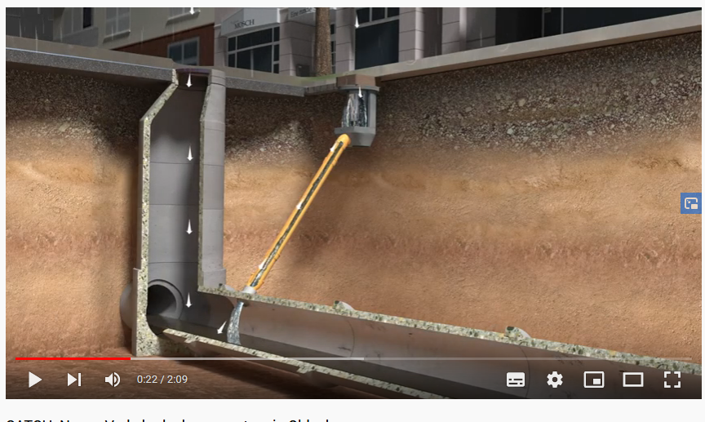
The Oldenburg CATCH pilot
Traffic redirection in Oldenburg (Germany) in case of flooding
The pilot approach
Local traffic redirection in case of heavy rainfall
Based on sensors in the sewage system
Source: https://www.youtube.com/watch?v=8QoD-RdfNKE

Slide 6
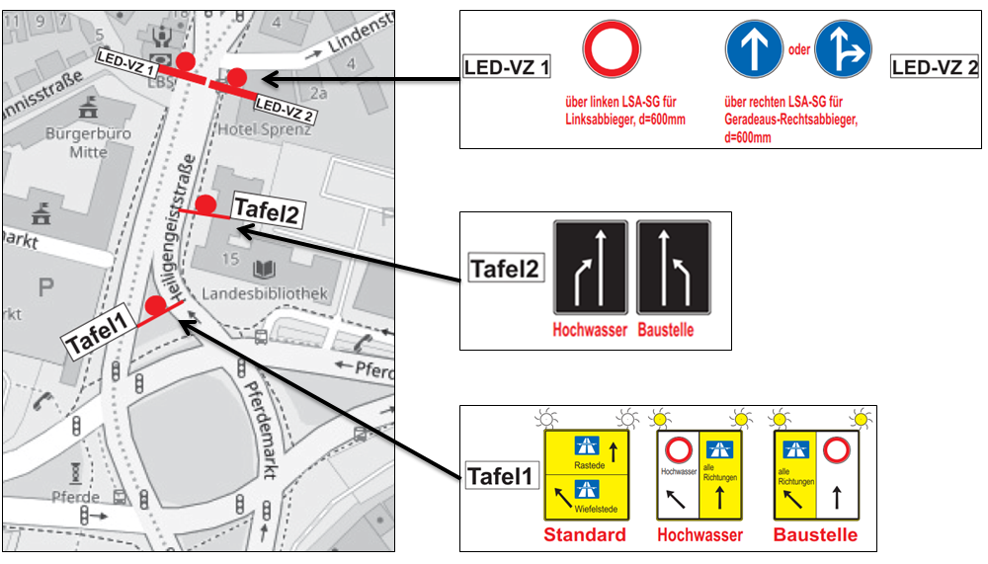
The Oldenburg CATCH pilot
Traffic redirection in Oldenburg (Germany) in case of flooding
The solution in detail
Driving direction out of the city
Source: Secumat GmbH

Slide 7
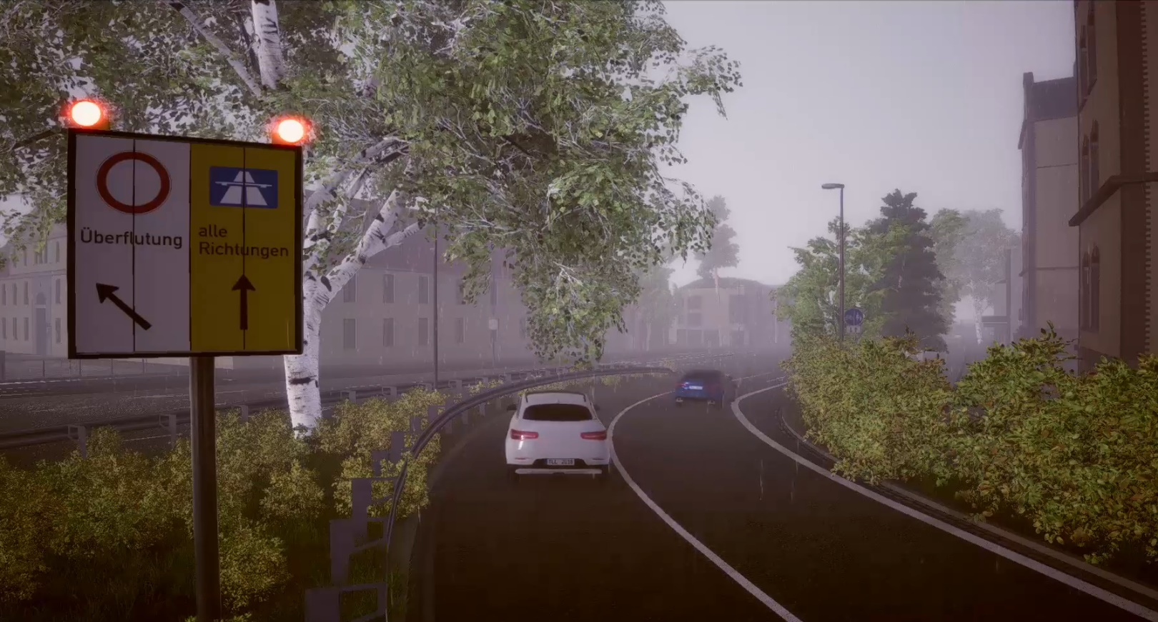
The Oldenburg CATCH pilot
Traffic redirection in Oldenburg (Germany) in case of flooding
The solution in detail
Driving direction out of the city
Source: https://www.youtube.com/watch?v=8QoD-RdfNKE

Slide 8
The Oldenburg CATCH pilot
Traffic redirection in Oldenburg (Germany) in case of flooding
The solution in detail
Source: Secumat GmbH

Slide 9
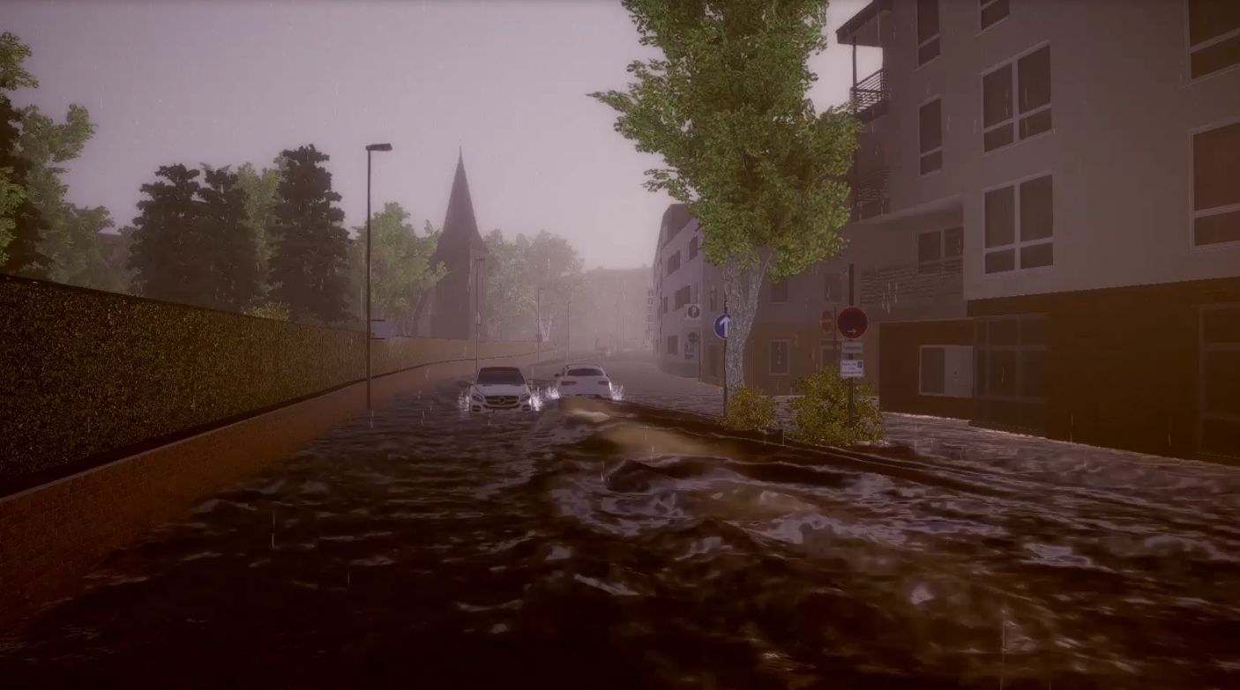
The Oldenburg CATCH pilot
Traffic redirection in Oldenburg (Germany) in case of flooding
The solution in detail
Source: https://www.youtube.com/watch?v=8QoD-RdfNKE

Slide 10
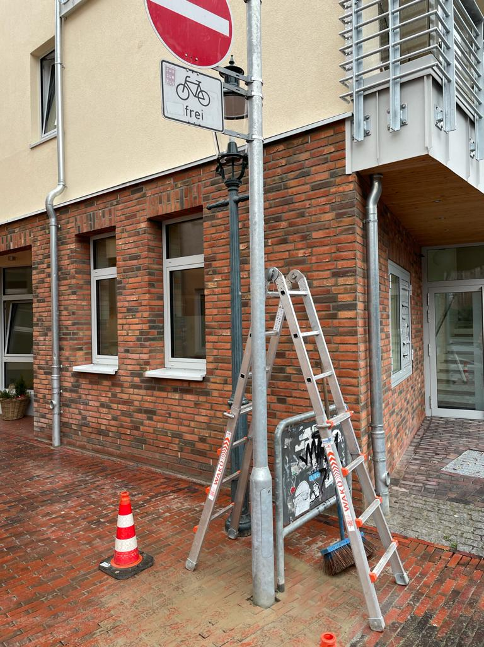
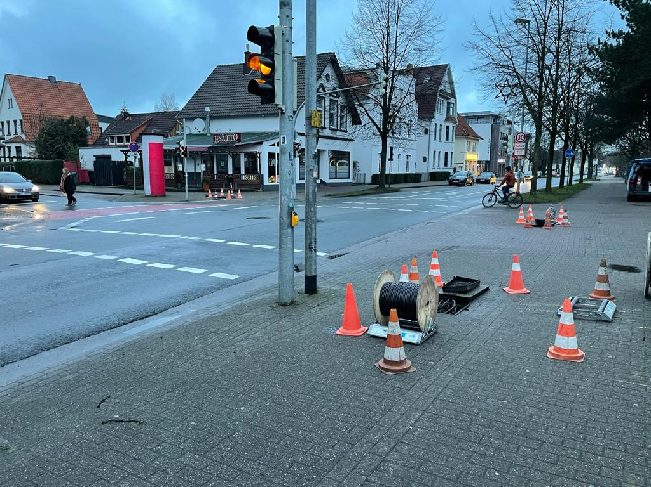
The Oldenburg CATCH pilot
Traffic redirection in Oldenburg (Germany) in case of flooding
Impressions of implementation
Source: Jähnig Elektrotechnik GmbH

Slide 11
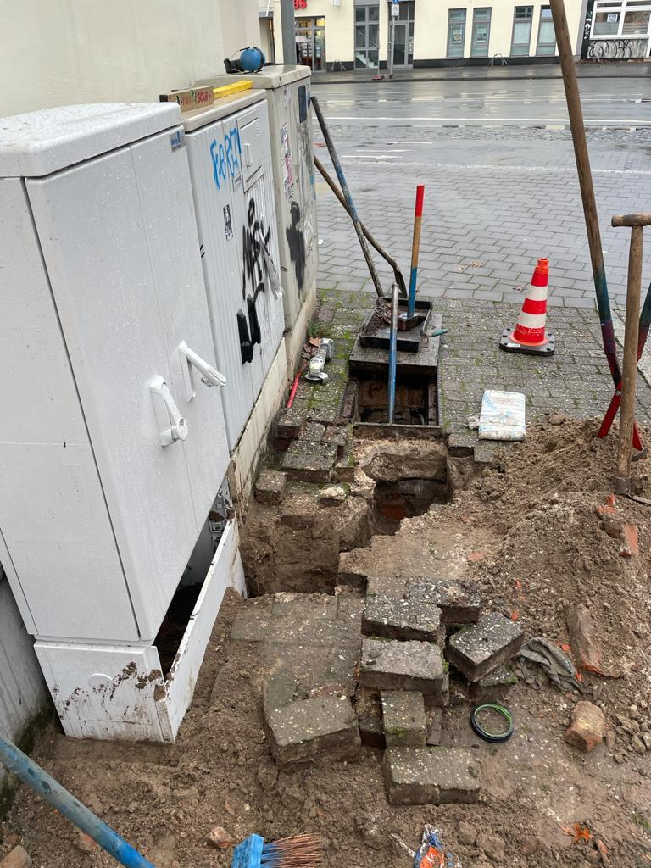
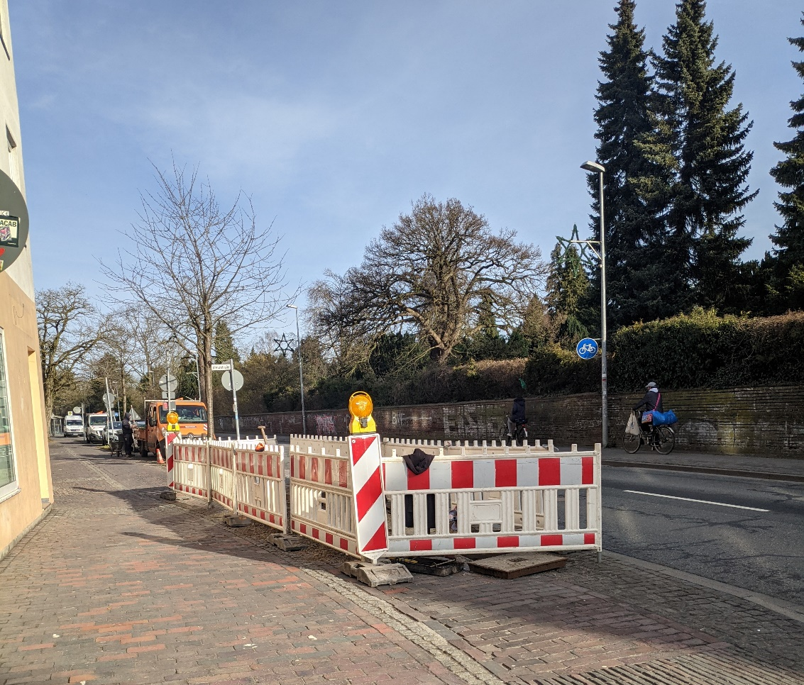
The Oldenburg CATCH pilot
Traffic redirection in Oldenburg (Germany) in case of flooding
Impressions of implementation
Source: Jähnig Elektrotechnik GmbH

Slide 12
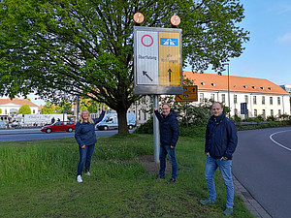
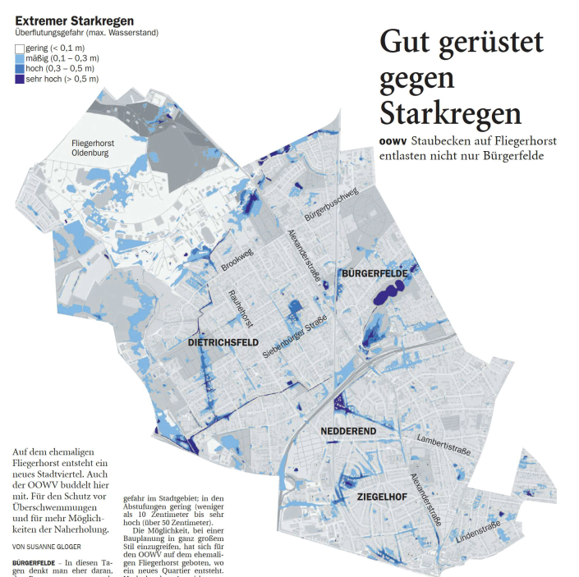
The Oldenburg CATCH pilot
Traffic redirection in Oldenburg (Germany) in case of flooding
Press work
Source: https://www.nwzonline.de

Slide 13
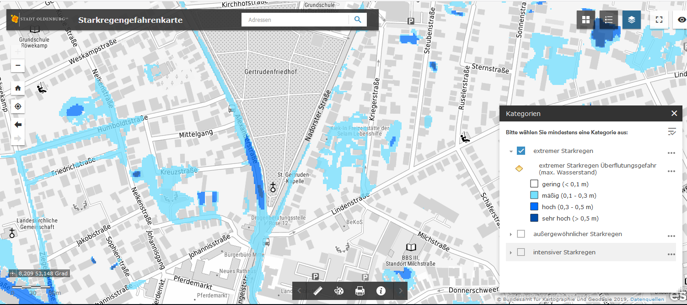
The Oldenburg CATCH pilot
Related activities by OOWV in Oldenburg
Heavy rainfall risk map for Oldenburg
Calculation of potentially flooded areas for 3 extreme rainfall scenarios:
29,8 mm/h; 36,5 mm/h; and 44 mm/h (shown here)
Source: https://gis4ol.oldenburg.de/Starkregengefahrenkarte/index.html

Slide 14
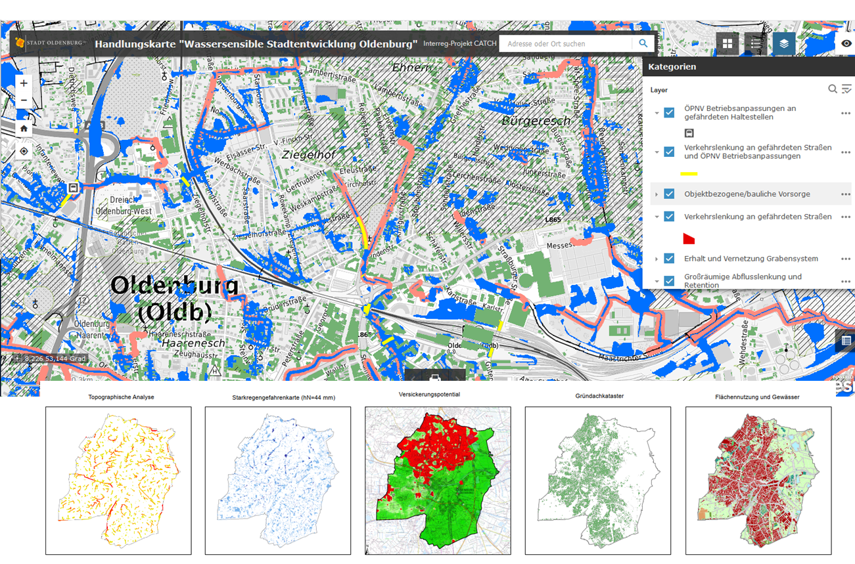
The Oldenburg CATCH pilot
Related activities by OOWV in Oldenburg
Merging data bases towards a Water Sensitive Oldenburg
Source: Dr. Pecher AG

Slide 15
The Oldenburg CATCH pilot
Related activities by OOWV in Oldenburg
The importance of ditches for draining Oldenburg
Results of a ditch study in the North of Oldenburg
Source: Planungsbüro Hahm

Slide 16
The Oldenburg CATCH pilot
Related activities by OOWV in Oldenburg
Moderated process of further development towards a water sensitive city of Oldenburg
Working group flooding
Working group flooding
Project group CATCH Oldenburg
Project group CATCH Oldenburg
GIS4OL Heavy Rain Hazard Map
CATCH Pilot Traffic control
Expert Workshops
Round Table
„Water Sensitive City Oldenburg“
Expert Workshops
Round Table
„Water Sensitive City Oldenburg“
Ditch Study Ofenerdiek
Action Map „Water Sensitive City Oldenburg“

