Slide 1
HyTrEc2 Hydrogen Transport Economy for the North Sea Region 2

Slide 2
The Hydrogen Transport Economy (HyTrEc) 2 project is part of the Interreg VB North Sea Programme Region Programme and is partly funded by the European Regional Development Fund.
Falls within programme Priority 4: Promoting green transport and mobility
Total budget of €6,180,602 of which the ERDF Contribution is €2,615,105
Six year project from 2016 to 2023.

Slide 3
The Hydrogen Transport Economy (HyTrEc) 2 project is part of the Interreg VB North Sea Programme Region Programme and is partly funded by the European Regional Development Fund.
Falls within programme Priority 4: Promoting green transport and mobility
Total budget of €6,180,602 of which the ERDF Contribution is €2,615,106
Six year project from 2016 to 2023.

Slide 4
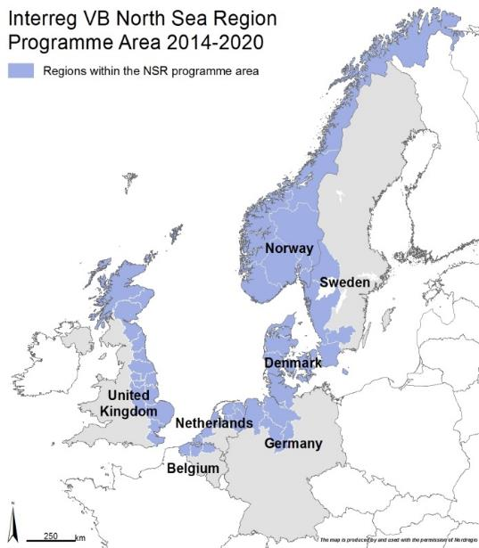
HyTrEc2 Partners

Slide 5
Pioneering
93%¹ of transport is currently oil based. Green transport solutions, such as hydrogen, will play a key role in achieving EU energy and climate change targets.
Hydrogen vehicles have a longer range than electric battery vehicles. This extended range is essential in those North Sea regions which have numerous small sized cities with a large suburban and rural hinterland.
¹ http://ec.europa.eu/eurostat/web/products-datasets/-/tsdcc340

Slide 6
Collaboration
Current market failure caused by the high cost of FCEVs and the need to make green hydrogen cheaper through more cost effective green hydrogen production, storage and distribution.
HyTrEc2 will create conditions so that a hydrogen market can develop providing a platform for collaborative development of strategies and initiatives that will inform and shape the development of infrastructure, technology and skills.

Slide 7
Objectives
Implementing innovative hydrogen transportation solutions involving cars, vans, large trucks and refuse collection vehicles to advance the case for zero emission solutions for public and private sector fleets.
Improving the supply chain and training so that the NSR becomes a Centre of Excellence for hydrogen transport.
Developing innovative methods for the production, storage and distribution of green hydrogen.
Complementing national programmes for hydrogen and facilitating joint NSR approaches and common standards.

Slide 8
What have we delivered so far?
Deliverable | Number
Number of hydrogen vehicles tested | 33
Green hydrogen from wind and solar projects | 4
Number of people trained in hydrogen | 160
Number of businesses entering the supply chain | 25
Organisations adopting hydrogen after HyTrEc2 influencing | 39
Organisations engaged with HyTrEc2 (presentations, downloads, events) | +700
Video Views on YouTube (how to refuel a vehicle, tours of stations, tour of cars) | +5,000

Slide 9
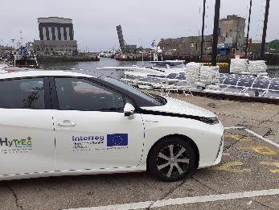
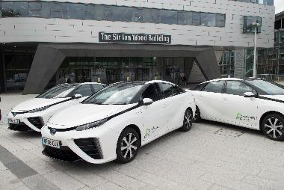
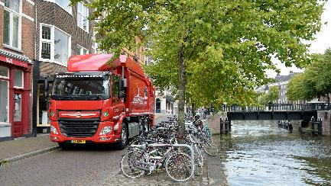
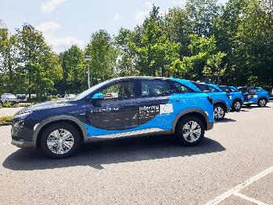
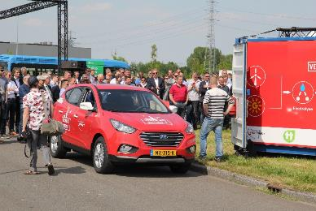
Vehicle Deployments – Fuel Cell Electric Vehicles
Hyundai ix35s in Groningen
Toyota Mirais in Aberdeen City and Aberdeenshire
Hyundai Nexos in Drenthe and Aberdeen City
Waste trucks in Groningen
Vehicles mainly used by staff but in some cases placed on Car Sharing Clubs for citizens to try

Slide 10
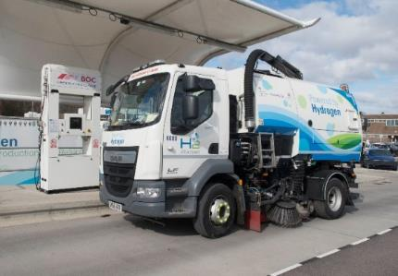
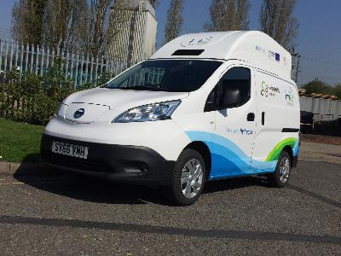
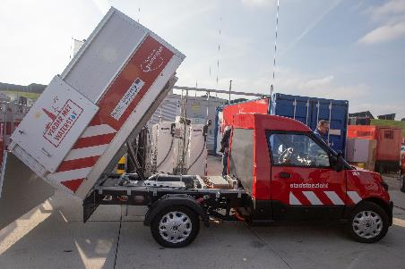
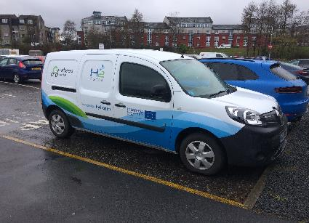
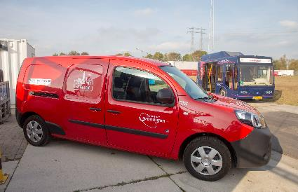
Vehicle Deployments – Retrofitting
Streetscooter in Groningen
Renault Kangoos in Groningen and Aberdeen
Nissan env200 van in Aberdeen
DAF H2ICEd Roadsweeper
Mix of electric + hydrogen range extenders and hydrogen-diesel injection

Slide 11
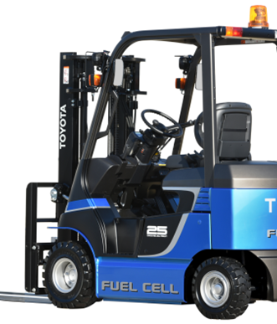
Vehicle Deployments - Simulation
Forklift Truck Simulation
Small and medium sized forklifts often have electrical drivelines
Battery capacity is often not big enough during long working days with several shifts
Trialled swapping out larger battery and replacing with Hydrogen storage and a battery with smaller capacity and volume
Assume battery capacity of 54kWh and fuel cell 15kW
Conclusion: possible to build and can perform, but size of fuel cell and optimal performance depends on detailed knowledge of the power requirement over the course of the day

Slide 12
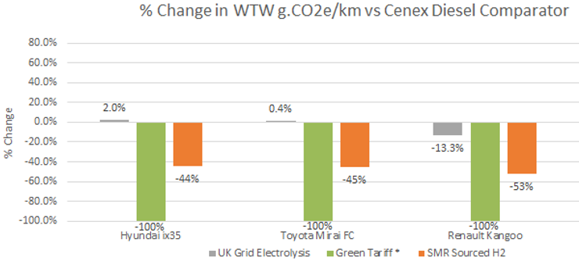
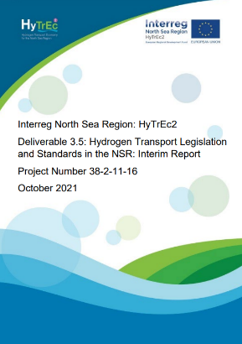
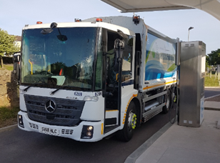
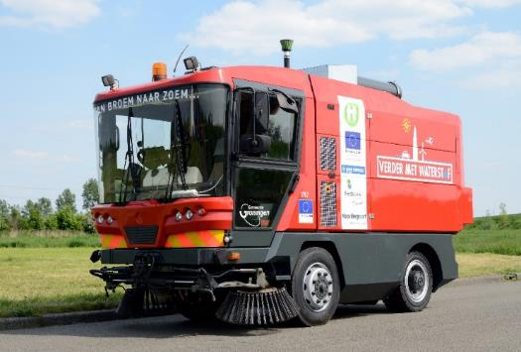
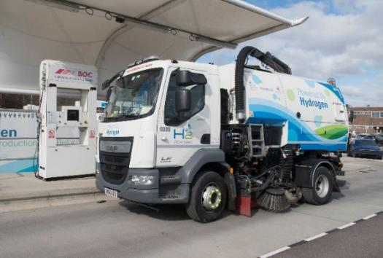
Vehicle Monitoring

Slide 13
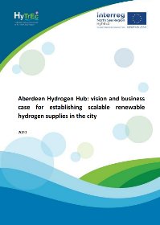
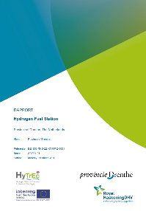
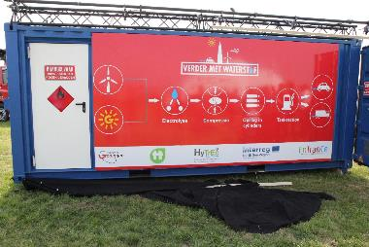
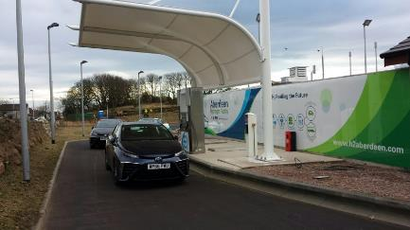
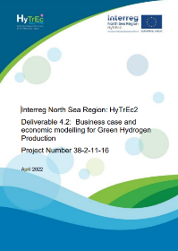
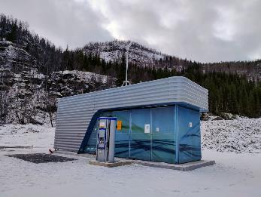
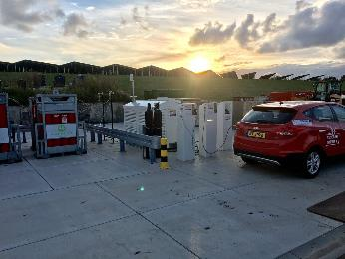
Green Hydrogen Production, Storage and Distribution
Hydrogen Refuelling Station connected to solar array in Groningen
Hydrogen refuelling station using green tariff electricity in Aberdeen
Hydrogen refuelling station in Narvik
Business cases for renewables and green hydrogen production in Drenthe, Aberdeen Hydrogen Hub and RISEs Economic Modelling for Green Hydrogen in the NSR

Slide 14
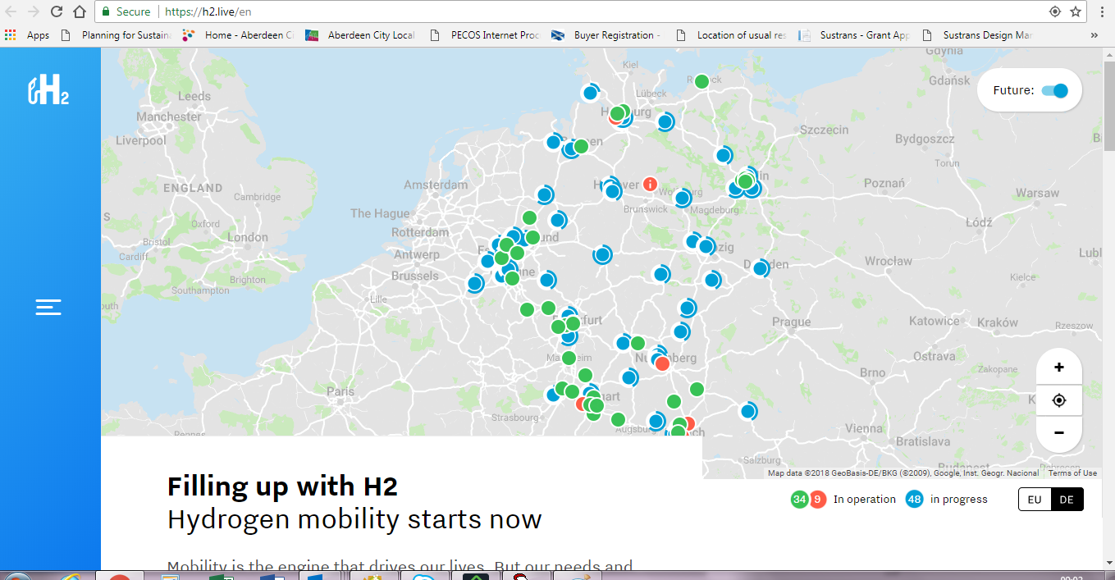
H2 Mobility and HyTrEc2 App

Slide 15
Enabling the Market
All Partners have been having difficulty on some level
Vehicle procurement/ retrofitting
Hydrogen Refuelling Stations and Green Hydrogen
Training courses for technicians to maintain vehicles
First exercise was for all Partners to speak to their national hydrogen organisations on supply chain identification
Commissioned consultant Pale Blue Dot to identify the hydrogen supply chain across the North Sea Region

Slide 16
Vision and Objectives

Slide 17
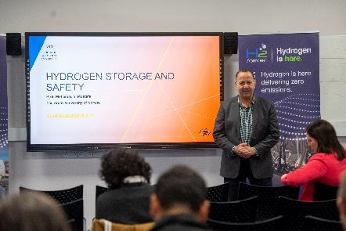
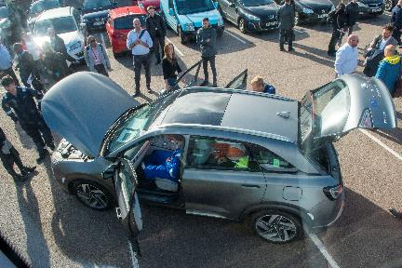
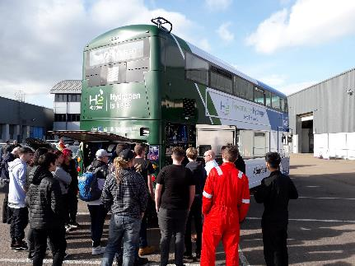
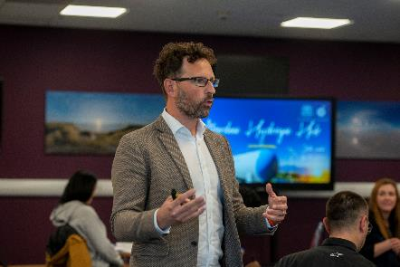
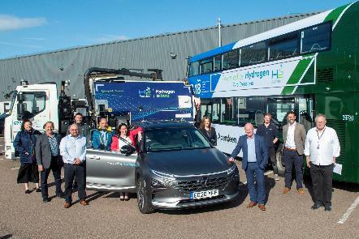
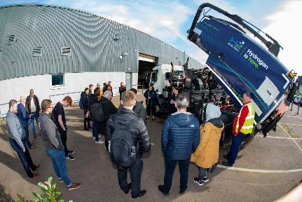
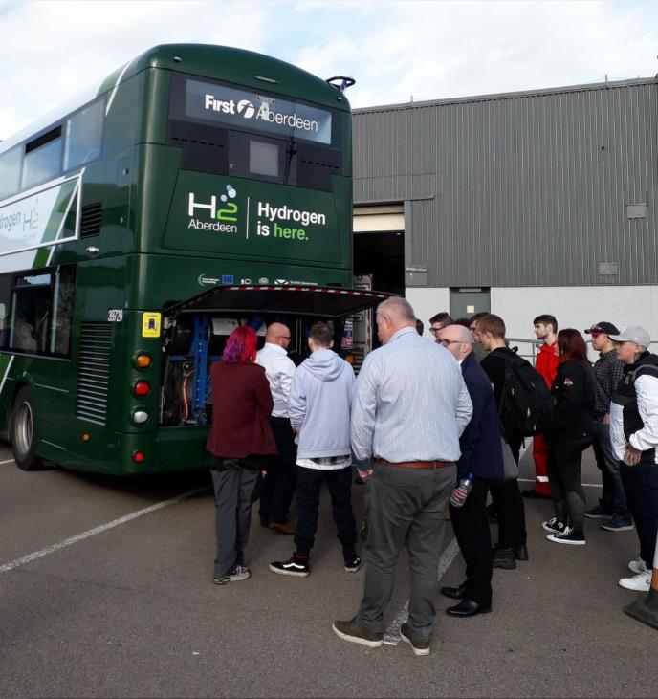
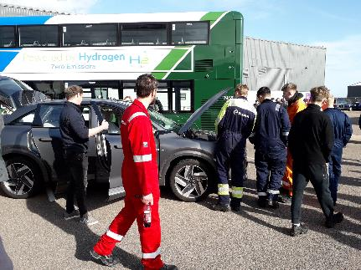
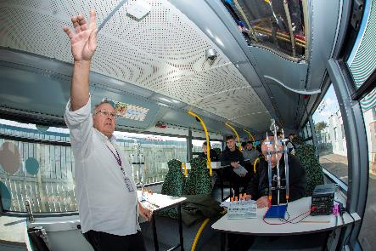
Training
Technicians training courses accompanying increasing numbers of vehicles offers opportunities for technical colleges as well
September 2022 training day at NESCol in Aberdeen – mix of presentations and practical sessions with students and stakeholders

Slide 18
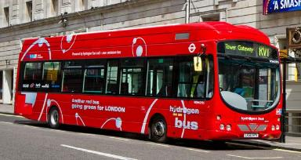
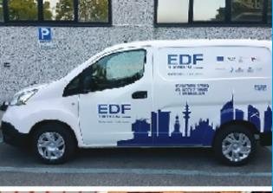
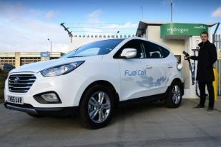
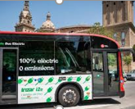
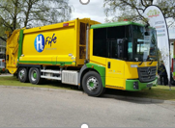
Collaboration
Local authorities will have to deliver decarbonisation targets!
Successful demonstration projects in Europe → learnings can be shared, many local authorities are facing the same challenges
Transnational interoperability, transnational customer information are essential for the development of zero-emission transport and energy systems → European cooperation is essential in these sectors
Engaging with other European projects such as G-Patra and HECTOR
Local authorities have purchasing power: creating the demand is key

Slide 19
What’s Next?!
Delivery of Ground Power Unit and “Transportable Hydrogen Demonstrator Model” which will engage with educational establishments in Drenthe
A couple of large hydrogen applications – including hydrogen truck in Aberdeenshire!
Hydrogen applications in port side settings including consideration of multi-modal (HGVs, maritime and rail) and multi-fuel (hydrogen, electric and diesel/ petrol) refuelling stations
Satellite Hydrogen Refuelling Station “Footprint”
Final Conference!

Slide 20
Contact Us/ Follow Us
northsearegion.eu/hytrec2
twitter.com/HyTrEc2/
uk.linkedin.com/in/hytrec2
YouTube.com/HyTrEc2
Project Manager
Louise Napier
lnapier@aberdeencity.gov.uk
Tel: + 44 (0)1224 523327

