Slide 1
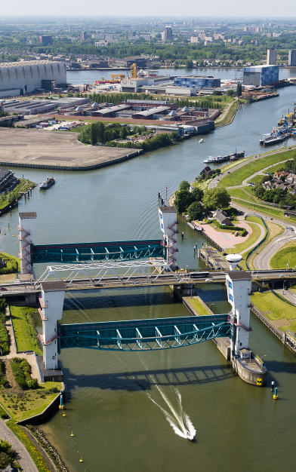
Introduction of second Rijkswaterstaat Pilot
Asses further improvements of the HIJ barrier in relation to system of HIJ
Ina Konterman
Celina de Ruiter
Rijkswaterstaat
7th of March 2018
Notes:
Welcome, my name is Pim Neefjes and I will give you a brief introduction of The Deltaprogramma, with a short history, the challenges and choosen strategies.
Hollandsche IJsselkering. De Hollandsche IJsselkering beschermt het laagstgelegen deel van Nederland, 6,76 m onder NAP. Dit Deltawerk bij Krimpen aan den IJssel was als eerste van de 13 klaar. Rijkswaterstaat begon een jaar na de watersnoodramp (1953) met de bouw van de Hollandsche IJsselkering.

Slide 2
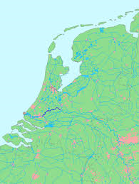
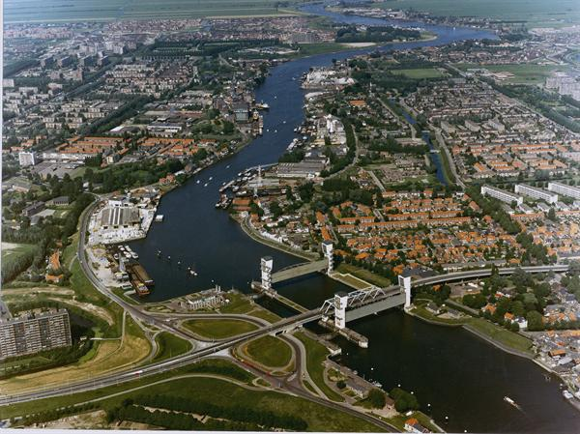
Hollandse IJssel
Fresh water tidal river, connected to North Sea – high ecological value
Important source of fresh water for western part of the Netherlands
Shipping movements freight transport: 25.000/year
Area is partly densely populated, especially at western side of HIJ

Slide 3
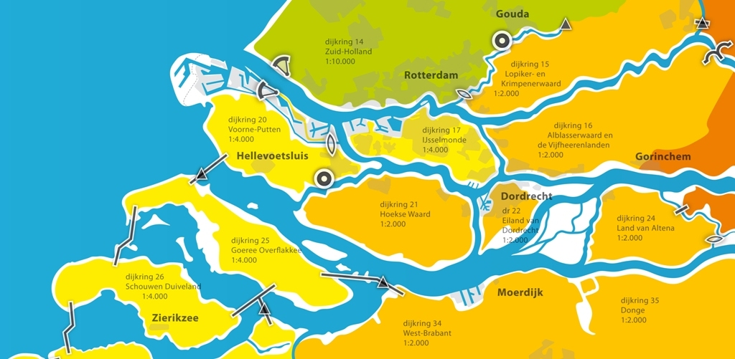
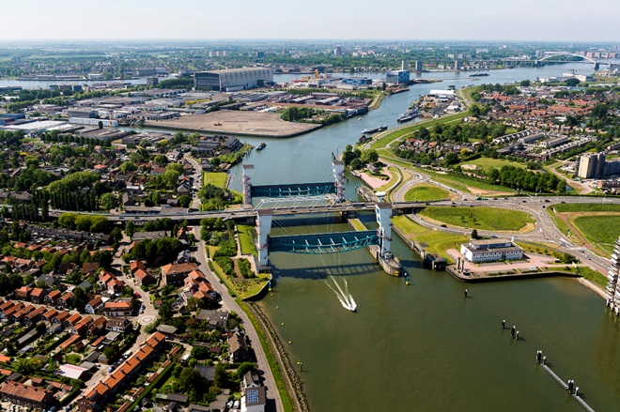
Asses further improvements of the HIJ barrier in relation to system of HIJ
Why?
Conclusion of system analysis of Deltaprogramme Rijnmond-Drechtsteden – look at system of HIJ as a whole
Large flood protection assignment expected at HIJ – what are alternatives for dike reinforcement?

Slide 4
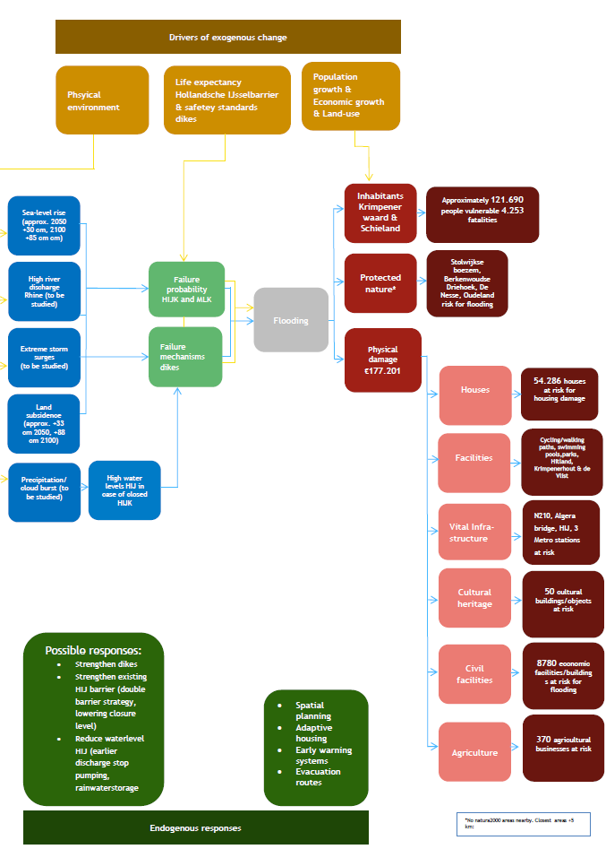
System analysis

Slide 5
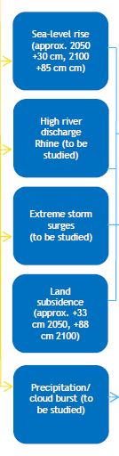
Sources (1)
Sealevel rise
Scenario’s used for sea-level rise
30 cm in 2050
85 cm in 2100
Sensitivity scenario’s, to be determined, for instance:
150 cm in 2100
New scenarios in 2019/2020
River discharge
Current discharge + 10%
Use of Grade Model

Slide 6
Sources (2)
Extreme storm surges
Various stormscenarios need to be included: strength of the storm, direction and timeline of the storm
Landsubsidence
1,1 cm / year in the Krimpenerwaard
2050: 33 cm
2100: 88 cm
Precipitation
Studie of Deltares is recently done on precipitation. Results are at Deltacommissioner and can be included in this study

Slide 7
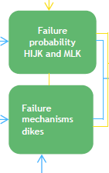
Pathway
Failure probability HIJK and MLK
Failure probability Maeslantkering: 1 op 100
Failure probability Hollandsche IJsselkering: 1 op 200
These may change in time

Slide 8
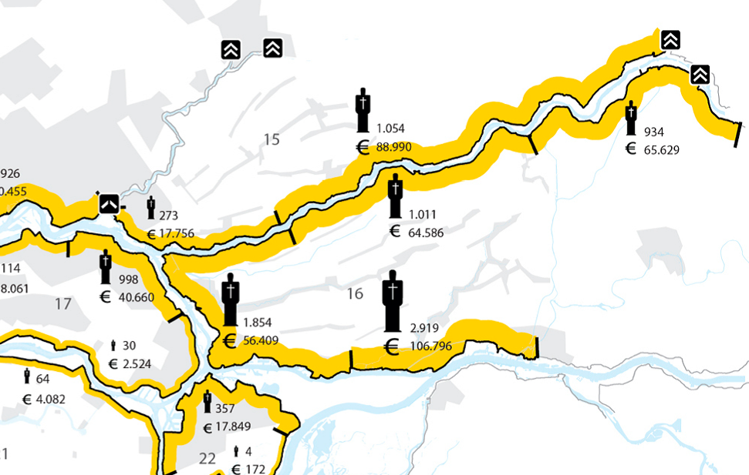
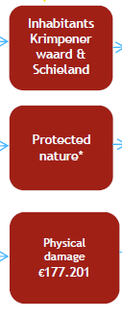
Precipitation
Receptor

