Slide 1
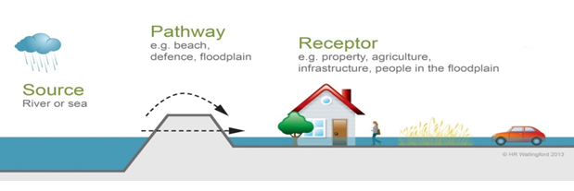
System analysis, Source-Path-Receptor approach
Project KIJK (water authority HHSK)

Slide 2
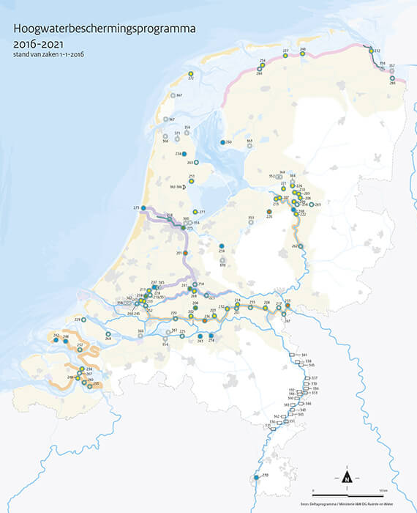
The flood protection assignment
Nearly 60% of The Netherlands is vulnerable to flooding
Most of Dutch population in that area
Climate change and land subsidence
Flood Protection Programme (the execution department of the Delta programme) keeps The Netherlands safe
Project KIJK is one the 300 projects
Notes:
Delta programme
Flood Protection Programme
To frame project KIJK

Slide 3
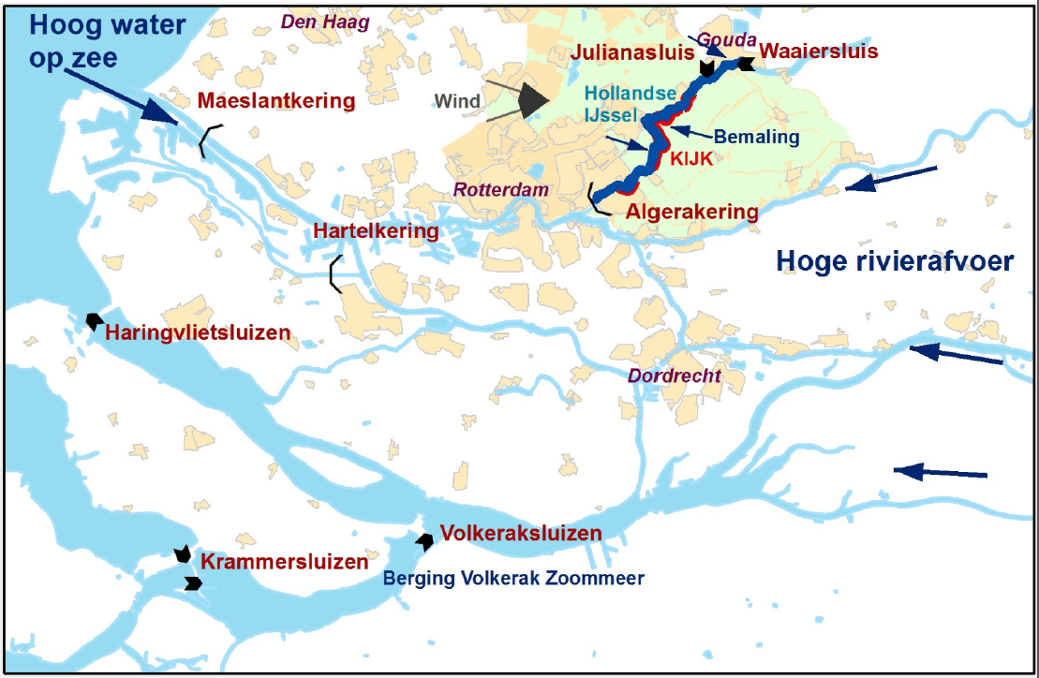
Source (1)
Tidal river connected to North Sea
Wind
Precipitation in the area or upstream with high discharge
Climate change worsens effects
Land subsidence 1,1 cm/yr
Notes:
Noordzee getijden – noem langs welke sluizen / dammen / Deltawerken het gaat – check plaatje Arnold
Δ Klimaatverandering: zeespiegelstijging vaker en vaker hogere golven door de wind
Hollandse ijssel vanuit bron … met afvoer vanuit bovenstrooms
Δ Klimaatverandering: meer regen vanuit bovenstrooms vaker, en water vanuit achterland wordt op HIJ gepompt
Bodemdaling!
the Hollandse IJssel is a tidal river that is connected to the North Sea. The Storm Surge Barrier was built after the 1953 North Sea flood disaster. It was built together with the Algera Bridge.

Slide 4
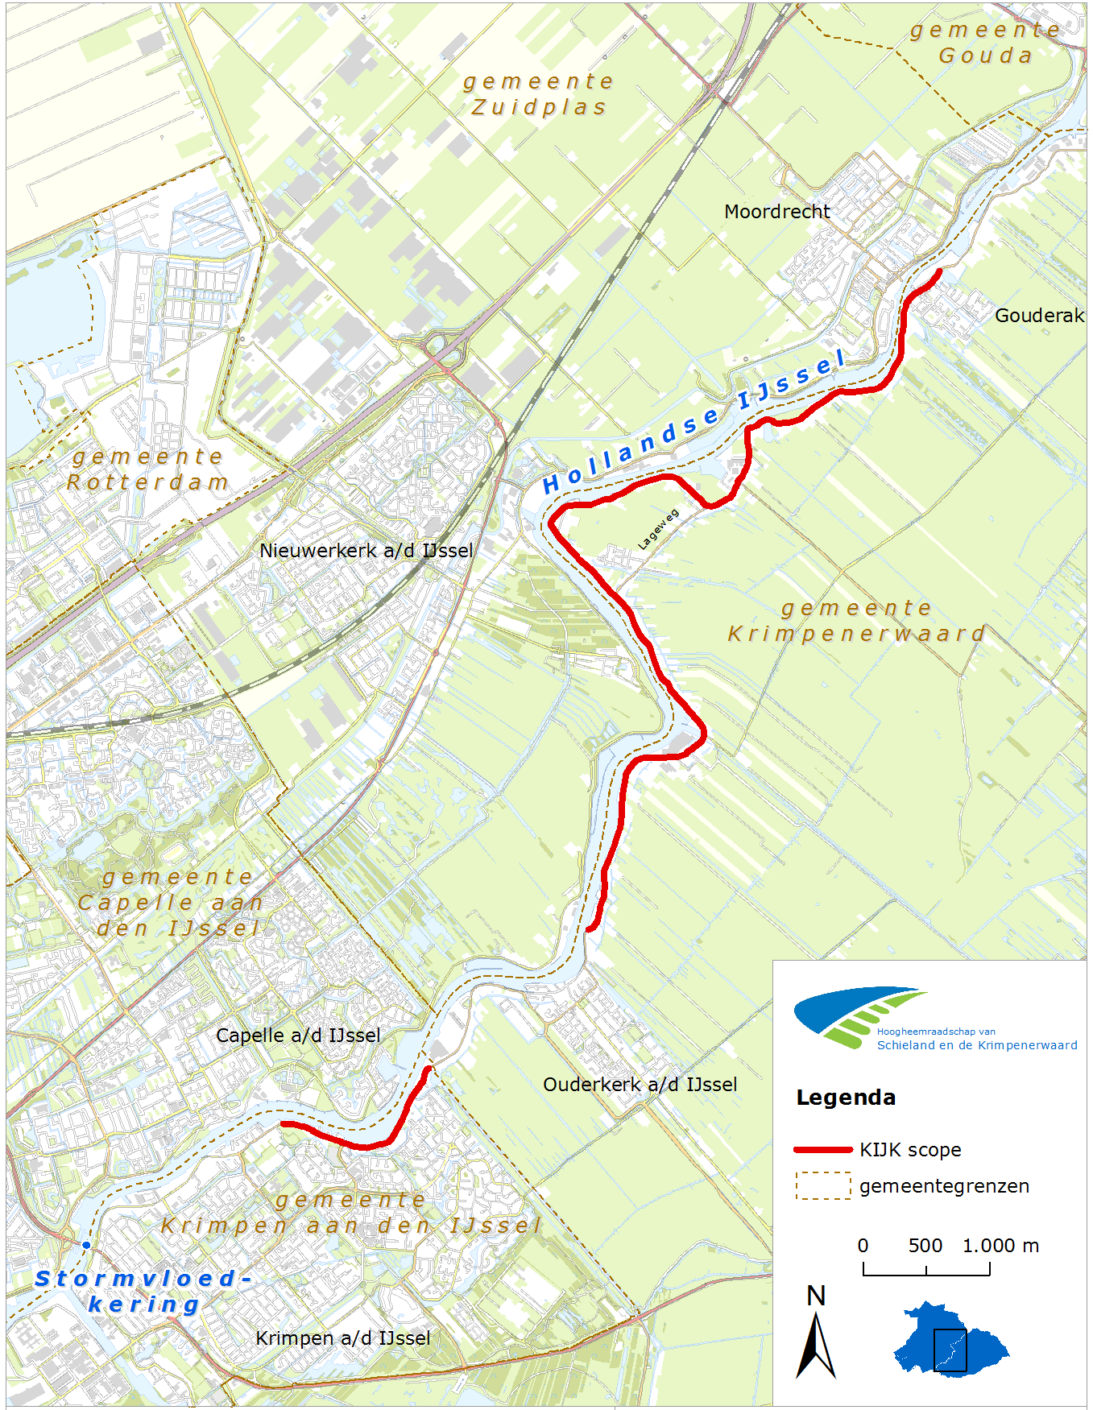
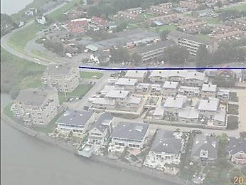
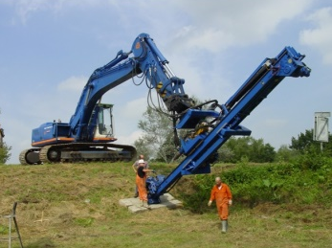
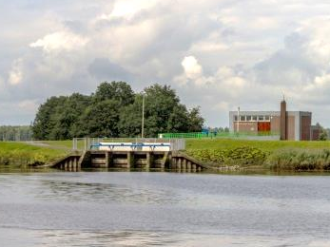
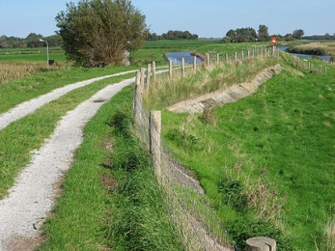
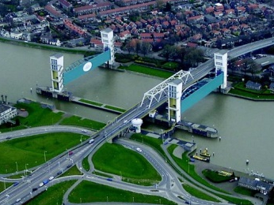
Source (2)
Floodplains (2,1km)
By using the strength of floodplains in calculating the safety of the dike.
Dike
Next to traditional solutions, innovative techniques (like nails) or advanced calculation tools are possible.
1
2
The Hollandse IJssel
By lowering the maximum water level by closing the Storm Surge Barrier earlier in time when extreme weather is predicted.
5
3
Polder
By minimizing the impact of a flooding (water retention area) or by reinforcing a secondary flood protection.
Storm Surge Barrier
By optimizing the failure probability of the Barrier.
4
4
Notes:
Broader perspective
In this project KIJK we adopted the whole system approach and the idea of thinking in functions rather than objects. This makes us not just finding solutions in the object dike. The traditional dike reinforcement solution has an enormous impact on the available space.
Project KIJK addresses the functional goal: protecting the citizens and economic values behind the dike against high water levels and flooding, and to meet the new Dutch safety standards.
This could not only be solved by reinforcing the dike, but also with a combination of solutions in a broader perspective such as lowering water levels, making agreements on adjusting the closing protocol of the Storm Surge Barrier, minimizing the impact of a possible flooding, or using innovative solutions.
the Hollandse IJssel is a tidal river that is connected to the North Sea. The Storm Surge Barrier was built after the 1953 North Sea flood disaster. It was built together with the Algera Bridge.

Slide 5
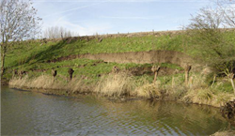
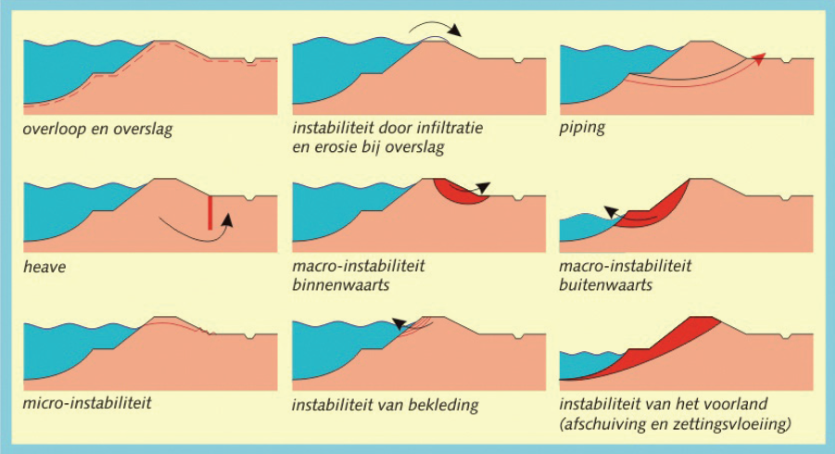
Pathway (1)
landward macro-instability
riverward macro-instability
micro-instability
Failure mechanisms project KIJK
wave overtopping and wave run-up
revetment instability (top soil layer)
floodplain instability
Notes:
grass/asphalt/stone dike cover / revetment instability (top soil layer).

Slide 6
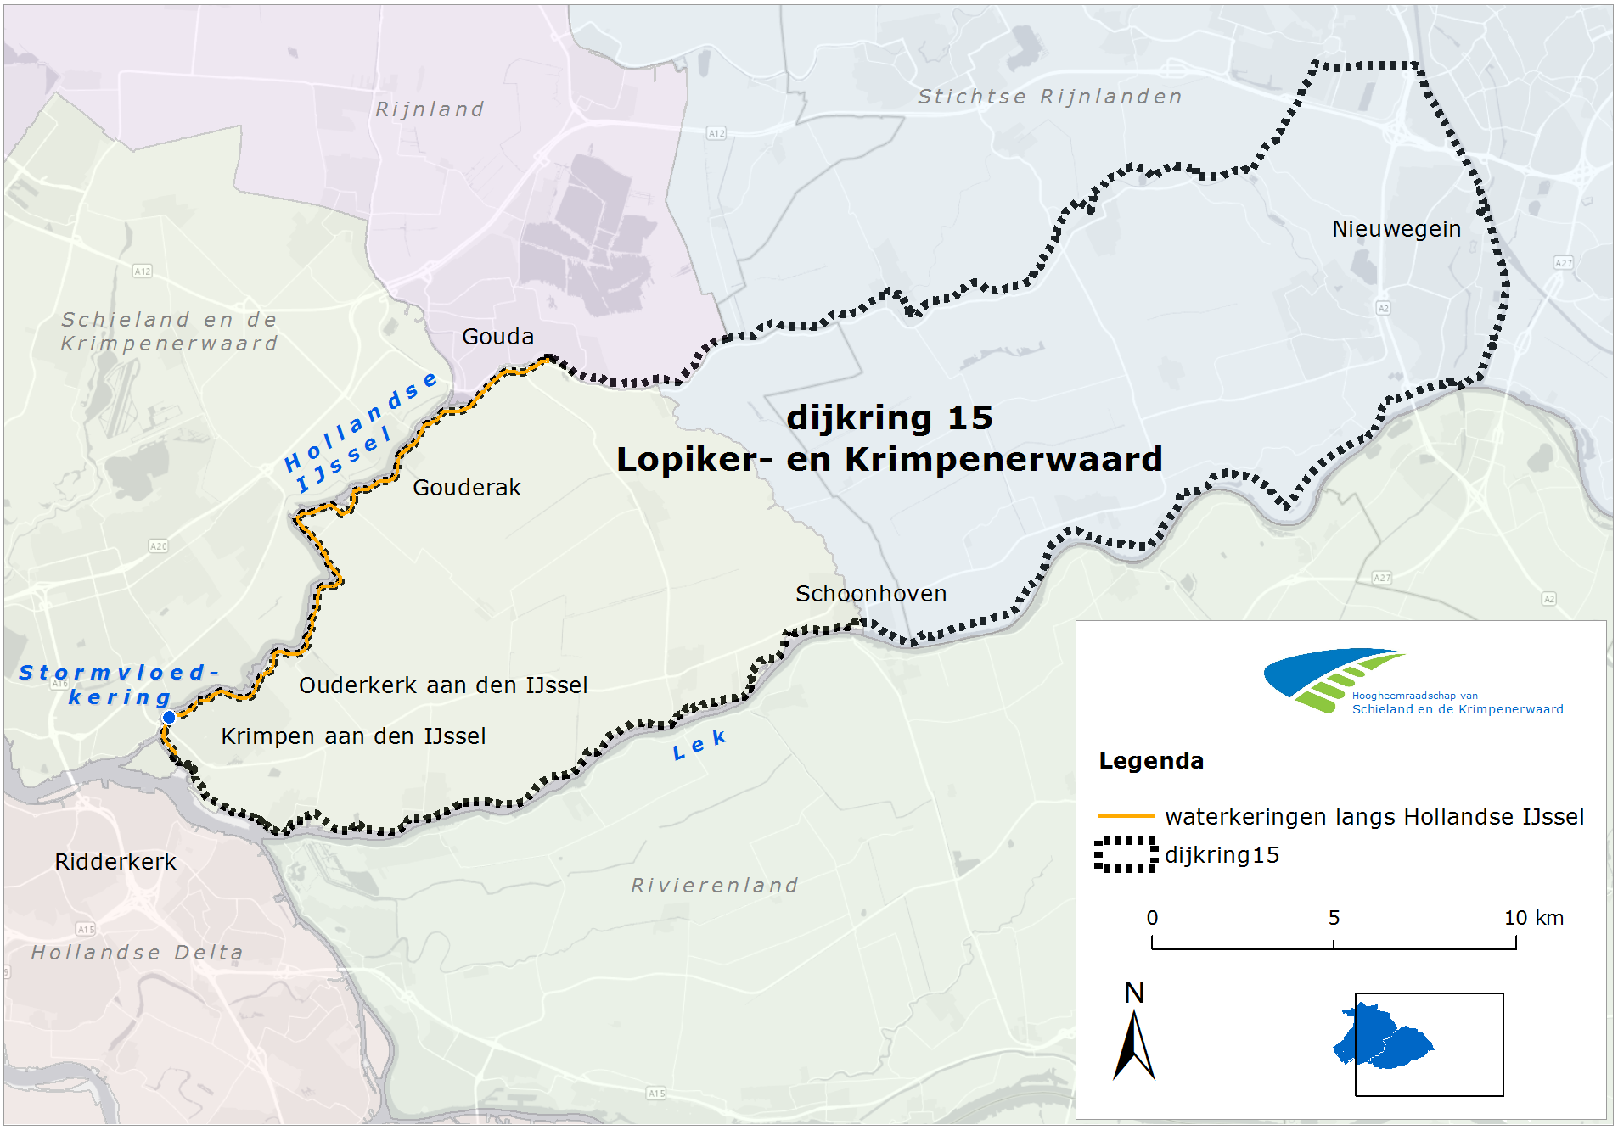
Receptor (1)

Slide 7
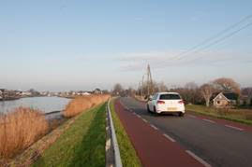
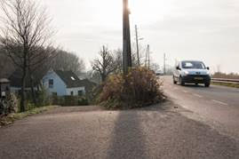
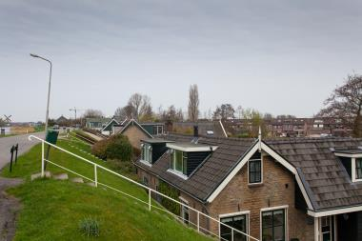
Receptor (2)
Flood protection assignment
Total of 10,15 km (red line)
Human environment
740 buildings
3 villages
Many monuments
Heavy traffic
Notes:
9 million residents and most of the jobs are in that area
Safe from high water levels and flooding
Next to the flood protection assignment that we have, we also have to make sure it fits. It’s a steep and narrow dike. So there is a spatial assignment as well. The human environment.
As you can see buildings are situated close to the dike: on the landside slope as well as the riverside slope there are houses, offices, schools, monuments, and hydraulic structures.
The area here is a semi-urban environment with 3 villages that are part of the two municipalities Krimpenerwaard and Krimpen aan den IJssel. The villages have become popular commuter towns for people working in Rotterdam, and have a combined resident number of about 37.000. The road on the dike is a major infrastructure service for cars, heavy traffic, recreational cyclists, school kids cyclists, and a bus line.

Slide 8
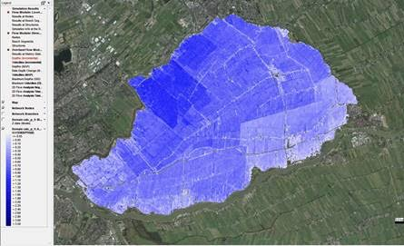
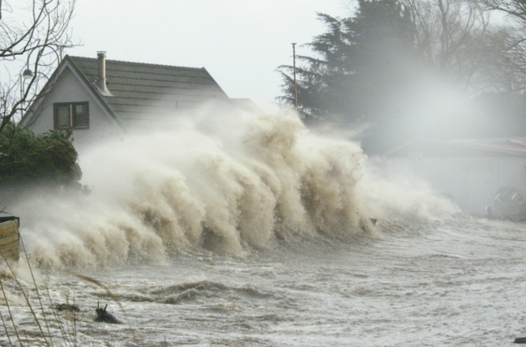
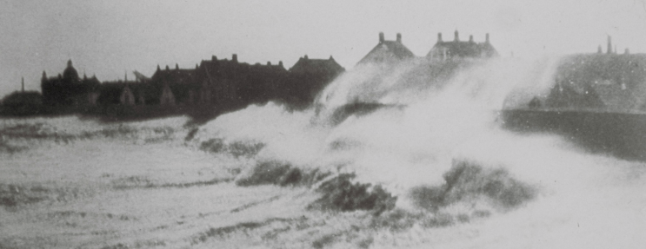
Receptor (3)
Notes:
Modelling flooding scenarios: a dike breach at a certain location and a certain duration of flooding (with a closed Storm Surge Barrier)

Slide 9
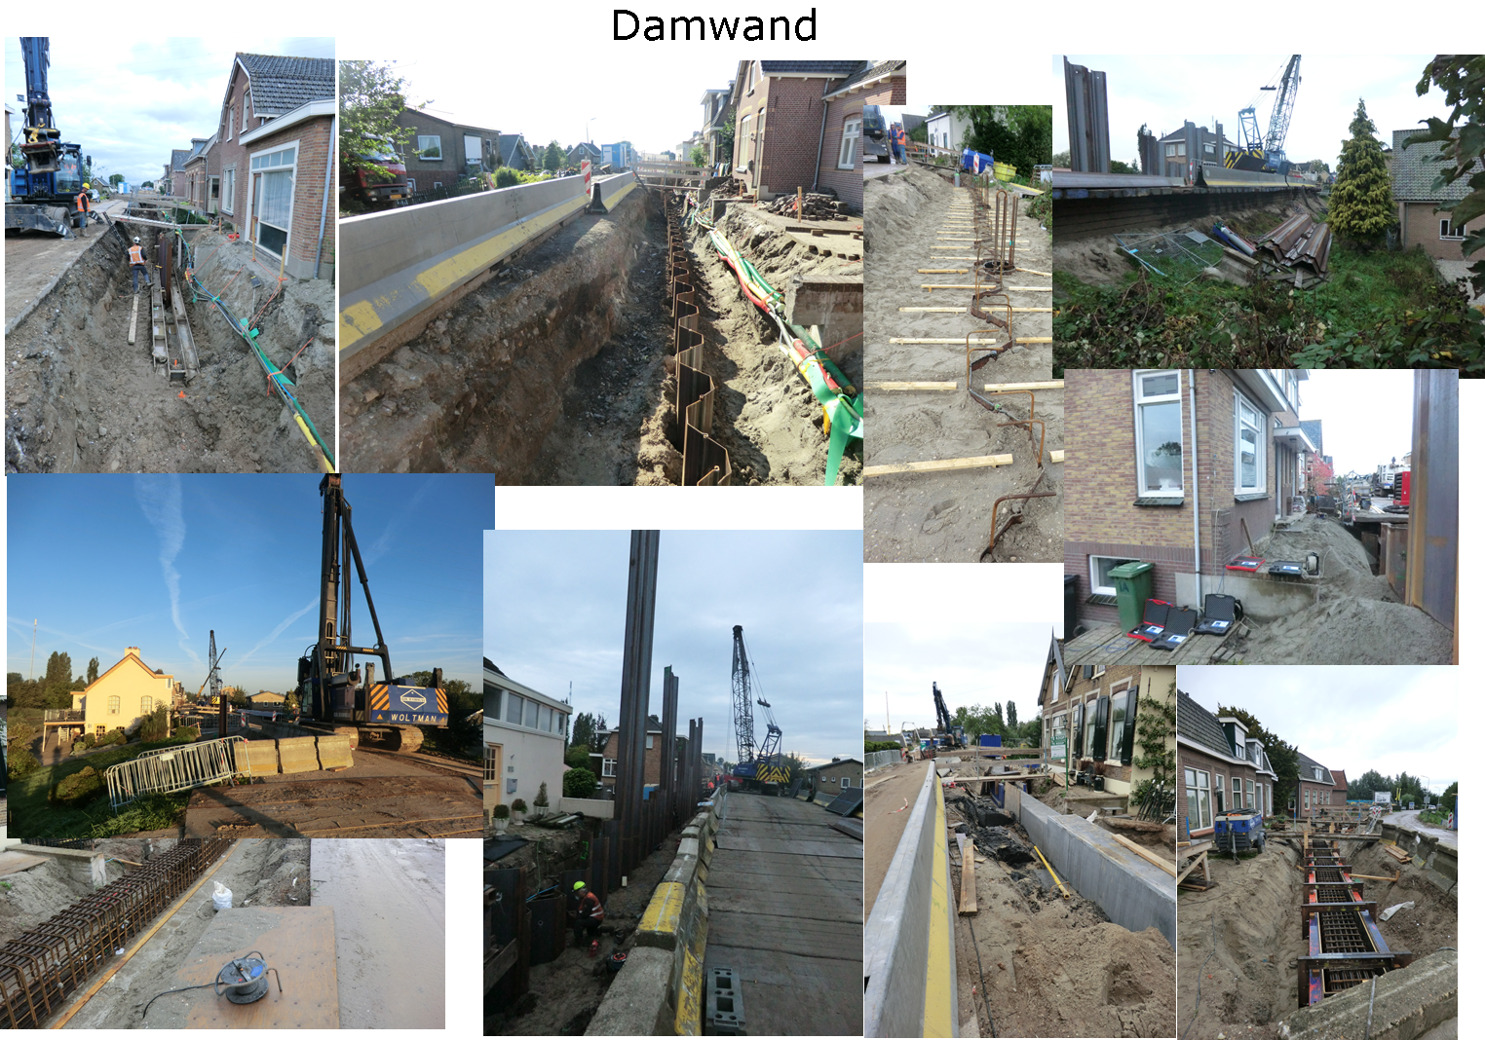
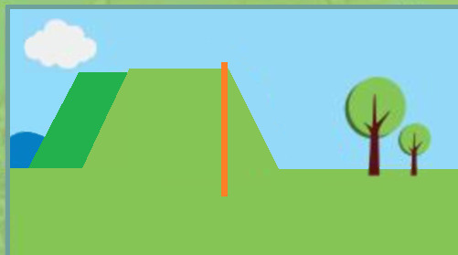
This means…

