Slide 1
WP4 – T1 Systems Analysis
7-3-2018
Ulf Radu Ciocan, Mie Thomsen

Slide 2
T1 – Systems Analysis
Create baseline
Conduct SPR analysis
Conduct flood risk analysis
Conduct performance analysis

Slide 3
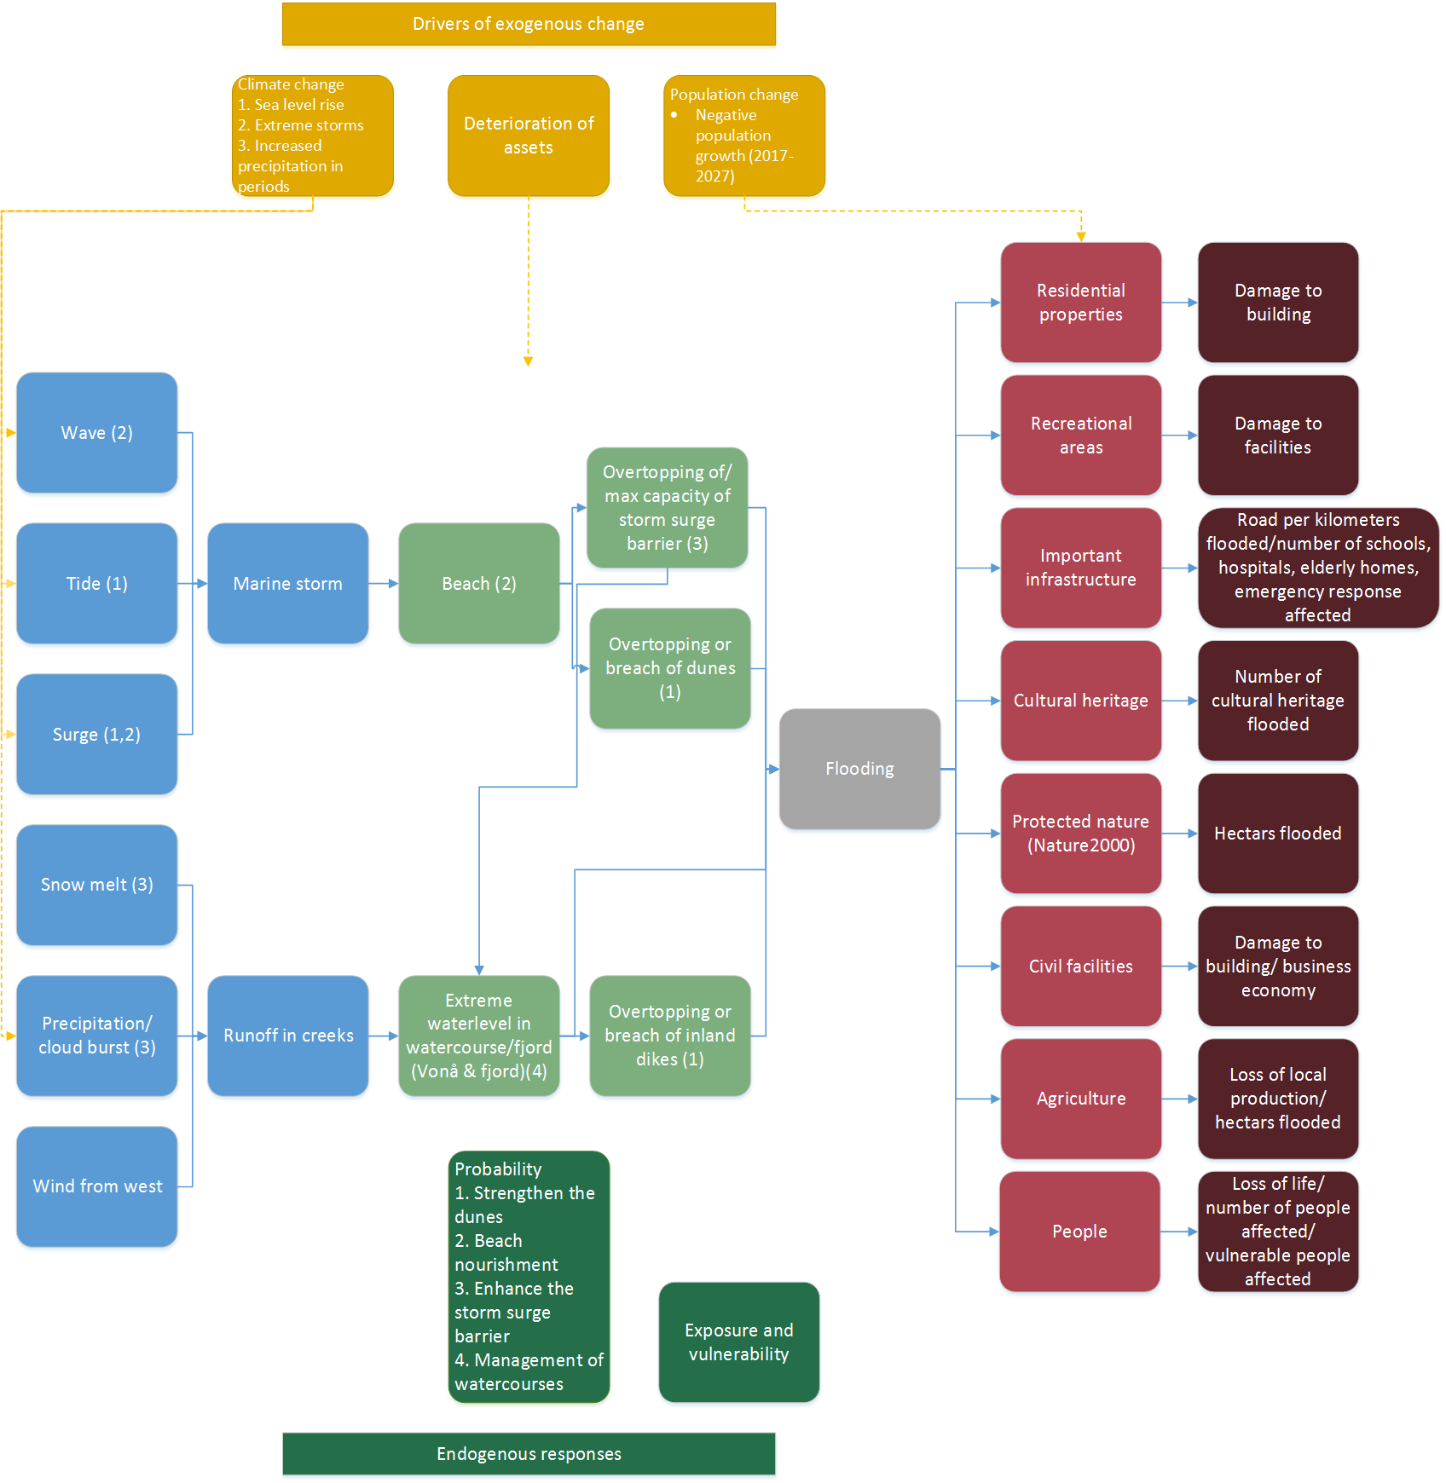

Slide 4
Performance
Assets
Asset functions
Failure mechanisms
Failure tree analysis
Probability of failure

