Slide 1
Performance analysis in the SPR framework
ST recap

Slide 2
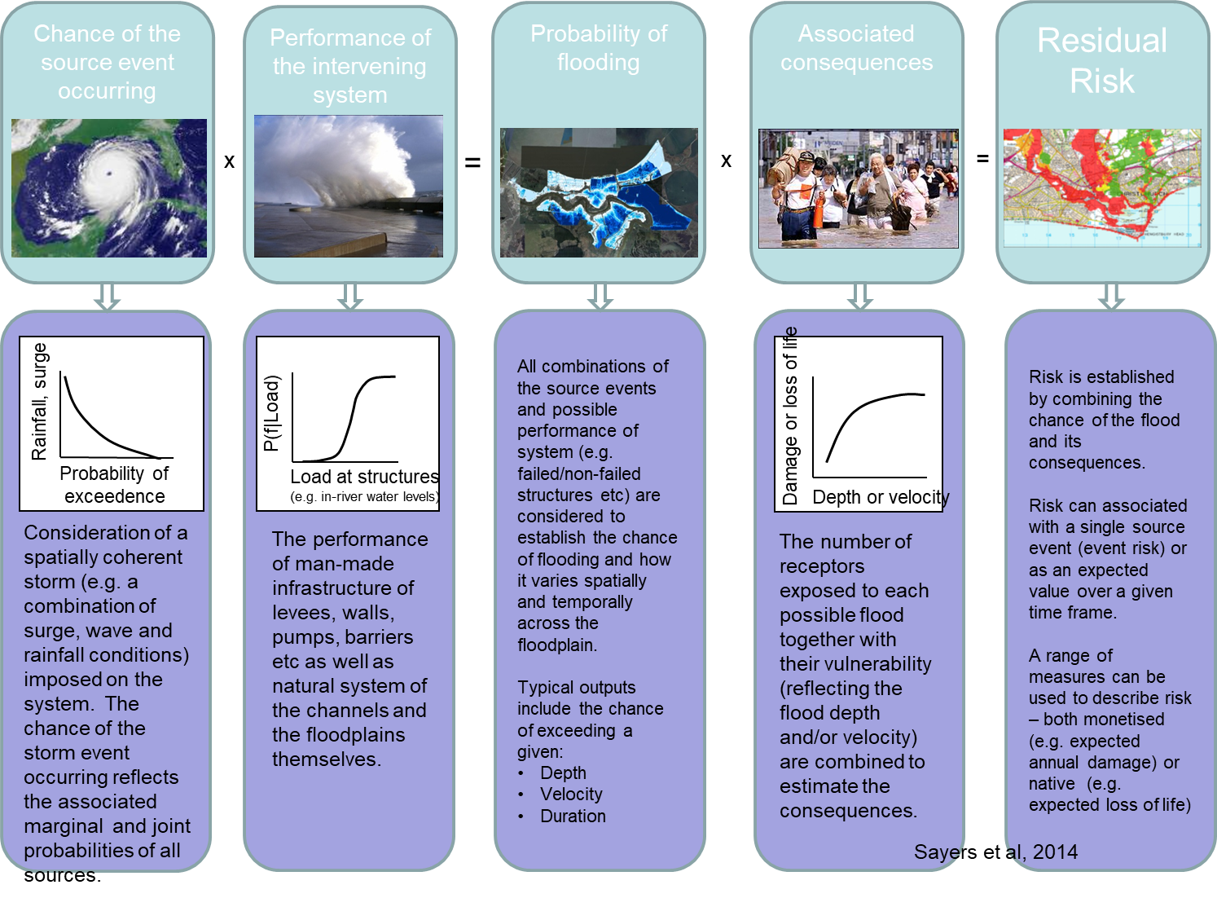

Slide 3
