Slide 1


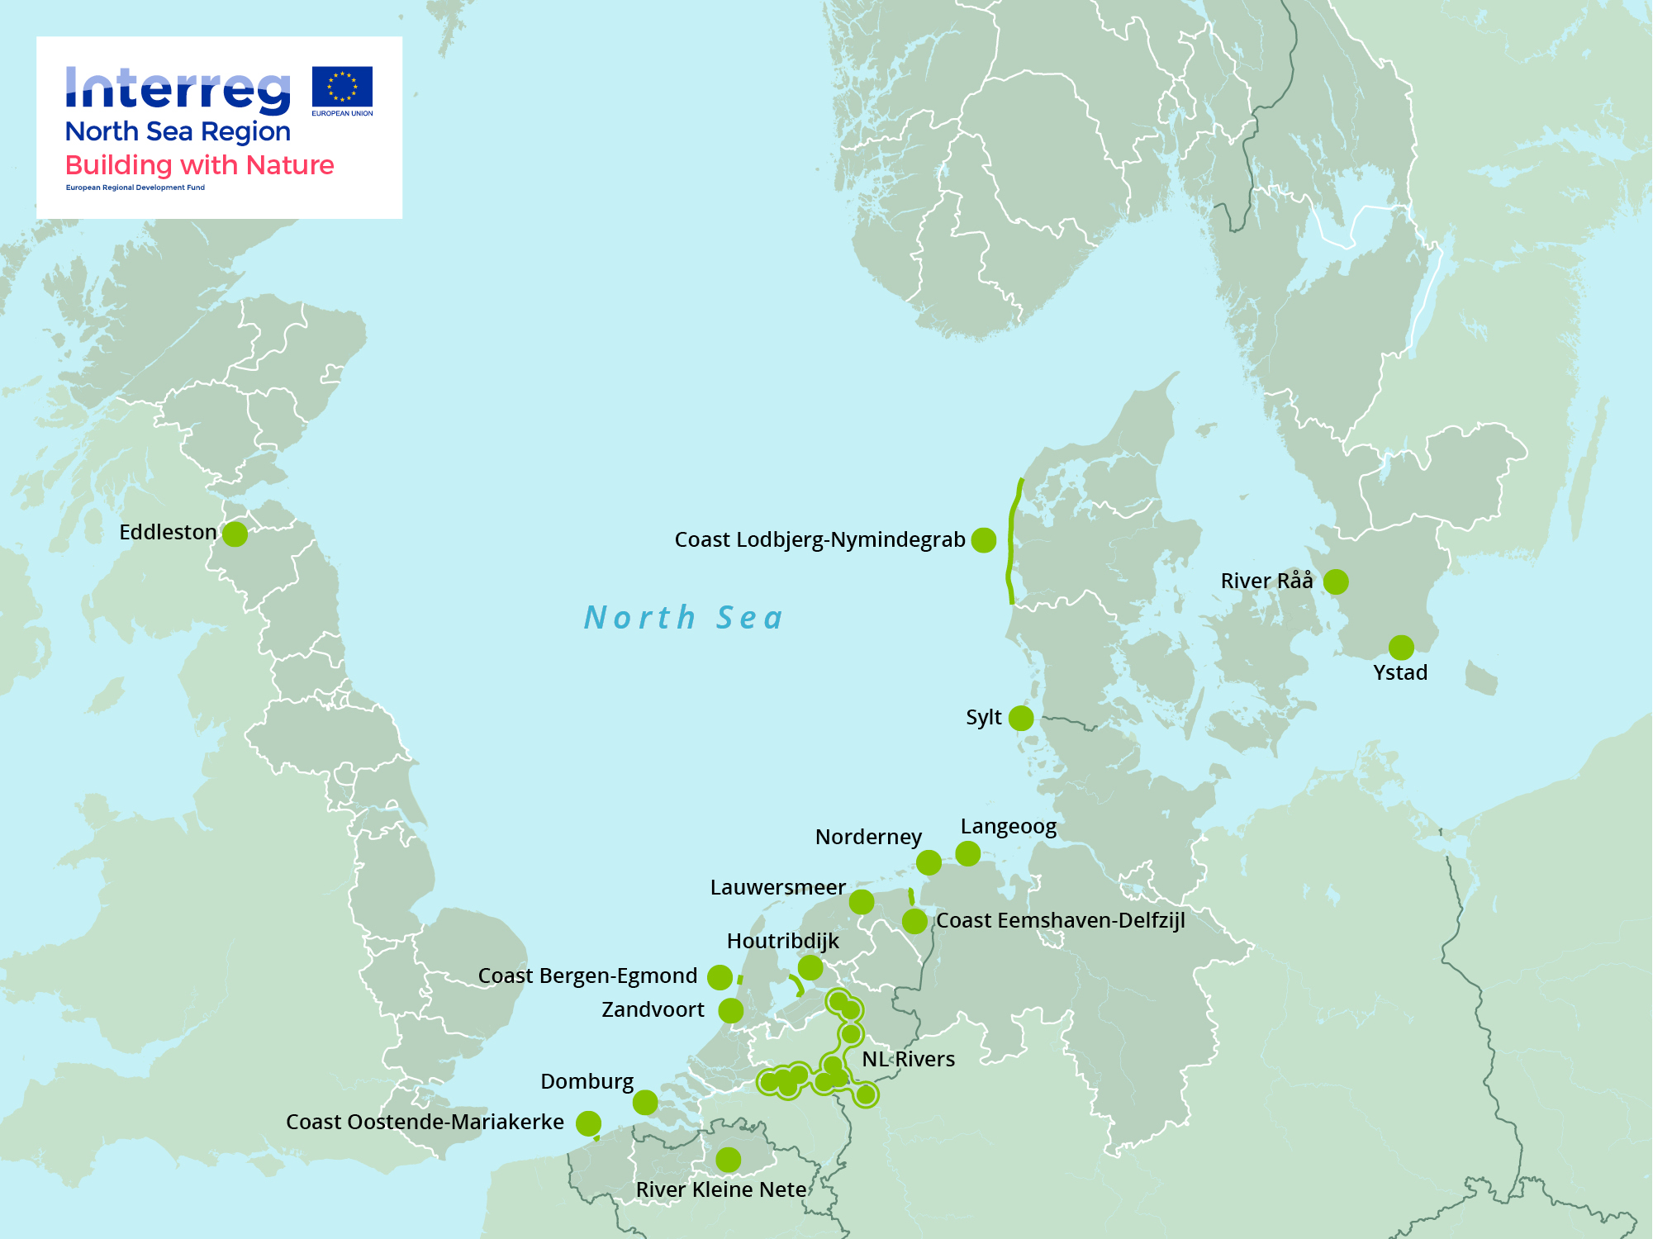
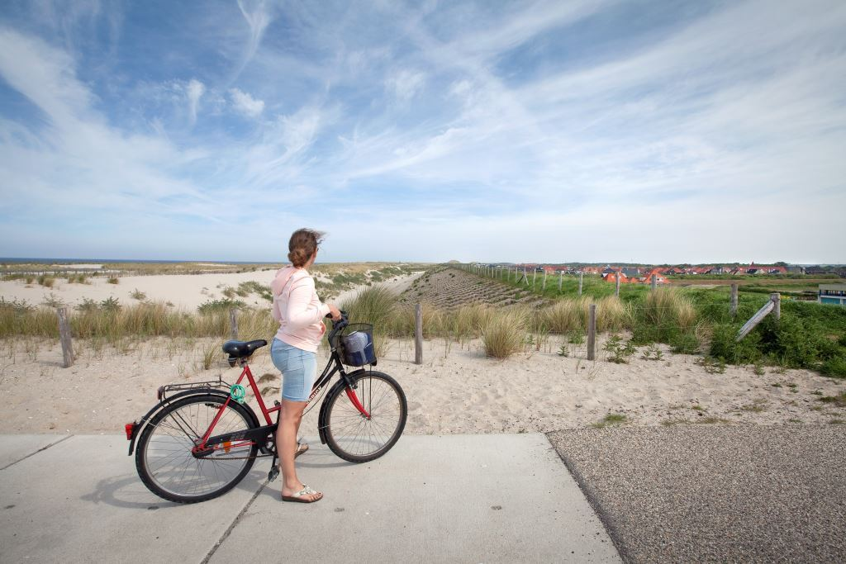
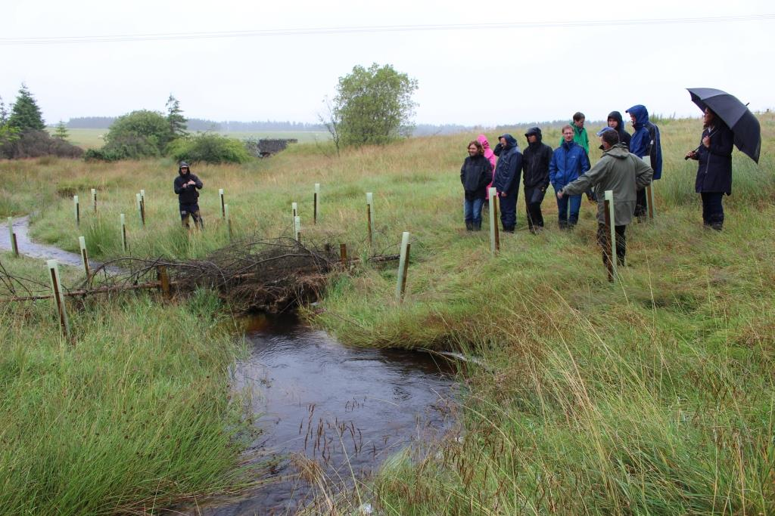
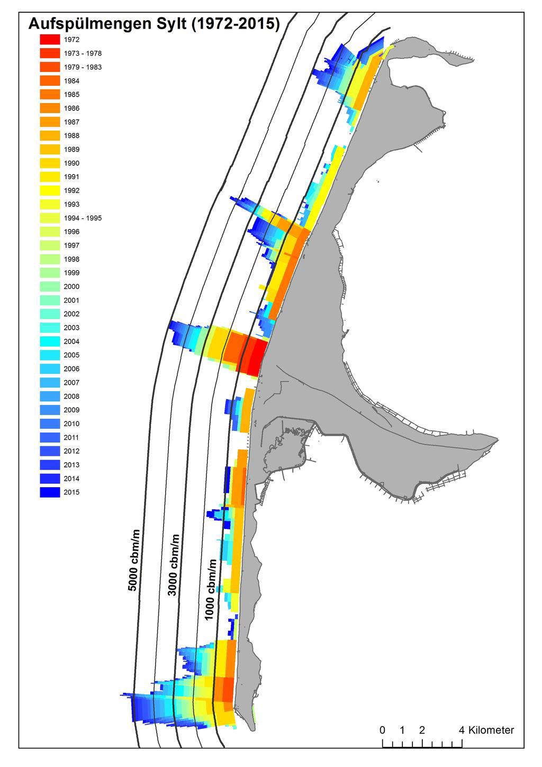
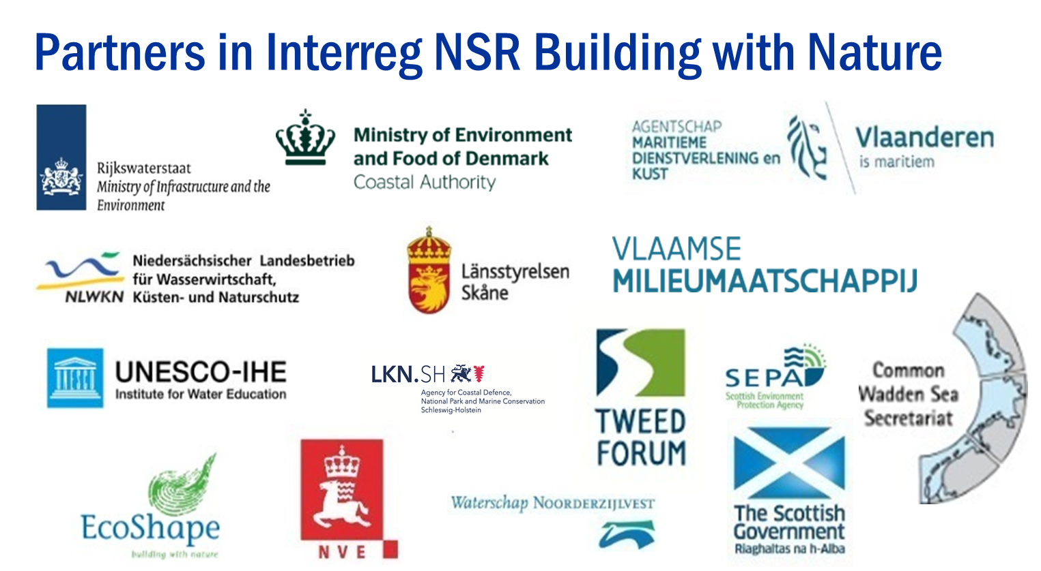
Nature Based Solutions in the North Sea region
A framework for opportunity mapping, capacity building and policy adoption
Egon A. Baldal, MSc Ph.D.
The Netherlands Ministry of Infrastructure and the Environment – DG Rijkswaterstaat. Egon.Baldal@RWS.NL 0031-610291671
The most serious threat facing the North Sea Region (NSR) is climate change. This takes effect in increased flood and coastal erosion risk from storm surges in coastal and estuarine areas and heavy rain causing flooding of rivers and lakes inland. The overall objective of the Building with Nature (BwN) project is to make coasts, estuaries and catchments of the NSR more adaptable and resilient to the effects of climate change by using nature based solutions.
The performance of BwN solutions is uncertain and hampers wider uptake across the North Sea Region. A common transnational evidence base is needed to underpin and justify investments, while optimizing the effectiveness of BwN solutions. The Building with Nature project will demonstrate nature based climate change adaptation solutions at a minimum of 7 coastal target sites in NL, D, DK, SE (sand nourishment at North Sea Coasts and Wadden Sea barrier islands) and on at least 6 catchment sites in B, NL, SE, SCO (e.g. river restoration).
Building with Nature goes beyond the technical. The way of thinking requires adoption by the public, practitioners, policy makers and politicians. This project therefore focusses also on the economic and societal aspects of NBS. A framework for opportunity mapping, capacity building and policy adoption is created on basis of the living laboratories, business case generation methodology (including ecosystem services, of course) and constraint analyses produced in the project. A transnational Policy Learning Group will help disseminate the work throughout the region.
Timeframe 2015 – 2020
Total budget 6.840.000 €
ERDF contribution 3.400.000 € (European Regional Development Fund)
Lead Beneficiary Rijkswaterstaat, The Netherlands
Overview map of the Interreg VB NSR Building with Nature living laboratory sites
An example of a Building with Nature solution; the Dutch Hondsbossche-Pettemer sea defense where a levee (on the right) is functionally replaced by an artificial dune area (on the left) covering 6km of coast, involving 35 million cubic meters of sand
Field trip to one of the Scottish Eddleston log jams. Showing the jam and its asset management: planting young trees around it that will also help reducing run off speed. Also showing that field trips are not always about shiny weather. Photo courtesy of Prof. Dr. Chris. J. Spray.
Nourishment overview for the German island of Sylt. Recent beach and shore face nourishments will be evaluated.

