Slide 1
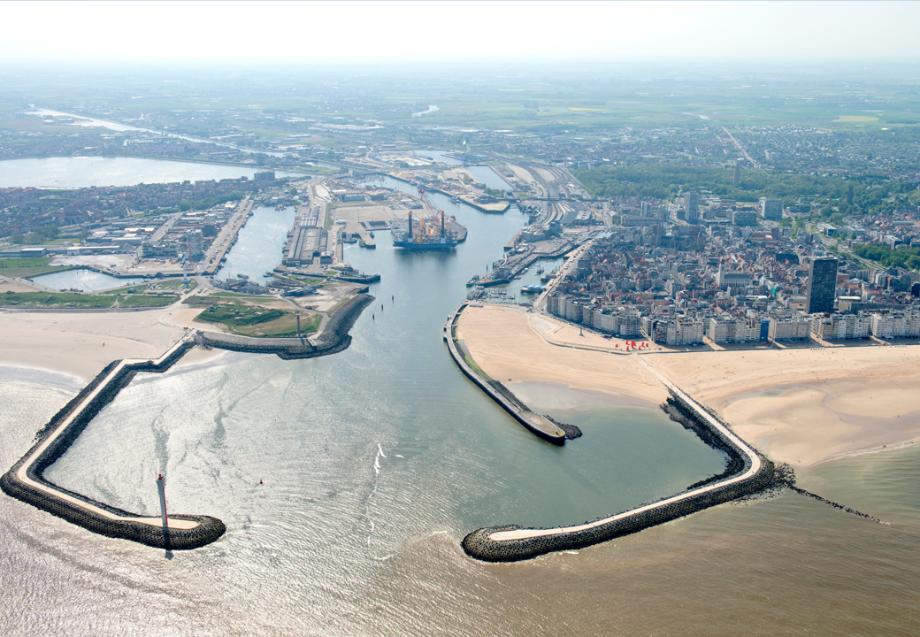



Slide 2
DUAL Ports
From SME PORTS to SME Ports of the future:
OCEAN CHALLENGE - PORTS OF THE FUTURE
Hack Belgium - Brussel 26.04.2018
DUAL Ports is co-funded by the North Sea Region Programme 2014-2020; Eco-innovation priority. www.northsearegion.eu/dual-ports J-No: 38-2-7-15

Slide 3
DUAL Ports
Situation of SME Ports in Europe
2. SME Port : Port of Oostende – today and tomorrow
3. Ports of the future
DUAL Ports is co-funded by the North Sea Region Programme 2014-2020; Eco-innovation priority. www.northsearegion.eu/dual-ports J-No: 38-2-7-15

Slide 4
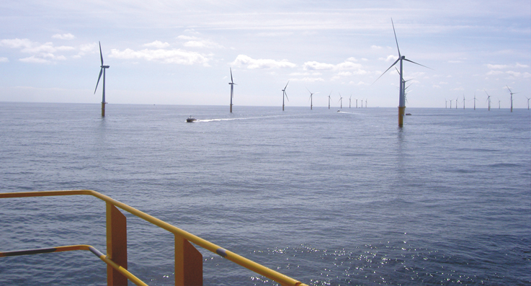
1. Situation of 1250 SME Ports in Europe :
SME port are
NOT ONLY: Center of logistic functions in the region
BUT CAN ALSO BE:
- Center for creating economic added value
- Center for pooling of maritime skills and competences
- Center for innovation as to blue industry

Slide 5
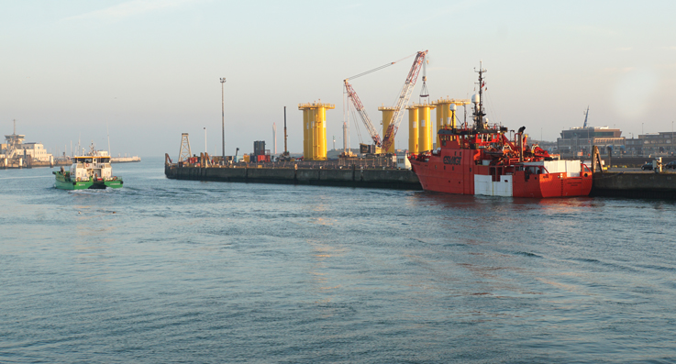
1. Obstacles and threats for the SME ports
- Limited Financial power – access to finances / limited resources and competences
- Isolation , lack of visibility and communication competences
- Pressure on revenue and costs
- Limited management capacities within SME ports & over-regularitis (complexity)
- Politics/Administration: the hunger for short term wins / one dimensional classification (TON-fixation instead of Added value)
- Pressure of real estate
- Energy transition

Slide 6
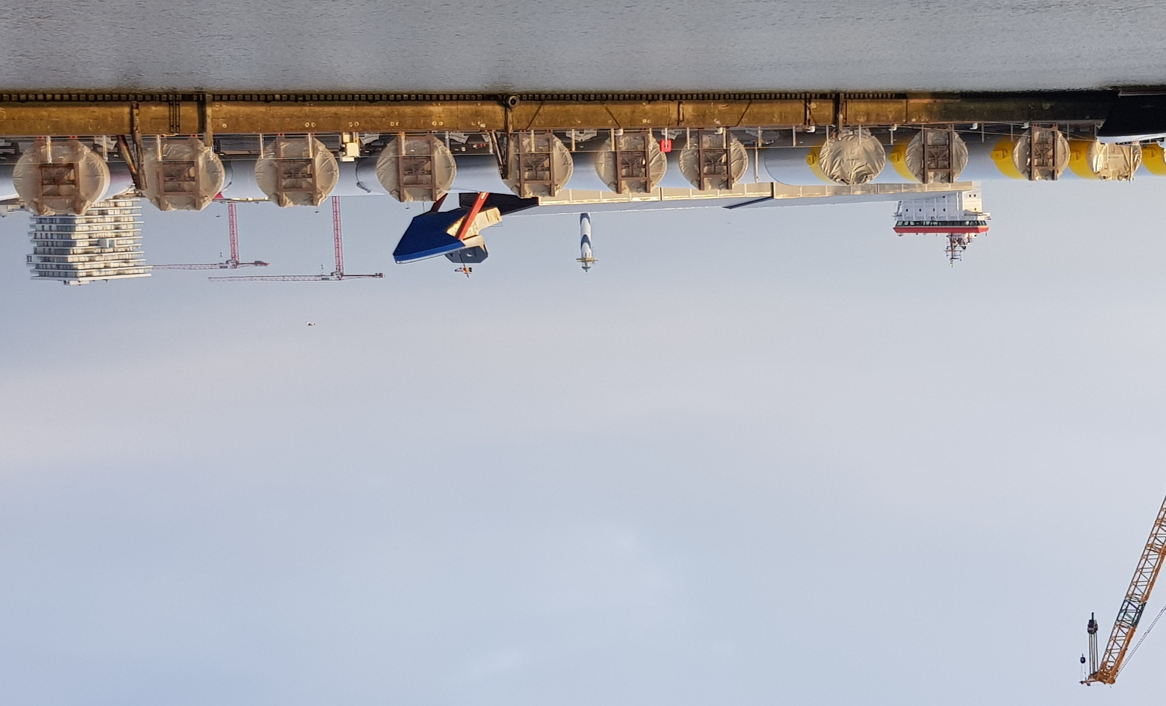
2. SME Port of Oostende : today and tomorrow
Offshore renewable energy : wind, wave and tidal
Traditional logistic operations : RoRo, bulk, project cargo, cruises
Innovation with SME ports: Dual Ports, PECS,
Innovation with research institutions: Greenbridge, centre for renewable energy and blue industry , wave and towing tank
DUAL Ports is co-funded by the North Sea Region Programme 2014-2020; Eco-innovation priority. www.northsearegion.eu/dual-ports J-No: 38-2-7-15

Slide 7
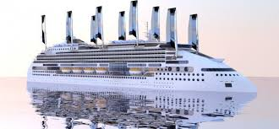
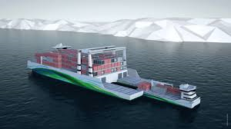
3. Ports of the future : challenges
1. Energy propulsion of shipping:
CNG/LNG
H2
Wind propulsed (H2 related)
2. Autonomous shipping
Smart logistic servicing at sea
DUAL Ports is co-funded by the North Sea Region Programme 2014-2020; Eco-innovation priority. www.northsearegion.eu/dual-ports J-No: 38-2-7-15

Slide 8
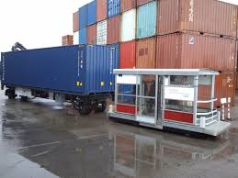
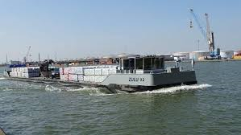
3. Ports of the future : challenges
3. Autonomous servicing in ports :
INTRADE
Autonomous pre and post
Logistics
DUAL Ports is co-funded by the North Sea Region Programme 2014-2020; Eco-innovation priority. www.northsearegion.eu/dual-ports J-No: 38-2-7-15

Slide 9
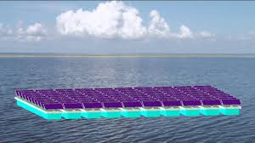
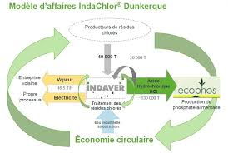
3. Ports of the future : challenges
5. Smart ports and smart port
Equipment :
6. Circular value chains
Logistics
DUAL Ports is co-funded by the North Sea Region Programme 2014-2020; Eco-innovation priority. www.northsearegion.eu/dual-ports J-No: 38-2-7-15

Slide 10
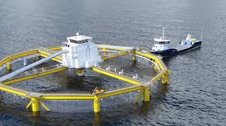
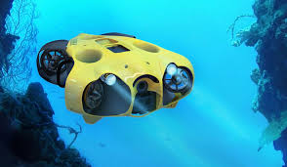
3. Ports of the future : challenges
7. Marine aqua industries :
DUAL Ports is co-funded by the North Sea Region Programme 2014-2020; Eco-innovation priority. www.northsearegion.eu/dual-ports J-No: 38-2-7-15

Slide 11
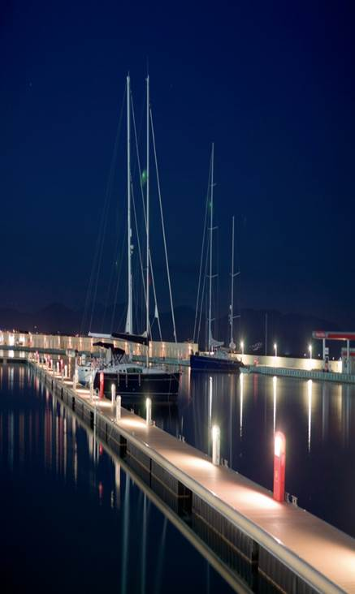
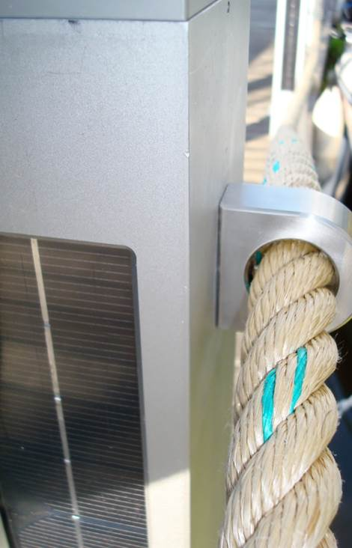
3. Ports of the future : challenges
8. Energy efficiency and
Low carbon solutions :
Smart Led Light in ports
(nozonsolar)
DUAL Ports is co-funded by the North Sea Region Programme 2014-2020; Eco-innovation priority. www.northsearegion.eu/dual-ports J-No: 38-2-7-15

Slide 12
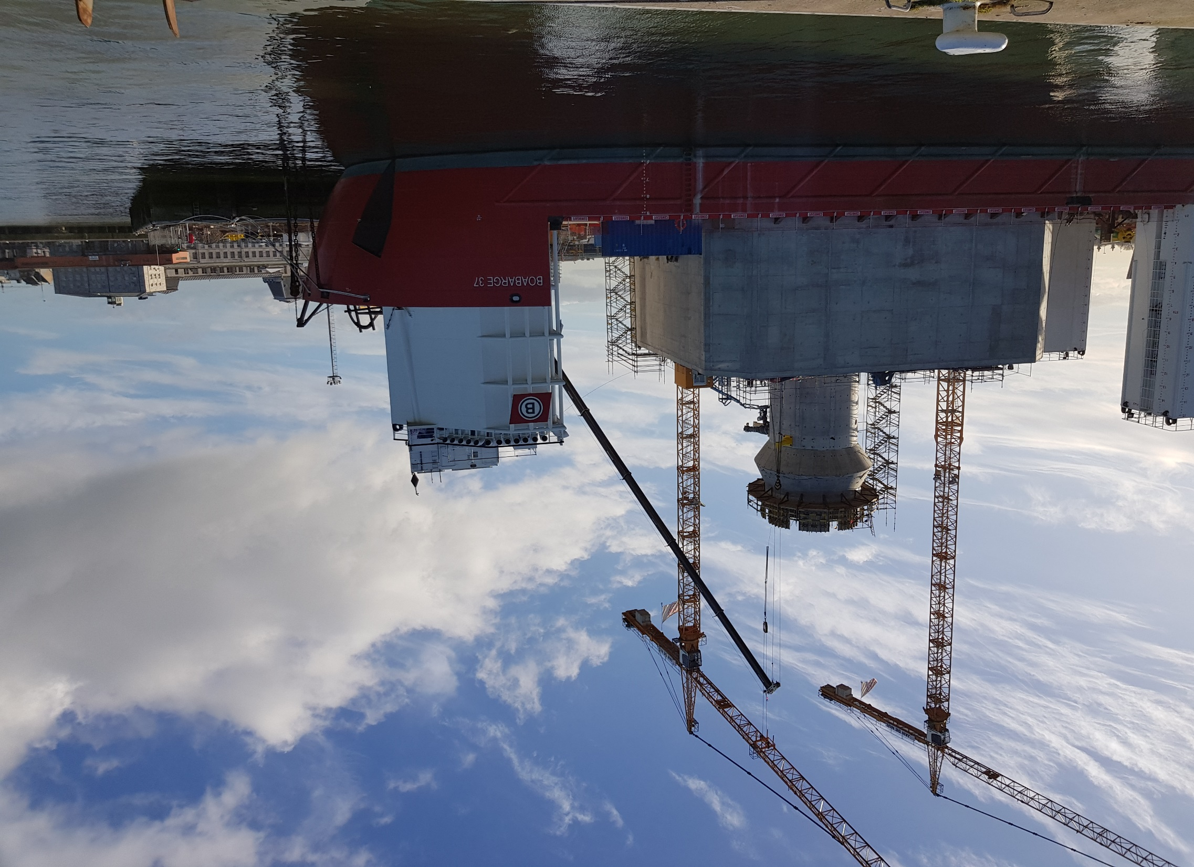

SME Ports of the future
^{Thank you for your attention}
Contact : wim.stubbe@portofoostende.be or + 32 487 548 768

