Slide 1
DUAL Ports
Developing Low Carbon Utilities, Abilities and potential of regional entrepreneurial Ports
*Venue*
DUAL Ports is co-funded by the North Sea Region Programme 2014-2020; Eco-innovation priority. www.northsearegion.eu/dual-ports J-No: 38-2-7-15

Slide 2
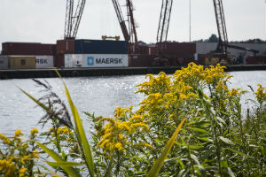
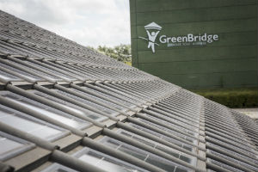
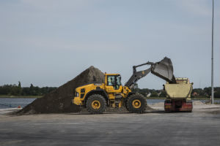
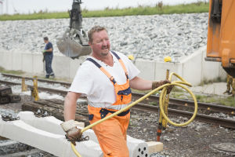
What is DUAL Ports?
DUAL Ports is a €5,2m project, 50% co-funded by the European Union and the European Regional Development Fund through the Interreg North Sea Region Programme 2014 – 2020, Eco-innovation priority. The project runs from 10/11/2015 until 30/06/2019.
Who are we?
The port of Oostende leads a consortium of 10 Flemish, Scottish, Danish, German and Dutch harbour authorities and organisations:
• The ports of Zwolle (with Kampen and Meppel), Vordingborg, Emden, Guldborgsund and Skagen (future).
• The private/public organisations: Fair Winds Trust; ITM Power; Orkney Islands Council; HWWI GmbH; Vordingborg Erhverv;

Slide 3
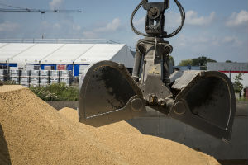
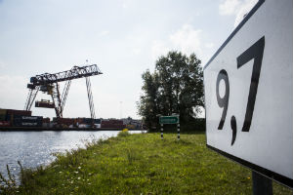
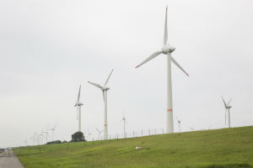
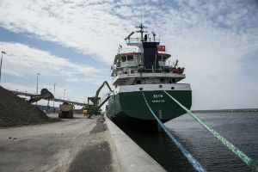
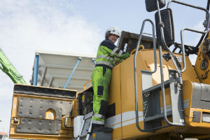
The objective of DUAL Ports
Stimulating eco-innovation, carbon emission reduction and sustainable use of resources is a widespread priority in Europe nowadays. Being businesses, and considering their industrial and logistic function, also ports are expected to identify pragmatic low carbon visions and implement concrete solutions to this purpose.
The aim is to decarbonise Regional Entrepreneurial Ports (REPs) through a shared eco-innovation port programme that minimises their environmental footprint.
The objective is to specifically develop sustainable utilities and abilities of REPs.
A transnational approach has been adopted to allow the DUAL small & medium size ports to capitalise on the potential, overcoming their individual limited staff, funding and capability to identify the most effective solutions on their own.

Slide 4
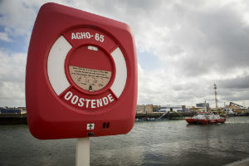
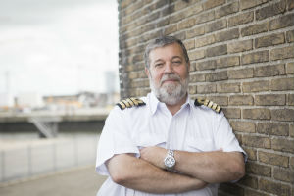
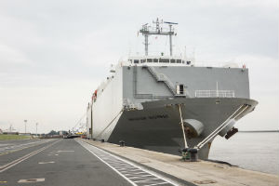
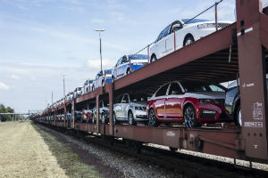
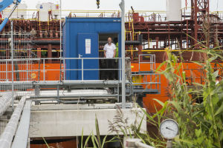
DUAL Ports Pilots
• building up business cases for alternative, non-conventional energy sources systems: e.g. liquefied natural gas,/hydrogen
• Developing low carbon logistic products, bridging old and new technologies: a Sailcargo trading network through port facilities´ eco-adaptation
• testing environmentally friendly equipment in ports : intelligent LED lightning network;
• piloting new way of sustainably managing the port environment : soil treatment; sustainable space use and port management through co-siting/dockland;
• sharing technology/processes/plans for resource efficient management: green officer + sustainability management system;
• sharing resources for low carbon management & processes in ports: low carbon planning & management.

