Slide 1
HyTrEc2
Hydrogen Transport Economy for the
North Sea Region 2
Louise Napier
HyTrEc2 Project Manager

Slide 2

The Hydrogen Transport Economy (HyTrEc) 2 project is part of the Interreg VB North Sea Programme Region Programme and is partly funded by the European Regional Development Fund.
Falls within programme Priority 4: Promoting green transport and mobility
Total budget of 5,246,271 € of which the ERDF Contribution is 2,197,940 €
Five year project from 2016 to 2021.

Slide 3
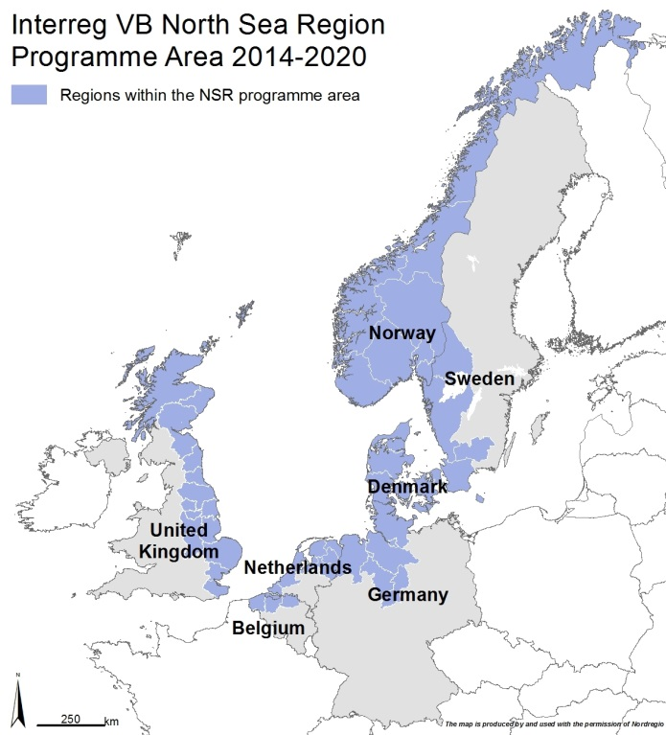








HyTrEc2 Partners

Slide 4
Pioneering
93%¹ of transport is currently oil based. Green transport solutions, such as hydrogen, will play a key role in achieving EU energy and climate change targets.
Hydrogen Fuel Cell Electric Vehicles (FCEV) have a longer range than electric battery vehicles. This extended range is essential in those North Sea regions which have numerous small sized cities with a large suburban and rural hinterland.
¹ http://ec.europa.eu/eurostat/web/products-datasets/-/tsdcc340

Slide 5
Collaboration
Current market failure caused by the high cost of FCEVs and the need to make green hydrogen cheaper through more cost effective green hydrogen production, storage and distribution.
HyTrEc2 will create conditions so that a FCEV market can develop providing a platform for collaborative development of strategies and initiatives that will inform and shape the development of infrastructure, technology and skills.

Slide 6
Vision:
Stimulating hydrogen fuelled transport solutions
for business, for the environment,
for the future.

Slide 7
Objectives
Implementing innovative hydrogen transportation solutions involving cars, vans, large trucks and refuse collection vehicles to advance the case for zero emission solutions for public and private sector fleets.
Improving the supply chain and training so that the NSR becomes a Centre of Excellence for hydrogen transport.
Developing innovative methods for the production, storage and distribution of green hydrogen.
Complementing national programmes for hydrogen and facilitating joint NSR approaches and common standards.

Slide 8
Deliverables
Deliverable | Target
Number of hydrogen vehicles tested | 33
Green hydrogen from wind and solar | 2
Number of people trained in hydrogen | 80
Number of businesses entering the supply chain | 25
Report of hydrogen transport rules and standards | 1
Report on business case and economic modelling of green hydrogen | 1
Report on distribution of hydrogen in isolated regions | 1
Report on supply chain mapping | 2

Slide 9
Outputs
Indicator | Target
Number of new and/ or improved green transport solutions adopted | 6
Number of enterprises participating in cross-border, transnational or interregional research projects | 25
Number of research institutions participating in cross-border, transnational or interregional research projects | 10
Number of organisations/ enterprises adopting new solutions by project end | 50
Number of organisations/ enterprises informed about new solutions by project end | 150

Slide 10
Results
Indicator
Reduction in the cost of hydrogen vans, large trucks and other tested vehicles | 25%
Public sector organisations and transport operators investing in hydrogen vans and other tested vehicles | 18
Reduction of CO2 compared to the equivalent diesel model | 18kg/ per vehicle/ per month

Slide 11
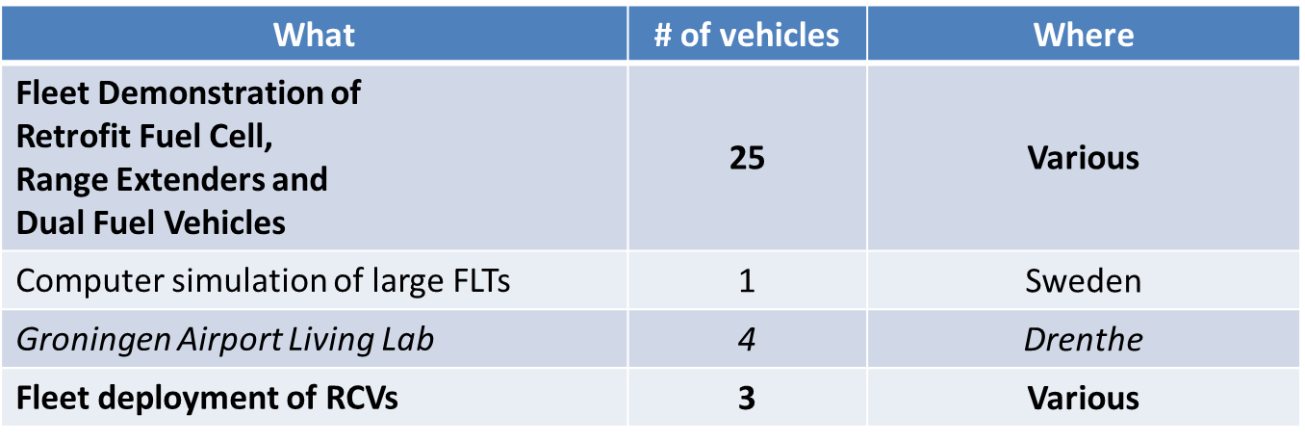
Key Partner Activities
Testing a range of transportation technologies such as fuel cell, range extenders, and dual fuel vehicles.

Slide 12
Sourcing Hydrogen Vehicles
Partners are leasing, purchasing or retrofitting hydrogen cars, vans and trucks through joint procurement frameworks or using each other’s retrofitting organisations
Purchase or lease cars such as Toyota Mirais and Hyundai ix35s. Hyundai Nexo. BMW in 2019
Purchase or lease retrofitted electric vans (Renault Kangoos)
Retrofit electric vehicles with a fuel cell and hydrogen tank (such as Nissan env200)
Retrofit diesel vehicles with fuel cell and hydrogen tank (Ford Transit vans)
Retrofit diesel vehicles with electric driveline and then add a fuel cell and hydrogen tank!

Slide 13
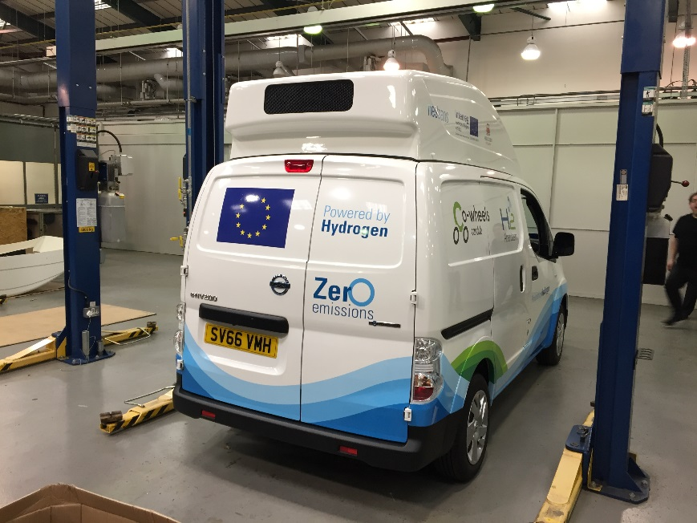
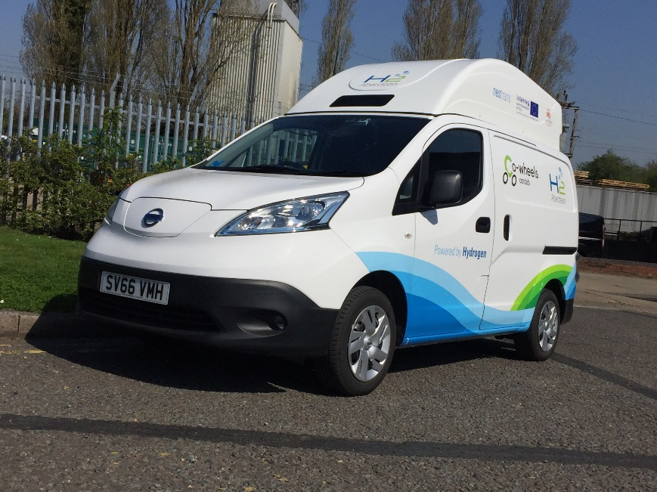
Vehicle Deployments - Retrofitting
Nissan eNV200 Acenta Rapid electric van
Retrofitted with 8.5kw hydrogen fuel cell and 350 bar hydrogen tank
Increase van range from 106 miles to a minimum of 192 miles
Compatible with TK17 nozzle for 350 bar fuelling

Slide 14
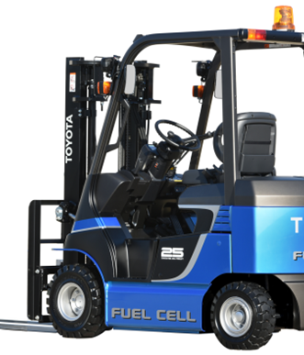
Vehicle Deployments - Simulation
Forklift Truck Simulation
Small and medium sized forklifts often have electrical drivelines
Battery capacity is often not big enough during long working days with several shifts
    Trialled swapping out larger battery and replacing with Hydrogen storage and a battery with smaller capacity and volume
    Assume battery capacity of 54kWh and fuel cell 15kW
    Conclusion: possible to build and can perform, but size of fuel cell and optimal performance depends on detailed knowledge of the power requirement over the course of the day

Slide 15
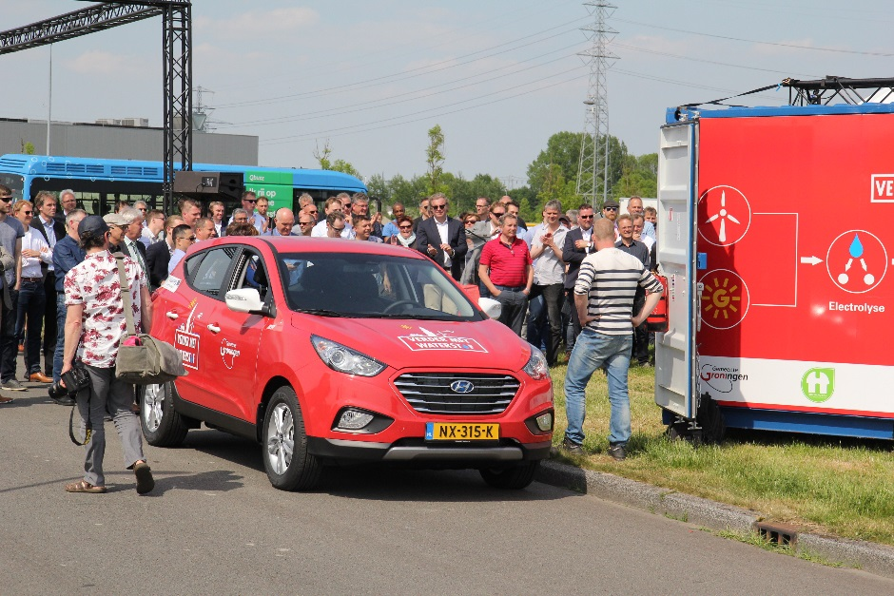
Vehicle Deployments - Purchase
Two Hyundai ix35s FCEVs
1,839 miles since October 2017 to March 2018
Daily average of 49.7 miles

Slide 16
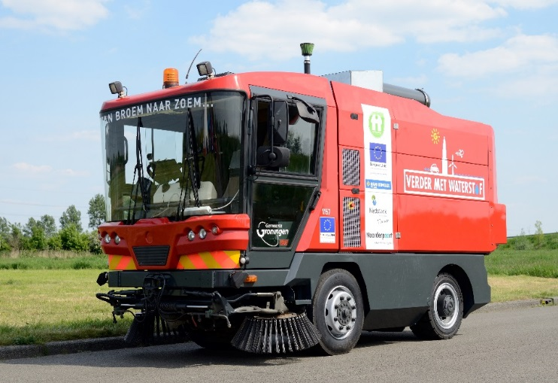
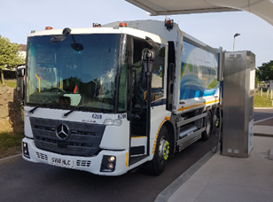
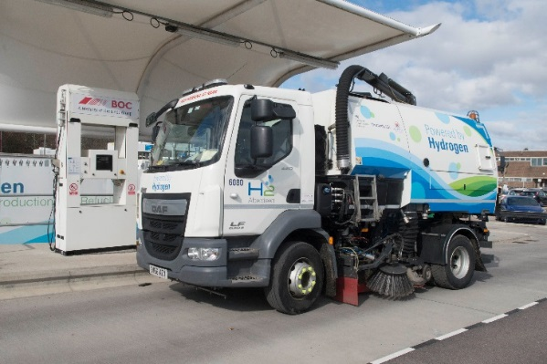
Vehicle Monitoring
Project / Driver | Vehicle reg | Vehicle make | Vehicle model
Groningen (Hytrec2) | NX-1157 |  | Streetsweeper
Groningen (Hytrec2) | NX-315-K | Hyundai | Tucson Fuel Cell
Groningen (Hytrec2) | NX-316-K | Hyundai | Tucson Fuel Cell
Aberdeen (Hytrec2) | WP66 PXG | Toyota | Mirai
Aberdeen (Hytrec2) | WP66 PXF | Toyota | Mirai
Aberdeenshire (Hytrec2) | SD64 EXU | Citroen | Berlingo
Aberdeen Cowheels (Hytrec2) | EA65 ZWS | Hyundai | iX35
Aberdeen Cowheels (Hytrec2) | EA65 ZWZ | Hyundai | iX35
Aberdeen (Hytrec2) | EA16 BXX | Hyundai | iX35
Aberdeen Taxis (Hytrec2) | EA16 BYF | Hyundai | iX35
Aberdeenshire (Hytrec2) | MF67KWT | Renault | Kangoo
Aberdeenshire (Hytrec2) | ST12 WCP | Ford | Transit Connect
Aberdeenshire (Hytrec2) | SW17 FKG | Nissan | eNV200

Slide 17
Creating a Market for Hydrogen Vehicles
Offer opportunities for other public sector organisations to trial those vehicles
  NHS Grampian trialling Toyota Mirais
  Arnold Clark Toyota training local staff on Toyota maintenance
  Groningen Fire department trialling Hyundai ix35s
Offer opportunities for private sector organisations and citizens to trial those vehicles
  Co-wheels trialling Nissan env200
  Co-wheels trialling Renault Kangoo van
  Co-wheels trialling Toyota Mirais

Slide 18
Developing the Market
‘Prototypes’ are more expensive than ‘from the forecourt’ petrol, diesel and even electric counterparts
Not only is hydrogen developing fairly sporadically but the base electric vehicles are improving as well
Major vehicle manufacturers producing cars but usually delays to deployment - initially not for sale on mass market nor were they at an affordable price - especially when compared to their diesel or petrol equivalent
Fuel anxiety
Two Hydrogen Refuelling Stations required

Slide 19
Cooperation
Investigate ways to improve production, storage and distribution of green hydrogen including use of solar and wind power.
Tend to build bespoke Hydrogen Refuelling stations
A number of HRS purchase electricity on a ‘green tariff’
Hydrogen is produced ‘on demand’ (unless large amounts of storage) quite often making electricity/ hydrogen expensive.
Aim is to demonstrate the business case for using wind and solar to produce electricity

Slide 20
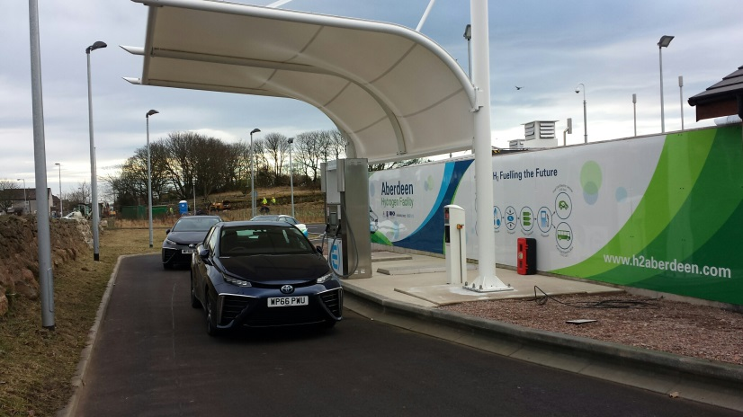
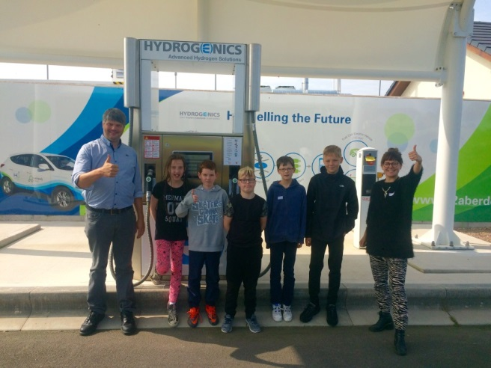
Green Hydrogen: Wind
Investigated wind at Aberdeen City Hydrogen Energy Storage (ACHES)
Issue for urban areas – nearby land sold for a residential development
Feasibility study for options and conclusion was small scale solar panels or off-site wind development and investigate possibilities for deploying hydrogen to ‘distribution locations’
We believe this is the future for hydrogen refuelling
Market testing with Dundee City Council, Fife Council and Perth and Kinross Council

Slide 21
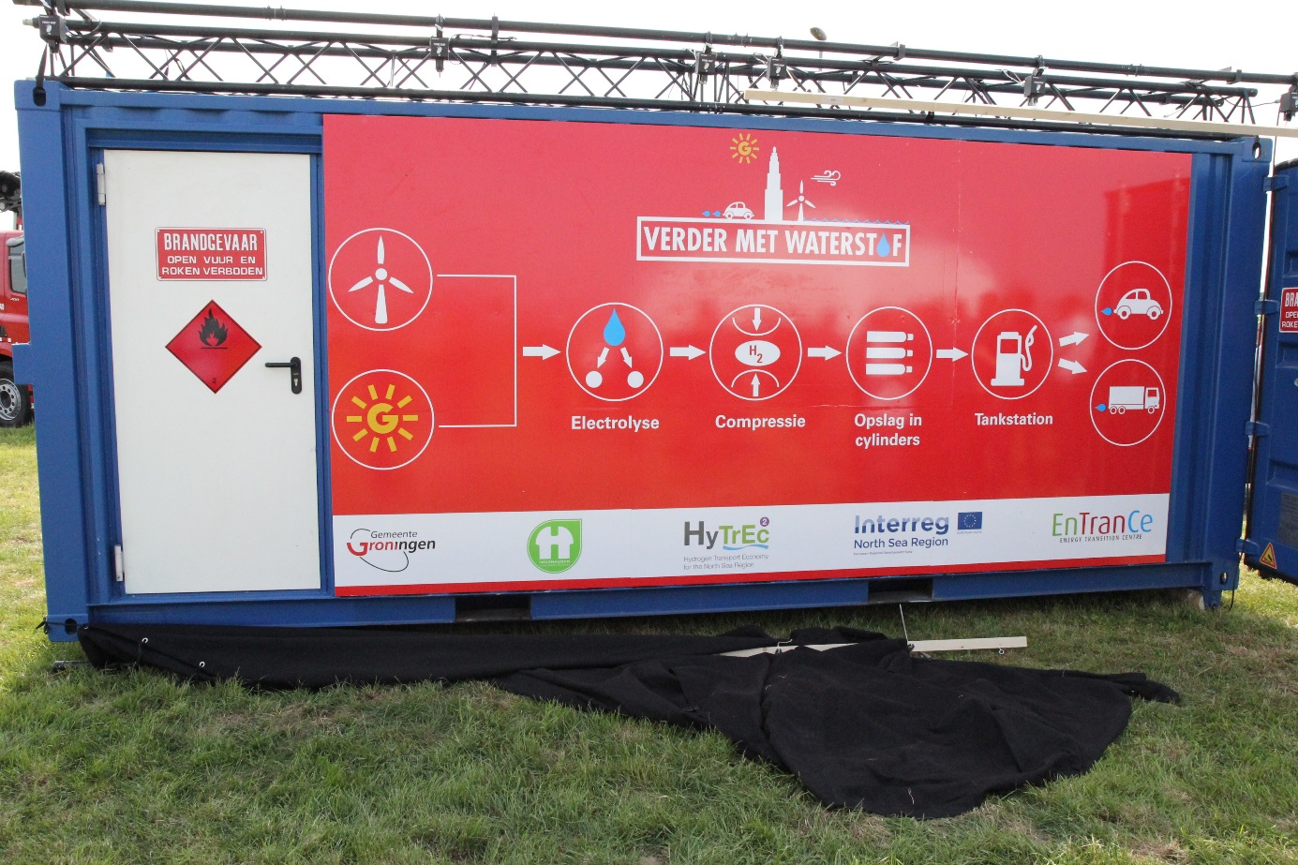
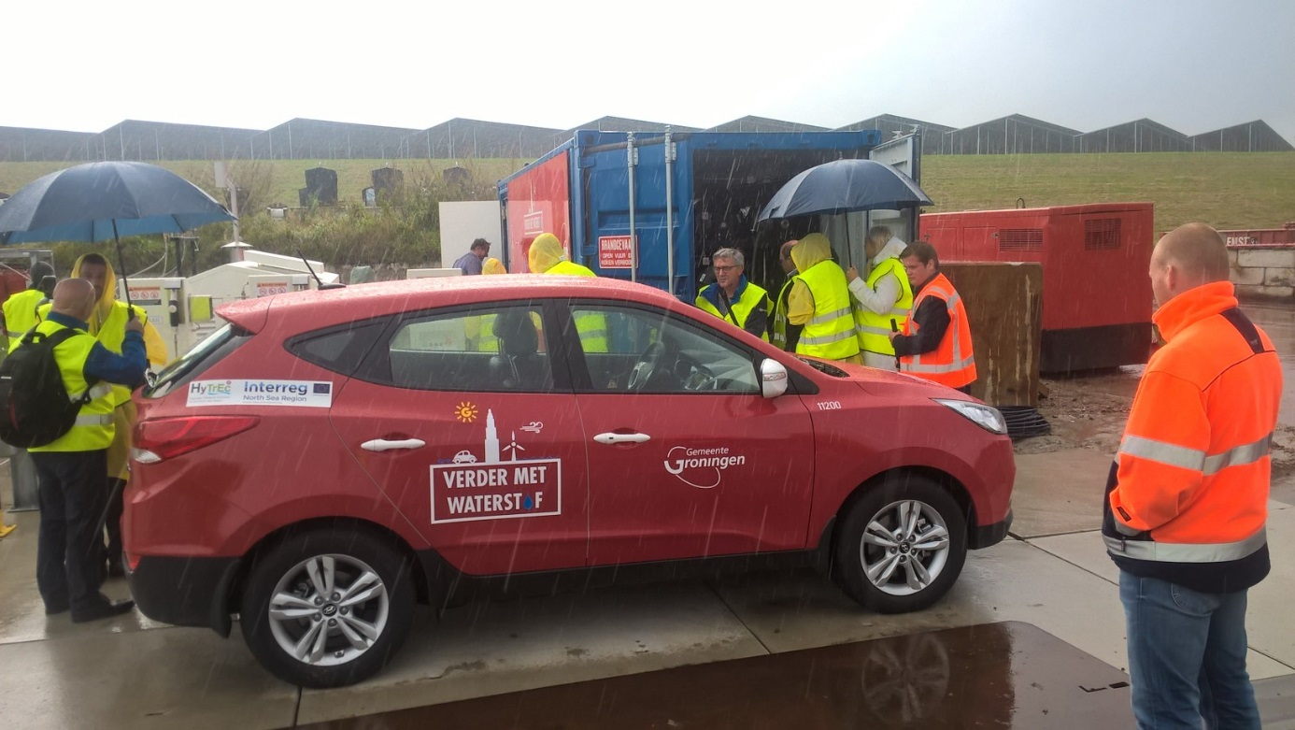

Green Hydrogen: Solar

Slide 22
Cooperation
Develop the supply chain for green hydrogen transport and identify the training requirements and organisations that would benefit from training as well as identifying common rules and standards for the use of hydrogen in the transport sector.
Why?

Slide 23
Enabling the Market
All Partners have been having difficulty on some level
  Vehicle procurement/ retrofitting
  Hydrogen Refuelling Stations and Green Hydrogen
  Training courses for technicians to maintain vehicles
First exercise was for all Partners to speak to their national hydrogen organisations on supply chain identification
Commissioned consultant Pale Blue Dot to identify the hydrogen supply chain

Slide 24
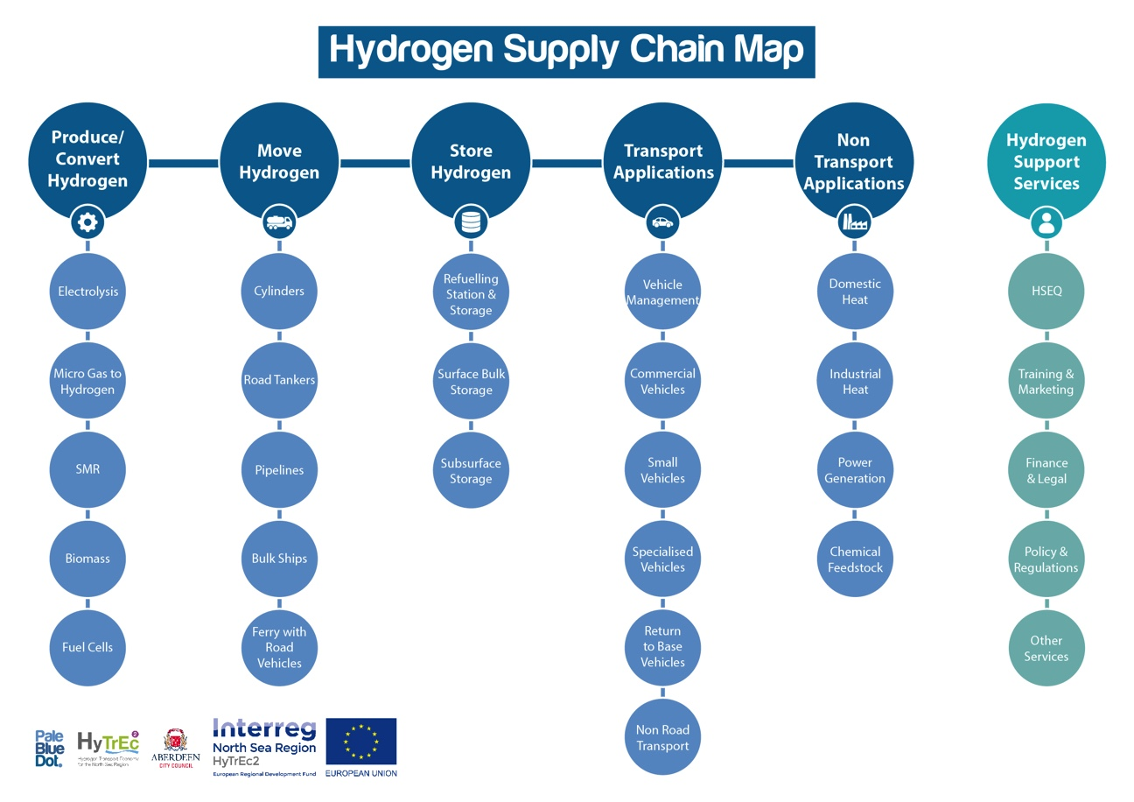
Vision and Objectives

Slide 25
Entering the Hydrogen Market
Not only identified the supply chain but which businesses would be best placed to adapt to hydrogen.
Hosting a number of business to business meetings to encourage this:
  Groningen in September 2017
  Aberdeen 9th October 2018
Technicians training courses accompanying increasing numbers of vehicles offers opportunities for technical colleges as well

Slide 26
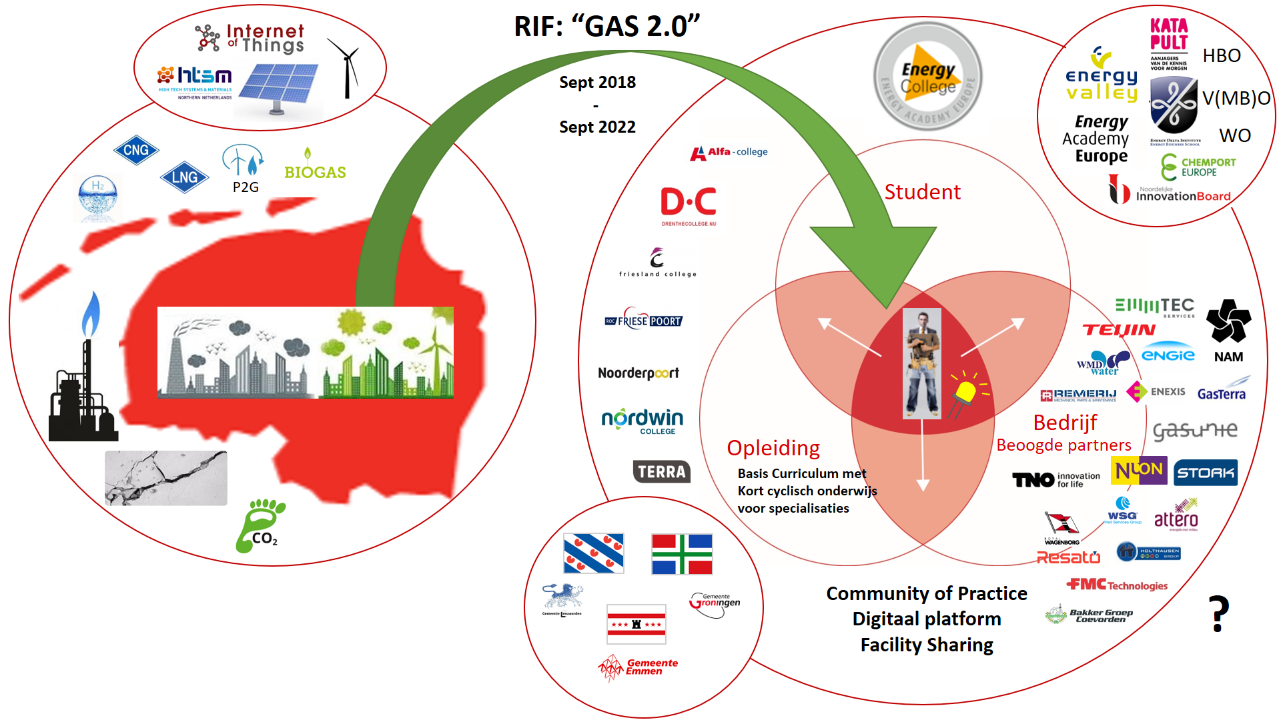
Deliverables

Slide 27
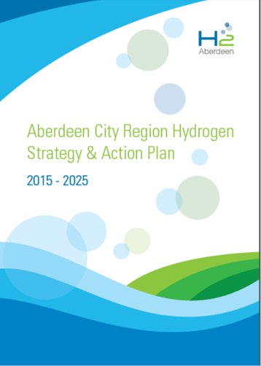
Collaboration

Slide 28
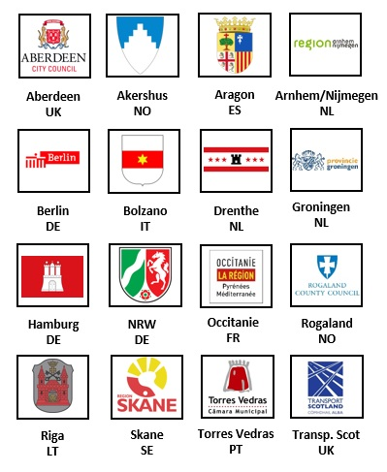
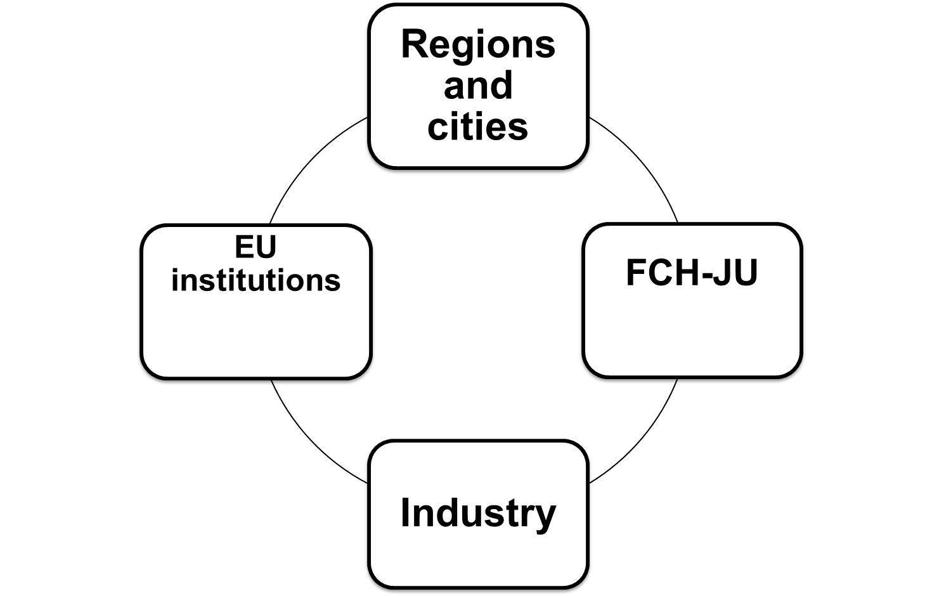


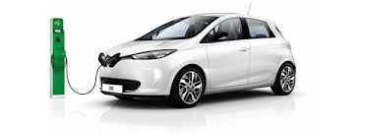

About HyER
Representing the interests of European regions and cities active in the field of hydrogen, fuel cells and electro mobility
Hydrogen, fuel cells and electro-mobility in European regions
Membership based network / political organisation
Aim: help our members to develop their hydrogen and electro-mobility activities
Enabling the share of knowledge
Bringing stakeholders together
Industry

Slide 29
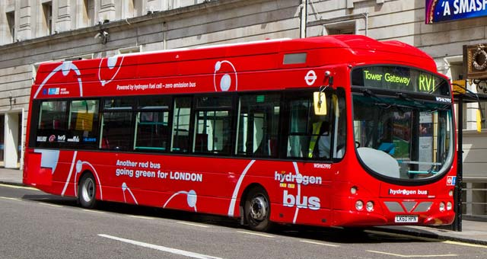
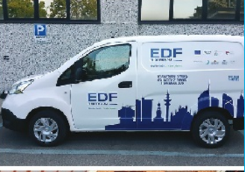
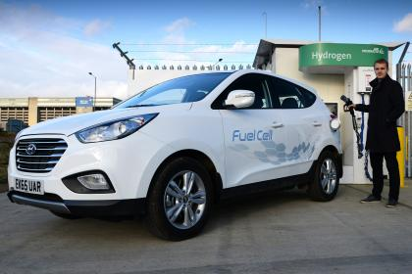
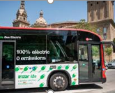
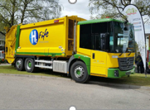
Collaboration
Local authorities will have to deliver decarbonisation targets!
Successful demonstration projects in Europe → learnings can be shared, many local authorities are facing the same challenges
Transnational interoperability, transnational customer information are essential for the development of zero-emission transport and energy systems → European cooperation is essential in these sectors
Local authorities have a purchasing power: creating the demand is key

Slide 30
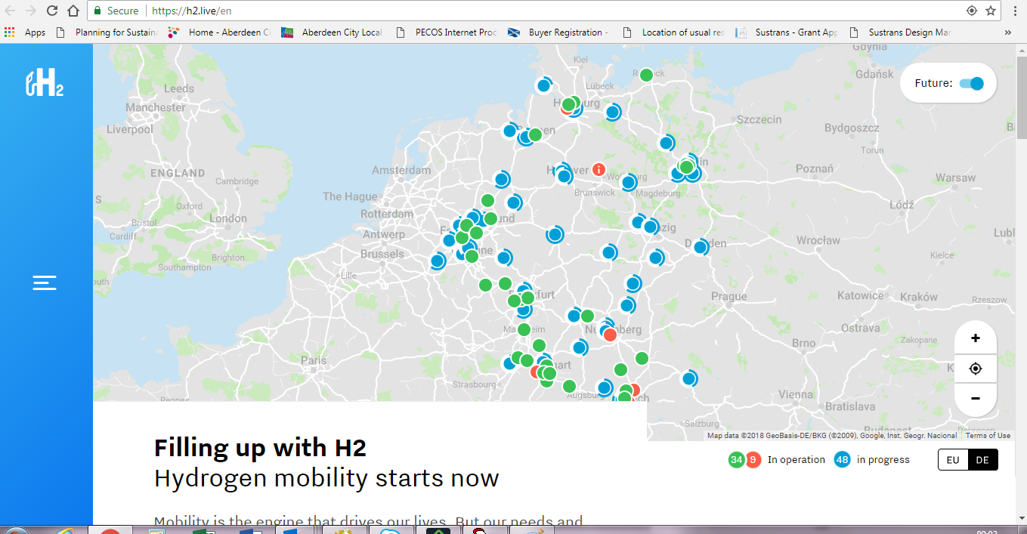
HyTrEc2 App

Slide 31
For more information:
northsearegion.eu/hytrec2
www.hyer.eu
Project Manager
Louise Napier
lnapier@aberdeencity.gov.uk
Tel: + 44 (0)1224 523327
Mob: + 44 (0)788 000 2510

