Slide 1
HyTrEc2
Hydrogen Transport Economy for the
North Sea Region 2
General Presentation

Slide 2
Background

Slide 3

The Hydrogen Transport Economy (HyTrEc) 2 project is part of the Interreg VB North Sea Programme Region Programme and is partly funded by the European Regional Development Fund.
Falls within programme Priority 4: Promoting green transport and mobility
Total budget of 5,246,271 of which the € ERDF Contribution is 2,197,940 €
Five year project from 2016 to 2021.

Slide 4
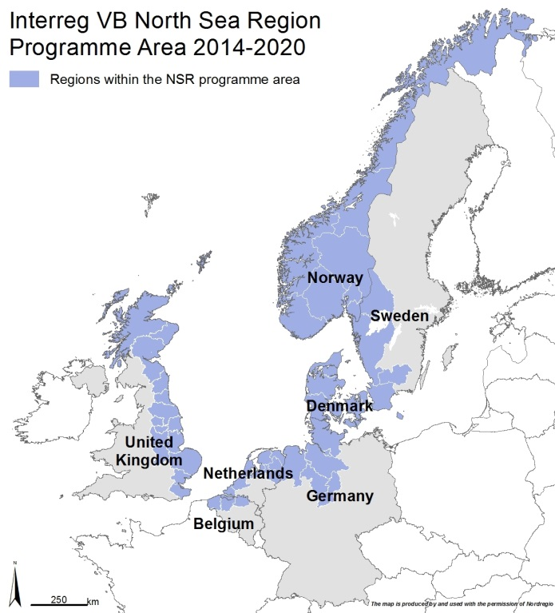








HyTrEc2 Partners

Slide 5
Vision and Objectives

Slide 6
Vision:
Stimulating hydrogen fuelled transport solutions
for business, for the environment,
for the future.

Slide 7
Objectives
Implementing innovative hydrogen transportation solutions involving vans, large trucks and refuse collection vehicles to advance the case for zero emission solutions for public and private sector fleets.
Improving the supply chain and training so that the NSR becomes a Centre of Excellence for hydrogen transport.
Developing innovative methods for the production, storage and distribution of green hydrogen.
Complementing national programmes for hydrogen and facilitating joint NSR approaches and common standards.

Slide 8
Pioneering
93%¹ of transport is currently oil based. Green transport solutions, such as hydrogen, will play a key role in achieving EU energy and climate change targets.
Hydrogen Fuel Cell Electric Vehicles (FCEV) have a longer range than electric battery vehicles. This extended range is essential in those North Sea regions which have numerous small sized cities with a large suburban and rural hinterland.
¹ http://ec.europa.eu/eurostat/web/products-datasets/-/tsdcc340

Slide 9
Collaboration
Current market failure caused by the high cost of FCEVs and the need to make green hydrogen cheaper through more cost effective green hydrogen production, storage and distribution.
HyTrEc2 will create conditions so that a FCEV market can develop providing a platform for collaborative development of strategies and initiatives that will inform and shape the development of infrastructure, technology and skills.

Slide 10
Cooperation
The project will establish a transnational network which will improve accessibility to hydrogen powered vehicles and fuel across the North Sea Region as an alternative energy sector by:
Testing a range of transportation technologies such as fuel cell, range extenders, and dual fuel vehicles.
Investigate ways to improve production, storage and distribution of green hydrogen including use of solar and wind power.

Slide 11
Cooperation
Develop the supply chain for green hydrogen transport and identify the training requirements and organisations that would benefit from training as well as identifying common rules and standards for the use of hydrogen in the transport sector.
Trialling an app that can be used transnationally to show the location of fuelling stations, their real time availability and safety standards etc.

Slide 12
Deliverables

Slide 13
Deliverables
Deliverable | Target
Number of hydrogen vehicles tested | 33
Green hydrogen from wind and solar | 2
Number of people trained in hydrogen | 80
Number of businesses entering the supply chain | 25
Report of hydrogen transport rules and standards | 1
Report on business case and economic modelling of green hydrogen | 1
Report on distribution of hydrogen in isolated regions | 1
Report on supply chain mapping | 2

Slide 14
Outputs

Slide 15
Outputs
Indicator | Target
Number of new and/ or improved green transport solutions adopted | 6
Number of enterprises participating in cross-border, transnational or interregional research projects | 25
Number of research institutions participating in cross-border, transnational or interregional research projects | 10
Number of organisations/ enterprises adopting new solutions by project end | 50
Number of organisations/ enterprises informed about new solutions by project end | 150

Slide 16
Results

Slide 17
Results
Indicator | Definition
25% reduction in the cost of hydrogen vans, large trucks and other tested vehicles | Reduction in the cost of hydrogen vans, large trucks and other tested vehicles
18 public sector organisations and transport operators investing in hydrogen vans and other tested vehicles | Additional organisations purchasing/ testing hydrogen vehicles
18 kg/per vehicle per month reduction in CO2 from tested vehicles | Hydrogen vehicles to have a target of 18kg/ month less than equivalent diesel model

Slide 18
Key Partner Activities

Slide 19
Key Partner Activities
Aberdeen City Council
Fleet demonstration of retrofit fuel cell, range extenders and dual fuel vans
Fleet deployment of refuse collection lorry
Production of green hydrogen using wind turbines and electrolyser
Supply Chain Development and Training
Supply chain mapping report and study for the NSR
Aberdeenshire Council
Fleet demonstration of retrofit fuel cell, range extenders and dual fuel vans

Slide 20
Key Partner Activities
CENEX
Monitoring and analysing the operational efficiency of a wide range of hydrogen vehicles
Overview of hydrogen transport rules and standards in the NSR
Provincie Drenthe
Sustainable Transport Living Lab at Groningen Airport
Fleet demonstration of retrofit fuel cell, range extenders and dual fuel vehicles
Fleet deployment of large truck for Living Lab
Supply Chain Development and Training
Business case development of a power to gas facility storing excess solar energy as hydrogen

Slide 21
Key Partner Activities
Europaisches Institut fur Innovation
Development of mobile phone app for location of hydrogen refuelling stations and communication platform
Fleet demonstration of retrofit fuel cell, range extenders and dual fuel vehicles
Low Carbon Hydrogen Production, Storage and Distribution
Supply Chain Development and Training
Gemeente Groningen
Fleet demonstration of retrofit fuel cell, range extenders and dual fuel cars and vans
Fleet deployment of large trucks
Low Carbon Hydrogen Production, Storage and Distribution and use of solar energy to power a Hydrogen Refuelling Station

Slide 22
Key Partner Activities
SP Sveriges/ RISE
Development of large hydrogen fork lift truck simulation
Overview of hydrogen transport rules and standards in the NSR
Business case and economic modelling for green hydrogen production
Report on the distribution of hydrogen in isolated regions
Supply Chain Development and Training
Hogskolen I Narvick/ UiT
Fleet demonstration of retrofit fuel cell, range extenders and dual fuel vans, forklift and cars
Improvement of Hydrogen Refuelling Station
Supply Chain Development and Training
Development of Training Modules

Slide 23
For more information:
northsearegion.eu/hytrec2
Project Manager
Louise Napier
lnapier@aberdeencity.gov.uk
Tel: + 44 (0)1224 523327
Mob: + 44 (0)788 000 2510

