Slide 1
HyTrEc2
Hydrogen Transport Economy for the
North Sea Region 2
Louise Napier
HyTrEc2 Project Manager

Slide 2
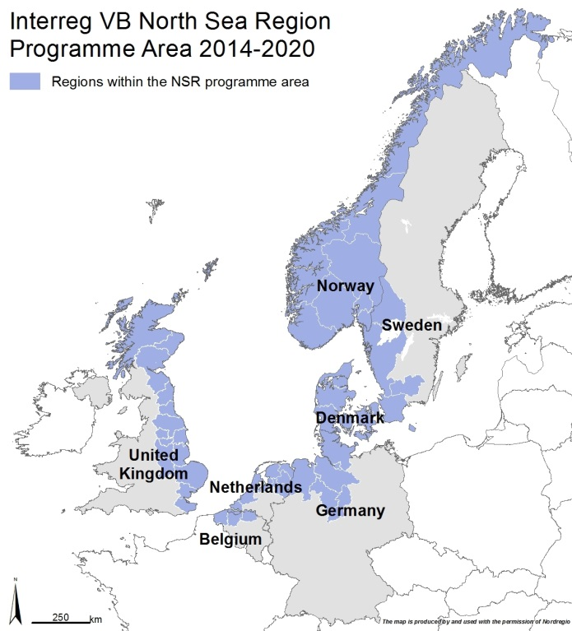








HyTrEc2 Partners

Slide 3
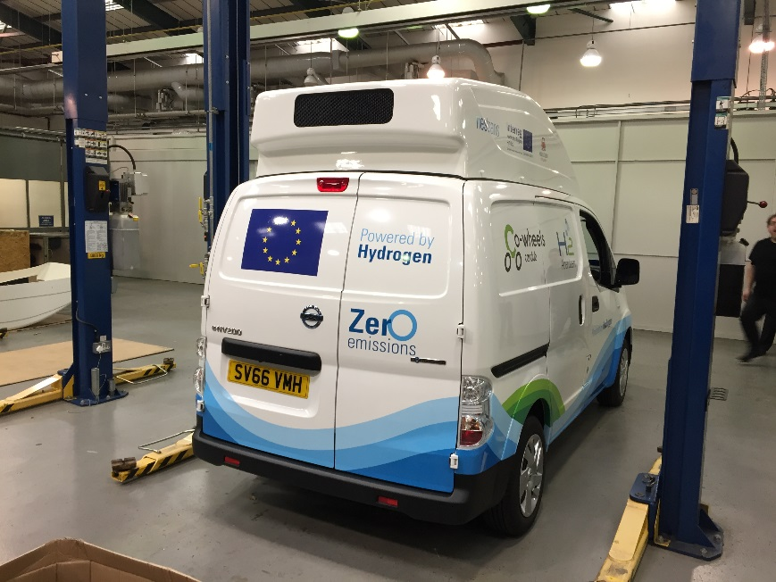
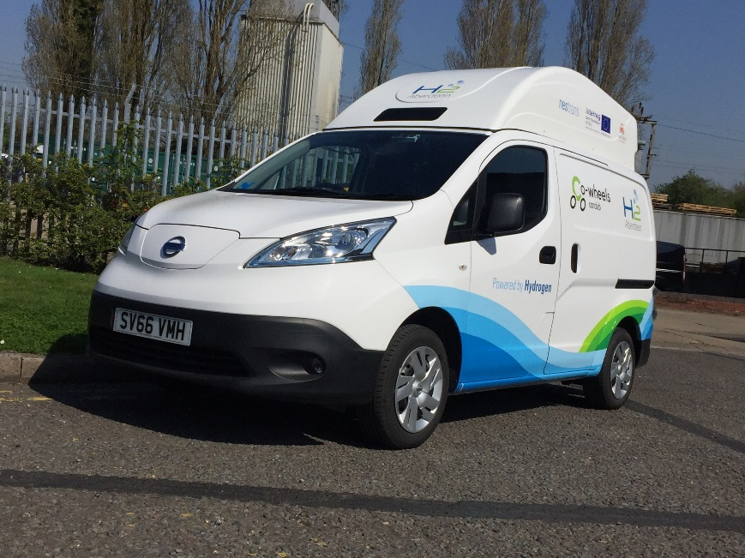
Vehicle Deployments - Retrofitting
Nissan eNV200 Acenta Rapid electric van
Retrofitted with 8.5kw hydrogen fuel cell and 350 bar hydrogen tank
Increase van range from 106 miles to a minimum of 192 miles
Compatible with TK17 nozzle for 350 bar fuelling

Slide 4
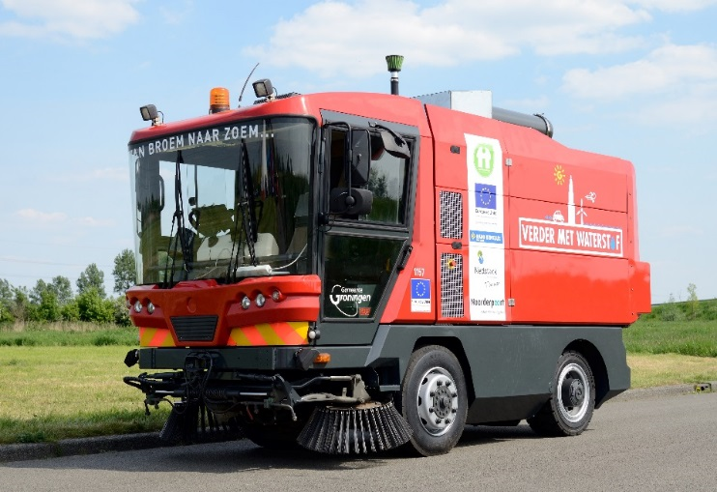
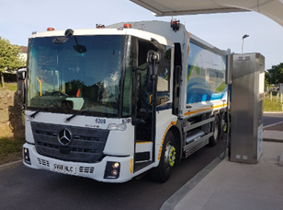
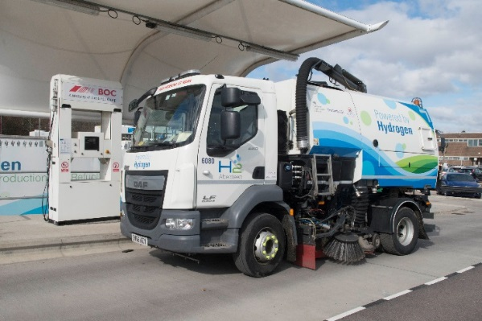
Vehicle Monitoring
Project / Driver | Vehicle reg | Vehicle make | Vehicle model
Groningen (Hytrec2) | NX-1157 |  | Streetsweeper
Groningen (Hytrec2) | NX-315-K | Hyundai | Tucson Fuel Cell
Groningen (Hytrec2) | NX-316-K | Hyundai | Tucson Fuel Cell
Aberdeen (Hytrec2) | WP66 PXG | Toyota | Mirai
Aberdeen (Hytrec2) | WP66 PXF | Toyota | Mirai
Aberdeenshire (Hytrec2) | SD64 EXU | Citroen | Berlingo
Aberdeen Cowheels (Hytrec2) | EA65 ZWS | Hyundai | iX35
Aberdeen Cowheels (Hytrec2) | EA65 ZWZ | Hyundai | iX35
Aberdeen (Hytrec2) | EA16 BXX | Hyundai | iX35
Aberdeen Taxis (Hytrec2) | EA16 BYF | Hyundai | iX35
Aberdeenshire (Hytrec2) | MF67KWT | Renault | Kangoo
Aberdeenshire (Hytrec2) | ST12 WCP | Ford | Transit Connect
Aberdeenshire (Hytrec2) | SW17 FKG | Nissan | eNV200

Slide 5
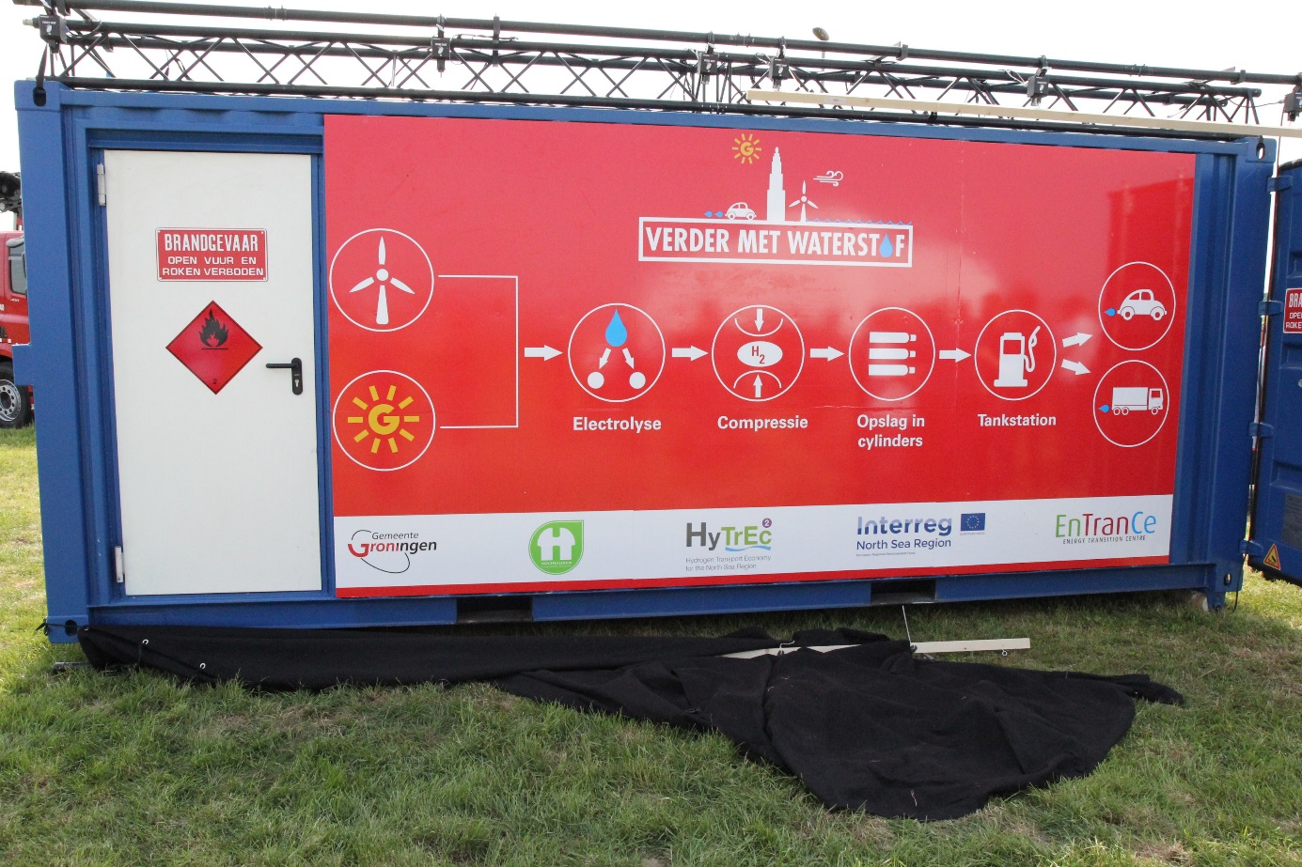
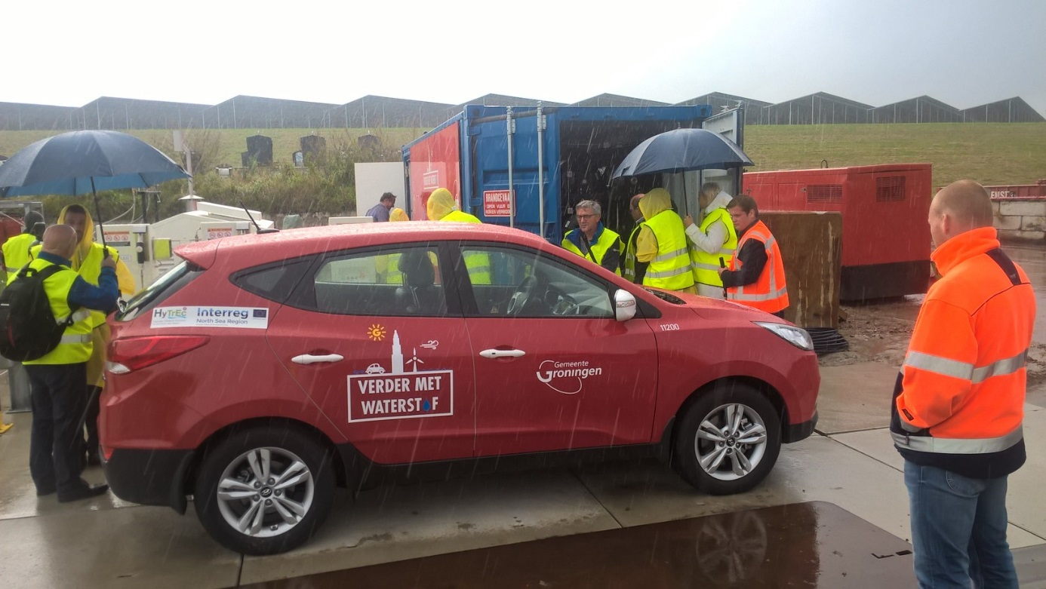

Green Hydrogen: Solar

Slide 6
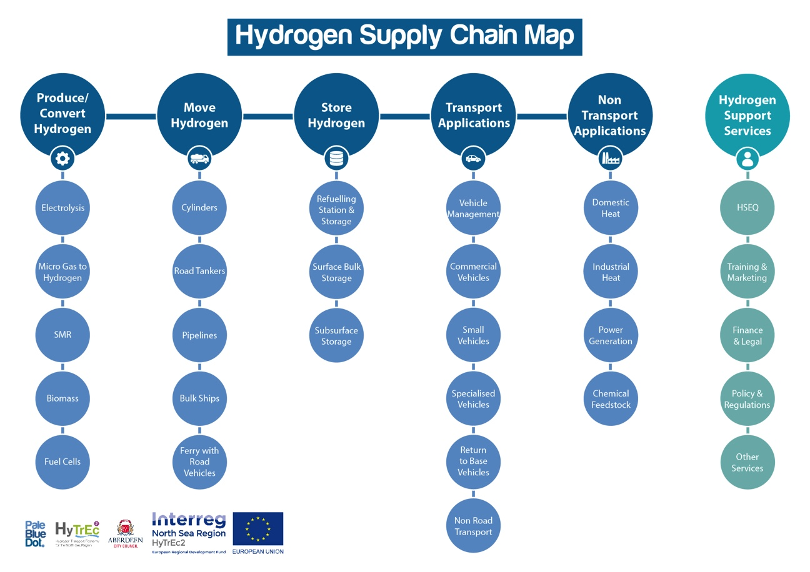
Vision and Objectives

